Slide 1
Semi-automated molecular functional knowledge discovery with FACTS
FACTS for IMMUNOGRID
Christian Schönbach
schoen@gsc.riken.go.jp
Biomedical Knowledge Discovery Team
Bioinformatics Group
RIKEN Genomic Sciences Center
06-Feb-03 CS

Slide 2
Inference of gene, transcript and protein functions in larger context
Databases
Literature
Applications for
diagnostics
or therapy
Genetic/experimental
system
New mol. functional
relations
relevant to diseases
Computational
and biological
experiments
Transcriptional
Networks
Signalling Networks
Analysis
Modeling
Prediction
06-FEB-03 CS

Slide 3

Challenges
Presenting diversity & interconnectivity of data
Exchanging data and integrating data
Knowledge discovery from literature
Understanding regulation using expression data
Understanding diversity:
genetic
transcriptional
epigenetic
structural
06-FEB-03 CS

Slide 4
Transcript →Abstracts → Mol. Interactions → Ontology → Disease associations
06-FEB-03 CS

Slide 5
Help from existing tools and databases ?
Abstract Mining Tools
ENTREZ, Pubgene , XplorMed, MedMiner, …
SWISS-PROT, RefSeq, …
Lack of integration capabilities
Bottleneck: interpretation of complex and incomplete data
Fully automated systems are not suitable because they cause massive error propagation
06-FEB-03 CS

Slide 6
Enhancing Interpretation and Functional Inference
FACTS -- Functional Association/Annotation
of cDNA Clones from Text/Sequence sources
Inferring higher functional information for RIKEN mouse full-length cDNA clones with FACTS
Takeshi Nagashima^{1,2}, Diego G. Silva^{3,4}, Nikolai Petrovsky^{3,4}, Luis A. Socha^{3,4}, Harukazu Suzuki⁵, Rintaro Saito^{5,6}, Takeya Kasukawa⁵, Igor V. Kurochkin¹, Akihiko Konagaya^{2,7}, and Christian Schönbach^{1,8}
Genome Research 2003, Accepted for publication
06-FEB-03 CS

Slide 7
Target data
FACTS
MEDLINE
Abstracts
FANTOM2
(60K sequences)
Query Construction Rules
Abstract Filter Rules
Sentence Delimiter Rules
QueryMaker
QueryEngine
TermMatcher
Integrator
TermMatcher
Sequence Search
Computationally Inferred
Molecular interactions
(e.g. PPI)
Disease associations
Gene ontology
LocusLink
TIGR-MGI
SPTR
OMIM
BIND, etc.
InterPro
BIND
DIP
etc.
User Interfaces
Text Querying, BLAST
Annotation
06-FEB-03 CS

Slide 8
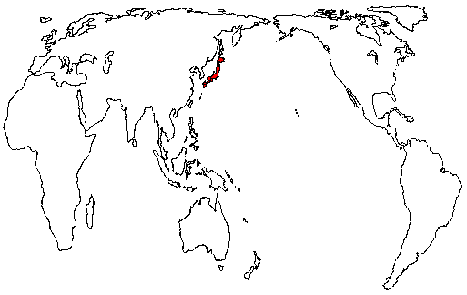
FACTS web server (1)
Query engines (3)
Linux mini-cluster
for processing (4)
Annotators
Users
(MEDLINE queries)
06-FEB-03 CS

Slide 9
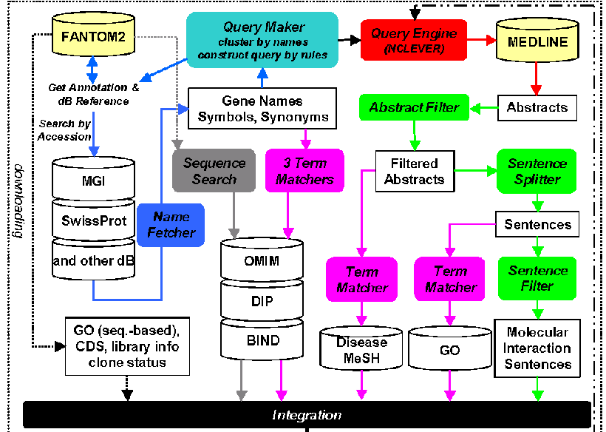
FACTS System
FACTS System
06-FEB-03 CS

Slide 10
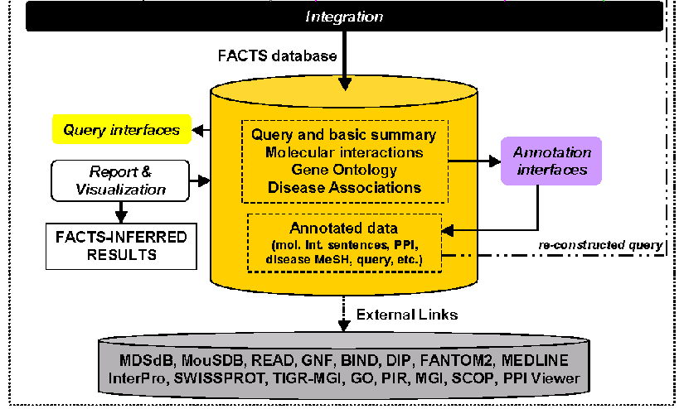
FACTS Database
06-FEB-03 CS

Slide 11
Functionalities
Command-line level
Large-scale MEDLINE abstract or feature retrievals
from sequence databases
Filtering
Integrating
Web Interface level
Querying (10) and Annotating (3)
Inference of 1) biological processes and roles
2) transcript-disease associations
3) molecular interactions
06-FEB-03 CS

Slide 12
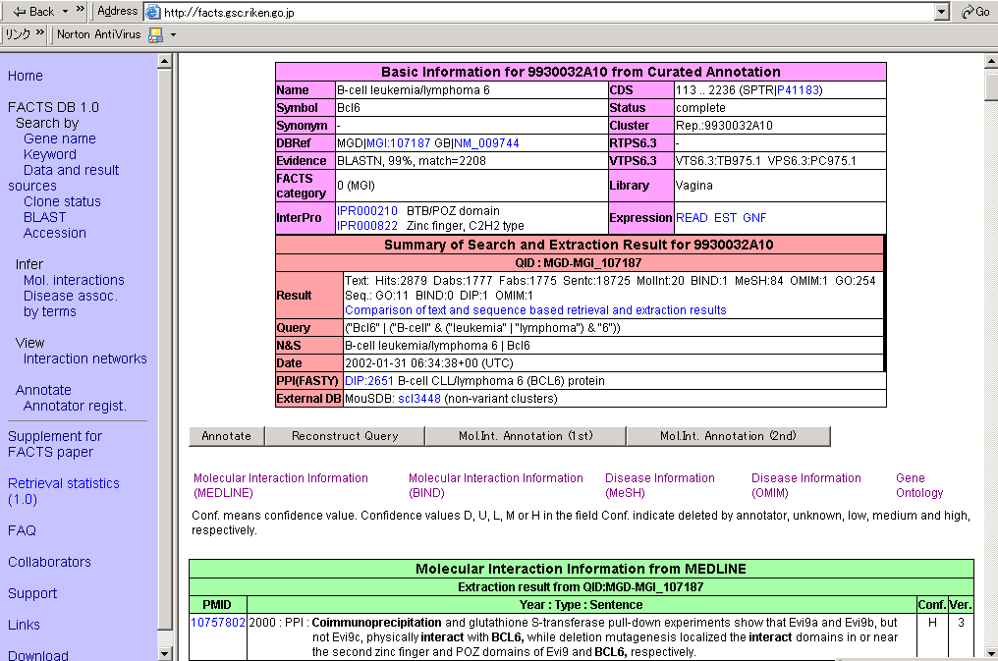
FACTS Interface with Menu and Report Example

Slide 13
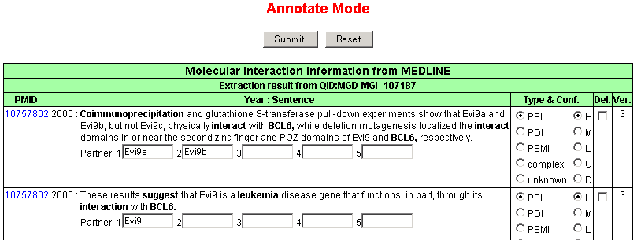
Molecular Interaction Sentence Annotation
06-FEB-03 CS

Slide 14
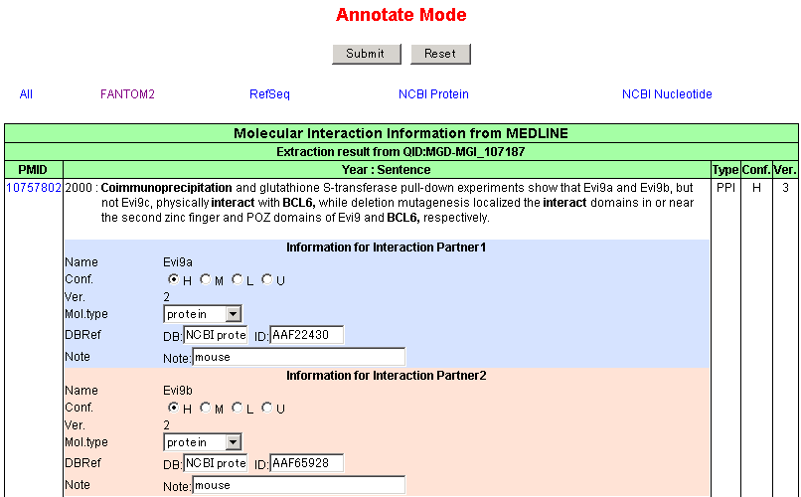
Assignment of Sequences to Protein Names
06-FEB-03 CS

Slide 15
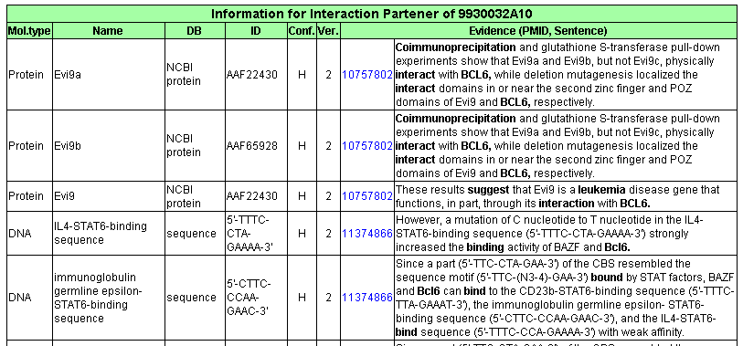
Annotation Report
06-FEB-03 CS

Slide 16
Traversing Biological Hierarchies
Disease
MeSH
MeSH
GO
Q
U
E
R
I
S
Mol. Int.
Expression
Detection of different pathways/mechanisms
GO
Expression
Domains
Mol. Interaction
Sentences
Sequence
Context-dependent protein interaction
Potential targets for intervention
06-FEB-03 CS

Slide 17
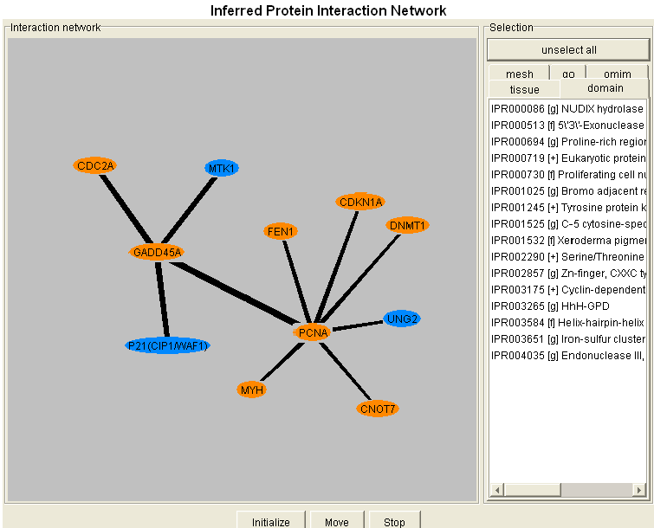
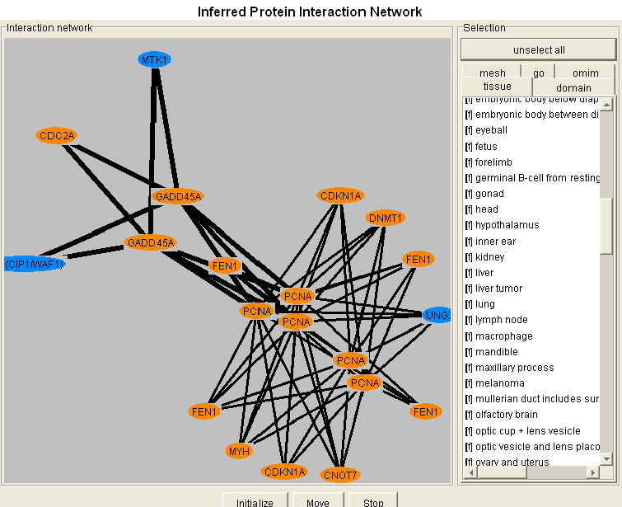
Gene-based View
Transcript-based
View

Slide 18
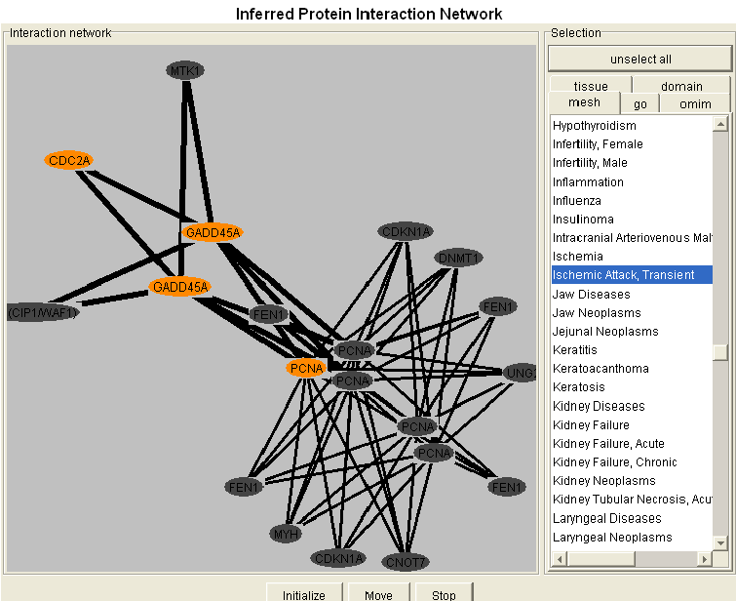
Disease Candidate Context-View
Tissue: Head
Disease: Ischemic Attack, Transient
06-FEB-03 CS

Slide 19
Gene expression
data source
Immuno FACTS
MEDLINE
Abstracts
2HAPI
Corbeil et al. 2001
Query Construction Rules
Abstract Filter Rules
Sentence Delimiter Rules
QueryMaker
QueryEngine
TermMatcher
Integrator
TermMatcher
Sequence Search
Computationally Inferred
Molecular interactions
Disease associations
Gene ontology
Epitopes
LocusLink, GB,
SPTR, etc.
BioCarta, KEGG
MeSH Tree
OMIM
InterPro
GO
BIND
sequences
from chip/array
User Interfaces
Text Querying, BLAST
Annotation
30-Nov-02 CS

Slide 20
Extraction Summary
Categories | Term/Sentence Coverage | Query Coverage
Text-based
Mol. Interaction | 3.5% | 74.1%
Disease MeSH | 26.0% | 85.1%
GO | 44.9% | 94.7%
Sequence-based
OMIM | 58.3% | 89.5%
BIND | 16.9% | 8.0%
GO | 14.5% | 84.7%
30-Nov-02 CS

Slide 21
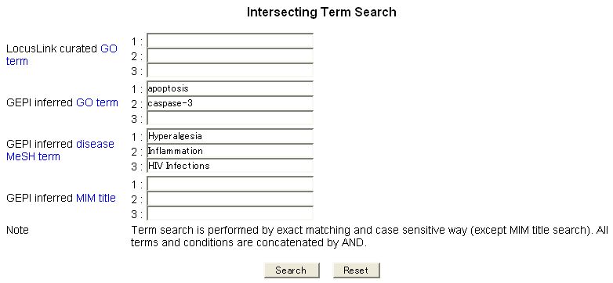
Concept Mapping
30-Nov-02 CS

Slide 22
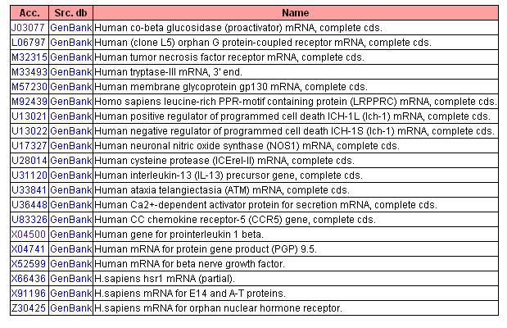
Candidates related by similar concepts
Mechanism/pathway can be different
30-Nov-02 CS

Slide 23
Prosaposin expression in HIV infected CEM T-cells
Known functions of Prosaposin?
Role of Prosaposin in HIV infection?
Known disease associations?
30-Nov-02 CS

Slide 24
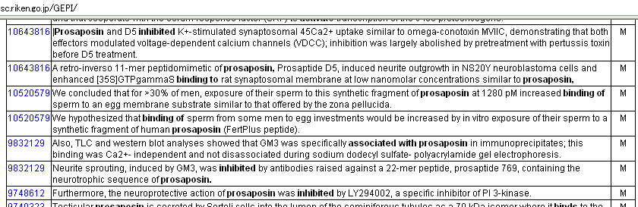
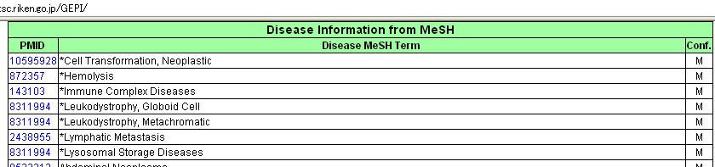
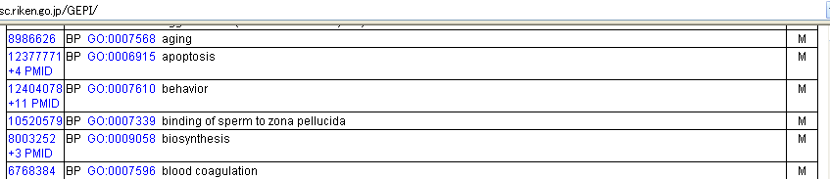
Mol Int.
MeSH
GO

Slide 25
MeSH term inferred disease associations of Prosaposin
Neoplasms
Adrenal Gland, Neoplasms; Neuroblastoma; Hodgkin Disease
Acute Central Nervous System Diseases
Brain Edema; Brain Injuries; Brain Ischemia; Hypoxia, Brain
Ischemia; Ischemic Attack, Transient; Cerebral Infarction;
Chronic Central Nervous System Diseases
Thalamic Diseases; Learning Disorders; Movement Disorders; Nerve Degeneration; Hyperalgesia; Neuralgia
Allergy
Dermatitis, Atopic
Autoimmunity
Psoriasis; Diabetes Mellitus, Experimental; Diabetic Neuropathies;
Nephrotic Syndrome
Hereditary Metabolic diseases
Lysosomal storage diseases; Gaucher Disease; Sphingolipidoses
30-Nov-02 CS

Slide 26
Inferred PSAP functions in context of HIV infection
Prosaposin in context of HIV-infected T-cell
PSAP down-regulation may cause:
- cell-cycle retardation
- apoptosis → high virus load
Prosaposin in context of AIDS-associated neuropathies
- hyperanalgesy
30-Nov-02 CS

Slide 27
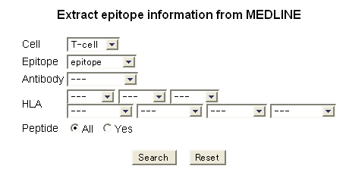
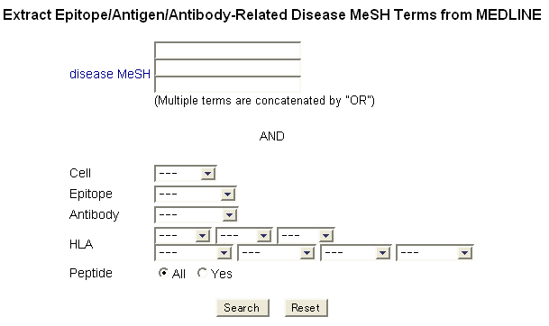
E
P
I
T
O
P
E
M
I
N
I
N
G
30-Nov-02 CS

Slide 28
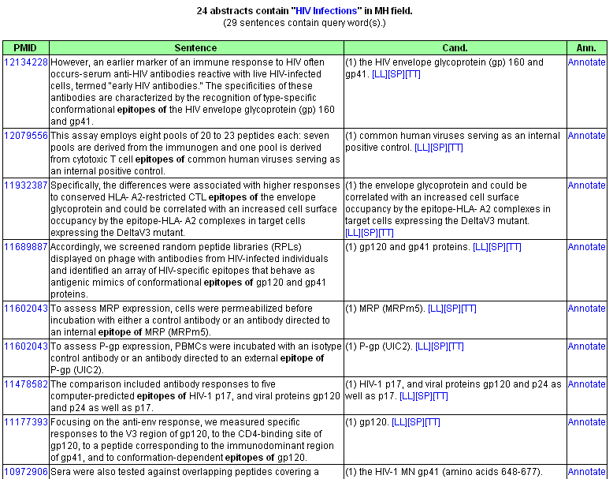
30-Nov-02 CS

Slide 29
Summary
Text and sequence-based semi-automated knowledge discovery support system
Easy to customize for various domains
Overlap for manual and computational inferred disease association is ~50%. 25% were detected only by manual and 25% by the computational method (Silva et al. manuscript in prep.)
Intuitive querying and summarization
Faster interpretation
Starting point for further experiments and expansion as GRID application
06-FEB-03 CS

Slide 30
FACTS will be available to the public
on the day of publication
…coming soon

Slide 31
Thanks to FACTS members & collaborators
Bioinformatics Group, RIKEN GSC
Takeshi Nagashima, Akihhiko Konagaya
Genome Exploration Research Group, RIKEN GSC
Harukazu Suzuki, Takeya Kasukawa
The Canberra Hospital and Australian National University
Nikolai Petrovsky , Diego Silva , Luis Socha
Rockefeller University
Mihaela Zavolan

