Slide 1

TelescienceＷＧ
- Improvement of observation throughput on special devices -
Ｓｈｉｎｊｉ Ｓｈｉｍｏｊｏ
Notes:
My name is Toyokazu Akiyama from Cybermedia Center, Osaka University.
I would like to introduce you Telescience group activity.
We have 7 collaborators in this project.

Slide 2
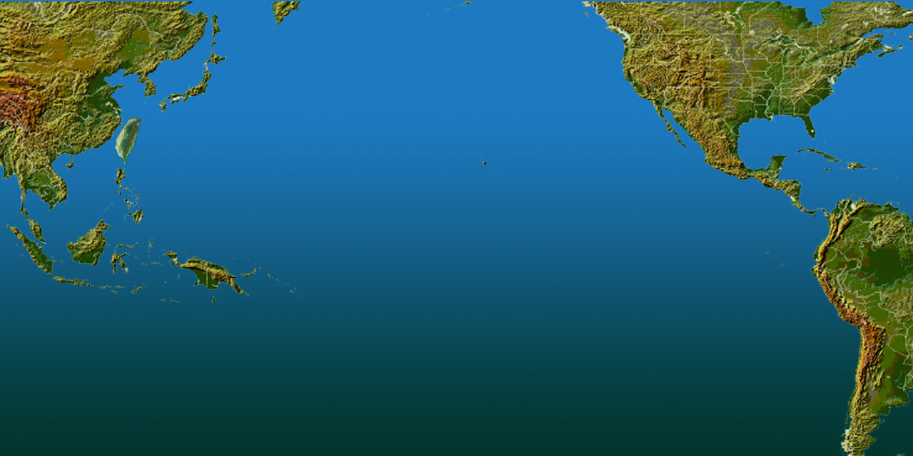
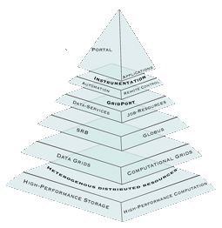

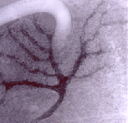
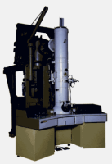
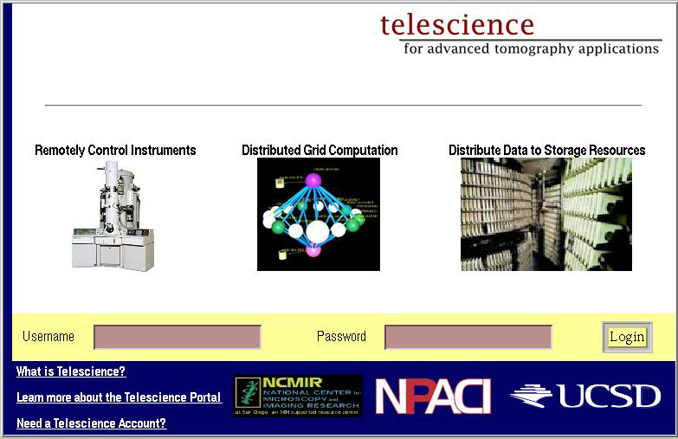
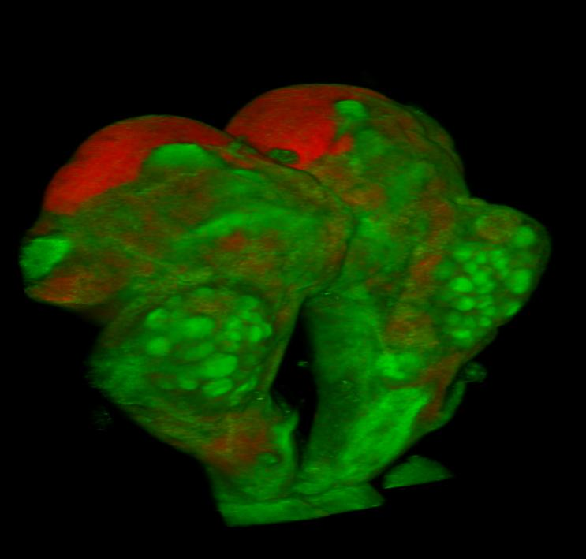
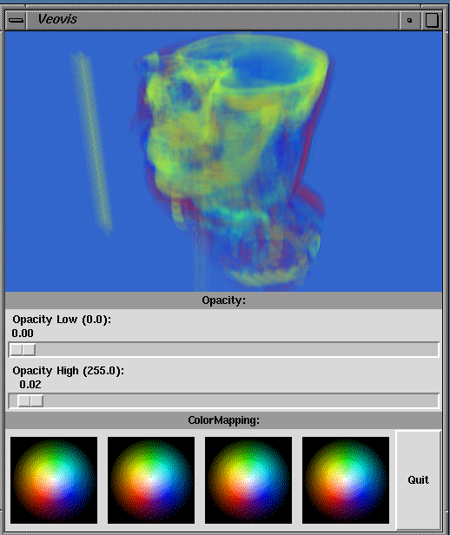
Tele-science on Tomography
Pacific
Rim
Application
Grid
Middleware
Assembly
SDSC
Osaka U.
NCHC
NCHC will host 5th PRAGMA in Oct. 2003
iGrid 02, joint demo, Sep. 2002
SC 02, HPC Challenge, Nov. 2002

Slide 3
Goal
Improve throughput of observation facility providing the following functions by the introduction of Grid:
  Data analysis function
  Knowledge sharing function
  Telecontrol function
Over International Collaboration
Notes:
So thus, we set our research goal up as improving throughput of observation facility providing the following functions:
Telecontrol function
Data analysis function
Knowledge sharing function
In the following slides, I would like to explain each function.

Slide 4
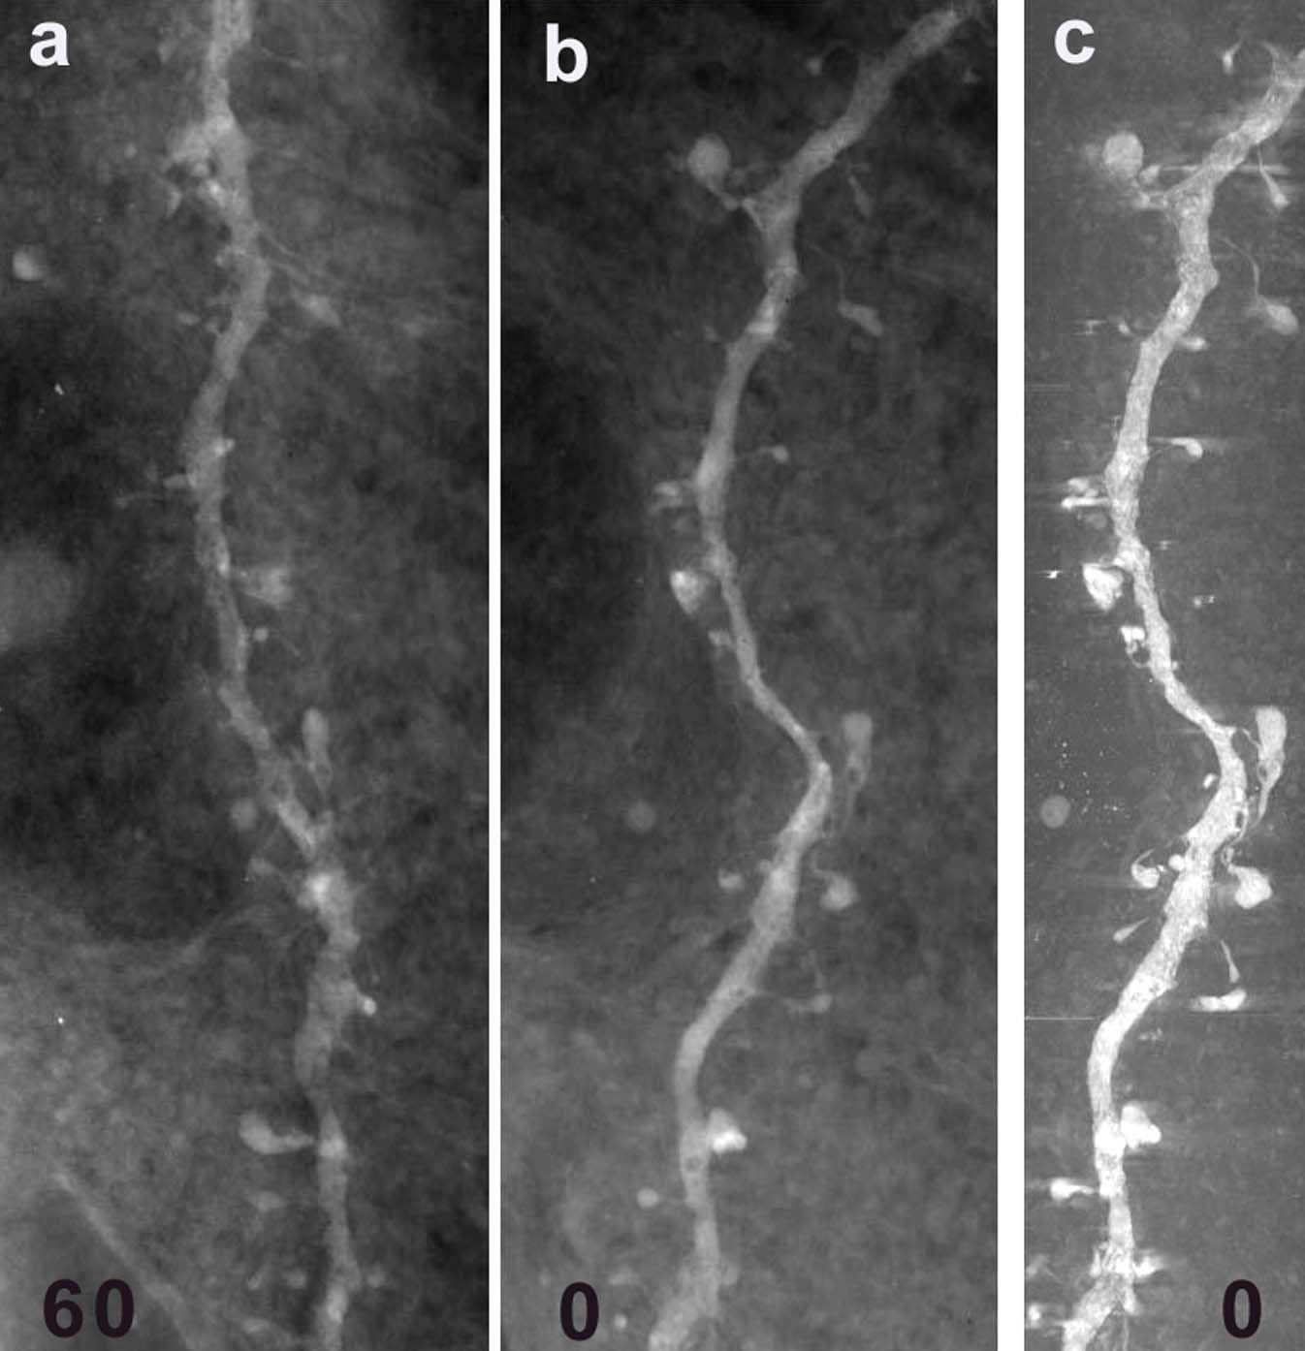
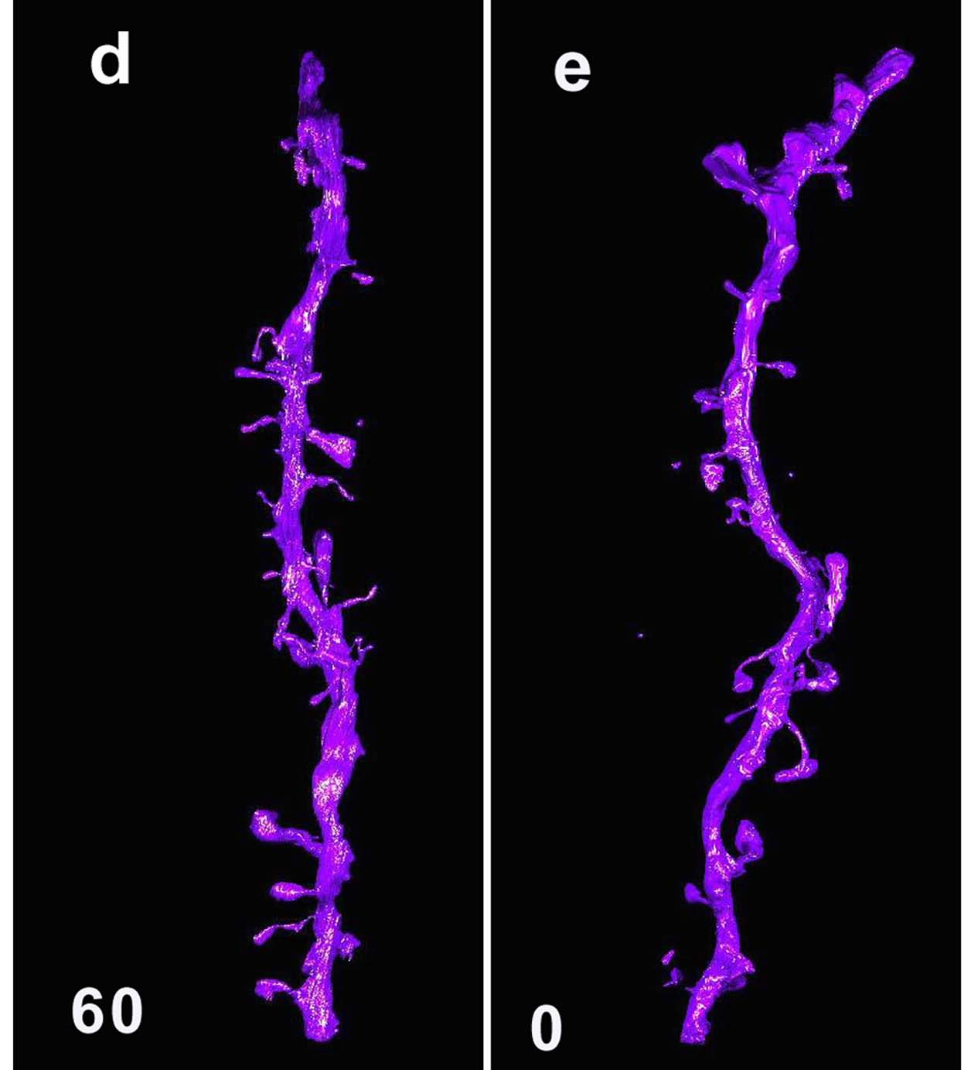
Data analysis function
Image data analysis on UHVEM and High resolution CT (SPring-8)
  Real-time analysis of large scale data obtained from special devices
    Dataflow optimiaztion
  Adaptive visualization system for handling various environments
Provided by Dr. Naoko Yamada (NCMIR)
Notes:
First I talk about Data analysis function.
As a first phase, we deal with image processing analysis on UHVEM and high resolution CT developed at SPring-8.
There are two research issues we are handling.
One is real-time analysis of large scale data obtained from special devices.
Image data obtained from UHVEM and SPring-8 have very high resolution, so they have large data size.
To analyze such large scale data, high performance computation resources are required.
We are considering how to store and process large scale image data.
The combination of data grid and computational grid can be one of the solutions.
We are investigating how to optimize a dataflow in a grid environment.
To visualize image data, we have to consider not only server optimization but also server-client coordination.
We will develop adaptive visualization system for handling various environments.
試料はいつもの「マウスの脳神経細胞樹状突起」です。
(Electron Tomography of 4μm-thick Spiny Dendrite at 3MeV)
1 実際に撮影したTEM像(a 傾斜角；60度, b 0度)
2 其れを合成した立体像(c 0度)
3 最終的に作成した3D構築像(d 60度, e 0度)
(UHVEM Image, Maximum Intensity Projection Image, 3D Reconstruction Image)
傾斜して撮影したTomoのメリットを示す意味で、傾斜角度が0度と60度の写真を比較
しています。スパインの細い元の部分が明確に観察されている事を強調しています。
矢印も入れたかったのですが、ポスターの内容や目的等が判りませんので入れずに
そのままにして有ります。

Slide 5
Progresses
GT3 enabled new architecture of telescience portal (NCMIR, SDSC)
Telecontrol and analysis system for UHVEM (Cybermedia Center, NCHC)
Pipelined image processing method (Cybermedia Center)
New HDTV codec using JPEG2000 (KDDI R&D Laboratory)
Telecontrol and analysis system for UHVEM (Cybermedia Center, NCHC)
New HDTV codec using JPEG2000 (KDDI R&D Laboratory)
Akiyama

Slide 6
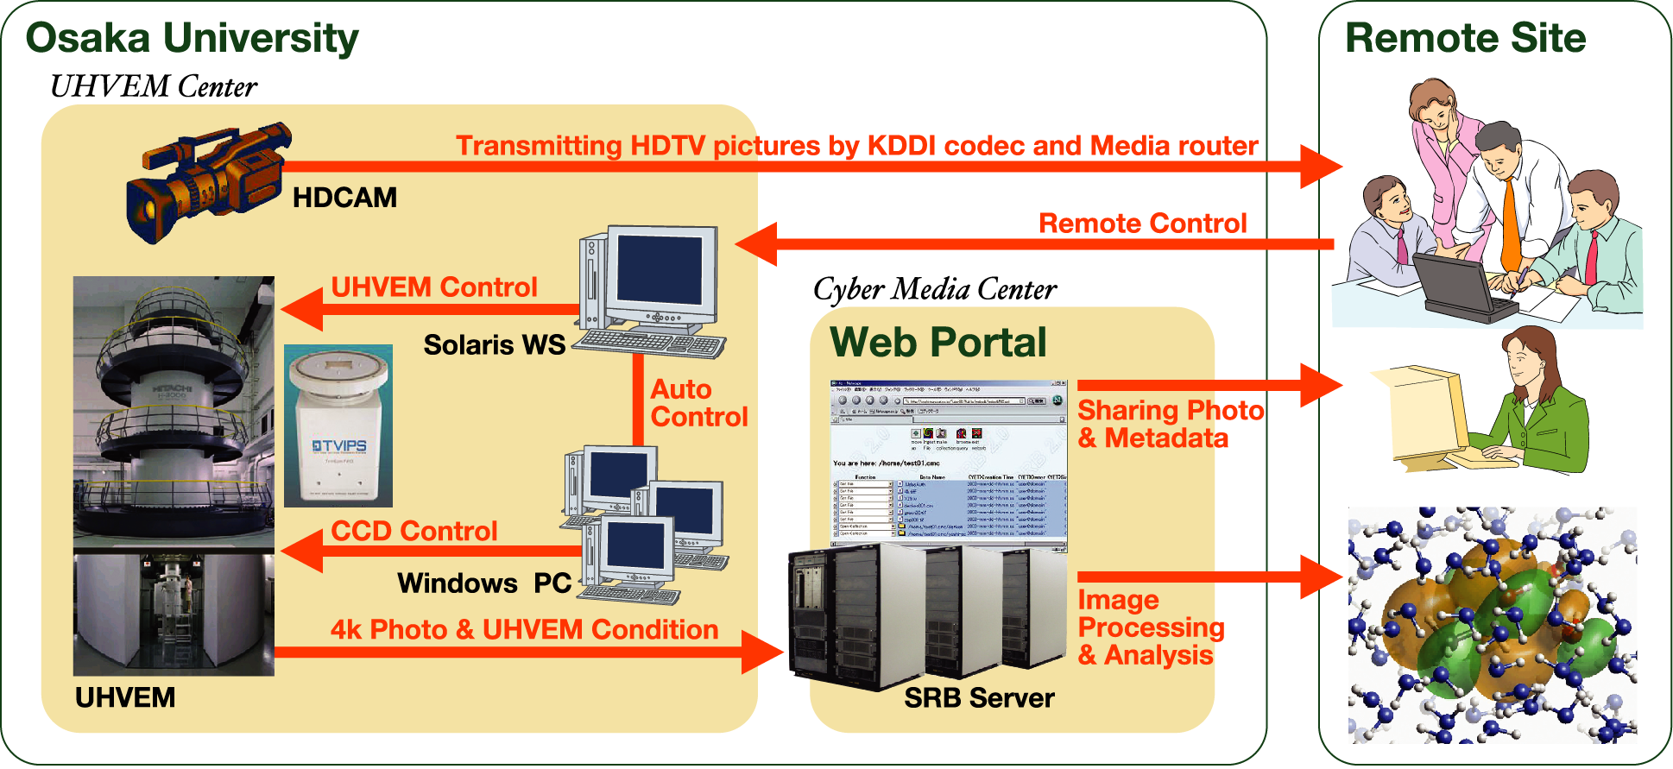
Demonstration
Telecontrol and image processing system prototype
  HDTV transfer system (demonstrated at NPACI booth)
  Image analysis web portal (demonstrated at BioGrid booth)
Notes:
We have two demonstration in this conference.
One is done at NPACI booth. KDDI labs has developed new HDTV codec using JPEG2000. That codec has function of controlling bandwidth and quality. We have also developed image analysis web portal. The demonstration of this portal is done at BioGrid booth. Please come to our booth. Thank you.

Slide 7
HDTV codec using JPEG2000
Previous codec was using MPEG2
JPEG2000 enables us to …
  Show clear image
  Control bandwidth to be required

Slide 8
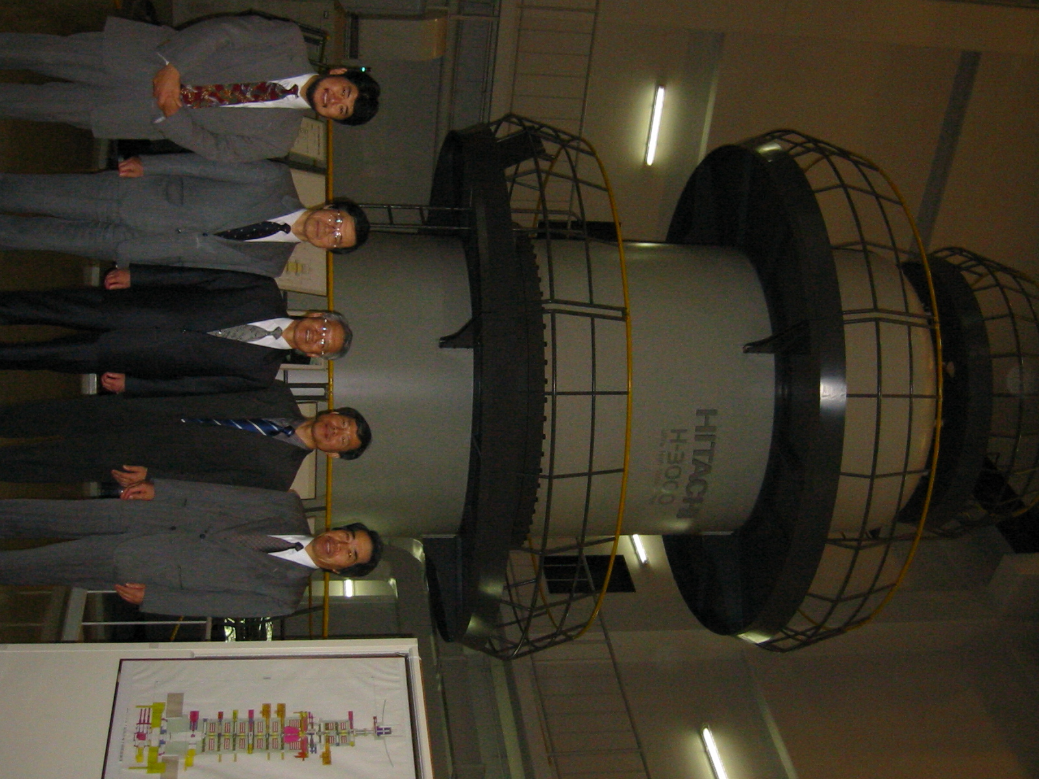
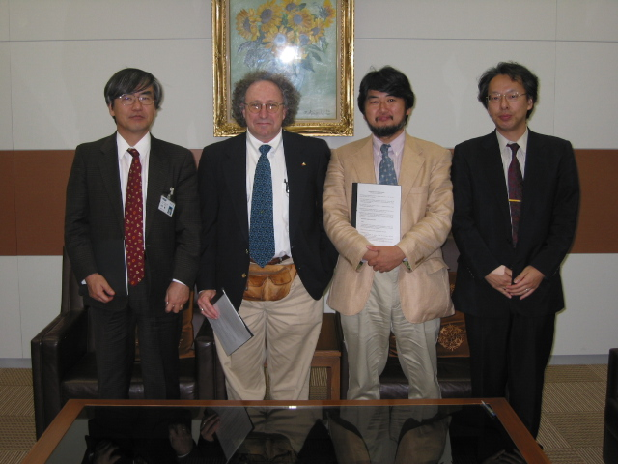
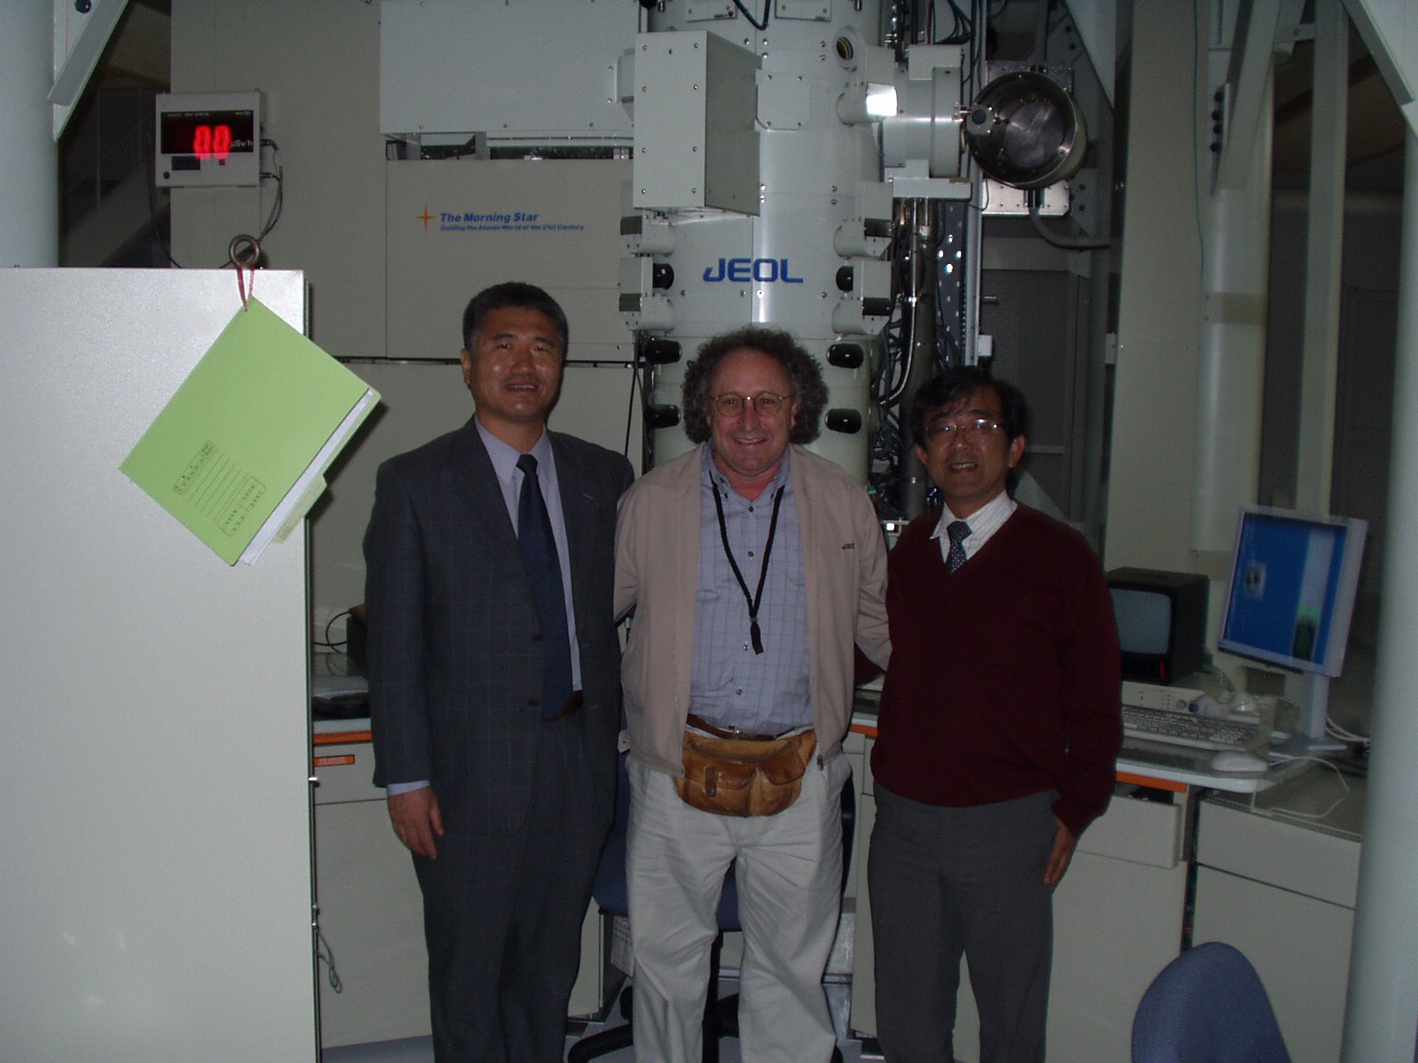
Collaborations
MoU among NCMIR (UCSD), CMC, UHVEM, (Osaka Univ), KDDI, KBSI

Slide 9
Our Goals
Develop telescience portal environment among Japan, Korea, US and other.
International collaboration for Agriculture & Ecogrid
  Taiwan, US, Japan, Thailand, Australia, China and other

