Slide 1
TransPAC and PRAGMA
John Hicks
Indiana University
jhicks@iu.edu

Slide 2
Recent upgrade
OC-48 POS from APAN NOC in Tokyo to US (Los Angeles)
2 x GE from APAN NOC in Tokyo to Chicago to participate in TransLight activities

Slide 3
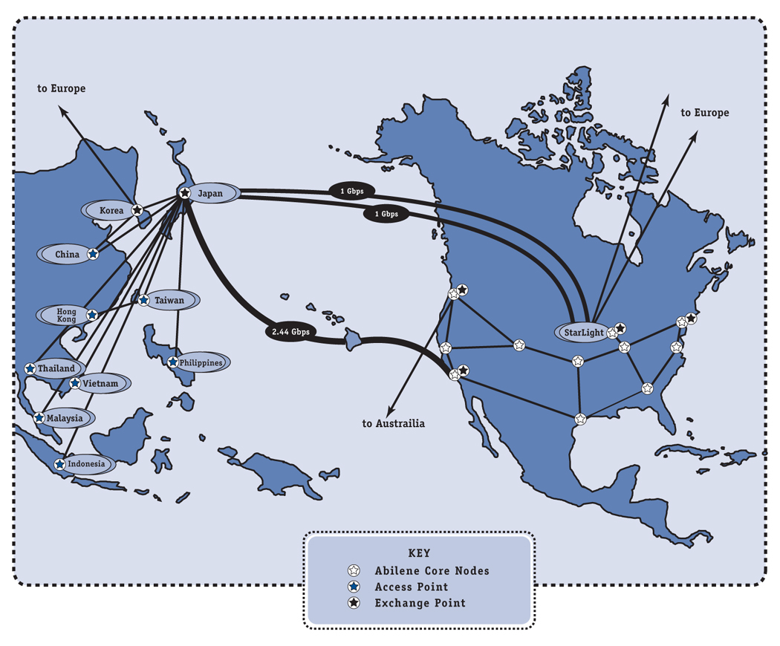
ADD new network here

Slide 4
SC2003
This upgrade of TransPAC provides a significant opportunity to showcase Asia-US-EU science collaborations at SC2003.
We are excited about this opportunity and ready to assist.

Slide 5
TransPAC Upgrade Path
2004-2008
2004-2005 2 x 10G
2005-2006 4 x 10G
2006-2008 10 x 10G
Perhaps these circuits would land on the US West Coast and in Chicago.

Slide 6
Critical Areas of Cooperation
Measurement
NOC functions
Security
Cooperation among all R/E networks is necessary for Global e-Science to meet expectations

Slide 7
Additional Areas of Focus
Global collaborations such as GFarm, Abilene Observatory and PlanetLab.
Security cooperation.
Tool development and sharing.

Slide 8
Web sites of interest
TransPAC
http://www.transpac.org
PRAGMA
http://www.pragma-grid.org
TransLight http://www.startap.net/translight/
Ap Grid
http://www.apgrid.org
Grid Datafarm
http://datafarm.apgrid.org/

Slide 9
Questions?
John Hicks
Jhicks@iu.edu

