Slide 1
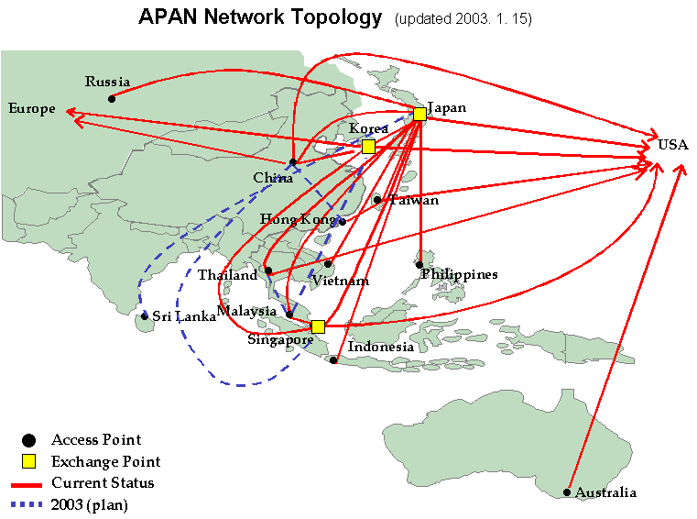



























PRAGMA Testbed
Affiliate Member

Slide 2
Testbed and the Resources/Middleware Working Group
Bottom-up approach on hardware
  Most systems linux-based
  More than 240 nodes across 15 (or more) sites
  Work with ApGrid (http://www.apgrid.org)
  Contrast with TeraGrid
Agreement to Participate:
  Minimum software requirement to join (e.g. Globus 2.2)
  Need to exchange certificates with all other sites
Goodness Index
  Format provides a way to document a minimal level of interoperability
Technical and Policy Issues
  Compatibility of basic middleware (versions of Globus)
  What other software to have at all sites
    Which of competing software to have
    Where are the incompatible software
    Can software be packaged for easy installation
  Tracking users
  Monitor system dynamically (and update “degree of interoperability of system)
Challenges
  Run applications on grid on routine basis (only a few at first)
  Capture rough measure of usage (international resource)
  What does it mean to dedicate a resource to an international group (with national funding supporting the resource)?

Slide 3
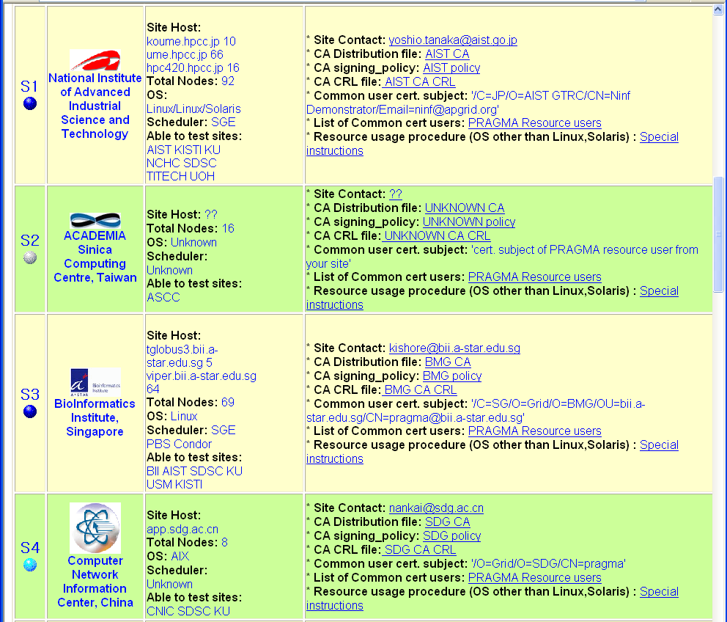
Notes:
http://www.bii.a-star.edu.sg/~kishore/PRAGMA/

Slide 4
Gridware
Minimum
  Globus 2.2.x (or higher)
    2.4 missing Java library support
    Cannot submit jobs from 2.2 to 2.4
  Paths
    Local grid shell environment is correct (LD_LIBRARY_PATH, PATH, …)
  Local Scheduler
    Site specific PBS, SGE, etc
    Must include correct globus job-manager (not just fork)
Optional
  MPICHG2
    Not all cluster nodes are on public network
  Ninf-G
    Will also work with NAT firewalls (on most clusters)
    Proposed to be a required component
  Monitoring
    General: SCMSWeb, Ganglia
    Network: Iperf, NWS

Slide 5
Status
Resource Pool
  Approximately a dozen committed resources
  Most not dedicated to PRAGMA (this is good)
Grid Connectivity
  Nearly all have published CA information
  CA trust varies from site to site
  Grid-mapfile varies from site to site
  A few sites maintain CRLs
  Root GIIS at SDSC, found to not be scalable (local MDS access only)
PRAGMA Heartbeat
  Tests Globus connectivity of hosts
  Measures network bandwidth
  Run from AIST
Resource List
  Repository for CA information, and primary tech contact user certificate information
  Evolving towards dynamic QoS measurement

Slide 6


Thank you
http://www.pragma-grid.net

Slide 7

http://pragma5.nchc.org.tw
Notes:
Art, Culture, Technology

