Slide 1



Pacific Rim Application and Grid Middleware Assembly: PRAGMA
A community
building collaborations and
advancing grid-based applications
SC’03
19 November 2003
http://www.pragma-grid.net

Slide 2
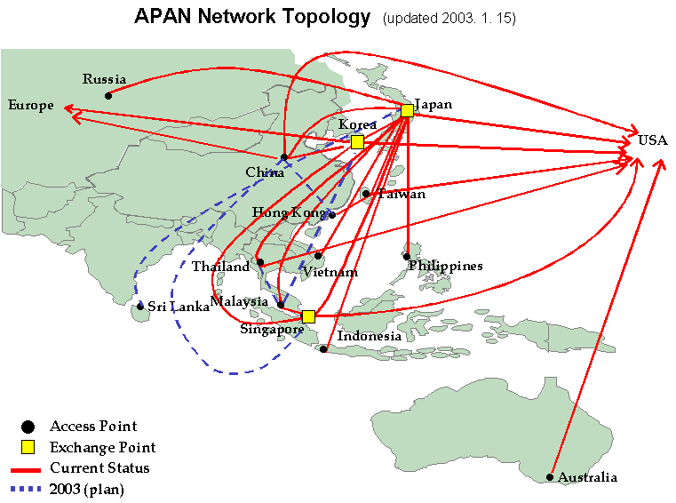


























PRAGMA PARTNERS
Affiliate Member
Notes:
20 institutions

Slide 3
PRAGMA
Overarching Goals
Establish sustained collaborations
and
Advance the use of the grid technologies for applications
among a community of investigators working with leading institutions around the Pacific Rim
Working closely with established activities
that promote grid activities or the underlying infrastructure,
both in the Pacific Rim and globally.
Notes:
Advance scientific applications
Contribute to the international development of the Grid
More productive and effective use of the Grid by researchers in the Pacific Rim
Increased collaboration on the Grid in the Pacific Rim
Greater interoperability of grid middleware
“And this global connectivity allows scientists like Mark Ellisman to control and obtain information from a microscopy in Japan”. Actually, Mark has been a pioneer in telescience, leading the charge to take advantage of the network and the larger microscopes in Japan to advance our science.”
Science, Technology, And Research Transit Access Point, or STAR TAP,
Europeans are pursuing building the internet infrastructure very aggresively
The Pacific Rim will be accelerating their growth in this arena.
About STAR TAP The Science, Technology, And Research Transit Access Point, or STAR TAP, is a proving ground for long-term interconnection and interoperability of advanced international networking. STAR TAP is made possible by major funding from the US National Science Foundation to the University of Illinois at Chicago. See: http://www.startap.net

Slide 4

Institutional Members
International Model
of Collaboration
Success Stories
Working Groups
Institutions
Workshop Schedules
Acknowledgements
http://www.pragma-
grid.net/

Slide 5
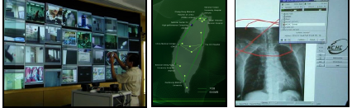
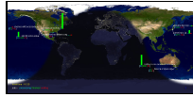
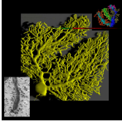
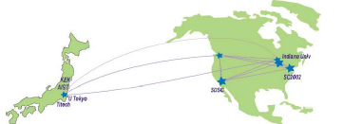
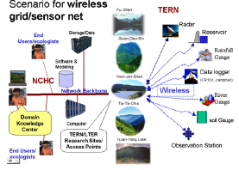
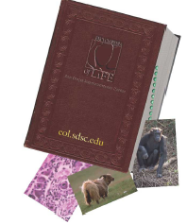
PRAGMA Success Stories
Grid Community Pulls together to Battle SARS
Merging Grid Technology and Computational Chemistry
Telescience Marshals Rich Network of Technologies at iGRID2002
Grid Demo Sets US to Japan Data Speed Records
EcoGrid
Encyclopedia of Life
PRAGMA
Brochure

Slide 6
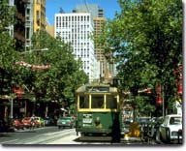

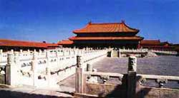
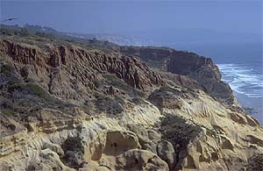
Schedule of Meetings
PRAGMA 4: 4-5 June 2003, Melbourne, Australia
  ICCS2003: 3-4 June
  David Abramson (APAC): Chair; Co-chair: Fang-Pang Lin (NCHC)
PRAGMA 5: 22-23 October 2003, Hsinchu/Fushan, Taiwan
  Fang-Pang Lin (NCHC): Chair; Co-chair: Kai Nan (CNIC)
PRAGMA 6: 16 – 18 May 2004, Beijing, China
  Baoping Yan (CNIC): Chair; Co-chairs: Mason Katz (UCSD), Jim Williams (TransPAC)
PRAGMA 7: Mid September 2004, San Diego, USA
  Chairs: Mason Katz (UCSD), Jim Williams (TransPAC)
Notes:
Not only did we organize a second meeting – but we pushed out the schedule (for planning) for two more meeting.
Have joint chairs (current, future)
1st meeting: getting to know each other: information exchange rich
2nd Meeting: starting to frame activities
3rd Meeting: Work plans and collaborations; begin tutorials; begin lessons learned; set goals for 4th meeting

Slide 7



Summary of PRAGMA SC’03 Demos
Total 22 Abstracts: Accomplishments or Promotions
Most involve 3 or more partners
Every members involved in at least one demo.
13 institutions present, 9 have booths
Technologies: Ninf-G, Nimrod, Grid Datafarm, MGrid, Grid Server Broker, Optimization Algorithms, Lattice Data Grids, Telescience
Applications: Quantum Chemistry, Molecular Energy Calculations, Astronomy, Climate, Molecular Biology, Structural Biology, Ecology and Environment, SARS Grid, Neuroscience

Slide 8
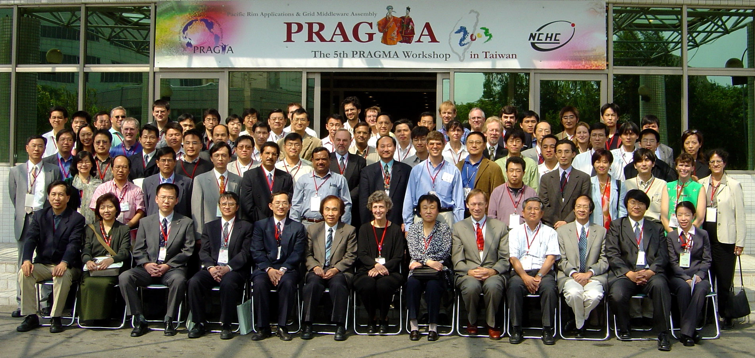
PRAGMA 5
22 October 2003
Hsinchu, Taiwan

Slide 9
Presentations
Academia Sinica Computing Centre – Hsin-Yen Chen
Australian Partnership for Advanced Computing – David Abramson
Center for Computational Physics, U. Tsukuba – Taisuke Boku
Cray Inc – Richard Russell
Global Scientific Information Computer Center, Tokyo Institute of Technology – Satoshi Matsuoka
Grid Technology Research Center, National Institute of Advanced Industrial Science and Technology – Satoshi Sekiguchi, Yoshio Tanaka
Korea Institute of Science and Technology Information – Kum-Won Cho

Slide 10
Presentations Continued
National Center for High Performance Computing – Whey-Fone Tsai, Fang-Pang Lin
National Center for Supercomputing Applications – Radha Nandkumar
Cybermedia Center and BioGrid, Osaka University – Shinji Shimojo
STAR TAP – Maxine Brown
TransPAC – John Hicks, Rick McMullen
University of California San Diego, San Diego Supercomputer Center – Philip Papadopoulos, Mason Katz

Slide 12

Thank you
http://www.pragma-grid.net

Slide 13
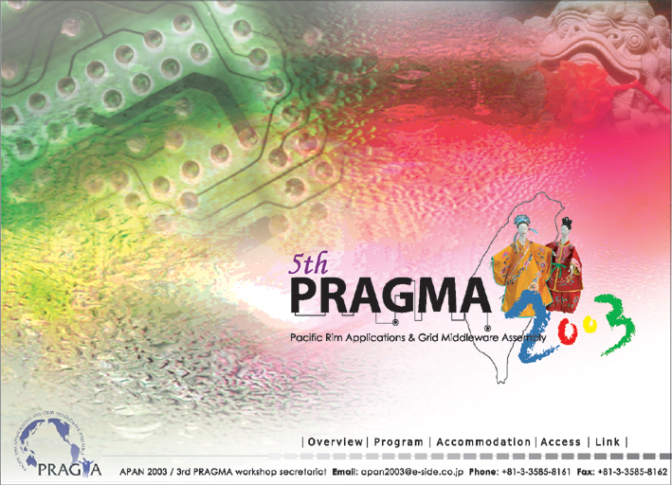
http://pragma5.nchc.org.tw
Notes:
Art, Culture, Technology

