Slide 1
Exploring New Spatial and Temporal Scales in Ecology Using Wireless Sensor Networks
September 20, 2003

Slide 2
Goals for the Workshop
To identify scientific research opportunities and areas enabled and opened up by wireless sensor networks
To exchange information on capabilities, techniques and technologies, and experiences for wireless sensor networks
Develop products that help achieve the goals above

Slide 3
Workshop Format
Keynotes:
  Science opportunities – Tim Kratz
  Technological opportunities – Bill Michener
Panel Discussion -Mediated by Peter Arzberger
  Stuart Gage – Sound
  Paul Hanson – Buoy networks
  Hen-biau King & Fang-Pang Lin – Eco-Grid
  John Porter – Barrier Island wireless network

Slide 4
Topics for Panel
What are the biggest opportunity for new science and cross-site or synthetic research with this technology?
What lessons have been learned for putting in wireless networks in the field?
What are the biggest challenges remaining to fully realize the potential of this technology?
Have there been changes to the conduct or the type of science undertaken?
How have or can these networks impact work at new spatial and temporal scales?
What unique contribution has your site made to instrumenting the environment?

Slide 5
Most Important Part!
Discussion working groups
Sensor Needs: What are pressing sensor needs for analyzing ecological systems?
Information Dissemination on Wireless Techniques: How can information exchange on technologies and implementations be shared?
Collaborative Efforts: What joint projects are possible? What new science can be done?Advancing collaboration on development of wireless sensor arrays – how?
Need Raporteur for each working group to report

Slide 6
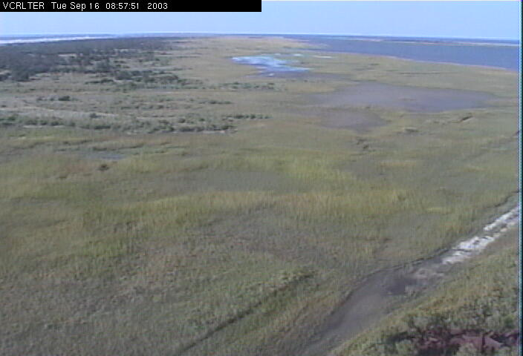
Wireless Webcam –pre Isabel

Slide 7
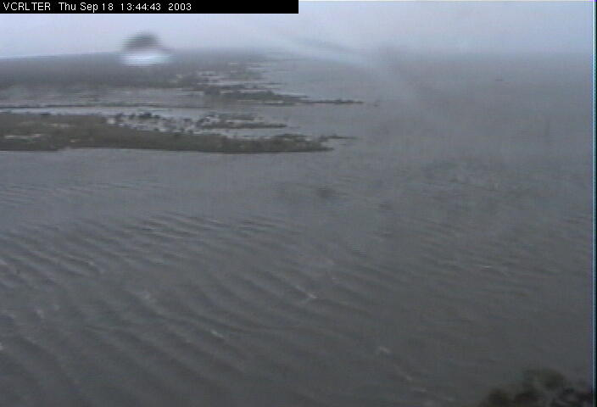
During Isabel

Slide 8
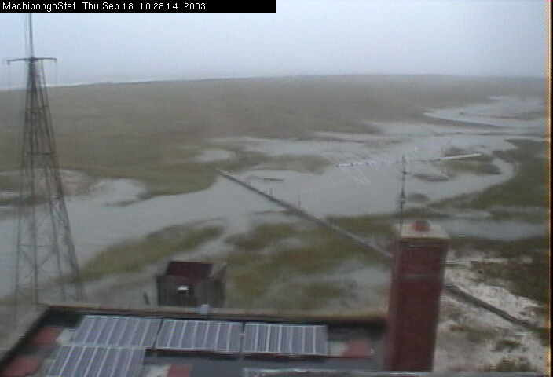
Early Isabel

Slide 9
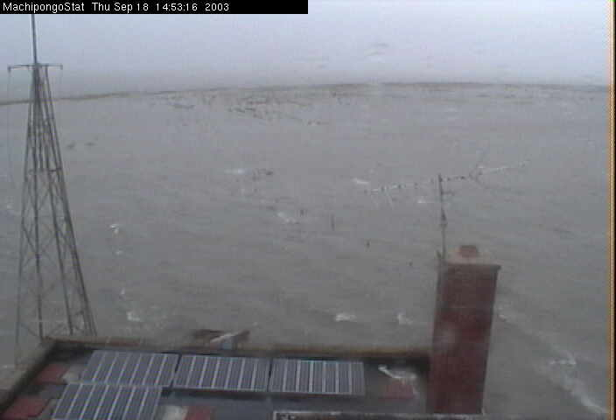
Peak Flooding

Slide 10
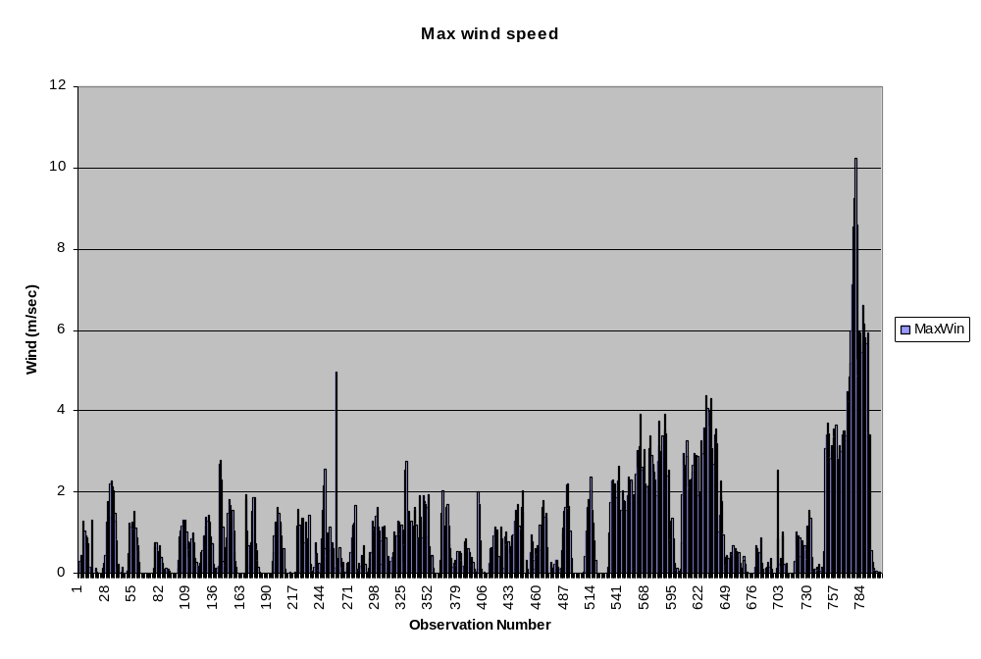
Isabel Winds

