Slide 1
Bioinformatics Computing Portal
@
ASCC BioPortal
Hsin-Yen Chen & Chi-Wei Wang
Academia Sinica Computing Centre
Nov. 18~21, 2003
SC2003, Phoenix, USA
ASCC Bioinformatics IT Service/Support Team

Slide 2
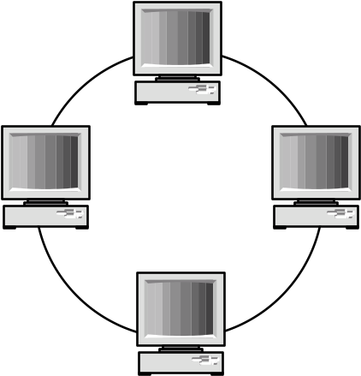

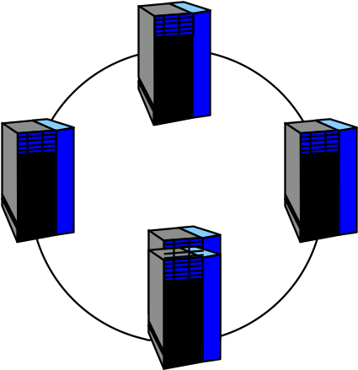

Introduction (3)
High throughput architecture
UI (Web server)
Sequence analysis tools (CE 1)
Virtual Organization
GRID technology
Network
Database cluster (DBMS)
Structure biology tools (CE2)

Slide 3
Grid + Web Service Solution
Grid is an (network) environment that provides uniform access and management to a large number of diverse and distributed resources
  Grid is not batch schedulers, cluster managers, or storage systems that happen to be connected to the Internet
  Grid incorporates Network Computing as its fundamental component
  Grid may add new standards that extends the network protocol layers
Web Services is to hide the complexity and provide transparent access to the Grid services
  Typical components are: WSDL, UDDI and SOAP
However, Grid is still largely a framework, explicit support to Bioinformatics and Contents needs to be worked out

Slide 4
Conceptual Bio-Grid Application Infrastructure
Life Scientist Access
ACCESS GRID
Bio Portal Web
Life Science A
pplications
IBM WebSphere
, OGSA
Data Analysis/Visualization
Federated Database
Oracle, DB2, MySQL, Text file
IBM DiscoveryLink
Grid Middleware
Network/Computing Infrastructure

Slide 5
Grid Enabled BioPortal@ASCC
Design Considerations
  Allows for the end user to share the computing resources and complex databases under one system
  The scale of computing resource can be re-sized as needed
  The computing resource can be allocated dynamically
  The complexities of computing resources allocation should be hidden by web interface

Slide 6
Grid Enabled BioPortal@ASCC
Implemention
  A Web-based uniform entrance for providing bioinformatics computing service to biology researchers world-wide
  The integration of heterogeneous computing platforms
  The integration of federated bioinformatics data bases
  A high throughput computing environment
Current Status
  Open for On-line services since July 2003
  Based on home grown grid emulated middleware
  On-line applications including
    Analysis Tools: NCBI BLAST (all types), CRASA, FASTA, OPASS, R (Microarray analysis), etc.
    Databases: SMD
  Web Site: http://bits.sinica.edu.tw
Sponsor: National Research Program for Genomic Medicine

Slide 7
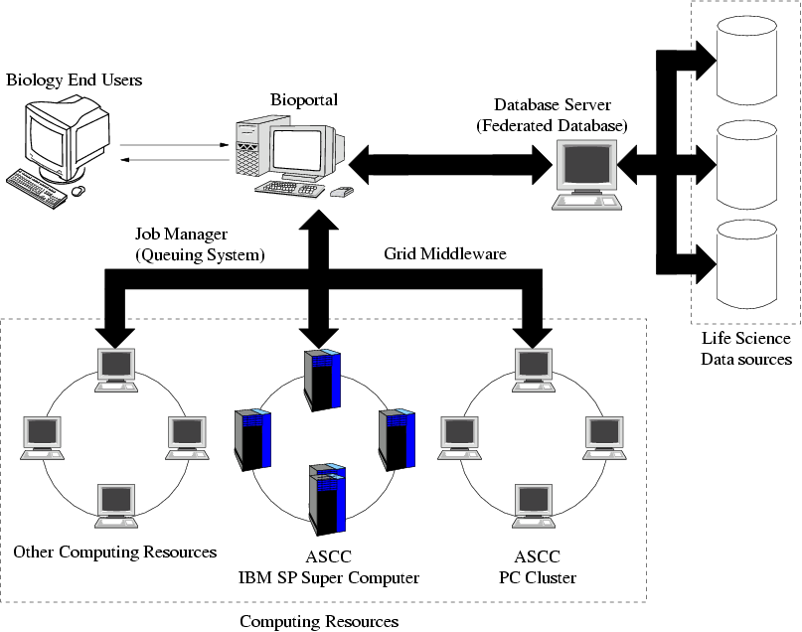
System Architecture - Schematic Diagram

Slide 8
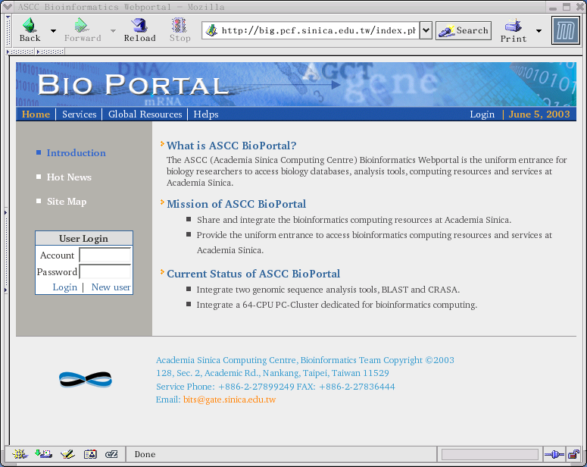
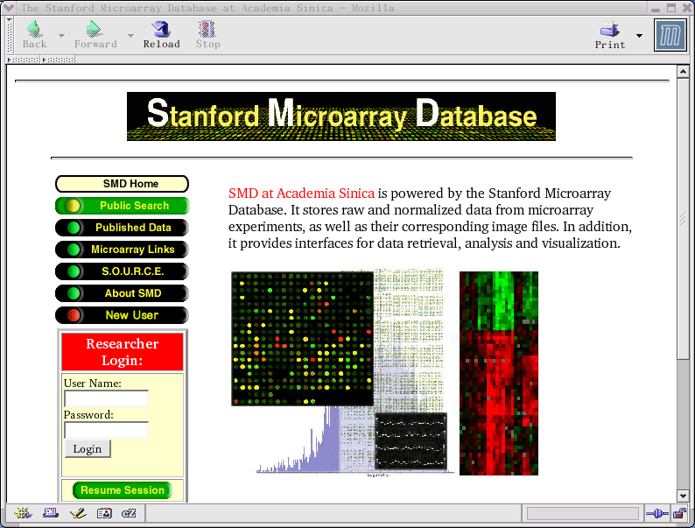
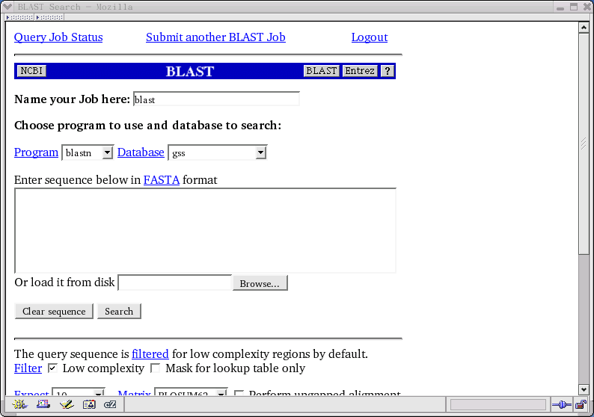
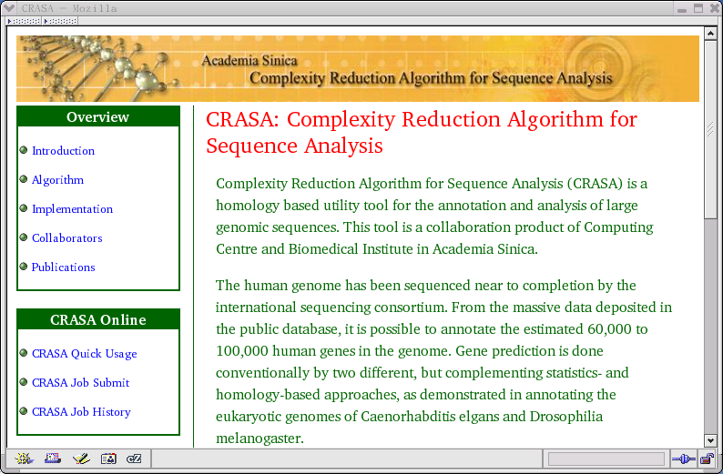
BioPortal@ASCC http://bits.sinica.edu.tw

Slide 9
Future works
Expand application suites to fulfil the NRPGM need
Build necessary life science databases
Federated database implementation
  Collaborate with IBM, Taiwan
Add more computing elements
Migrate to IBM WebSphere portal environment

Slide 10

Thank you!

