Slide 1
Exploring New Spatial and Temporal Scales in Ecology Using Wireless Sensor Networks
Panel Discussion

Slide 2
Panelist
Stuart Gage – Acoustic Sensing
  Kellogg Biological Station
Paul Hanson – Buoy Networks
  North Temperate Lakes
Fang-Pang Lin & Hen-biau King – Eco-Grid
  Taiwan Ecological Research Network and National Center for High Performance Computing
John Porter – Barrier Island Wireless Network
  Virginia Coastal Reserve

Slide 3
Topics for Panel
What are the biggest opportunity for new science and cross-site or synthetic research with this technology?
  How have or can these networks impact work at new spatial and temporal scales?
  Have there been changes to the conduct or the type of science undertaken?
What lessons have been learned for putting in wireless networks in the field?
What are the biggest challenges remaining to fully realize the potential of this technology?
What unique contribution has your site made to instrumenting the environment?

Slide 4
Discussion groups
Sensor Needs: What are pressing sensor needs for analyzing ecological systems?
Information Dissemination on Wireless Techniques: How can information exchange on technologies and implementations be shared?
Collaborative Efforts: What joint projects are possible? What new science can be done?Advancing collaboration on development of wireless sensor arrays – how?
Need Raporteur for each working group to report

Slide 6
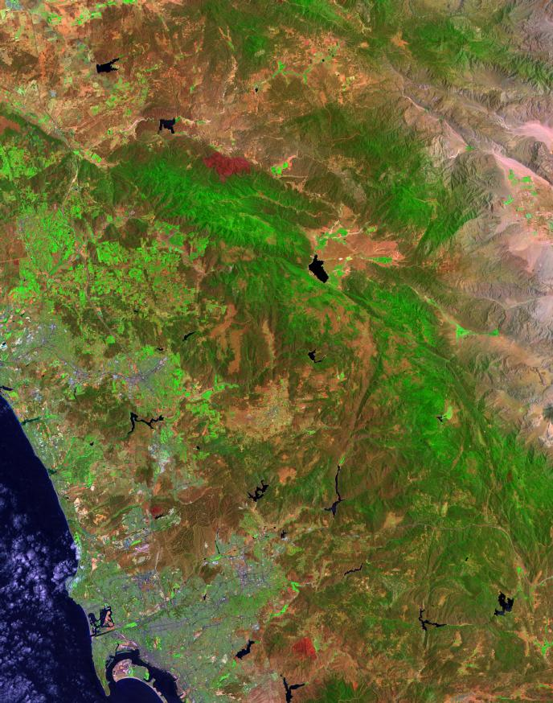
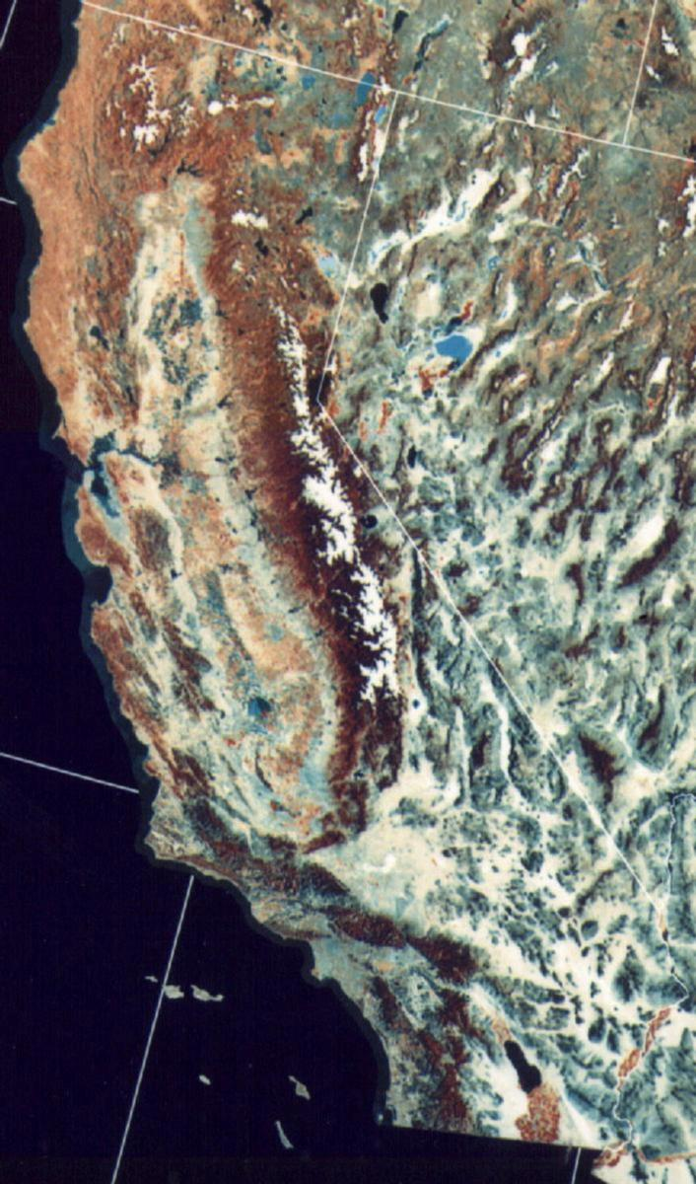
HPWREN
connected topology
agenda
May 2002
Santa Margarita
Ecological Reserve
Palomar
Observatory
Los Coyotes
Indian Res.
Pala
Indian Res.
Pauma
Indian Res.
Rincon
Indian
Res.
La Jolla
Indian Res.
San Pasqual
Indian Res.
Mesa Grande
Indian Res.
Santa Ysabel
Indian Res.
Mt. Laguna
Observatory
UCSD/SDSC
SIO
Backbone/relay node
Science site
Researcher location
Education site
Incident mgmt. site
Scripps Pier
Courtesy Hans-Werner Braun

