Slide 1
HMCS-G : Grid-enabled
Hybrid Computing System for
Computational Astrophysics
Taisuke Boku & Mitsuhisa Sato
Center for Computational Physics
University of Tsukuba
Booth#626

Slide 2
CCP, U. Tsukuba
Center for Computational Physics,
University of Tsukuba
Specially dedicated for computational physics and computer science for HPC
Computational Physicists and Computer Scientists are working together
(2/3 = CP and 1/3 = CS)
Resources: CP-PACS MPP (2048PU), clusters (IA-32, IA-64, Alpha) and GRAPE-6

Slide 3
What is HMCS-G ?
Importance of Grid for Computational Physics
Efficient utilization of world-wide generic HPC resources (MPP, cluster, storage, network, etc.)
= Quantitative Contribution
Sharing special purpose machines installed to small number of institutes from all over the world
= Qualitative Contribution
HMCS-G is a concept of hybrid computational system
to combine General purpose and Special purpose machines
based on grid-RPC on wide area network

Slide 4
HMCS-G
Grid-enabled Heterogeneous Multi-Computer System for Gravity
Purpose
  Sharing special purpose machine GRAPE-6 among users over the world who needs gravity calculation
  Providing local and remote services of GRAPE-6 facility access simultaneously
  Utilizing GRAPE-6 resource efficiently
  Hiding long network access latency through communication buffers between end-points
Implementation
  grid-RPC system OmniRPC
  Modifying original HMCS server to fit grid access

Slide 5
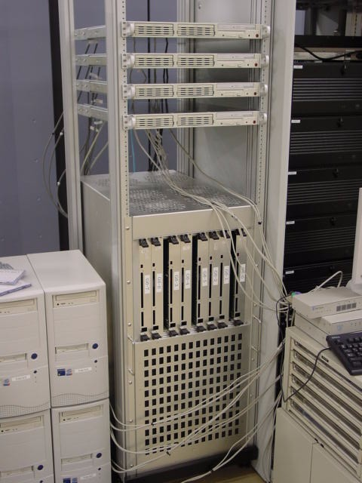
GRAPE-6
The 6th generation of GRAPE
(Gravity Pipe) Project
Gravity calculation for many particles
with 31 Gflops/chip
32 chips / board ⇒ 1 Tflops/board
8-board system (= 8 Tflops) is installed at Center for Computational Physics, U. Tsukuba
Working at a part of HMCS for hybrid simulation in astrophysics:
Galaxy generation with RT-SPH-G
(Radiation-Transfer Smoothed Particle Hydrodynamics with Gravity)

Slide 6

HMCS-G block diagram
U. Tsukuba
CCP
Cluster
CP-PACS
G6
HMCS-G
server cluster
G6
Cluster
G6
Agent
(OmniRPC stub)
Vector Machine
Firewall
HMCS-L protocol
OmniRPC (ssh)
Cluster
PC
OmniRPC (globus)
SC2003, Phoenix

Slide 7
Server for grid-enabling
Previous version (HMCS-L) connects just a pair of client and server
⇒ No authentication, communication phase control,
robustness
HMCS-G provides
  Authentication
    globus & ssh
    globus = de facto standard of Grid
    ssh = easy implementation, no firewall problem
  Resource scheduling
    Do not lock GRAPE-6 server for long time
    Fine grained phase control
  Robustness
    Time-out mechanism to detect network or client failure

Slide 8
On-line Demonstration
Run simple client process to compute 10,000 ～ 100,000 particles from various site including Linux PC at our booth in Phoenix
Show particles movement on 2-D projection (actual calculation is performed in 3-D)
Multiple processes can be served simultaneously
Real-time load monitoring on the web
1 TFLOPS GRAPE-6 board is now opened for trial usage. Anyone can access it with a simple registration and software downloading

Slide 9
Visit Our Booth !!
Booth#626 (next of Sun Microsystems)
On-line demonstration to access GRAPE-6 from multiple client machines including a note- PC in our booth
Real-time load monitoring of HMCS-G
Another demonstration of OmniRPC

