Slide 1
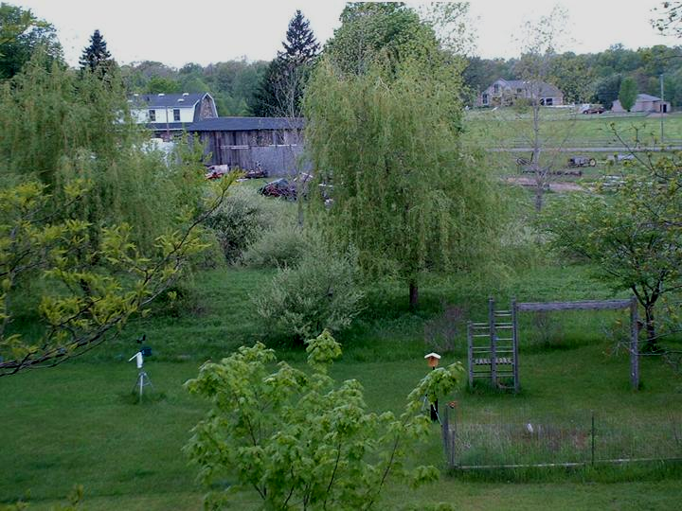
Development of Wireless Instrumentation for Remote Environmental Acoustic Sensing
Stuart Gage
Computational Ecology and Visualization Laboratory
Michigan State University

Slide 2
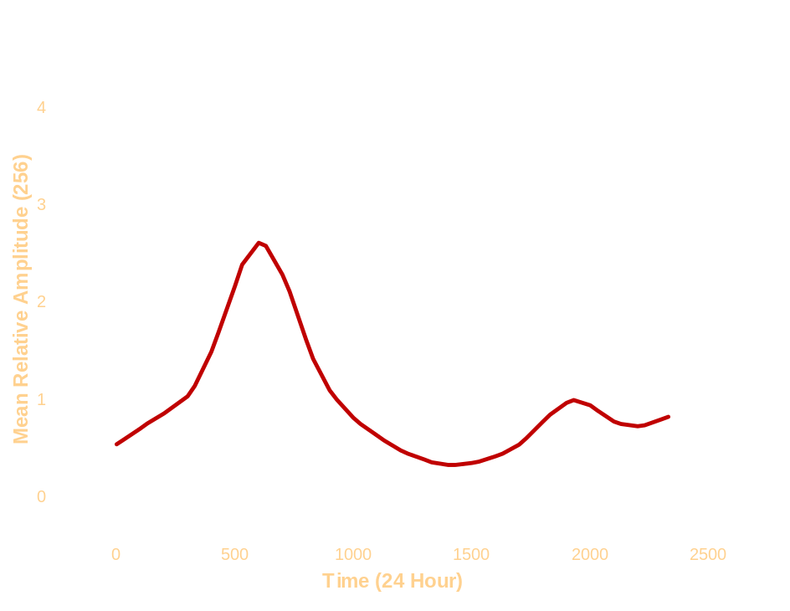
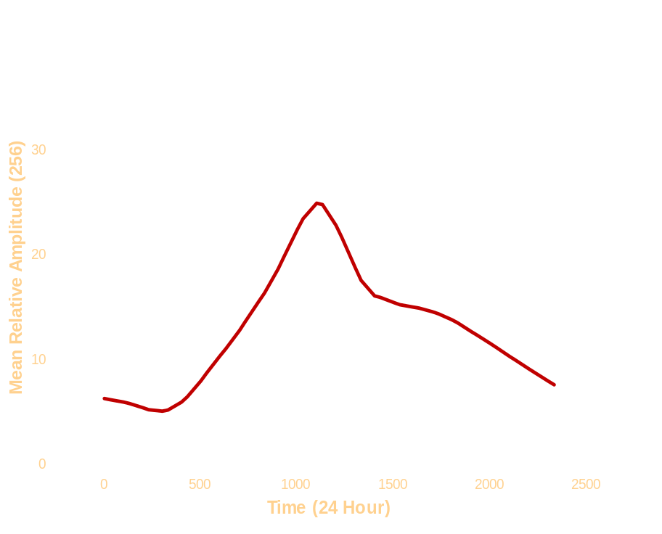
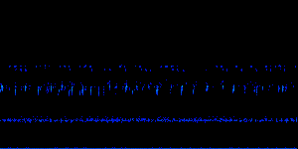
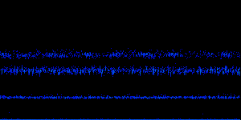
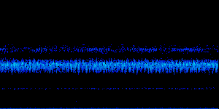
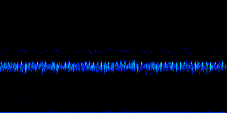





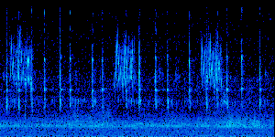
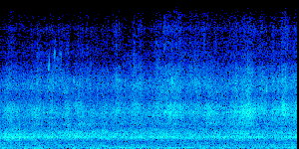
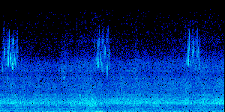
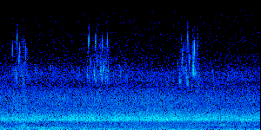
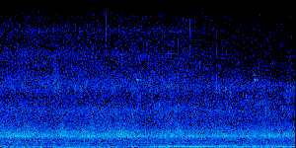
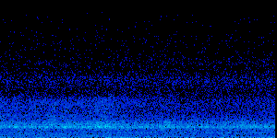

Sound as an Ecological Indicator and a Stressor
As an Ecological Indicator-
The integrity and dynamics of an ecosystem may be correlated to the complexity of that ecosystem’s soundscape.
As a Stressor-
Organisms require communication for their survival. Organism population may be inversely proportional to the degree of acoustic disruption.
Diurnal Curve of Total Activity in an Agricultural/Forested Landscape
Diurnal Curve of Total Activity in an Urban/Human Dominated Landscape
Cooper Ranch 2002/08/24
Ferris State 2002/05/23

Slide 3
Taxonomy of an acoustical signal
Soundscape
Acoustic Spectrum from 40 Hz to 11.050 kHz
Geophony
Diffuse Across the Spectrum
Anthrophony
40 Hz to 2 kHz
Biophony
2.5 kHz to 8 kHz
Mechanical
Industrial and
Mechanical
Oral
Communication
Intentional
Communication
Among Organisms
Incidental
Signals Caused
by Organisms
Stationary
Consistent or Periodic
Temporal
Non-periodic or Brief

Slide 4


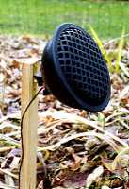


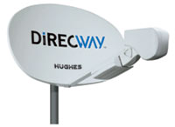
Environmental Acoustic Monitoring Infrastructure
Weather Station
Digital Camera
Microphone
Server and Digital Library
Satellite Uplink
Monitoring Computer
Internet Community
Environmental Acoustics Analysis System
Clickable
Ecosystem
Clickable Ecosystem Website

Slide 5
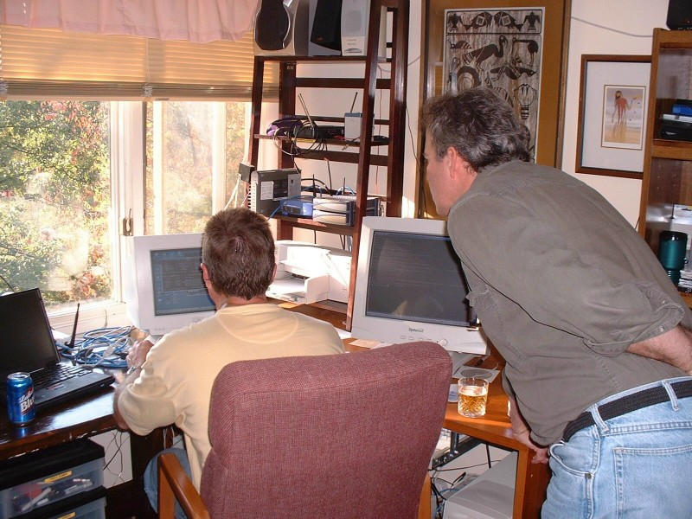
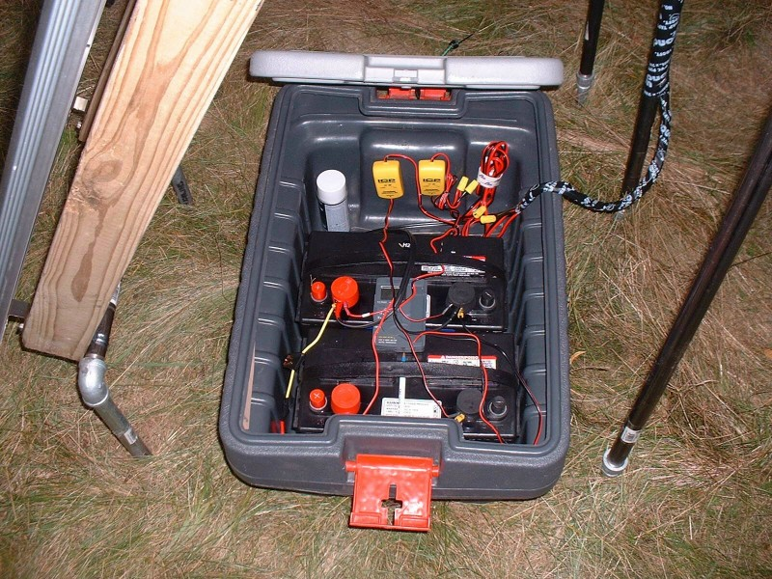
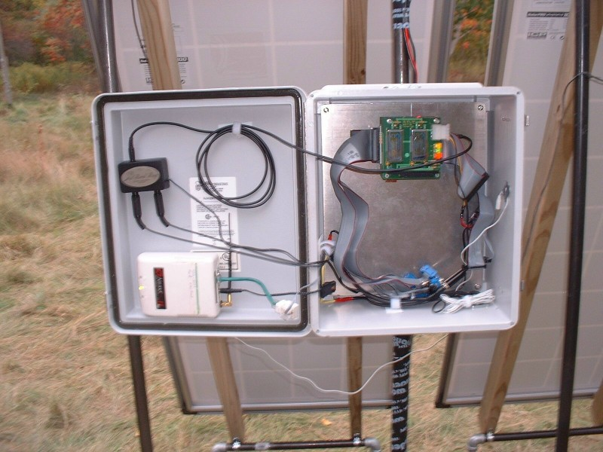
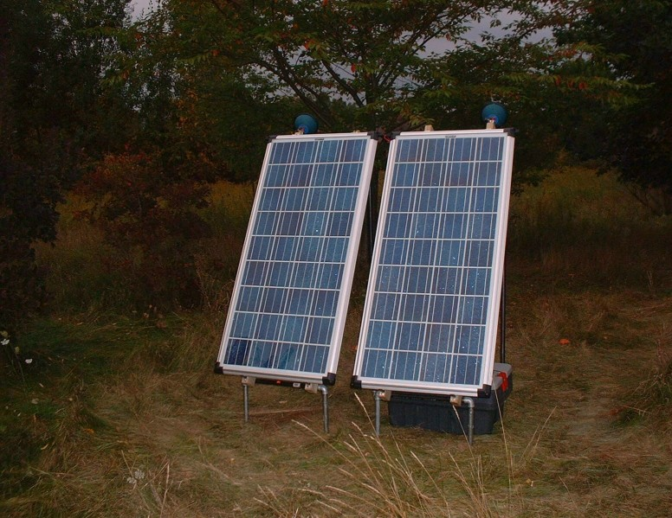

Slide 6
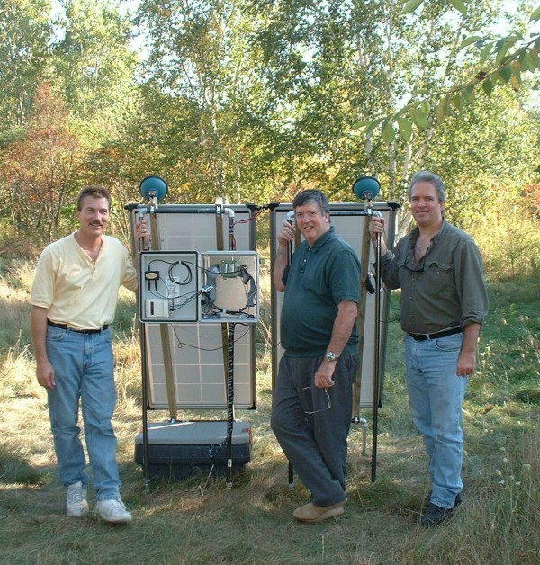
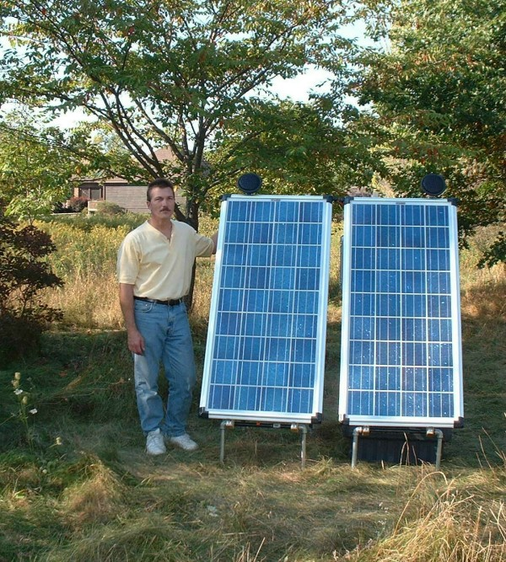
00:00
03:00
06:00
09:00
October 3, 2002

Slide 7
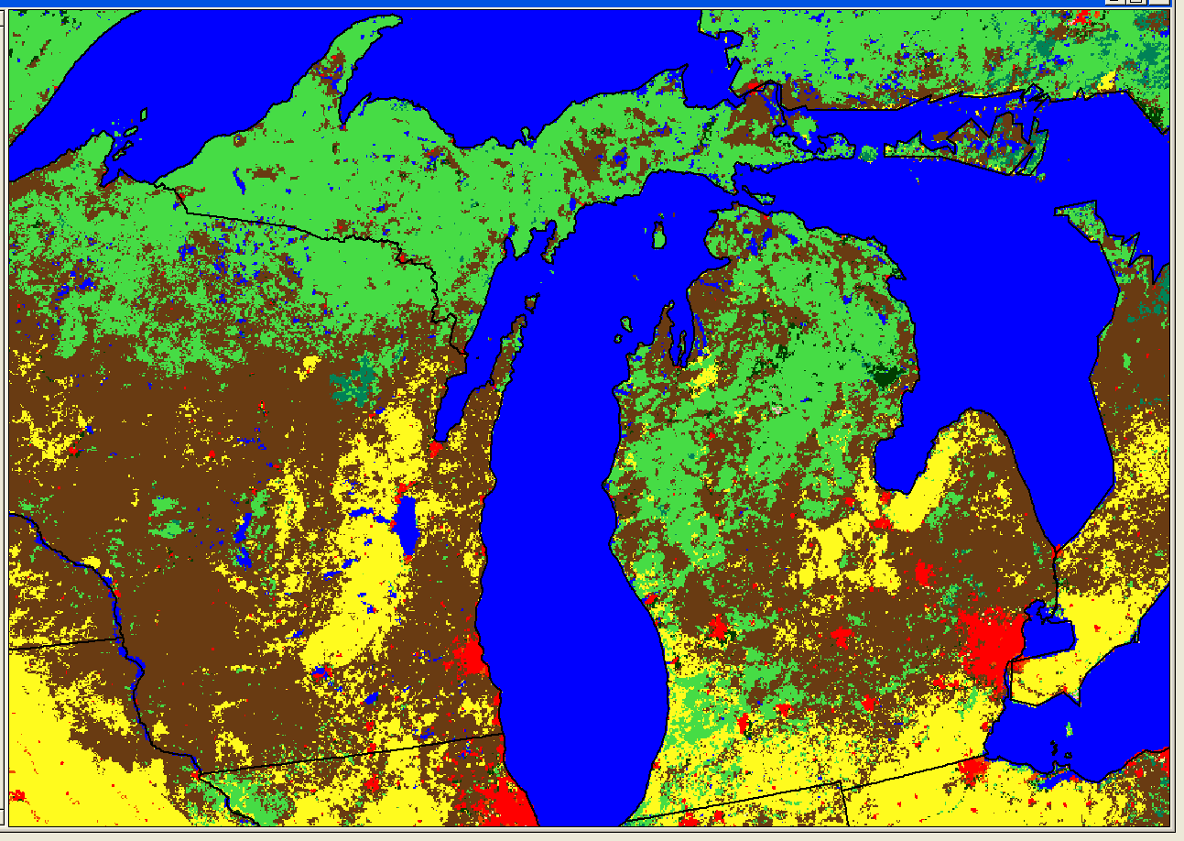
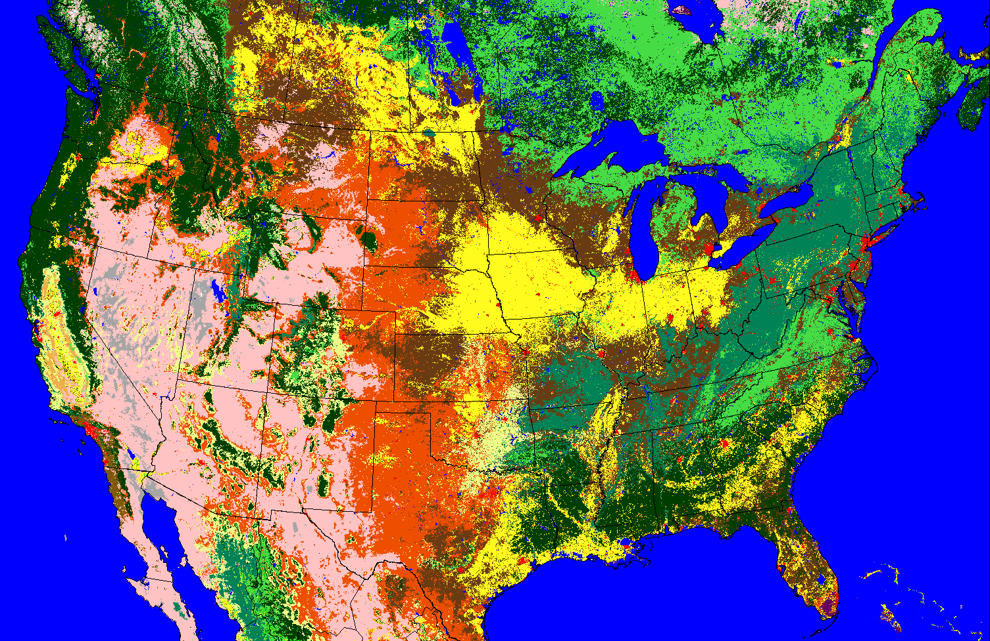

Current Acoustic Monitoring Locations
Acoustic Monitoring System Data Relays
1
‘Pony Express’
1
5
Satellite Relay
1
1
Wireless-> broadband
1
DSL Network
2
REAL Server
Esonic Server

Slide 8
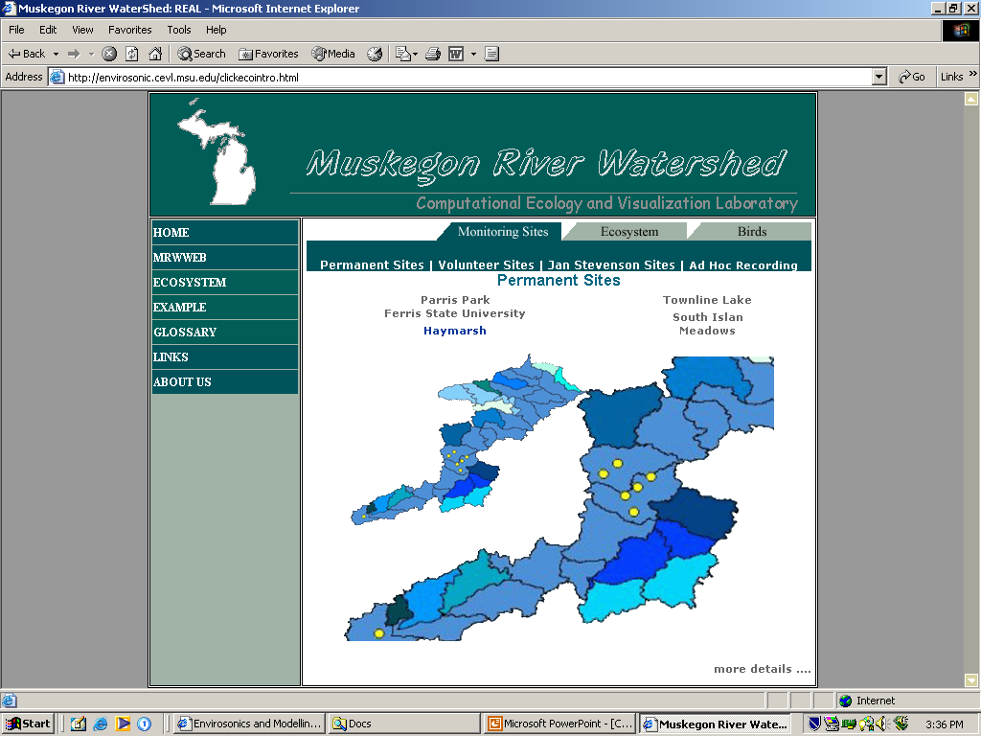
Near Real-time Acoustic Analysis System
Media File
audio, image, weather
Remote Computer
Media File Server
File Processing
Components
Automation Process
Integration
layer
Database API
components
Meta-Data
Database
Web/Application
Server
Notes:
File Processing Components to “File Processing Components”

Slide 9
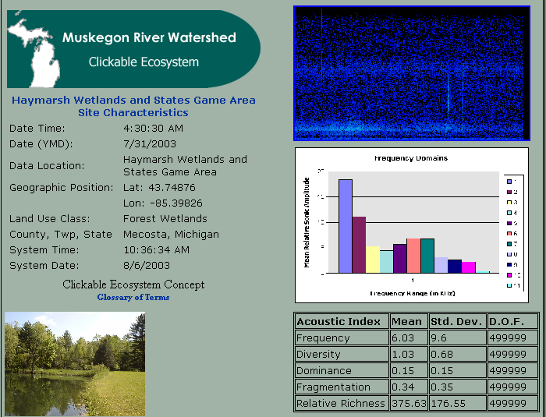
Site Access Time –Date
Specific
http://envirosonic.cevl.msu.edu
Notes:
Back arrow to “ Clickable Ecosystem Website”

Slide 10
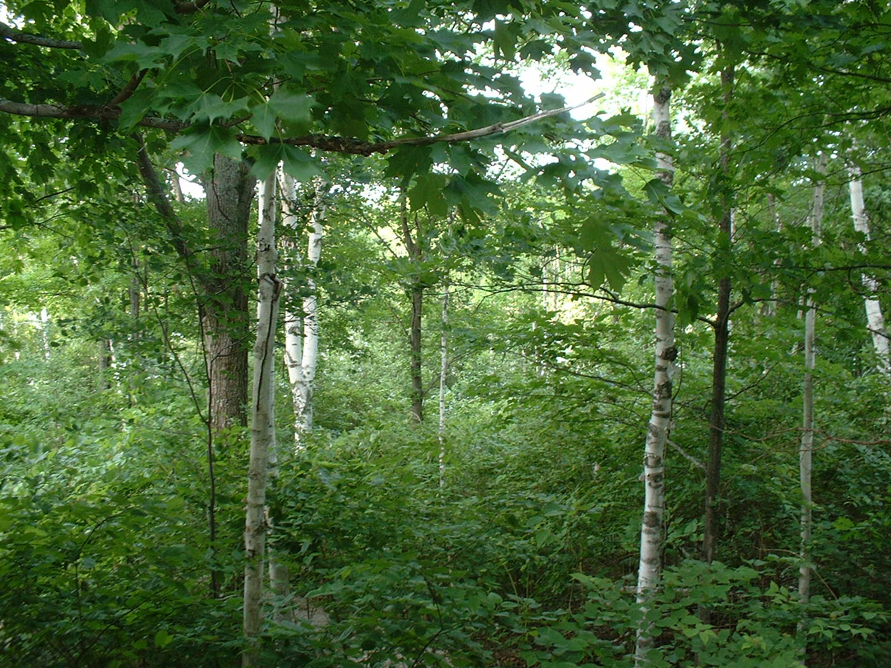
SUMMARY
  Quantify environmental acoustics for interpretation of soundscape meaning
  Dividing a spectrogram into frequency domains provides ability to develop ecosystem stressor and indicator indices.
  Standardized measurements and methods permits comparison within and between soundscapes.
  Automation provides an ability to analyze and interpret soundscapes at times not usually monitored.
  Linking soundscapes and landscapes via remote sensing provides mechanism to scale to region
  Developing soundscape system demonstrates potential for other sensors

