Slide 1
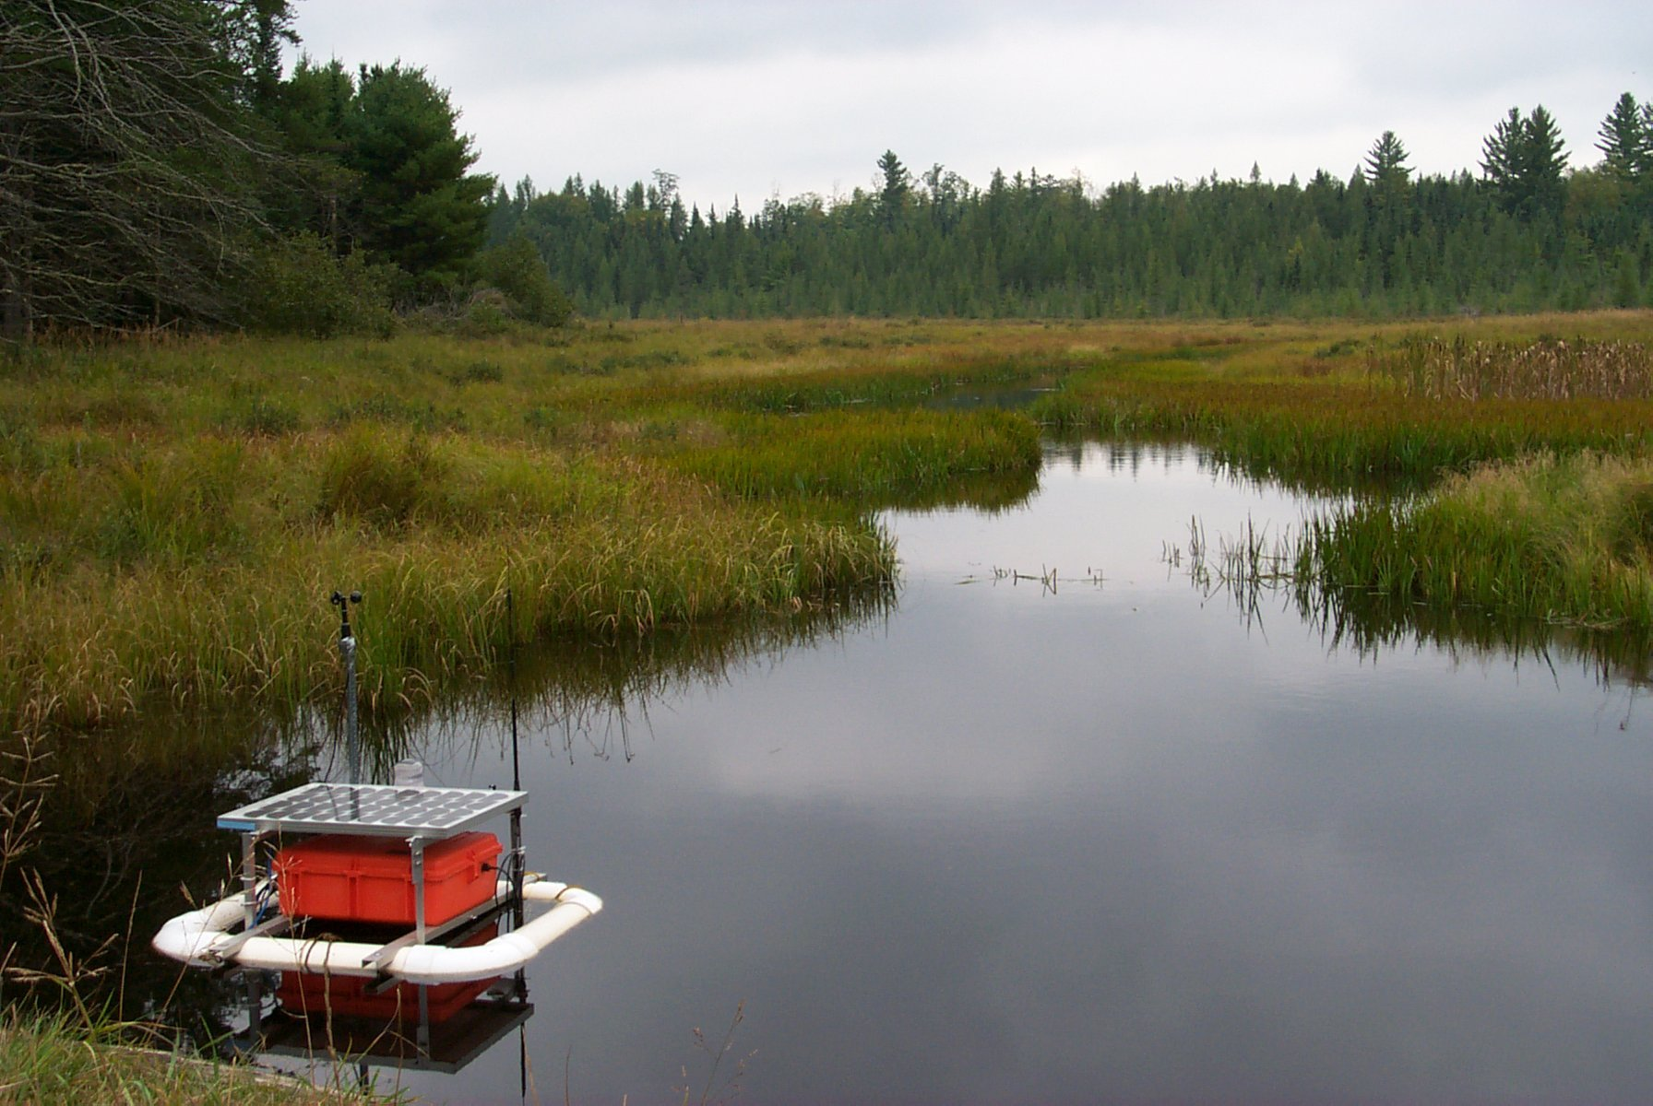
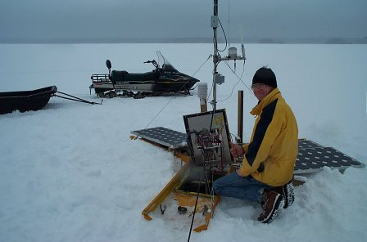
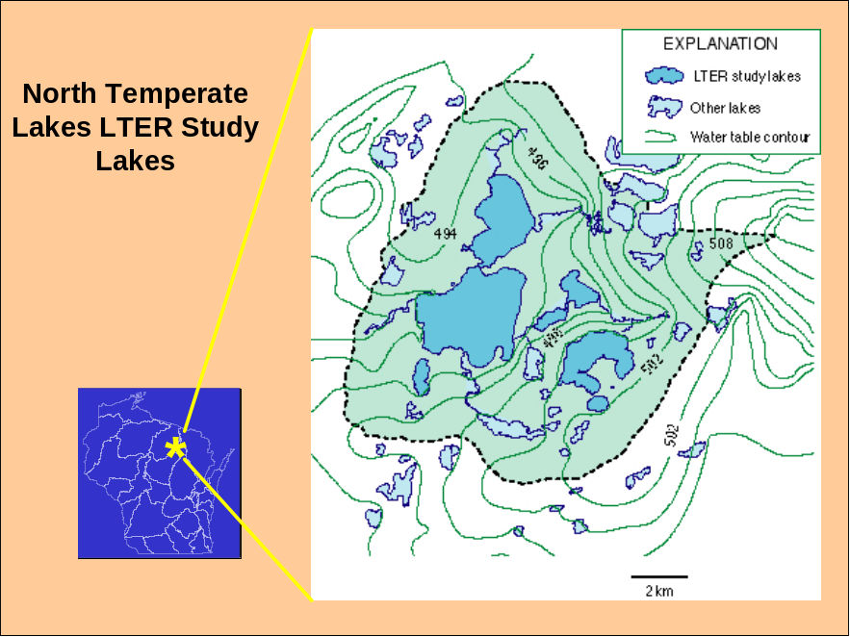
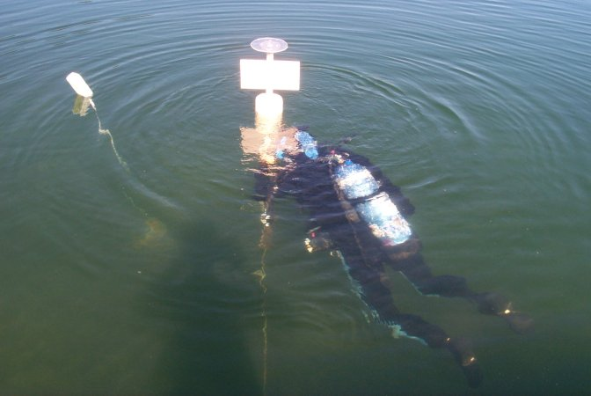
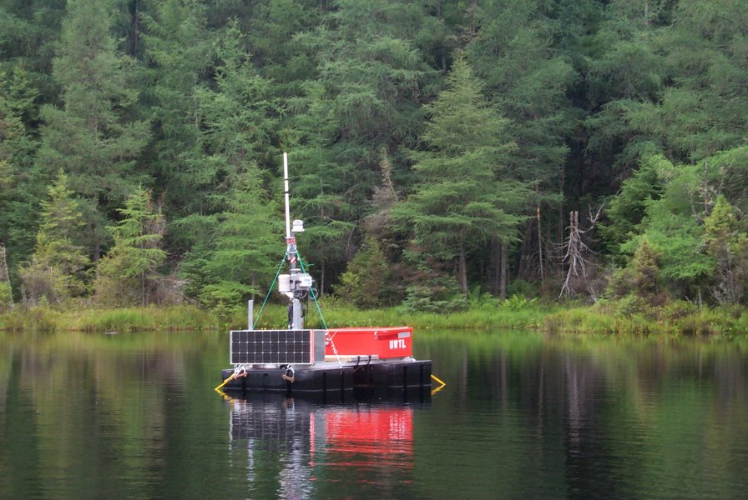
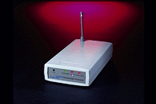
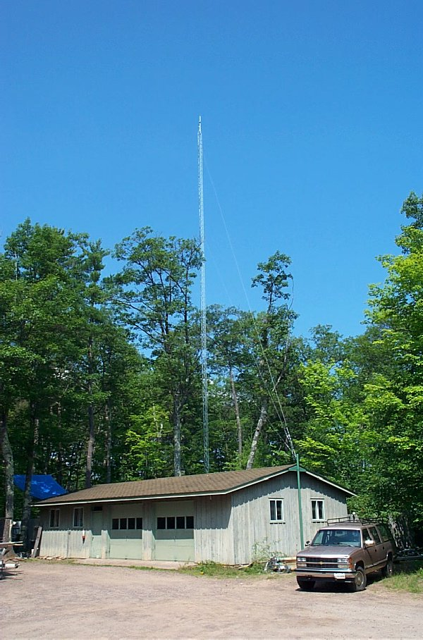
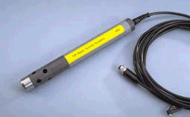
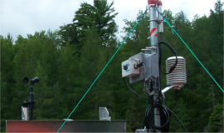
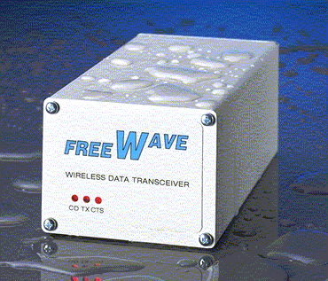
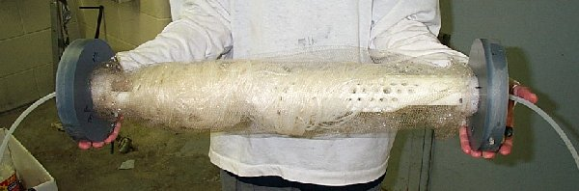
North Temperate Lakes
University of Wisconsin
Automated Sampling Buoys
Picture of
Lab Freewave
Sensors
Picture of
Buoy Freewave
Communication

Slide 2
Trout
Lake
Station
hardware
hardware
DSS
serial radio
hardware
DSS
serial radio
DSS
serial radio
hardware
hardware
DSS
serial radio
Programmable
datalogger
hardware
hardware
Programmable
datalogger
IP addressable
multiplexer
hardware
Programmable
datalogger
Buoys on lakes
(n=7)
Internet
software
Datalogger Com.
data / program
download / upload
and queue
Ad hoc cluster
per lake
software
Utilities
Data QC
Event detection
Adaptive sampling
Web publishing
Internet
software
software
Internet
Oracle DB
Internet
Data handler
Web services context; conforms
to standards, e.g., SOAP, EML

Slide 3
Successes (the dedicated network)
Building large platforms
Establishing bi-directional communication
Publishing data to the Web
Studying processes contained within an ecosystem
Studying processes at few spatio-temporal resolutions
Current Exploration (the adaptive network)
Optimizing wireless networks
Auto-configuring ad hoc networks
Managing the data load from ad hoc networks
Managing power
Distributing data to diverse clients
Developing network intelligence
Studying links across ecosystem boundaries
Studying processes at multiple spatio-temporal resolutions

