Slide 1
AIST Activities in PRAGMA
Grid Data Farm and
Resource/Middleware
Yoshio Tanaka
AIST, Japan

Slide 2

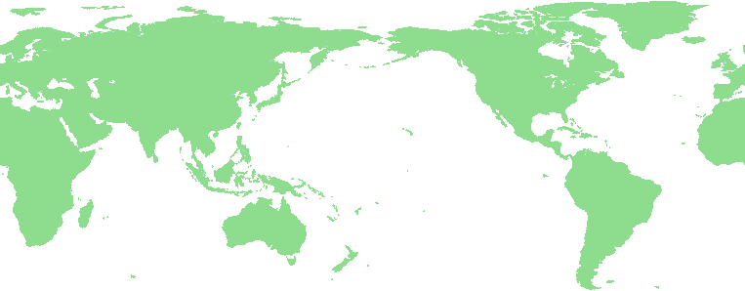

Grid Datafarm: Gfarm file system
- World-wide virtual file system -
Osamu Tatebe is a co-chair of Data WG
Transparent access to dispersed file data in a Grid
  POSIX I/O APIs, and native Gfarm APIs for extended file view semantics and replications
  Map from virtual directory tree to physical file
  Automatic and transparent replica access for fault tolerance and access-concentration avoidance
Virtual Directory
Tree
/grid
File system metadata
ggf
jp
aist
gtrc
file1
file2
mapping
file1
file2
file3
file4
File replica creation
Gfarm File System

Slide 3


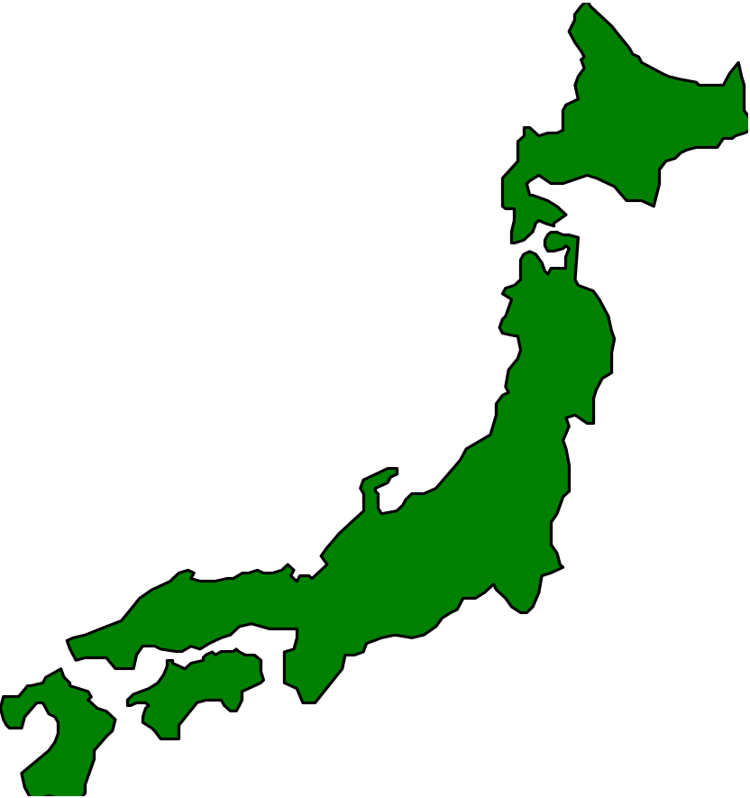


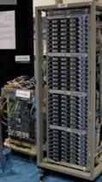





Band Width Challenge at SC2003
Trans-Pacific Gfarm Datafarm testbed
SuperSINET
Trans-Pacific thoretical peak 3.9 Gbps
Gfarm disk capacity 70 TBytes
disk read/write 13 GB/sec
Indiana
Univ
Titech
147 nodes
16 TBytes
4 GB/sec
10G
NII
SuperSINET
Univ
Tsukuba
2.4G
Abilene
SC2003
Phoenix
New
York
2.4G
10 nodes
1 TBytes
300 MB/sec
10G
2.4G(1G)
KEK
10G
7 nodes
3.7 TBytes
200 MB/sec
1G
OC-12 ATM
Chicago
500M
10G
10G
APAN/TransPAC
1G
32 nodes
23.3 TBytes
2 GB/sec
AIST
Maffin
APAN
Tokyo XP
Los Angeles
1G+1G
2.4G
10G
5G
SDSC
16 nodes
11.7 TBytes
1 GB/sec
Tsukuba
WAN
16 nodes
11.7 TBytes
1 GB/sec
Kasetsert
Univ,
Thailand

Slide 4
Activities at Resource WG
Yoshio Tanaka is a co-chair of this WG
Mission of Resource WG
  Deploy middleware on all PRAGMA institutions to support development and execution of applications
    Define minimum requirements for middleware
    Define recommended configuration of the middleware
  Define policy for resource sharing
  Will document the Middleware Deployment Guide (based on the ApGrid documents)

Slide 5
Milestones on GridRPC Application
Subject
  GridRPC Application
Leaders
  Yoshio Tanaka, Hiroshi Takemiya (AIST)
Purpose
  Promote and evaluate GridRPC-application-level connectivity.
Todo
  Deploy GridRPC and its applications on PRAGMA resources.
  GridRPC system: Ninf-G (ver.1)
  Test application: Climate Simulation

Slide 6





















Demo Testbed
PRAGMA / ApGrid Testbed
    10 countries
    21 organizations
    22 clusters
    853 CPUs

Slide 7

LIVE DEMO
Climate Simulation on the
PRAGMA/TeraGrid Testbed
TODAY! 3:00 pm – 3:30 pm at NCSA Booth
ANNOUNCEMENT
Yoshio Tanaka, Hiroshi Takemiya, Satoshi Sekiguchi
AIST, Japan

