Slide 1
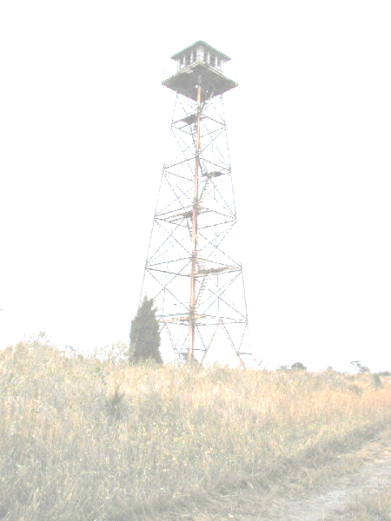
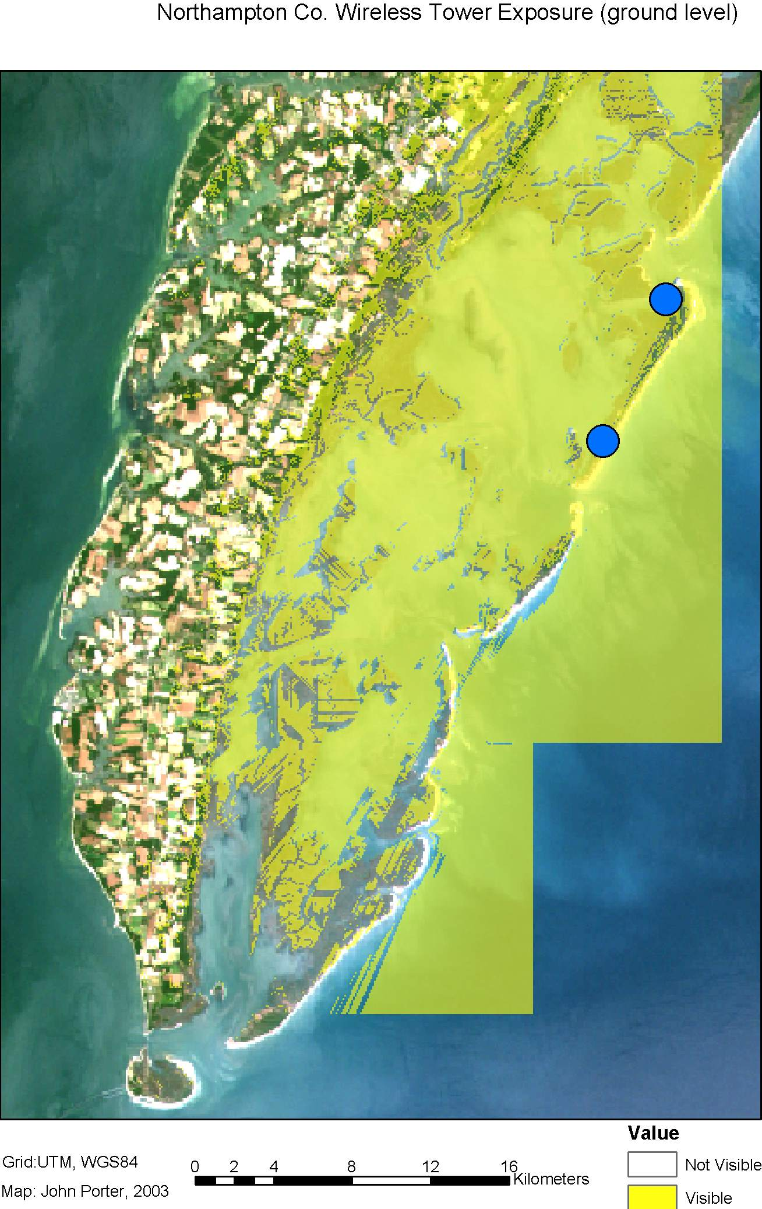
VCR/LTER Wireless Net
John Porter, Tom Williams, Dave Smith
802.11b
11 Mb/s
The VCR/LTER uses a hybrid network with both proprietary 900 MHz and standard WiFi 802.11b 2.4 GHz wireless Ethernet connections.
Areas within line of sight of our two towers are tinted in yellow
900 MHz
2 Mb/s
= VCR/LTER Lab
Notes:
The VCR/LTER wireless backbone extends approximately 30 km (22 km between the LTER lab and Broadwater Tower (picture on the left) and an additional 8 km north to Machipongo Station). Coverage areas were calculated in a GIS using a digital elevation model and land cover data to identify where signals would be blocked by topography and trees.

Slide 2
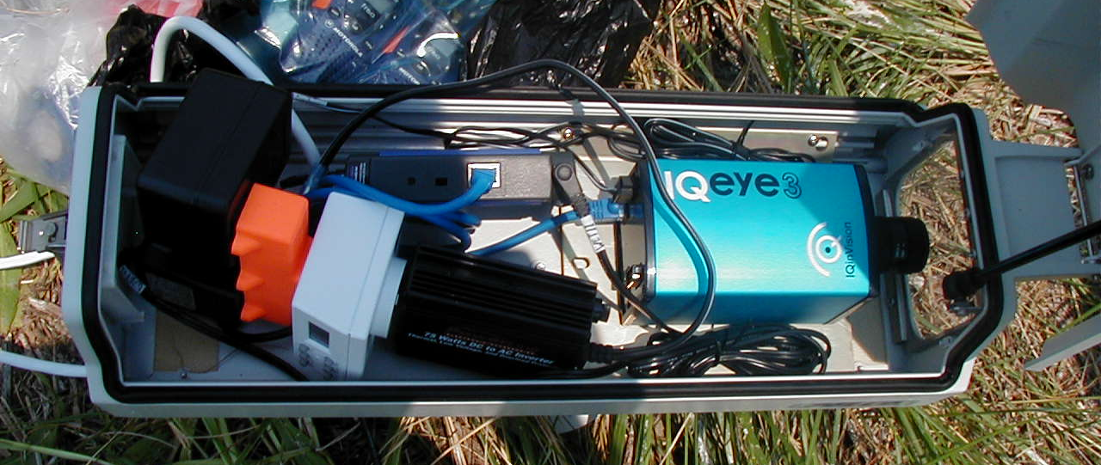
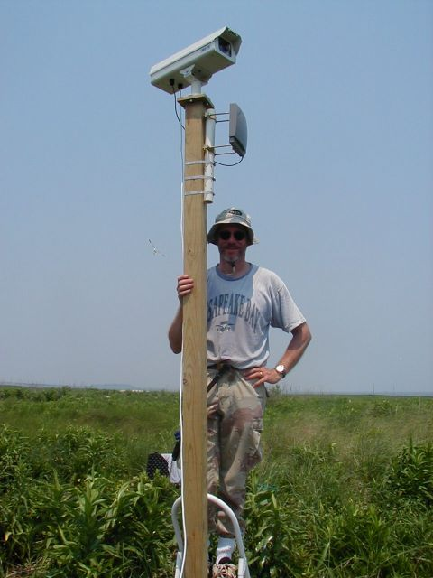
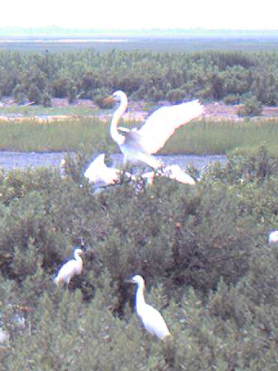
Uses of Wireless at VCR/LTER
Integrated camera/ web server/radio/power
Real-time Meteorological & Tide data
Web Cameras (6 currently deployed)
Access to networked data resources (e.g., the web) in the field
Notes:
The real time tide and meterological data comes from remotely-dumped Campbell data loggers.
Webcams are relatively easy to develop, once the network backbone is in place. Shown here is a “birdcam” that includes power, radio and camera in a waterproof case mounted on top of a pole (shown below). Not shown are a battery, charge controller and solar panel which sit on the ground at the base of the pole. The picture on the right bottom was actually obtained from the camera.
Access to network data resources is especially valuable for our boat operators as it gives them access to weather radar etc. when out on the islands.

Slide 3
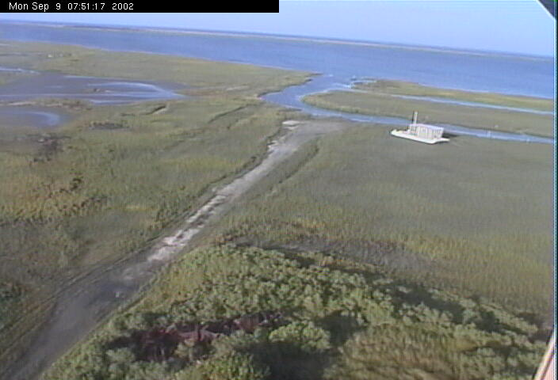
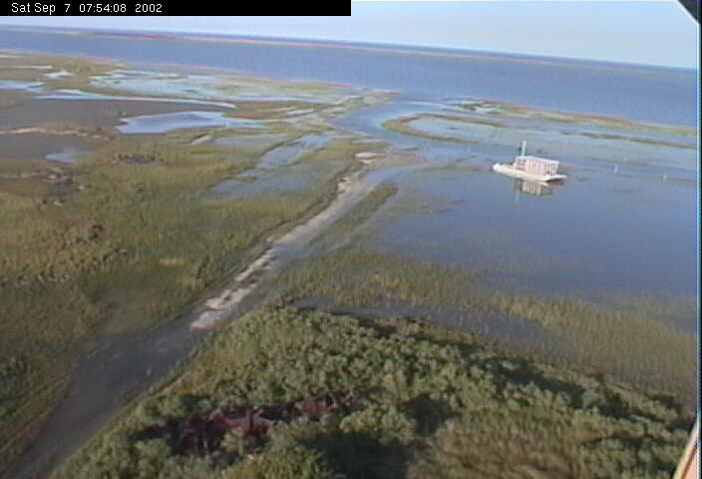
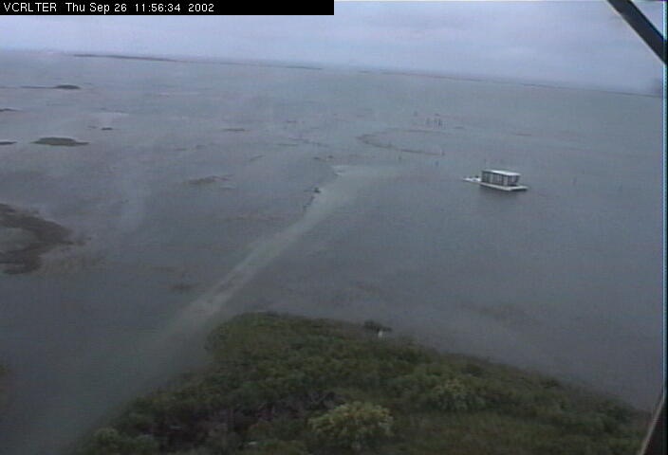
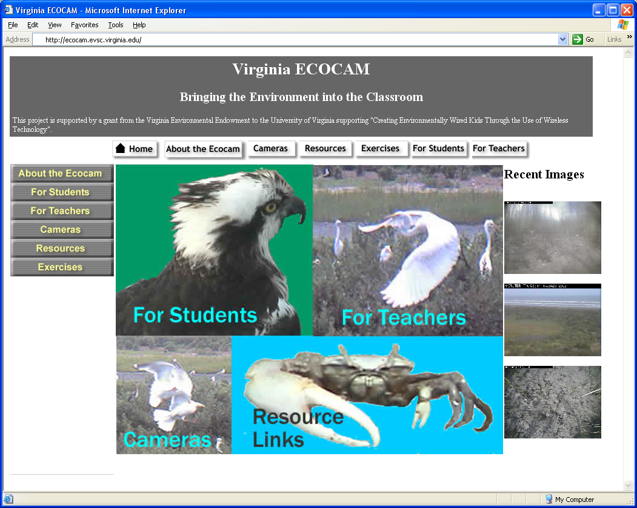
Uses of Webcams
Capture time series
Education
Non-obtrusive observation
Observe rare events
“A picture is worth a thousand
words”
Notes:
Capture Time Series: Time series of images are obtained hourly for 21 sites using pan-tilt-zoom and fixed webcams.
Education: The Virginia Environmental Endowment has funded the production of a web site and webcams for use in K-12 environmental education.
Observation: Webcams are being used to observe both birds and Fiddler Crabs
Observe rare events: The Broadwater Tower webcam allowed us to identify days when the bay adjacent to the island was frozen over during the winter. This information is otherwise inaccessible since fiberglass boats can’t operate in icy waters. Similarly it can be used to observe the deposition and removal of wrack (floating mats of grasses) during storms.

Slide 4
Some lessons learned
Power supplies, not radios, are the most difficult component
  Most consumer-grade DC-DC voltage converters are power hogs
  Use cheap inverters, not expensive ones
    The cheap ones reset automatically if batteries are drawn down, expensive ones don’t….
  Use digital, not analog timers to cut down on hours of operation to save power
    Cheap inverters have poor frequency control

Slide 5
Lessons Learned
Amplification works
  Even if used on only one end of a link, an amplifier can greatly improve range for 802.11b, especially when linked to directional antennas
    We can connect to our boats using amplified omnidirectional antennas on both ends over distances of 18-20 km
    Ranges of at least 8 km can be obtained between an amplified omnidirectional antenna going to a directional, unamplified antenna

