Slide 1
Grid Middleware Experiences
Nadya Williams
OCI Grid Computing, University of Zurich
nadya@oci.uzh.ch

Slide 2
Outline
  Middleware
    Condor
    Globus
    Nordugrid
    Unicore
  Middleware Flaws
  Middleware Desired Components
  Lessons Learned

Slide 3

Grid Middleware:
Condor
Developed at University of Wisconsin
http://www.cs.wisc.edu/condor
Latest stable version: 6.8.5
What is Condor ?
Software system that runs on a cluster of workstations to harness wasted CPU cycles
Specialized workload management system for compute-intensive jobs
High-Throughput Computing (HTC) environment
Condor pool consists of any number of machines
    possibly different architectures
    possibly different operating systems
    connected by a network

Slide 4
Typical Condor Pool
CM - condor central manager
SE - submit and execute machine
E - execute machine
S - submit machine

Slide 5
Condor features and use
Unique Features
Transparent process checkpoint and migration
    migrates only between machines of the same architecture
    migrates only within its own pool
Remote system calls
    System calls are executed on submit machine thus preserving local execution environment
ClassAds - scheduling key
    http://www.cs.wisc.edu/condor/classad/
      Machine attributes
      Job requirements
      user preferences
Use of idle resources
    Balance between resource owner and resource user wishes
    condor_startd policy configuration
When to use?
Parameter studies
    Embarrassingly parallel
High-throughput computing where individual jobs do not need to communicate
    Long computation
Complex sequence of jobs - DAG jobs (a.k.a workflow)
A
B1
B2
B3
C

Slide 6
Roadmap to run condor jobs
Steps
Code preparation
    Job run as a background batch (no user IO)
    create files with needed input/keystrokes
    re-link with condor libraries
Submit jobs
Monitor jobs
Results retrieval depends on condor universe
Submit Files
DAG job
Job A /home/condor/tests/subs/submit_a_dag
Job B /home/condor/tests/subs/submit_b_dag
Job C /home/condor/tests/subs/submit_c_dag
Job D /home/condor/tests/subs/submit_d_dag
PARENT A CHILD B C
PARENT B C CHILD D
Standard job A
Universe = standard
initialdir = /home/condor/tests/results
Executable = /home/condor/bin/simple.std
Arguments = 4 10
Log = simple_dag.log
Output = simple_a_dag.out
Error = simple_a_dag.error
notification = Never
queue

Slide 7
Grid Middleware:
Globus
Developed by Globus Alliance http://www.globus.org
Latest stable release: 4.0.6
Globus Alliance:
  Argonne National Laboratory/University of Chicago
  EPCC, University of Edinburgh
  National Center for Supercomputing Applications (NCSA)
  Royal Institute of Technology, Sweden
  Univa Corporation
  University of Southern California/Information Sciences Institute
What is Globus Toolkit ?
Fundamental enabling technology for the Grid
Includes software for
    security
    information infrastructure
    resource and data management
    communication
    fault detection
    portability
Set of components that can be used either independently or together to develop applications
Used for building grids

Slide 8
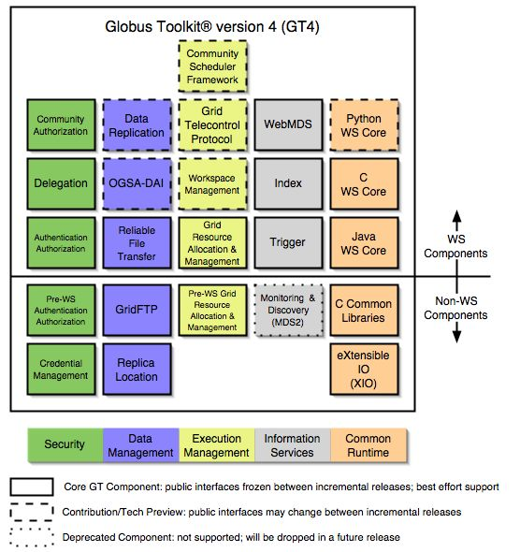
Globus toolkit components
From http://www.globus.org/toolkit/about.html

Slide 9
Grid Middleware:
NorduGrid
Developed by NorduGrud http://www.nordugrid.org/
Latest stable release: 0.6.1
Nordugrid - a Grid Research and Development collaboration to develop, maintain and support of the Advance Resource Connector (ARC) middleware.
What is NorduGrid ARC?
Solution for a global computational and data Grid system
Aims to provide a solution:
    robust
    scalable
    portable
    fully featured
Set of tools and services - ARC middleware
External software components
    GPT (Grid Packaging tools)
    Globus Toolkit
    gSOAP (generator tools for coding SOAP/XML)
    Virtual Organization Membership Service (VOMS)
    International Grid Trust Federation (IGTF) Distribution of Authority Root Certificates.

Slide 10
NorduGrid ARC main components
Grid Manager
  job submission to a cluster
User interface
  resource discovery
  brokering
  grid job submission
  job status query
Replica Catalog
  register and locate data resources
Information System
  distributed service to serve information to other components
Computing Cluster
  shared file system
  batch system
Storage Element
  gridftp server (not fully developed)
hardware

Slide 11
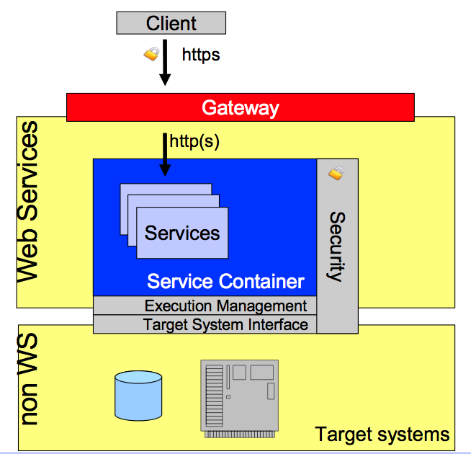
Grid Middleware:
UNICORE
Developed by UNICORE http://www.unicore.eu
Latest stable release: 6.0.1
UNICORE - UNiform Interface to Computing Resources.
What is UNICORE?
Ready to run system that includes server and client software
Design principles:
  Integrated, complete stack (server/client)
  Easy installation and configuration
  Fully featured
    Application support
    Workflows support
    GUI clients
    Multiple OS support
    Multiple batch systems support

Slide 12
Grid Middleware:
UNICORE
UNICORE aims to provide a solution
Scalable (execution engine)
Extensible ( Java Management eXtensions support )
Flexible (Grid Programming Environment client framework)
Service oriented
Secure (pluggable components and X.509 certificates)
Developer friendly

Slide 13
Middleware Flaws
middleware interoperability - poor
usability and productivity - hard to achieve
heterogeneity
  Variety of applications and sciences
  Infrastructure management is diverse
  Numerous and often conflicting site policies
  Computing systems and networks are diverse
usually not user-friendly
poor automation and integration in already existing environments
poor configuration

Slide 14
Middleware Desired Components
Grid collaboration
Grid security
Grid monitoring and discovery
Grid computation
Grid data management
Software packaging and distribution
Web services
Inter-operability
data access
computational

Slide 15
Lessons Learned
focus on minimizing “time to production”
  Ease and simplification of integration into existing environment
  Automation of installation and configuration
tight collaboration with the middleware developers
  Find new ways to collaborate
  Use feedback
    what works
    what is “flash and fade”
interoperability
  Choose middleware by the best features it provides
  Get missing features by creating “bridges” between different middleware
the aim must be: users come first
  Simplification and Unification of the user grid access setup
    Grid access
    Job submission via robust reusable and intuitive UI
      Science portals
      Web services
      Specialized pluggable clients

Slide 16
How to implement
collaboration among members
  Sharing resources
  Sharing experiences
  Working together on ideas and implementation
keep things in perspective
  Don’t reinvent the wheel
  Keep users happy
???

Slide 17
Historical lessons
Inscription on an ancient jade plate:
Pang made this treasured vessel.
May it be used and treasured by
my descendents for 10 000 years.

