Slide 1
PRAGMA GEO Science WG
- Global Earth Observation -
GEO WG Team

Slide 2
Overview
The youngest WG in PRAGMA
  Officially started at PRAGMA 12 (Mar. 2007).
Goals
  GEO Science WG aims at development of a grid testbed to support geosciences and practical applications based on huge datasets of satellite imagery and GIS data, such as disaster prevention or environment monitoring.
Chairs
  Ryosuke Nakamura (AIST, Japan)
  Guey-Shin Chang (NARL, Taiwan)
  Ashraf Memon (SDSC, USA)
  Sornthep Vannarat (NECTEC, Thailand)

Slide 3
GEO WG @ PRAGMA14
Notes:
Update 1 or 2 slides
DEMO, for what? By what? ASTER MODIS
Working group, database federation
Chiaki/Ootsuki, IDL, HK,

Slide 4
Presentations@GEO WG
Surface Heat Balance Analysis by using ASTER and Formosat-2 data (Kato,NCKU)
Cross Calibration of Multiple Satellite Sensors using GEO Grid (Kamei, AIST)
Simulation of Coastal Changes in Thailand (Sirisup, NECTEC)
Development of Micro-scale air management System for an Urban Geography in Seoul (Woo, Konkuk Univ.)
A Service-Oriented Architecture for Pioneer Study on Ubiquitous Geographic Informaton Service GRID (Wang, Taitung Univ.)
Solar Variability and Climate Change (Yau, CUHK)
Applications of Taiwan Earthquake Loss Estimation System TELES (Lin, NCREE)
NCHC’s 3D WebGIS SensorNet Grid prototype (Chang, NCHC)
Notes:
MODIS = Bio
PEN, DCP, TWD

Slide 5
Related DEMOs @ PRAGMA14
Surface Heat Balance Analysis by using ASTER and Formosat-2 data (Kato,NCKU)
Satellite Database Federations on GEO Grid Portal (Yamamoto, AIST)
A Framework for Accurate Estimation of Geospatial Models from Sparse Field Measurements Using Image Processing and Machine Learning (Lin, UIUC)
Distributed Search Over Science Portals Using Service Oriented Architectures (Memon,SDSC)
Notes:
MODIS = Bio
PEN, DCP, TWD

Slide 6
Prospects
Actual applications based on satellite database federation
Actual applications in three VOs (IT, Environment, Geohazard)
Distributed Search between GEON/GEO Grid Using OGC standard (CSW)
Notes:
MODIS = Bio
PEN, DCP, TWD

Slide 7
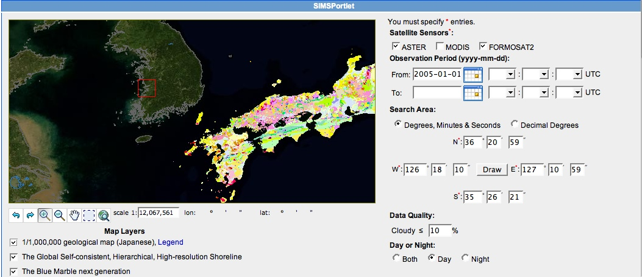
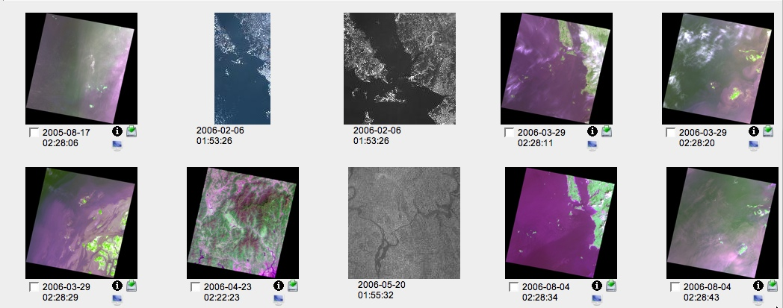

Slide 8
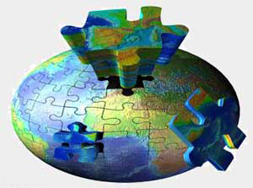
Toward global coverage of Earth’s geology
In PRAGMA and Asia-Pacific
  Synergy with GEON (US, India,)
  Collaboration with CCOP (South-East Asia)
Globe-wide
  OneGeology project
  Standardization of the specification of metadata catalogue service (Catalogue Services for Web, CSW) with European sectors (e.g. IONIC, SPOT).
  Made-in-EU middleware
    VOMS, OGSA-DAI, etc.
Notes:
MODIS = Bio
PEN, DCP, TWD

