Slide 1

Swiss National Grid Association
Dean Flanders, FMI
Nabil Abdennadher, HES-SO
Peter Kunszt, CSCS
Heinz Stockinger, SIB
Wibke Sudholt, UZH
Christoph Witzig, SWITCH

Slide 2
Content
Grid in Switzerland: three years ago
Formation of the Swiss National Grid Association (SwiNG)
Grid in Switzerland: in three years
  (personal view)

Slide 3
Grid in Switzerland three years ago
Various, somewhat isolated efforts in Swiss higher education sector
  Few projects between a limited number of Swiss partners
  Participation in EU sponsored projects by a few institutions
  Participation in WLCG / EGEE by a few institutions
  Participation in international projects by a few institutions
No national co-ordination, no dedicated funding

Slide 4







Some projects three years ago
Notes:
Unter einem Grid versteht man die Gesamtheit von vernetzten Ressourcen (z.B. Rechner, Instrumente, Sensoren, ...) sowie die darauf bereitgestellte Vermittlungsschicht (Grid Middleware), die für Anwender als Grid Dienste zur Verfügung stehen. Dieser Zusammenschluss von Benutzern, Ressourcen und Diensten zur gemeinsamen Bewältigung einer Aufgabe wird als virtuelle Organisation bezeichnet. Im Unterschied zum Internet, wo prinzipiell Nachrichten zwischen zwei Punkten ausgetauscht werden, realisiert ein Grid somit eine höhere Abstraktionsstufe, durch die der Benutzer Dienstleistungen (in Form von Grid Services) in Anspruch nehmen kann. Die Dienstleistungen werden von der Vermittlungsschicht weitgehend automatisch durchgeführt, wobei zwischen der Basis-Grid-Middleware - mit möglichst allgemein gültigen Diensten - und höheren Grid Diensten - mit entsprechender Spezialisierung auf bestimmte Dienstleistungen - unterschieden wird.

Slide 5
Situation in Europe three years ago
Funding for Grid projects within FP5/FP6 by EU
LCG/EGEE under leadership of high energy physics was well underway
  Reach-out to other scientific communities
Some European countries started to form National Grid Initiatives (NGIs), some with considerable funding
  e.g. UK e-Science program

Slide 6
What is a NGI = National Grid Initiative?
“Coordinating body” for Grid activities within a nation
Must
  Have a mandate to represent researchers and institutions in Grid related matters towards
    International bodies (e.g. EU)
    Funding agencies
    Federal government (SBF, BBT)
  Have only one NGI per country
May
  Involve only coordination
  Develop and operate national grid infrastructure(s)
  Be a legal entity on its own
  Be limited to academic or research institutions
  Also involve participation by the industry
Note: “Definition” by SwiNG EB
Notes:
There is no good definition what an NGI is. It is as it is defined on its slide, an entity of NATIONAL scope with a NATIONAL MANDATE.
Details on what kind of organization, legal entity, etc, do not exist as each country is free to set it up as they wish. But there can be only one, as stated on the slide.

Slide 7
Motivations for an NGI: National Level
Grid Computing involves by definition several institutions
  paradigm change: collaboration and resource sharing
A national body (i.e. the NGI) should act as
  promoter
  coordinator
  single point of contact (nationally and internationally)
for the dissemination of Grid technology within national boundaries

Slide 8
Motivations for an NGI: International Level
EU heavily promotes Grid technology in their technology funding programs (FP6, FP7)
Coordination of big international Grid projects becomes difficult
  Example: EGEE-2: 91 partners
EU sees NGIs as a means to
  Enable the transition from large Grid projects to a sustainable Grid infrastructure
    In Europe as a whole as well as
    In every individual member state
  Simplify the organizational structure of large Grid projects (management overhead)
  While still giving consideration to the national character of the research and education sector in every member country

Slide 9
Comparison: Academic Network Infrastructure
Education and Research community in every country needed to establish a network infrastructure to provide basic internet connectivity services
Establishment of NRENs (national research and education networks – SWITCH in Switzerland)
Today:
  NRENs are mature bodies that operate production quality, sustainable network infrastructure in every European country
  TERENA as “top-level body” of the national NRENs
  Role of GEANT as European network infrastructure
Mapping to Grids:
  NGIs can operate a national Grid
  A European Grid Initiative (EGI) as the top-level-body, a design study is already funded by the EU

Slide 10
A Bit of History: SWITCH
Founded in 1987 by Swiss Government and the University Cantons
Initiation by a group of “Founding Fathers”
Is a foundation with CHF 100k as foundation capital
Took more than 10 years to have a budget on its own
Today: 3 domains:
  Network for Swiss Higher Education Sector
  DNS of .CH and .LI
  Offers services to the Swiss Higher Education Sector
Can be considered as a well established institution on the national as well as international level

Slide 11
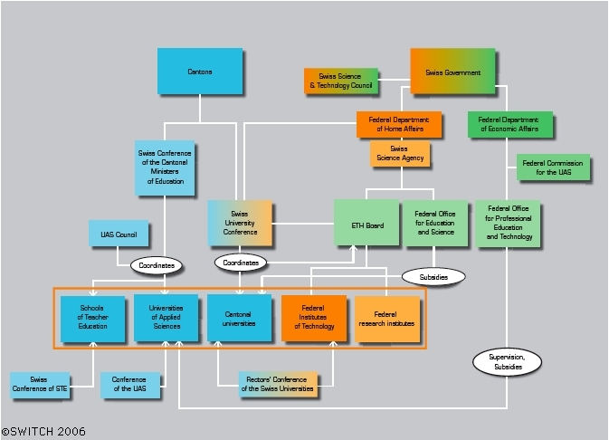
Environment of HiEd in Switzerland

Slide 12
Content
Grid in Switzerland: three years ago
Formation of the Swiss National Grid Association (SwiNG)
  History of the formation
  Organization
  Strategy
  Current Activities
Grid in Switzerland: in three years
  (personal view)

Slide 13
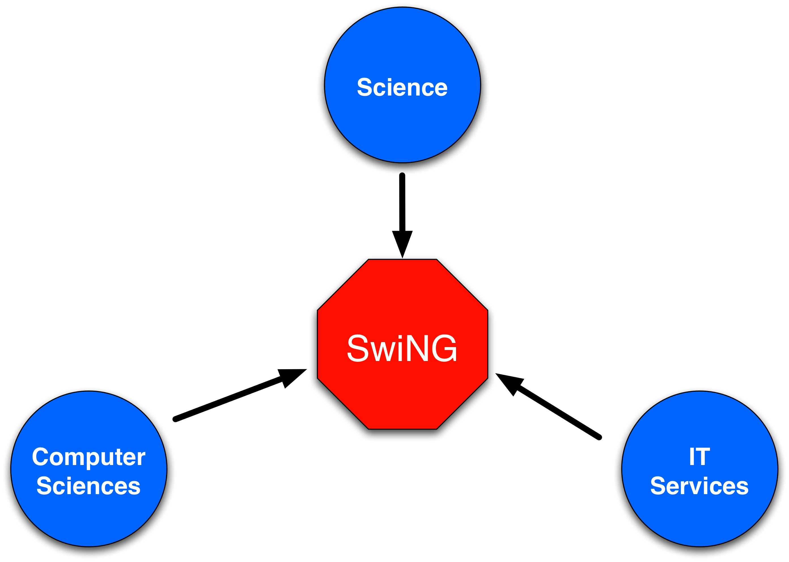
Stakeholders of SwiNG

Slide 14
SwiNG Story so far….
Swiss Grid Days involving representatives from many academic institutions
  September 28, 2006: EGEE conference, Geneva
  November 23, 2006: Berne
  December 7, 2006: Grid Crunching Demo in Fribourg
  May 7, 2007: Berne
Participants identify clear need for an NGI in Switzerland
Working Groups
  `’Letter WG” to propose an organizational structure and initiate SwiNG
    Lead: Christoph Witzig, SWITCH, christoph.witzig@switch.ch
    Dean Flanders FMI, dean.flanders@fmi.ch
    Alexander Godknecht, UZH, alexander.godknecht@id.uzh.ch
    Victor Jongeneel, SIB
    Peter Kunszt, CSCS, peter.kunszt@cscs.ch
    Pierre Kuonen, EIA-FR, pierre.kuonen@eif.ch
  Working Group to prototype the infrastructure and ‘seed’ it with applications
    Lead: Wibke Sudholt, University of Zurich, wibke@oci.uzh.ch
    Participation from UZH, HES-SO, UniBE, SIB, CSCS, EPFL, SWITCH, ETHZ, PSI, FMI

Slide 15
Swiss National Grid Association (SwiNG)
Requirement: must be a cooperative effort involving all interested institutions
Association of institutions → mandate, governance
  Members are institutions
  Assembly is the governing body of the association
Scientific Council → scientific and technical program
  Members are
    research groups with clear scientific interests
    IT departments with clear technological / operational interests
  Scientific and technical program
  Working Groups
Executive Board → running SwiNG’s daily business
  Members are elected by the Assembly
  Nomination by the Scientific Council

Slide 16
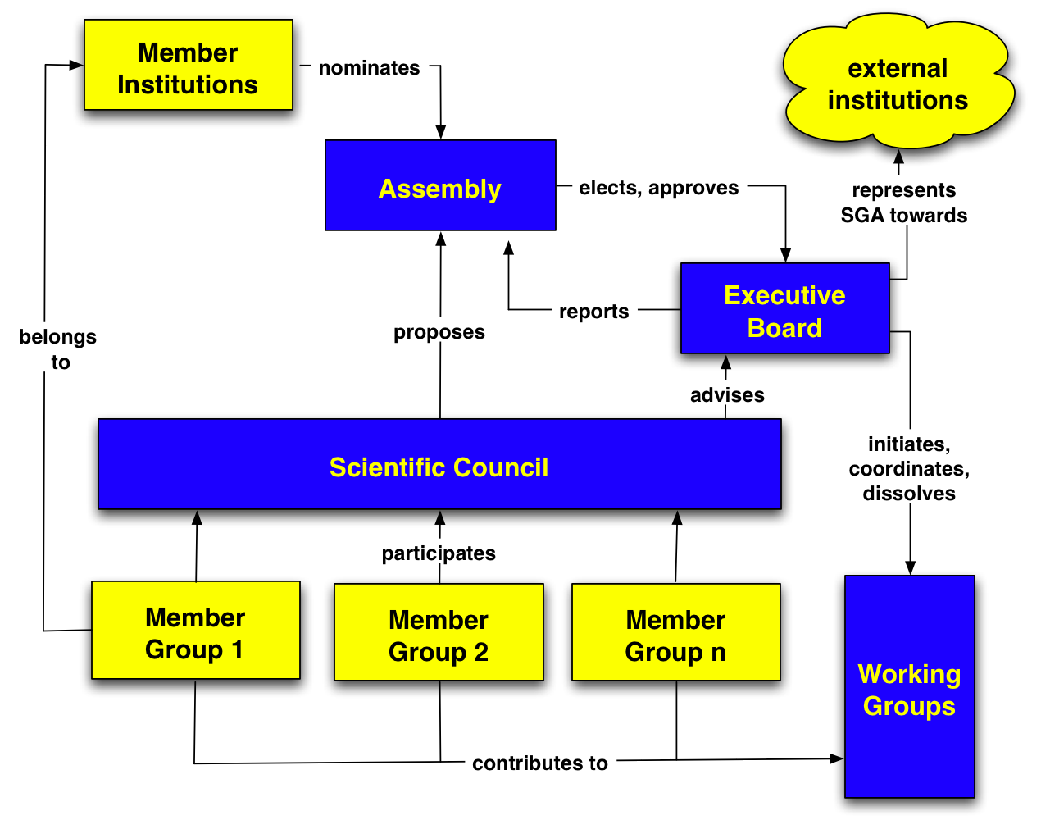
Swiss National Grid Association
See blueprint for details - http://www.swiss-grid.org/bern2007-swing.html

Slide 17
Status
Association was founded in Basel May 16, 2007
Institutions of the academic sectors were invited to become member
    All cantonal universities
    All Universities of Applied Sciences
    ETHZ, EPFL and ETH Research Institutions
    Friedrich Miescher Institute
    Swiss Institute for Bioinformatics
    CSCS
    SWITCH
Nomination of representative to the Assembly finished
  got nominations from 19 institutions
First assembly meeting: Oct 31, 2007 in Berne

Slide 18
Current Prototype and ‘seed’ Applications
Goals of Seed Working Group
Identify available resources (people, hardware, middleware, applications, ideas)
Propose initial projects (“low hanging fruits”)
Coordination and realization of the seed project

Slide 19
Seed Working Group: Achievements
 | gLite middleware | NorduGrid middleware | XtremWeb-CH middleware | Condor middleware
Pool established | CSCS, SIB, and SWITCH, VO created | CSCS, SIB, and UZH, from SwissBioGrid | HES-SO and UZH | EPFL, coupling with NorduGrid, to be tested
SLCS security | Tested at CSCS, SWITCH and SIB | Tested at UniBE and UZH | Needs changes in middleware | Tested at EPFL, via NorduGrid
Cones application | Tested at SIB | First scientific user | Not started yet | Tested at EPFL
GAMESS application | Not started yet | Work in progress at UZH | Work in progress at HES-SO | Tested at EPFL
Huygens application | No personnel or license | No personnel or license | No personnel or license | No personnel or license
PHYLIP application | Not started yet | Not started yet | Preexisting at HES-SO | Work in progress at EPFL

Slide 20
Lessons Learned from Seed and other Grids
General:
There is considerable interest and expertise in Grid collaboration in Switzerland
Applications can be ‘put on the Grid’ in different ways and therefore need direct cooperation among scientific developers and Grid experts – interdisciplinary work
Dedicated partners, clear responsibilities, continuous communication, detailed documentation, and active project management required
Funding has to be properly secured
Scientific:
There is an increased need for computing resources in Switzerland
There is an increase in complexity
Many data-oriented projects, not only number crunching
Technological:
Middleware architecture differ considerably between different Grids
Security mechanisms are not standardized

Slide 21
Composition of the Assembly
Uni Bern | Ueli Kienholz | Head IT Services
Uni Basel | Heiko Schuldt | Professor (computer science)
ETH Forschungsanstalten | Stephan Egli | Head IT Services
ETHZ | Christoph Grab | Senior Researcher (HEP
FHB | Gregor Nyffeler | Head IT Services
FHNW | Niklaus Lang | Head IT Services
FHO | TBA (P. Wieser)
Friedrich Miescher Institute | Dean Flanders | Head IT Services
SWITCH | Thomas Brunner | Managing Director
Uni Zurich | Kim Baldridge / Alexander Godknecht | Professor / IT Services
EPFL | Francois Avellan | Professor (fluid dynamics)
Uni Geneve | Bastien Chopard | Professor (computer science)
HES-SO | Daniel Mlynek | Manager
Uni Neuchatel | Philippe Renard | Professor (Hydrology)
Uni Lausanne | Hamid Hussain-Khan | IT (Grid specialist)
Swiss Institute for Bioinformatics | Ron Appel | Director
CSCS | Peter Kunszt | Group Leader
FHZ | René Hüsler | Professor (computer science)

Slide 22
Scientific Council
SCS – Distributed High Throughput Computing Group
EPFL – DIT
EPFL – LACAL
ETHZ – CMS
ETHZ & UZH – Functional Genomics Centre Zurich
HES-SO – EIG
PSI – CMS
SIB – PIG
SIB – Vital IT
SWITCH – Grid Team
UniBas – Biozentrum
UniBas – DBIS
UniBE – Computer Services Department
UniBE – LHEP
UniBE – Mathematical Crystallography
UniGE – HEP
USI – Software Composition
UZH – Computational Structural Biology
UZH – IT Services
UZH – OCI Computational Chemistry & Grid Computing

Slide 23
Executive Board
President: Dean Flanders (FMI)
Chairperson: Wibke Sudholt (UZH)
Nabil Abdennadher (HES-SO): outreach
Peter Kunszt (CSCS): National
Heinz Stockinger (SIB): International
Christoph Witzig (SWITCH): Finance and legal

Slide 24
Working Groups
Currently active WG
  Proteomics WG
  ATLAS WG
  Infrastructure and Basic Grid Services
In formation
  Grid Workflows
  Education and Training
  Industry

Slide 25
Strategic Goals (for next four years)
Successfully run Swiss Grid Applications from different scientific domains
Set up and maintain a core Grid infrastructure
Establish SwiNG as the Swiss NGI and obtain official representation for Swiss grid interests in established national and international bodies
Start the process of establishing long-term funding for SwiNG while securing short-term funding for Swiss Grid activities through projects
Set up and run education and outreach activities
Strategy discussion on-going in Assembly

Slide 26
Roadmap (for next four years)
Planned activities divided into four thrusts
Grid applications and scientific user communities
Grid infrastructure
Official representation and being the Swiss NGI
Funding
Education and outreach

Slide 27
Open Points
How to achieve the long term goal of establishing a sustaind Swiss Grid Infrastructure?
Possible roles of SwiNG towards projects:
  Loose coupling: SwiNG as a logical ‘shell’ of independent projects
  Medium coupling: SwiNG as active coordinator between independent projects
  Tight coupling: SwiNG as project manager of projects, controlling and building a production Grid infrastructure
How will funding be raised and distributed?
How should SwiNG involve the Industry?
Should SwiNG have its own staff / project office?
Should SwiNG coordinate between institutions or projects?

Slide 28
SWITCH/AAA Projects
SWITCH has obtained funding for co-operation projects within the Swiss HiEd sector for 2008-2012 targeted at the following domains
  AAA
  Grid
  E-Learning
  Support for virtual organizations
Total budget: ca CHF 24 mio
First projects are being submitted now

Slide 29
Content
Grid in Switzerland: three years ago
Formation of the Swiss National Grid Association (SwiNG)
Grid in Switzerland: in three years
  (personal view)

Slide 30
Disclaimer
What follows is my very personal view

Slide 31

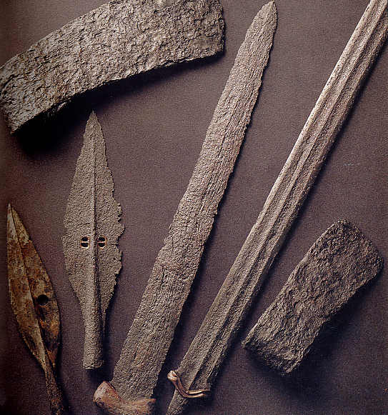

Three Scenarios
Gold
Iron
Dirt

Slide 32
“Gold Scenario”
Carry out a series of successful projects
Motivate scientific domains to use the Grid
Establish the Swiss Grid Infrastructure
… and we obtain dedicated funding by 2012
    Subsidies
    Service charges

Slide 33
“Iron Scenario”
Carry out a few successful projects
Some interests from scientific domains
to use the Grid as long as it works and
is free
Swiss Grid Infrastructure works (sort of)
Didn’t really get off the ground but has staying power
Decision needed if and how to continue 2012-2016

Slide 34
“Dirt”
Carry out a few successful projects
Swiss Grid Infrastructure never
reached a stable operational phase
Effort disintegrates, interest vanishes
Note: Dirt is a very previous commodity as it contains the seeds for future development

Slide 35
Summary
SwiNG as Swiss NGI established
We have funding for projects
… and a lot of work ahead !

