Slide 1
Lousy Introduction into
SWITCHaai
Pragma UZH Summit March 17, 2008
Christoph Witzig
SWITCH

Slide 2
Without AAI
University A
Tedious user registration at all resources
Unreliable and outdated user data at resources
Different login processes
Many different passwords
Many resources not protected due to difficulties
Often IP-based authorization
Costly implementation of inter-institutional access
Student Admin
Web Mail
e-Learning
Library B
e-Journals
Literature DB
University C
Research DB
e-Learning
User Administration
Authentication
Authorization
Resource
Credentials
Notes:
The next two slides are a very brief introduction, why the SWITCHaai project was started some years ago.
Here we have the situation without AAI.
In this picture we have 2 Universities and a Library with each of them having several resources.
Here, the user administration and authentication …..
This model has a couple of well known disadvantages ….

Slide 3
With AAI
University A
No user registration and user data maintenance at resource needed
Single login process for the users
Many new resources available for the users
Enlarged user communities for resources
Authorization independent of location
Efficient implementation of inter-institutional access
AAI
Student Admin
Web Mail
e-Learning
Library B
e-Journals
Literature DB
University C
Research DB
e-Learning
User Administration
Authentication
Authorization
Resource
Credentials
Notes:
This is the world with AAI.
Here, the user administration and authentication is very close to the place where the users are known best: e.g. the central student administration of a universitiy.
We call the orange boxes the AAI home organizations (in Shibboleth terms they are called Origins).
In this situation the disadvantages listed before have disappeared.
So, …

Slide 4
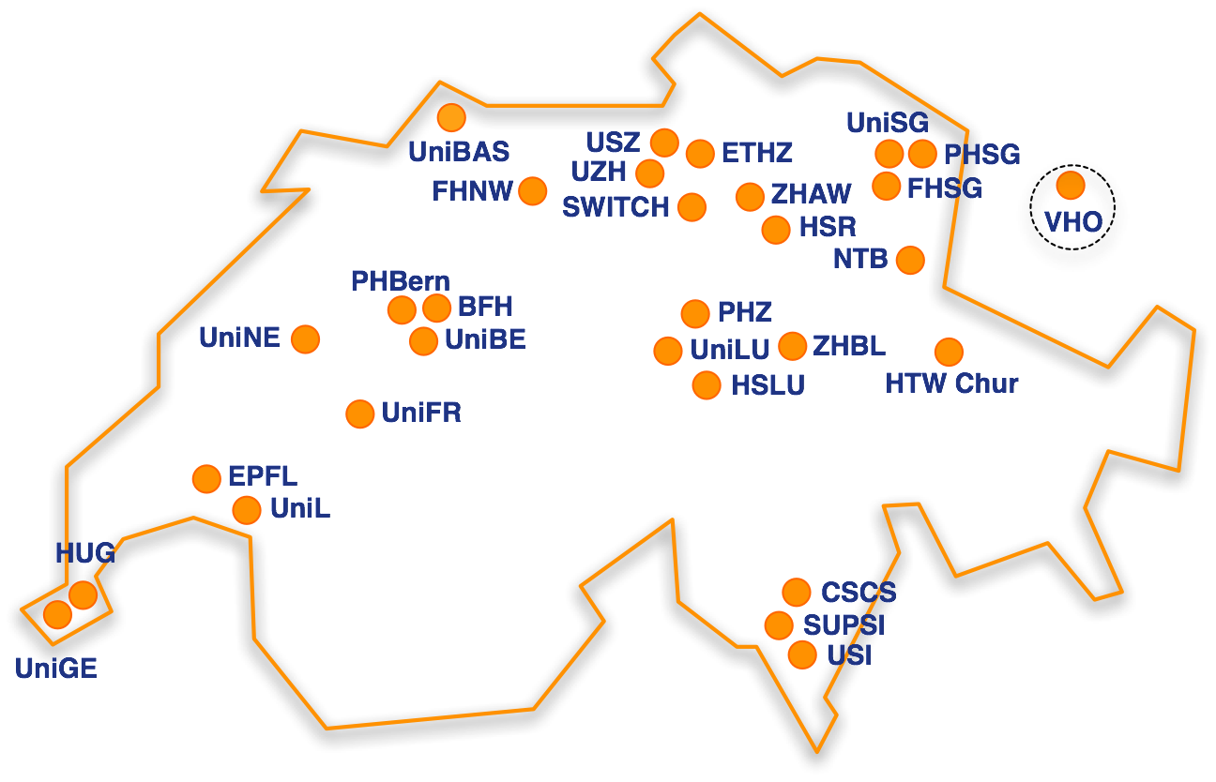
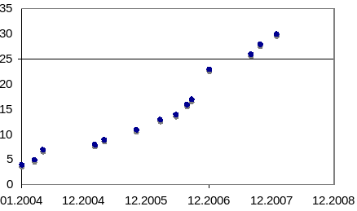
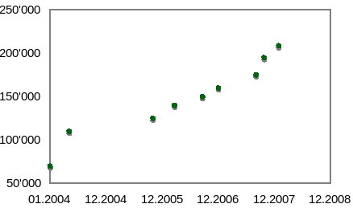
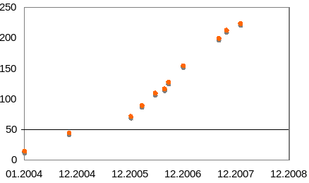
SWITCHaai Federation Jan 2008
# Home Organizations
# AAI enabled accounts
# Resources
80% coverage in
higher education

Slide 5
SWITCHaai Project Timeline
2001
2002
2003
2004
2005
2006
2007
2008
2009
Study
Pilot
Implemen-
tation
Production
Architecture
Evaluation
➔ Shibboleth
Shibboleth 1.3
Shibboleth 2.0
AAI Subsidies
2004 - 2007
AAA/SWITCH
2008 - 2011
Nov 1999: Term AAI first time mentioned in a document
Nov 2000: AAI Workshop

Slide 6
Shibboleth
Open Source
Developed by Internet2
Federated Approach
Privacy
National deployment projects in the US, UK and Finland,
growing interest in other European countries
Currenty for web resources only - will be extended
Based on SAML
Cooperations with Liberty Alliance
Cooperations with Content Providers (e-journals)
http://shibboleth.internet2.edu/

Slide 7
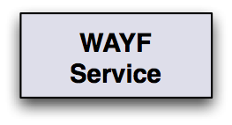
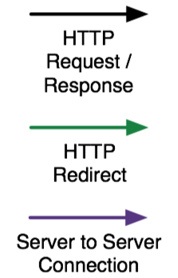





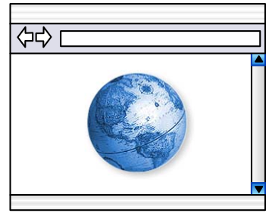


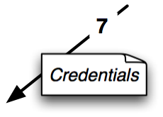
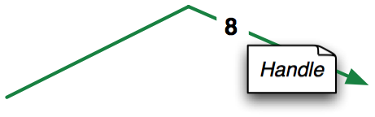
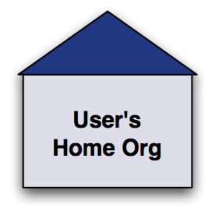
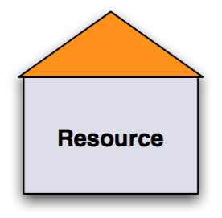
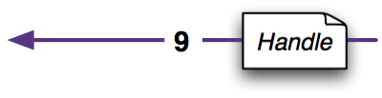
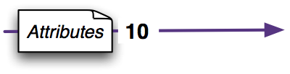
How it works

Slide 8

Virtual Home Organization - VHO
Integrate End Users without Identity Provider
Resource Owner creates @VHO “AAI-enabled” accounts for users without an Identity Provider
A VHO account is only usable for that resource managed by the Resource Owner
Federation Member
Some end users
without
Identity Provider
Identity
Provider
Resource
Owner
End User
Admin
VHO Policy
VHO Service
@SWITCH
Identity Providers
User Dir

Slide 9
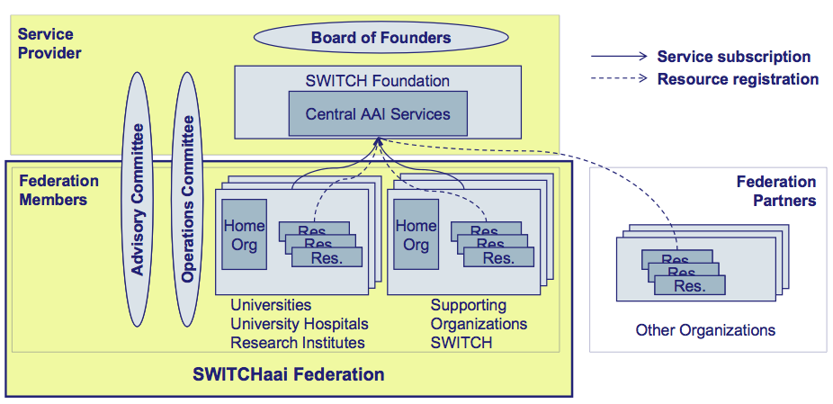
Organisational Framework
Organisation
SWITCH acts as SWITCHaai Federation Service Provider
Federation membership based on signed service agreements

Slide 10
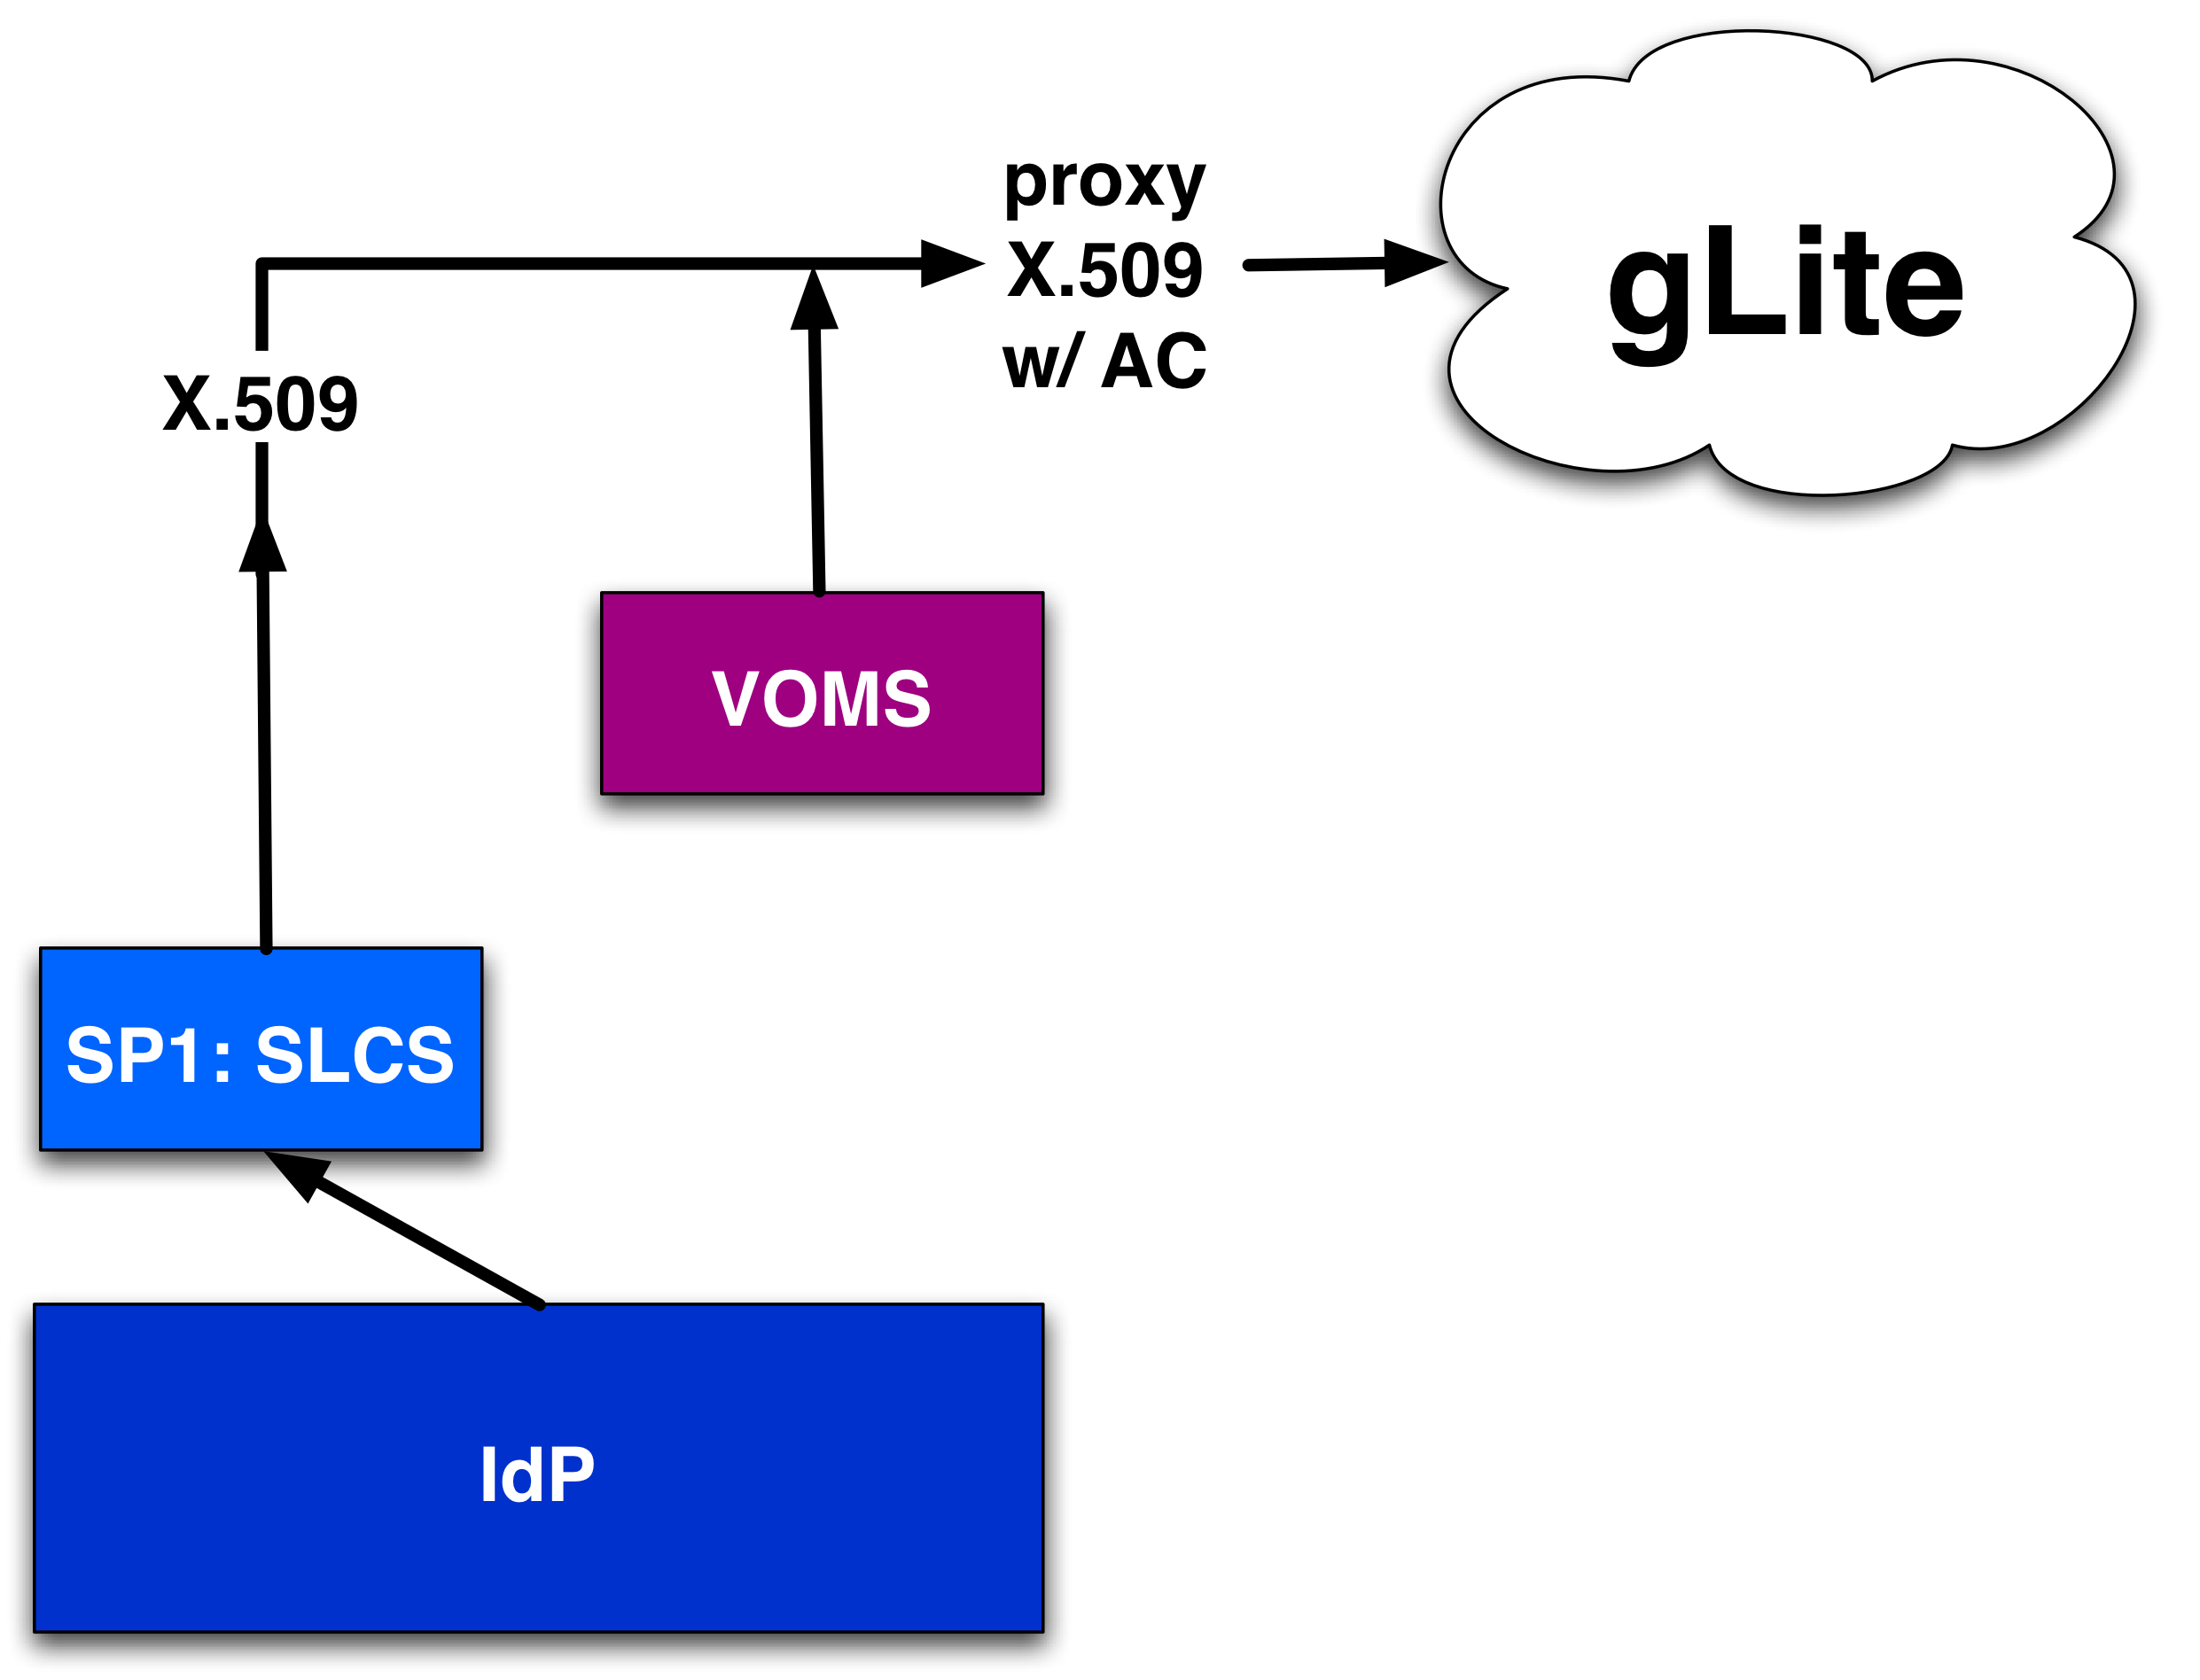
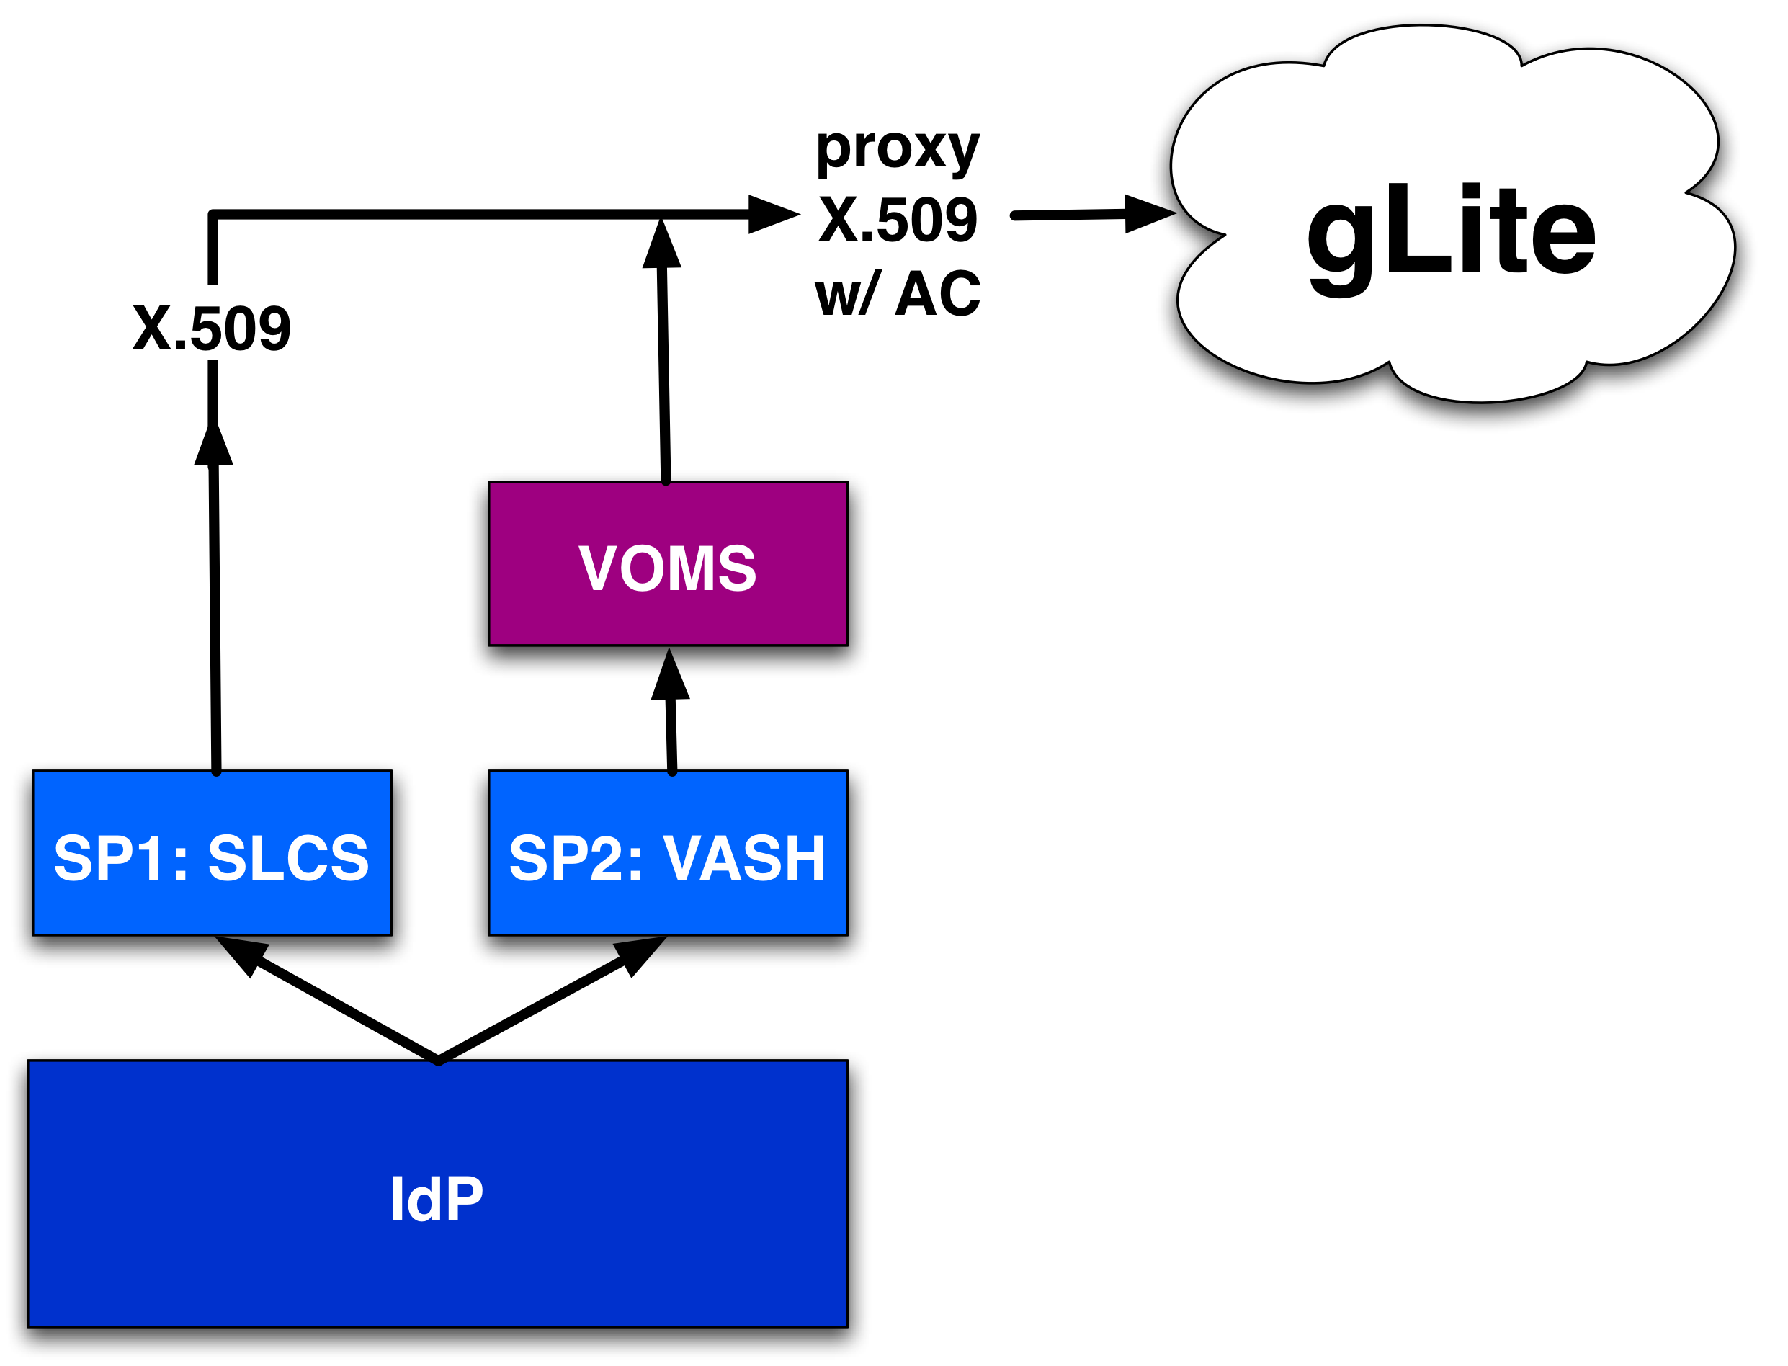

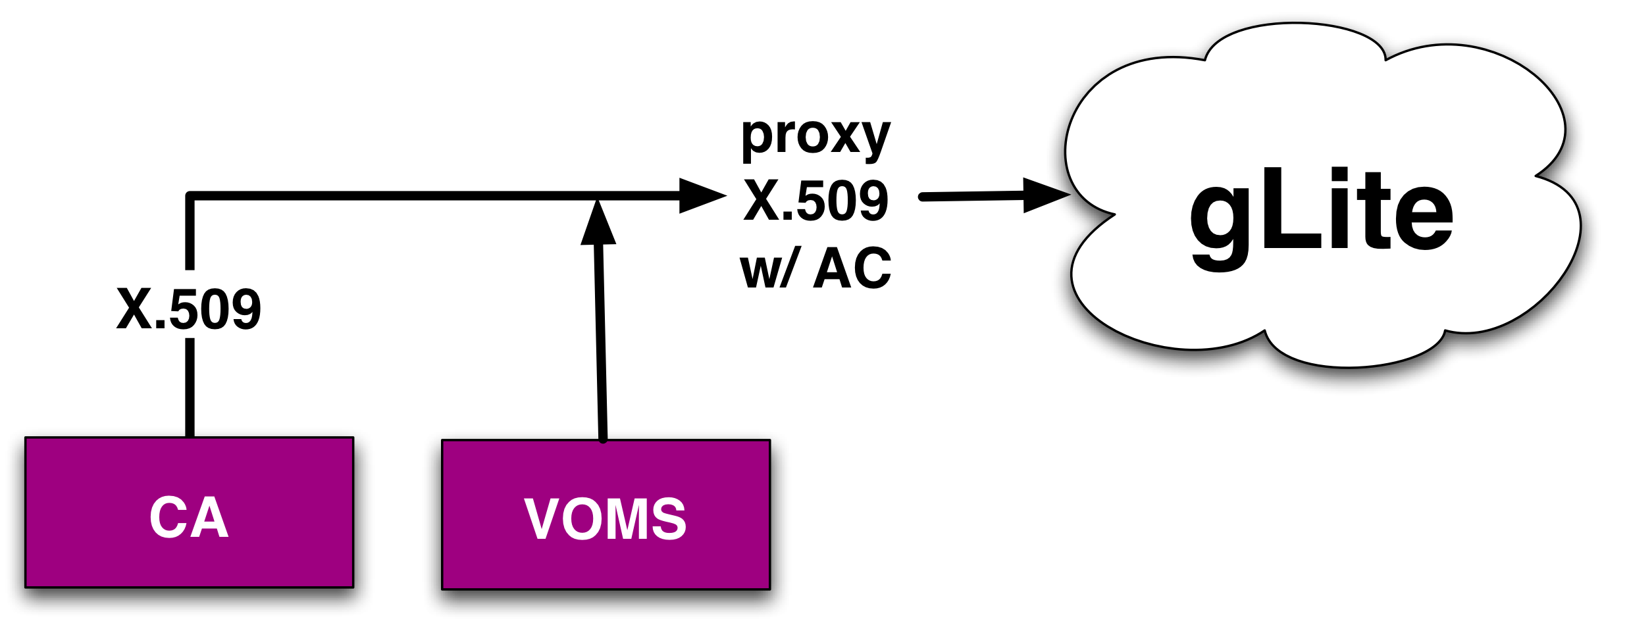
Overview of SLCS and VASH
gLite UI
SLCS = Short Lived
Credential Service
VASH = VOMS attributes
from Shibboleth

Slide 11
Outlook:
SAML Support in Grids

Slide 12
Phase 3: SAML Support
Goal of phase 3: Extend use of SAML in grids beyond what is already provided by phase 1 and 2
Benefits:
  (Average) User has no certificates anymore
  Introduce SAML gently beyond phase 1 and 2, gain experience
  Compatible with Shibboleth roadmap (2.0, 2.1) and WS-Trust STS implementation
  Options open for future
Requires: A mean for service to transform a security tokens it has into a security token it needs

Slide 13
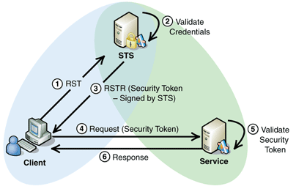
Security Token Service
WS-Trust defines mechanisms for brokering trust to an authority called Security Token Service (STS)
The Security Token Service have a trust relationship with both the client and the service.

Slide 14
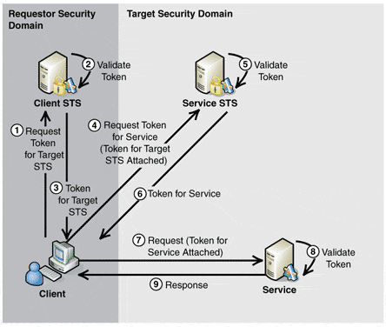
Multiple Security Domains
A client may need to communicate with services that operate across trust boundaries (i.e. Shibboleth SAML vs Grid X.509)
Multiple STS can be used in a trust chain across security domains (delegated trust)

Slide 15
Use Cases
Grid:
  Shibboleth user wants to access a Grid resource (e.g. WMS, File Catalogue, Storage Element…)
  He needs to obtains security token that the Grid services understand (X.509)
Non-browser based Shibboleth applications:
  User agent contacts Shibboleth IdP with credential (e.g. username, password)
  User agent receives SAML assertion to be sent to a Shibboleth SP

Slide 16
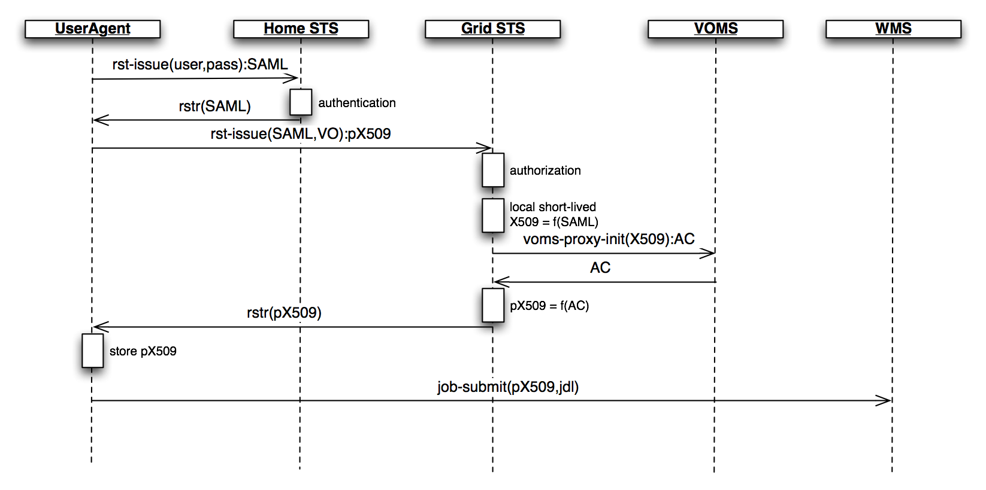
Issue a proxy X.509
User authenticates with his credential to a Shibboleth IdP STS and receives a SAML security token
He requests a proxy X.509 from a Grid STS using the SAML token

Slide 17
Summary
Interoperability Shibboleth - gLite
  Phase 1: SLCS
    Online CA issuing short-lived X.509 certificates based upon authentication at Shibboleth IdP
    Operative and in production
  Phase 2: VASH
    Transfers Shibboleth attributes into VOMS
    Shib attributes are available to grid resources as part of VOMS AC
    Software development finished
  Phase 3: SAML
    Actual phase: design of a WS-Trust STS for SAML and (proxy) X.509
    Grid use-case should be the same as the non-Browser-based use-case
Leverage the existing SWITCHaai Shibboleth federation

