Slide 1
Resource WG
PRAGMA
Mason Katz, Yoshio Tanaka, Cindy Zheng

Slide 2
Purpose
  Feed Applications
    Compute
    Data
    Network
Challenges
  Limited central management
  Limited compute / data resources
  Limited network bandwidth

Slide 3
Applications Define SubGrids
Applications
FMO
Savannah
MM5
CSTFT
Siesta
AMBER
Phylogenetic
…
Application Middleware
Infrastructure Middleware
Ninf-G
Nimrod/G
Mpich-GX
…
Gfarm
SCMSWeb
CSF
MOGAS
…
Globus (required)
Local job scheduler (require one)
SGE
PBS
LSF
SQMS
…

Slide 4
Expanding
New Site
  Ho Chi Minh City University of Technology
    Vietnam
Almost (Preparing) New Sites
  Advanced Science and Technology Institute
    Philippines
  Syiah Kuala University
    Indonesia
  University of Indonesia
    Indonesia

Slide 5
P13 - Account Creation
Complaint
  Too difficult to obtain user account on all resources
Observations
  Just ask Cindy and she will get it done
  Does not scale
Solution
  Deploy VOMs using APACs server
  Can be done in 1-2 months at some sites
  PRAGMA-wide by next meeting
  Then maybe our own VOMs server

Slide 6
Update
VOMS server has been setup at UCSD using VDT, currently in testing (UCSD, AIST)
Account Creation is still a problem
  Need tools to create semi-automatic grid and cluster account creation
  Looking into starting a student project at UCSD

Slide 7
P13 - GFarm
Complaint
  Latency of Meta Data updates on Gfarm is too high
Observations
  Just move the Meta Data server to the main user on Gfarm.
    When UCSD needs to write a lot of data move the server from AIST to UCSD
    Make Gfarm a single-user system
Solution
  Use Gfarm as a data drop-box not for running applications (at least for now)
  Gfarm 2 MD updates are faster but software is not complete
    Start testing gfarm 2 between AIST-Tsukuba-UCSD

Slide 8
Update
Gfarm V2 will be ready for testing soon
  (U Tsukuba, UCSD)

Slide 9
P13 - Application Environment
Complaint
  Too hard to know what applications are installed at each site
  Too hard to deal with different file locations on each cluster
Observations
  Need to think about having application czars that help get things installed at all sites
  Need an inventory of what application are where
  Resources is really about services/applications
Solutions
  SCMSWeb to catalog this
    Probe each sites software and network bandwidth
    Provide GUI display and XML (?) description of what applications are installed and their paths
    Can be done soon
  Sites to provide an /etc/profile.d/pragma.sh to define some common environment (TDB)

Slide 10
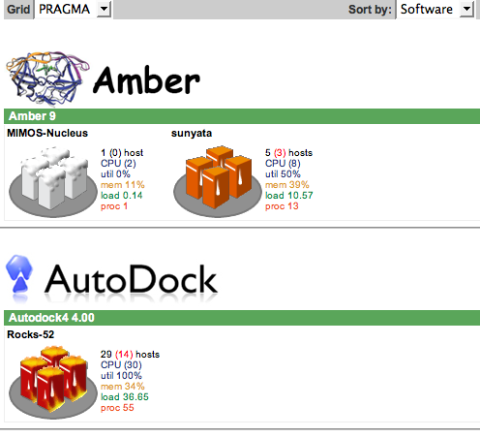
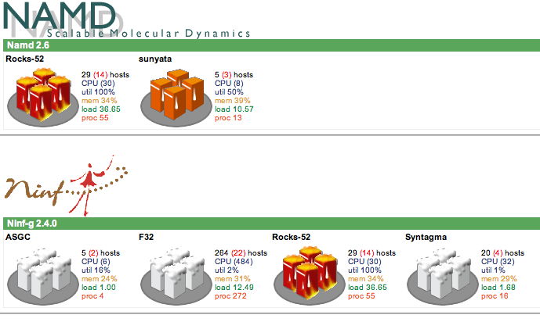
Update

Slide 11
Update - SCMSWeb
System status email alert deployed
Network bandwidth deployed on 5 sites 8 clusters
Software probe (previous slide) has been developed and deployed on GOC

Slide 12

Other Updates - Applications
New
  Phaser
    Monash
    Also running on OSG
Existing / Expanding
  Avian Flu Grid
    UCSD, JLU, & U Tsukuba
    CSF server has been setup and tested on portal.pragma-grid.net
  Siesta
    U Zurich
  Cyclic Short Time Fourier Transform (CSTFT)
    University of Puerto Rico Mayaguez (UPRM)

Slide 13
Other Updates - Middleware
PRAGMA production Certificate Authority has been setup and pending for approval from APGrid PMA
  UCSD
  APGrid
Nimrod portal has been setup at UCSD with help from MU
    A UNICORE system has been setup at UZH and ready for NIMROD-UNICORE bridge software development and testing
      UZH
      MU

Slide 14
Agenda
Today 13:30-15:20 (Blue Hall)
  Standard WG Meeting
  Talks and Open Discussions
Tomorrow 15:20-16:50 (Blue Hall)
  Meet with Bio WG as last meeting

Slide 15
Demos
13 Demos
Resources Expects a lot from the Demos
  Ideas
  Applications
  Middleware
Demo Awards
  Most Collaborative
  Most Impressive (Coolest)
  Most Immediate Impact

Slide 16
DataGrid
Another new Gfarm Plan
Pan-Pacific Data Centers
  University of Tsukuba
  AIST
  UCSD
Two different storage domains
  Gfarm (shared)
  Grid FTP & RFT (local)
Latency for MD on Gfarm v2 looks promising

Slide 17
VOMS
AFG would like to use
  CSF scheduling
  Simpler addition of new sites
VOMS Server is up and maybe working
Need clients for testing
  BeSTGrid to test
Initial VOs
  AFG
  Nimrod

Slide 18
Other
Software Catalog
  See Demo
  Plugged into Condor and CSF
Networking
  Need to figure what networks we are really on
  Last mile problem
  Need to match our routes to existing lambda/higher speed networks
  Work with UCSD (DeFanti)

Slide 19
We Need Applications

