Slide 1


Grid technology in Europe
Piotr Bała
ICM University of Warsaw
bala@icm.edu.pl.pl
Zurich 2008

Slide 2
Grid Technology in Europe
Development started in early 90’th
Middleware devlopment:
  gLite / globus
  UNICORE
  ARC (Nordu Grid Tools)
  ProActive
  …
Instrastructures
  EGEE (globus, gLite)
  DEISA (UNICORE, globus)
  National: UK, D-Grid, …
2008-03-17
P. Bała (ICM/UMK)

Slide 3
UNICORE
Main focus on access to the computational resources
Easy to install and maintain
OpenSource (unicore.sf.net)
Powerful user interface
  UNICORE Client
Long standing experience
  1992 – 1996 Unicore Project (Germany)
  1997 – 2002 Unicore Plus (Germany)
  1999 – 2003 Eurogrid (5FP IST)
  2001 – 2004 OpenMolGrid (5FP IST)
  2002 – 2003 Grip (5FP IST)
  2002 – 2006 NAREGI (Japan)
  2004 – 2006 UniGrids (6FP IST)
  2006 – 2008 Chemomentum, Aware(6FP IST)
2008-03-17
P. Bała (ICM/UMK)

Slide 4
UNICORE 5 architecture
Client Layer
SSL
Gateway
SSL
UNICORE Server (NJS)
User DB
TCP / SSL
Target System Interface
Computational Resources
Files
Data Storages Databases
Target System
2008-03-17
P. Bała (ICM/UMK)

Slide 5
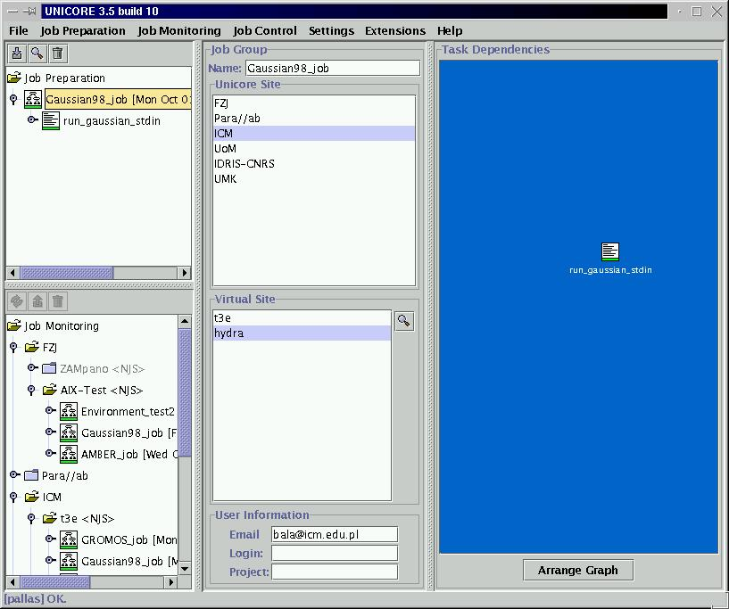
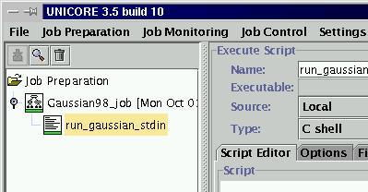
UNICORE Client
2008-03-17
P. Bała (ICM/UMK)

Slide 6
Unicore plugins
UNICORE Client (5.3, 5.6)
Example tasks:
  Quantum Chemistry: Gaussian, TBDFT
  Molecular Dynamics: Amber, Gromos
Plugins:
  Quantum Chemistry: Gaussian, Gamess, CPMD (FZJ)
  Molecular Dynamics: AMBER
  BioInformatics: Smith-Waterman
  DataBase Access: PDB Search, DBAccess
  Visualization: SapphireVis, IADemo, IVis, UVisit
  Broker: Resource Broker (UoM)
  Other: ListAllJobs, PluginLoaderPlugin
  Finite element: StarCD, Nastran, Fluent
2008-03-17
P. Bała (ICM/UMK)

Slide 7
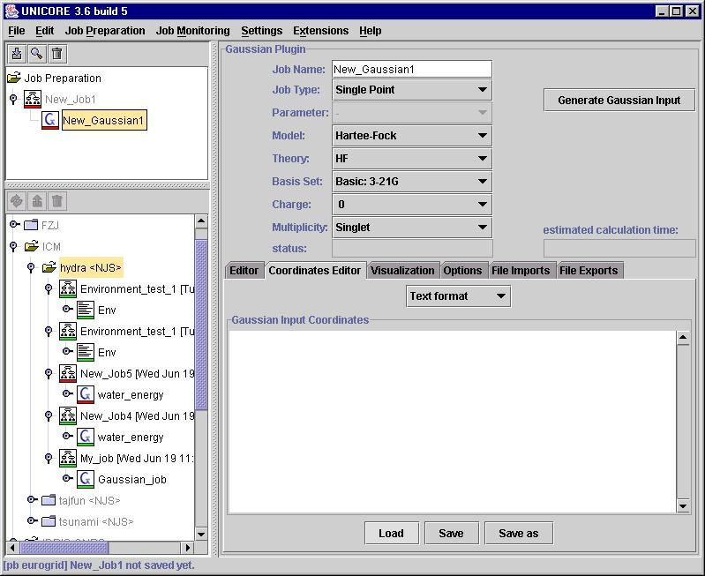
Gaussian98 plugin J. Pytliński
Input preparation
reads existing input, recognizes keywords
Molecule coordinate editor
formats:
XYZ
Z-matrix
text
2008-03-17
P. Bała (ICM/UMK)

Slide 8
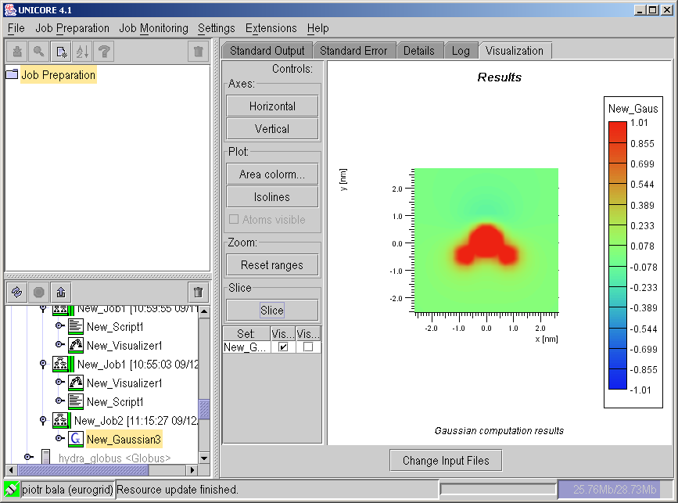
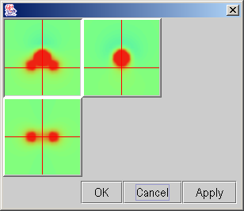
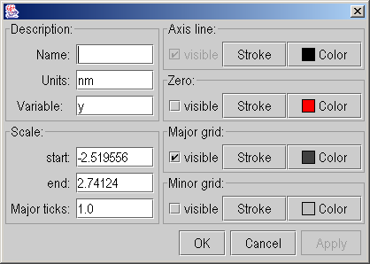
Gaussian Plugin J. Pytliński, A. Nowiński
2008-03-17
P. Bała (ICM/UMK)

Slide 9
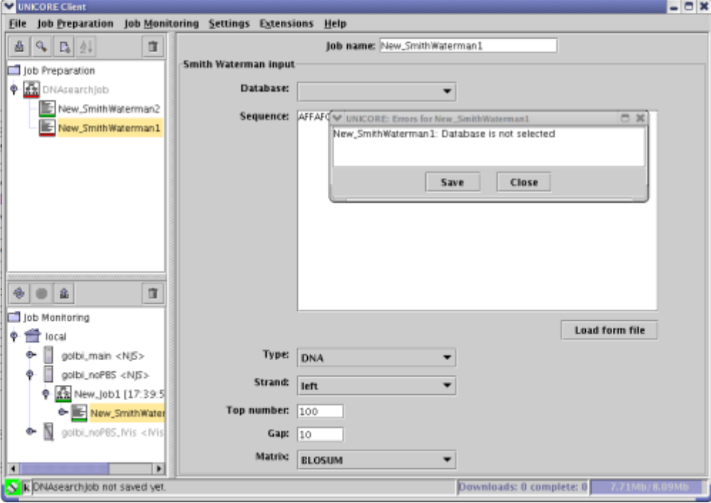
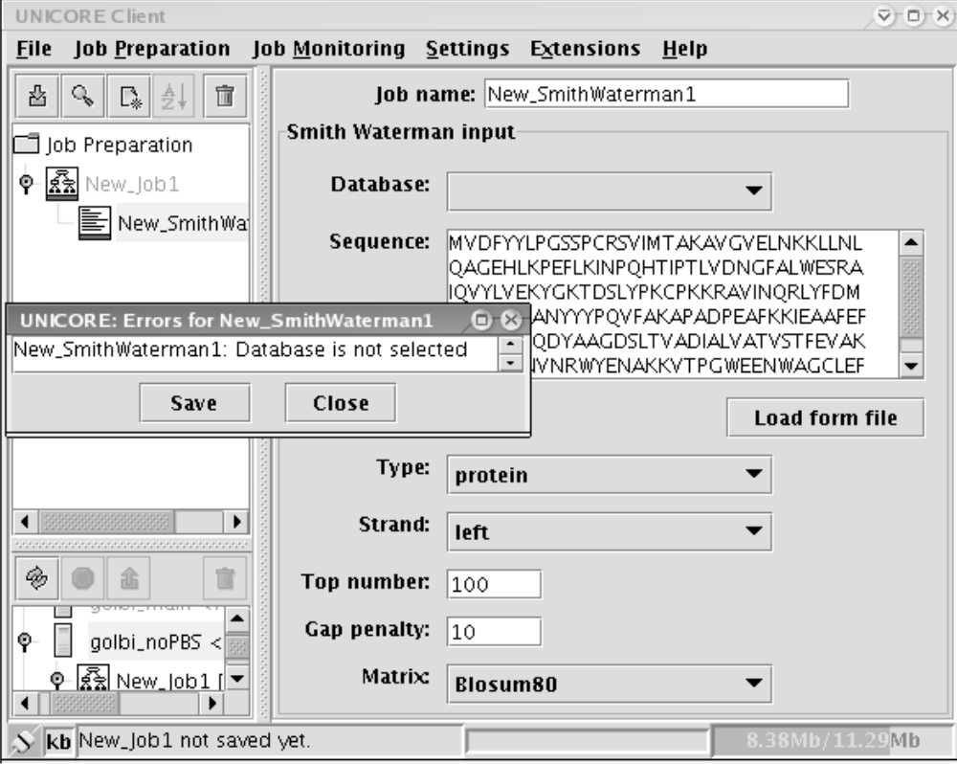
Sequence comparison K. Benedyczak, S. Dydel
2008-03-17
P. Bała (ICM/UMK)

Slide 10
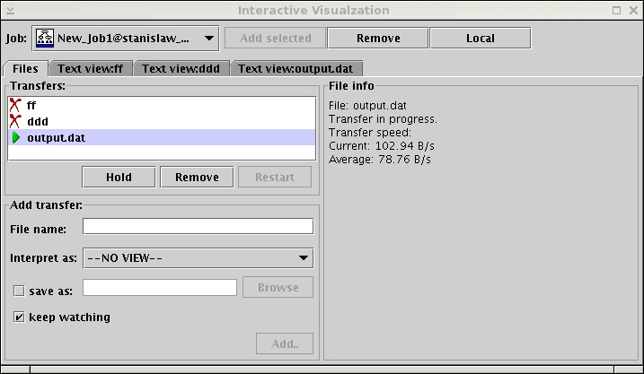
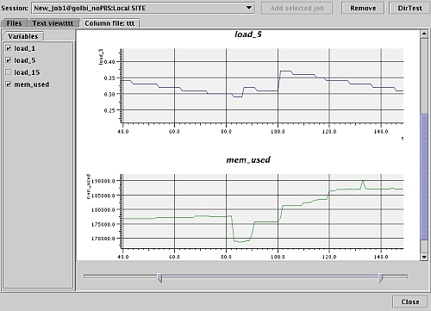
IVis – build-in visualization K. Benedyczak, A. Nowiński
2008-03-17
P. Bała (ICM/UMK)

Slide 11
Lesson learned - UNICORE
Stable, easy to configure, deploy and maintain solution
Very powerfull user interface
Still less popular than GT
  D-Grid
  NAREGI
  DEISA
  China Grid
Main technology: UPL, AJO
  Explicit Trust Delegation (EDT)
  Lack of grid services approach
Limmited interoperability with GT4
UNICORE Gateway – single point of failure
2008-03-17
P. Bała (ICM/UMK)

Slide 12
UNICORE 5 - Lesson learned
Stable, easy to configure, deploy and maintain solution
Very powerfull user interface
Limmited interoperability with GT4
Lack of Grid Services approach
UNICORE Gateway – single point of failure
Plugin is a very good concept
  development must be easier
  configure rather than program
  plugins too much depend on the UNICORE Client
    no clean interface,
  plugins are difficult to maintain
  need for modularity and internal workflows
    MetaPlugin
  applications are changing
2008-03-17
P. Bała (ICM/UMK)

Slide 13
UNICORE 6: The Big Picture…
Grid SDK
Deploy GridBean
Developer Workstation
Expert Client
Deploy GS
Plugins
Plugins
Grid
GridBeans
Application GS
Keystore
UNICORE
User Workstation
Application Client
Broker GS
Database GS
WSRF
G-API
Globus
GridBean
User Certificate
Application GS
Mobile Device
Condor
Web Client
Application Portal
Information GS
JSP
GridBean
Web Browser
Service Certificate
Service Provider
2008-03-17
P. Bała (ICM/UMK)

Slide 14
UNICORE 6 Architecture
Client Layer
HTTPS
Gateway
UNICORE 6 Hosting Environment
HTTPS / HTTP
Registry
Atomic Services
User DB
SECURITY
Other Services
Policies
WSRF Container
Execution Manager
Target System Interface
Computational Resources
Files
Data Storages Databases
Target System
2008-03-17
P. Bała (ICM/UMK)

Slide 15

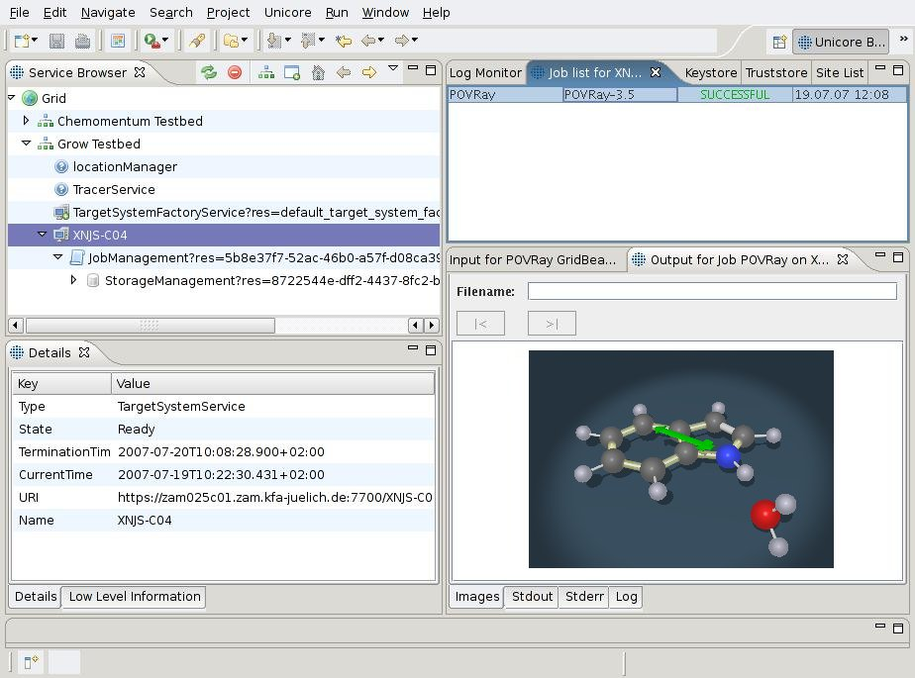
Eclipse based rich client
2008-03-17
P. Bała (ICM/UMK)

Slide 16
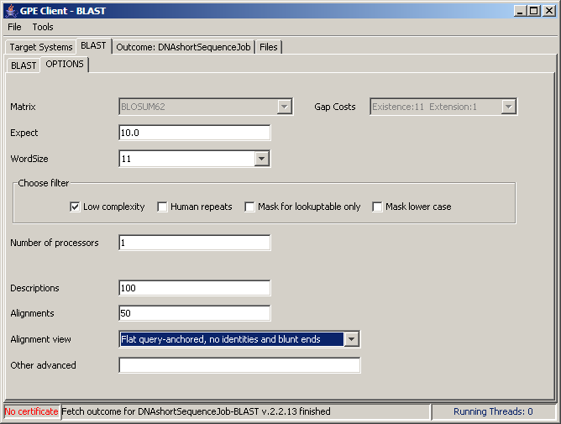
BLAST GridBean
2008-03-17
P. Bała (ICM/UMK)

Slide 17
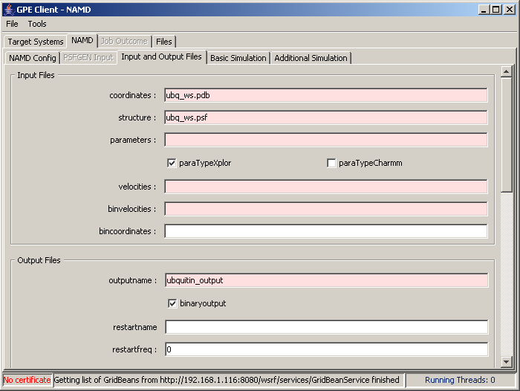
NAMD GridBean
2008-03-17
P. Bała (ICM/UMK)

Slide 18
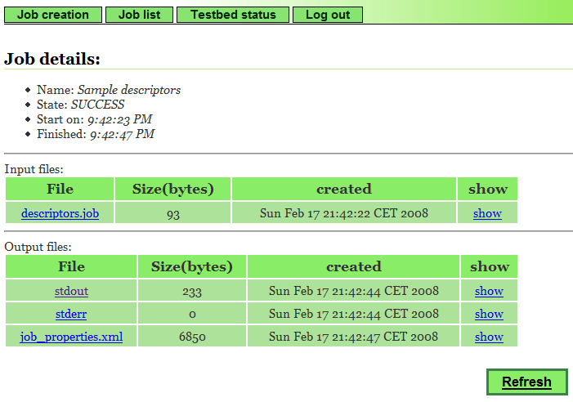
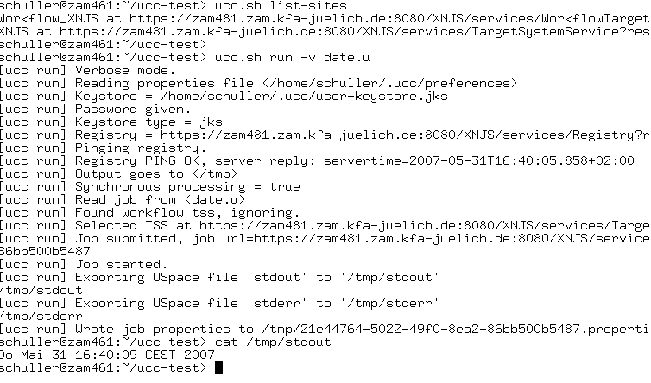
Web access, commandline client
2008-03-17
P. Bała (ICM/UMK)

Slide 19
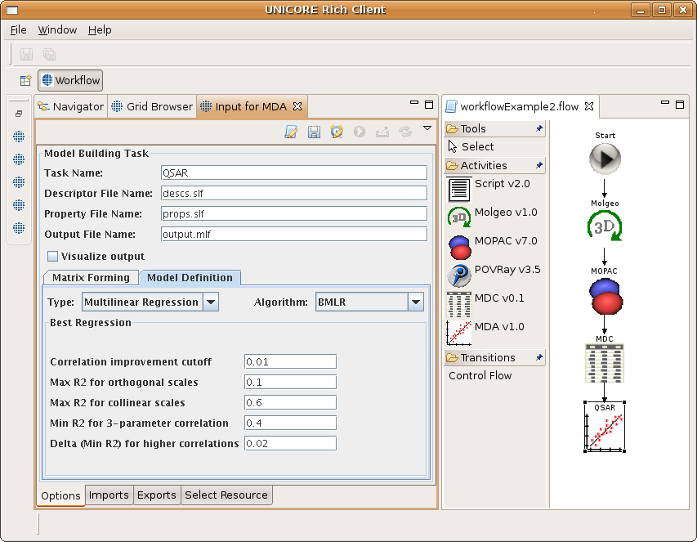
Eclipse Client – workflow editor
2008-03-17
P. Bała (ICM/UMK)

Slide 20
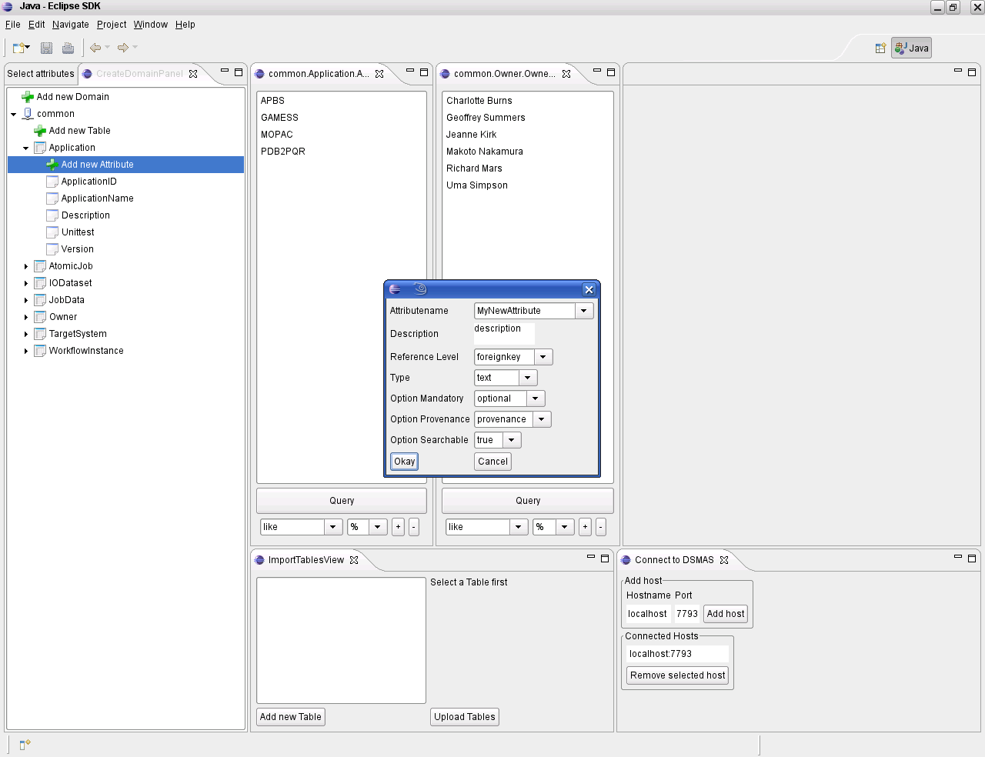
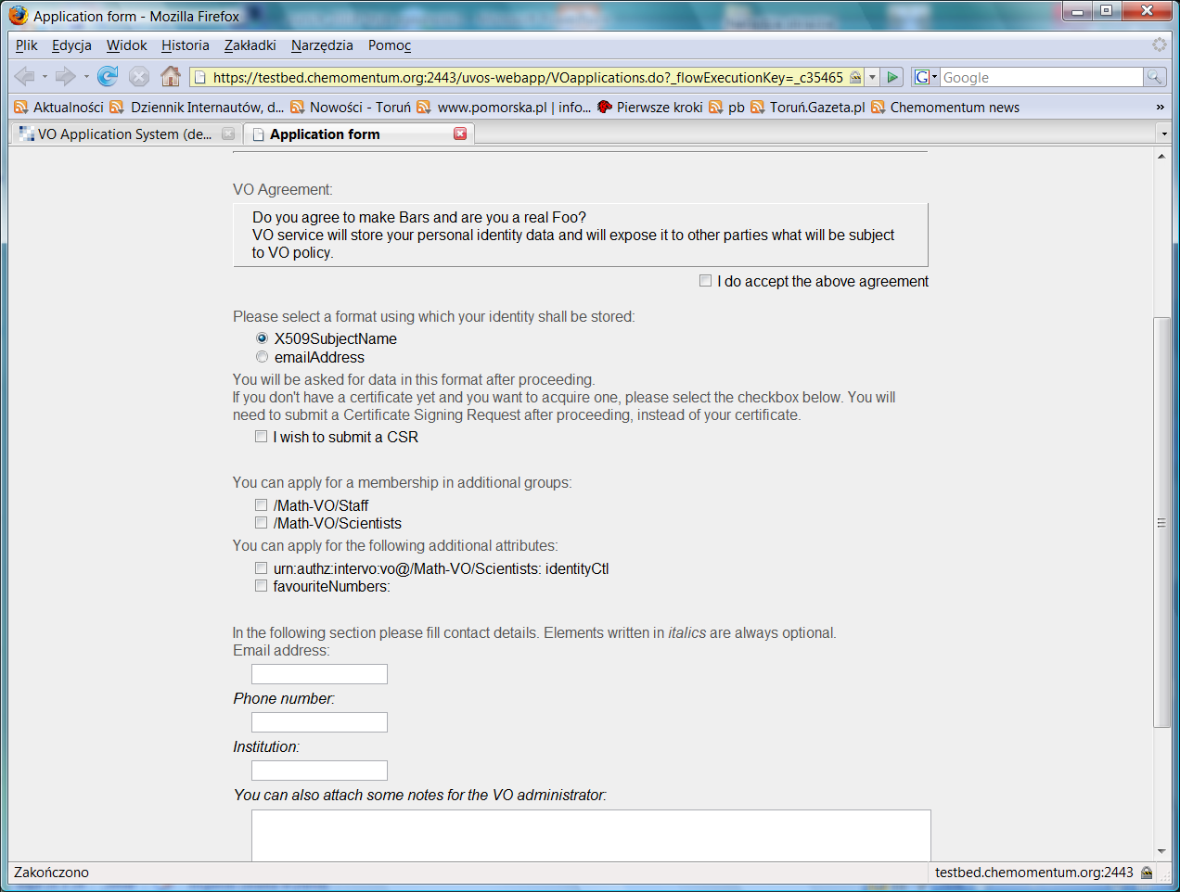
VO management
Mid-term Review, Brussels, February 20, 2008

Slide 21
Chemomentum project aims
Provide an integrated Grid solution for workflow-centric, complex applications with a focus on data management and knowledge.
Place the end users into the focus, enabling them to use powerful tools in a natural and transparent fashion;
  Do not limit to single application, provide different tools which can be easily adopted to the user preferences;
Grid
  Provides access to the distributed resources (databases, files, CPU, etc.)
  Works across different administrative domains (security, roles, access rights)
  Designed do handle large infrastructures
  Natural collaborative environment
2008-03-17
P. Bała (ICM/UMK)

Slide 22
Chemomentum project aims
Provide Grid-enabled applications, data services and knowledge management solutions, offering integrated decision support services for risk assessment, toxicity prediction and drug design;
Test-drive the developed services in the context of the European regulatory initiative “Registration and Evaluation of Chemicals” (REACH), promoting the REACH initiative aimed at reducing animal testing, by developing in silico, Grid-based tools.
2008-03-17
P. Bała (ICM/UMK)

Slide 23
Project aims
Test-drive the developed services in the context of the European regulatory initiative “Registration and Evaluation of Chemicals” (REACH), promoting the REACH initiative aimed at reducing animal testing, by developing in silico, Grid-based tools.
http://www.chemomentum.org
2008-03-17
P. Bała (ICM/UMK)

