Slide 1


Pacific Rim Application and Grid Middleware Assembly: PRAGMA
A community
building collaborations and
advancing grid-based applications
iGRID 2002 Demo

Slide 2

Research Center for Ultra High Voltage Electron Microscopy at Osaka University
National Center for Microscopy and Imaging Research
Courtesy Maryann Martone
1st PRAGMA Workshop

Slide 3
PRAGMA Demonstration Project: Telescience
Osaka University (Shinji Shimojo), UCSD (Mark Ellisman), National Center for High-Performance Computing (NCHC) (Fang-Pang Lin)
Remote control of microscope; real-time distributed tomographic reconstructions (Globus), volume auto-segmentation (vtk module, NCHC) and visualization (IvI, NCHC)
Weekly use of grid for teleconferencing
Applying tools developed for grid in real application
Update at 2nd PRAGMA Meeting
Demo at iGRID2002
Notes:
Important Point – this is a three way collaboration, sharing data.
Also – pulls together various aspects of the infrastructure

Slide 4
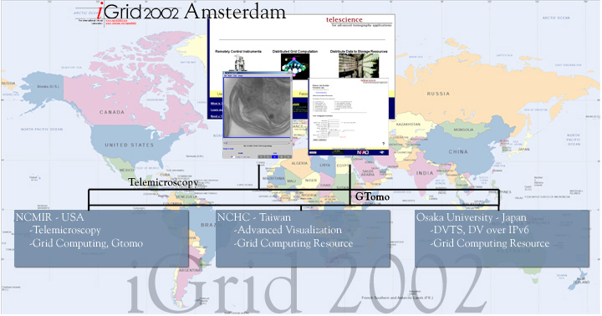
iGrid 2002
Demonstrate Advanced features of the Telescience Portal:
Perform Telemicroscopy controlling the IVEM at NCMIR
  Digital Video is encapsulated in NPv6 and transmitted at 30fps over native IPv6 networks
  (SDSC, Abeline, SURFnet) between San Diego and Amsterdam
Data will be computed with heterogeneous, distributed resources within NCMIR, NPACI, NCHC and Osaka University
Render and visualize data in Amsterdam using distributed resources in NCHC

Slide 5
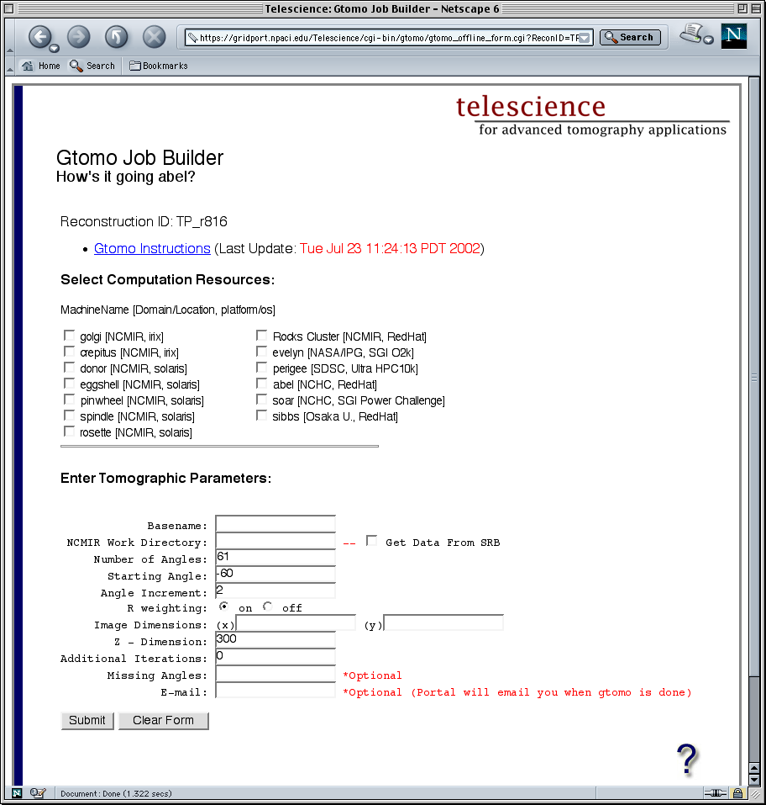

Globus Enabled Tomography (Gtomo)
Seleted Resource (s):
NCMIR NPACI NASA/IPG
NCHC Osaka U.
Gtomo Reader
Gtomo Writer
Data Input
Data Output
Gtomo Driver
Complete Abstraction of Grid
No need to manage Globus Certificates
Simply click resource(s) to use and enter biological parameters
Resources are transparently cross-platform, cross-domain

Slide 6
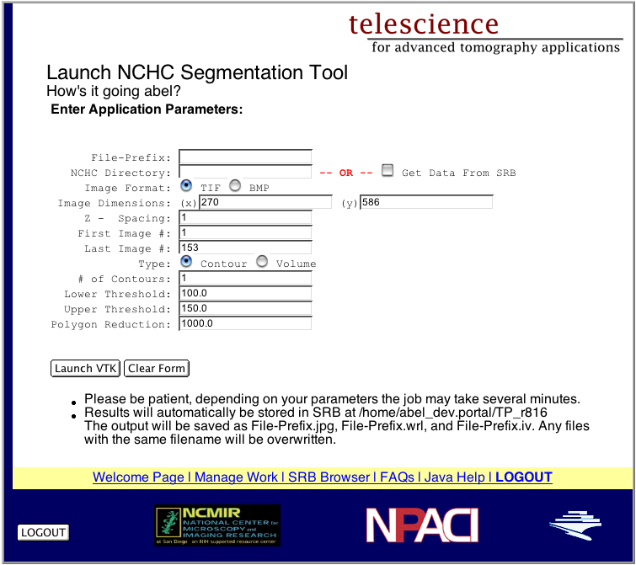
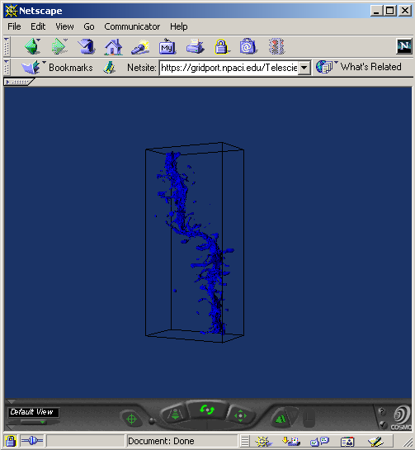
NCHC Auto - Segmentation
Data Input / Output to SRB
Job is initiated via Portal but computation is on NCHC compute resource
Output Formats: vrml, Open Inventor, IvI Vis Browser (vtk)

Slide 7
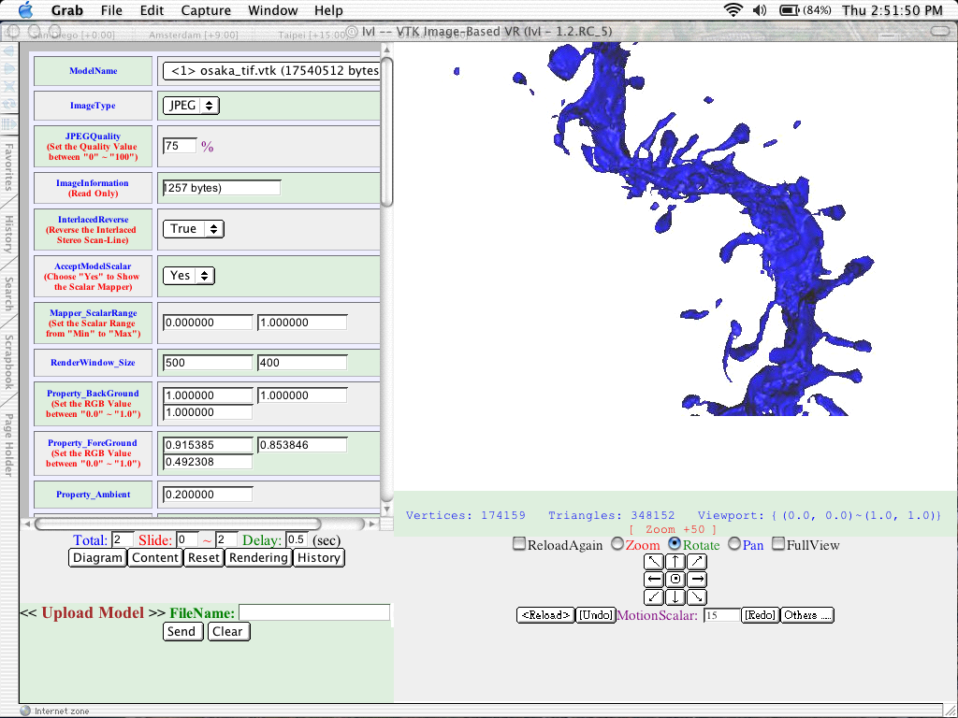
NCHC IvI Browser
Data is automatically selected from SRB
Visualization paramters are computed on NCHC resource

