Slide 1
NLANR/MNA Measurement and Network Analysis
Hans-Werner Braun
Ronn Ritke
NLANR/MNA
(UCSD/SDSC)
http://moat.nlanr.net/
Funded by the National Science Foundation/CISE/ANIR

Slide 2
Project Overview
The goal of the NLANR Measurement and Network Analysis Group is to characterize the behavior of high performance connection (HPC) networks; to this end, we have developed the Network Analysis Infrastructure (NAI).
Two projects form the core of this research: the Active Measurement Project (AMP) and the Passive Measurement and Analysis (PMA) project.
The NAI includes not only a growing collection of measurement data and multiple analyses, but also tools, methods, and numerous avenues for sharing information.

Slide 3
AMP
The current AMP architecture uses a full mesh (each monitor testing to all the others) between the approximately 125 active monitors deployed at remote sites. Across all sites, round trip time (RTT), packet loss, topology, and throughput (user/event driven) are currently measured.
Expansion and development of AMP will include a Gig interface for AMP and a repackaging of AMP for use by researchers and organizations wishing to deploy their own AMP mesh.
We make all data (AMP and PMA) publicly available for use by others.

Slide 4
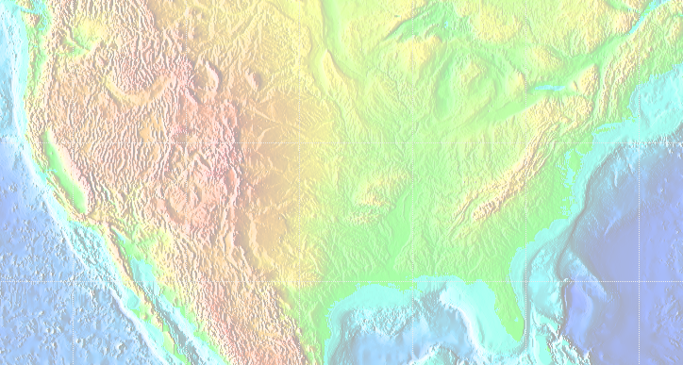

Active measurement deployment status
UAlaska
UWashington
Washington
State U.
Oregon State
Montana State
NDSU
MTU
UVermont
UWisc-
Milwaukee
UOregon
SDSMT
UWisc
MSU
Dartmouth
Iowa
State
UIowa
Startap
WSU
URochester
NTNU
UWyoming
NWU
UMich
UMass
BU
MIT
UIC
FNAL
PSU
UConn
Harvard
ColoState
NCSA
CMU/PSC
Columbia
Yale
NCAR
UIUC
UDel
UPenn
IU
WVU
UMBC
Princeton
UCBoulder
Kansas State
UC
UMd
JHU
ACCESS
UMissouri
GMU
NSF
UCB
UofUtah
Georgetown
Stanford
UKansas
UVirginia
ODU
UCSC
SLAC
Oklahoma State
WUSTL
NCREN/NCSC
Vanderbilt
UTK
UCLA
CSU-SB
UofOklahoma
UNC-CH
Duke
UC-Irvine
CSUPomona
ASU
UNM
UAH
GATech
NCSU
SDSC
UCSD
UArizona
Mississippi
State
UofGeorgia
SMU
UAB
Emory U.
SDSU
NMSU
UA
Rice
FSU
UFlorida
UHawaii
UCF
USF
UMiami
UWaikato
23 February 2000

Slide 5
PMA
The passive header trace data (PMA) provides the means to study workload profiles for a number of measurement points in high speed environments, soon up to OC48, with work under way for OC192/10GigE packet tracing capability.
Work is under way to reimplement some of the Trace Analysis tools, resulting in significant performance improvements.
Another PMA goal is to capture a unique view of the network by capturing all the traffic going into and out of a backbone router.

Slide 6
Passive measurement deployment status
U. of Michigan
Michigan State U.
NCAR
U. Colorado, Boulder
STARTAP/APAN
Argonne Nat. Lab
Ohio
State U.
Front Range GigaPoP
Columbia U.
Colorado State
NCSA
FIX-West
AIX/MAE-West
NASA-Ames
Indiana State
Old Dominion U.
MCNC
North Carolina State U.
U. of North Carolina
Duke U.
U. Memphis
SDSC, U. California, San Diego
Texas GigaPoP
Tel Aviv U.
(I-2)
Rice U.
Baylor College of Medicine
U. of Houston
Texas A&M U.
U. of Florida
Miami U.
Florida State U.
FDDI
OC3 ATM
OC3 PoS
OC12 ATM
OC12 PoS
26 September 2000

Slide 7
International Collaborations
Discussions with Tom DeFanti have included the monitoring of STAR LIGHT, and possible early insertion of optical splitters to allow quick installation of PMA machines. We have a PMA monitor at STAR TAP on the APAN link.
We are in talks with AMPATH regarding the placement of an OCXmon and AMP machine to measure the traffic from AMPATH.
We are in contact with Greg Cole of FASTnet (formerly MIRnet) and are discussing several possible measurement activities.

Slide 8
International Collaborations cont.
We have a PMA monitor in Israel, and AMP machines in Korea, Canada, Norway, Australia, and New Zealand.
Work with PRAGMA, the SDSC Pacific Rim Initiative.
Interest has also been expressed by other countries (China, Japan and Thailand) in both the AMP and PMA projects.
The following network maps were obtained from the Pacific Rim Networking Meeting, (Hawaii - February 21-22 2002) http://transpac.org/meeting/agenda.html

Slide 9

KOREA Network Map : ~2001
KIX
HPCnet
2M
Renater 2
Seoul
Seoul
XP
APAN
Tokyo
XP
8M
Suwon
2M
SingAREN
HPCnet
Taejon
45M
STAR
TAP
Taegu
HPCnet
HPCnet
HPCnet
Kwangju
Pusan
ATM
ATM/SONET 155Mbps/310Mbps
ATM/SONET 622Mbps

Slide 10
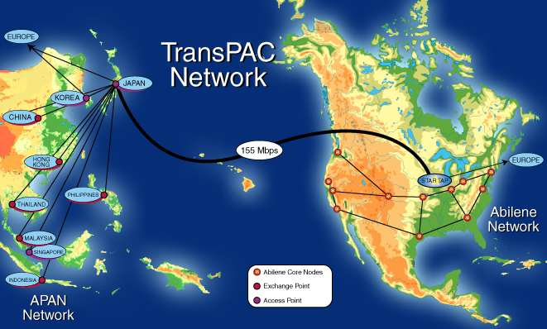

Slide 11
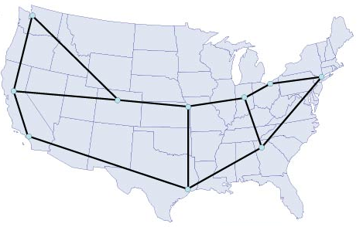

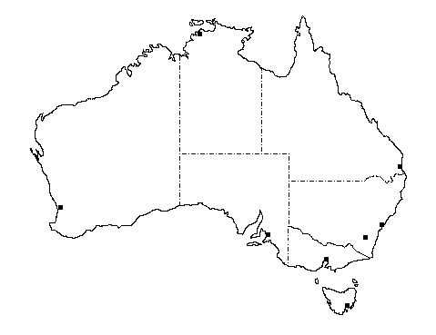
AARNet’s International Connections
Current and Planned
CANet
APAN
Seattle
StarTap
Japan
Europe
Abilene
GEANT
Hawaii
SLO
Taiwan
South
America
Singapore
PNG
International Transit Network
South Asia
Middle East
Europe
Fiji
AARNet
Perth
Sydney
Global
GRID
Forum
New Zealand

Slide 12
Possible CA*net 4 Topology
January 1, 2002
Edmonton
Prince George
Saskatoon
Winnipeg
Vancouver
Calgary
Regina
Halifax
Kamloops
Thunder Bay
Victoria
St. John's
Quebec City
Charlottetown
Seattle
Spokane
Sudbury
Montreal
Ottawa
Fredericton
Halifax
CA*net 4 Node Mini-IX
Minneapolis
Toronto
Kingston
Possible Future Breakout
London
Buffalo
Hamilton
Albany
Possible Future link or Option
Windsor
Chicago
CA*net 4 OC192
New York

