Slide 1
Applications Virtualization in VPC
Nadya Williams
nadya@sdsc.edu
UCSD

Slide 2
Why should I care about Cloud?
Cloud hosting is an architecture for server and application deployment
  Virtualization technology combined with infrastructure provide
    Flexibility, scalability, speed
    Deliver bandwidth, storage, CPU power
  Cost/performance benefits
  Solutions for different budgets and needs
  Computing resources are ready to be taken by applications
Users demands for the remote access to applications
  When: any time
  Where: wherever a user happens to be at the time
  How: Easy

Slide 3
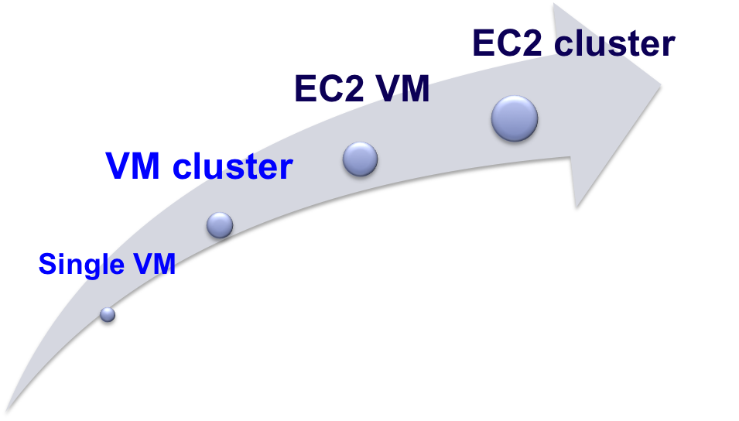
VM deployment
Minimizing “time to uptime” via automated
  VM creation (tight integration with Rocks environment)
  VM deployment into existing environment
    VM reconfiguration
Guarantee reproducibility
  Same application installation
  Same look and feel to the user
Interoperability
  Create VM anywhere – deploy anywhere.

Slide 4
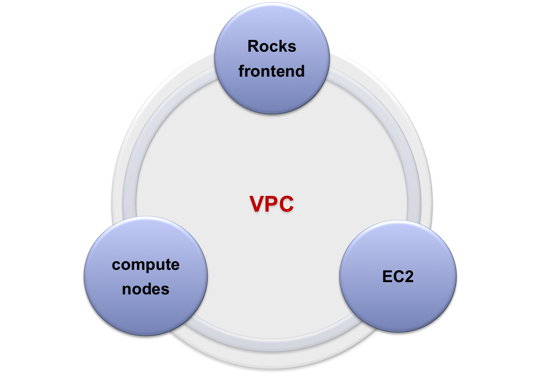
Virtual Private Cloud cluster key parts
Cluster management
SGE / Condor
Opal Toolkit
Applications
Network: security group
Authentication: key pair
SGE/ Condor
Applications

Slide 5
Bringing up cluster in EC2
Locally:
  Create VM frontend
  Add applications rolls
  Add a VM compute node
  Adjust Frontend VM partition (EC2 accepts 10Gb for primary partition)
Locally: VM to EC2 AMI
  create ec2 bundle
  upload ec2 bundle
  ec2-register <S3 bucket>/<manifest>.xml
EC2:
  Create VPC (one time)
  Start a frontend AMI instance (AWS console)
  Login and run reconfiguration script (on frontend instance)
  Start a compute node AMI (AWS console)
  Run add host script to add a compute node to the frontend (on frontend instance)

Slide 6
Lessons learned
EC2 cluster deployment is not easy
EC2 cluster deployment: room for improvement
  Automated deployment into VPC with command line tools
  Automated reconfiguration upon instance first boot
  Easy addition of EBS volumes when needed for specific applications
VM creation
  Create VM anywhere – deploy anywhere. Works now with Rocks.
  Get missing features by creating “bridges” between different Virtualizations
Future work
  Create a blueprint for making VM clusters
  Extend to KVM deployment on Rocks 6 (currently use Xen on Rocks 5.4.3)
  Deploy multiple clusters to VPC

Slide 7
Thank you !
Questions?

