Slide 1
Biosciences Working Group Update
Seok Jong Yu, KISTI
Hosted by Kunkuk University
Seoul, Korea, Oct 10-12, 2012
Notes:
Good morning It great to see you again in Korea. You might know that Dr wilfred couldn’t join this progma meeting due to his schedule.
So I would like to report Bioscience working group update that have Bioscience working group member’s activities during last 6 month

Slide 2
Recent Activities
NBCR – Dr. Wilfred Li
  Deployed LZU(Lanzhou U) bioscience application in PRAGMA Cloud. (demo)
  Hierarchical MapReduce: Towards Simplified Cross-Domain Data Processing.
Notes:
Dr. Wilfred group have deployed LZU bioscience application in PRGAGMA cloud reseource. So Cindy Zheng and Yang Zhang will present this work on demo session.
And also his group archived constructing applications virtualization in VPC you can see the application on demo session as well
NBCR is working with Indiana univ. they have designed and made the hierachical MapReduce system.

Slide 3
CNIC – Lucy
  Duckling portal with better support for applications, data handling and storage. Commercialization of conference support services.
KISTI – Dr. Seok Jong Yu
  Developing insilicoCell system which has Text mining tools and biological network simulation tools
  Working with KNIH for constructing aging related biological networks
  Setup OPAL system on KISTI cluster and add new functions
Notes:
Lucy is making Duckling portal and also concern about commercialization of conference support services.
And I have been developing insilicoCell system. The system integrated serveral analysis tool including text-mining and biological network simulation tools (Dr Tung in KISTI will present this system on demo session)
And also KISTI group is working on constructing aging related biological networks with KNIH.

Slide 4
HKU – Mr. Wing Keung Kwan
  Beijing Genomics Institute(BGI) moved to Shenzhen, with many NGS sequencers deployed
  HKU extension established in Shenzhen, Shenzhen Institute of Research and Innovation, eligible for funding from 863 program.
  HKU consolidates the bioinformatics resources with building a new organization (Bioinformatics Algorithms and Core Technology Research Lab)
Notes:
In HKU, Dr Kwan is interested in collaboration with Shenzhen supercomputer center which has huge computer resources. And also Beijing Genomics institute has been moved to shenzhen.
So He try to making collaboration project among those group. He is creating NGS analysis platform for genomics researcher.in this area But other researcher probably will join soon.

Slide 5
JLU – Dr. Xiaohui Wei
  Developing Map Reduce applications and algorithms
  Virtual cluster migration
  GPU based application optimization, with Many Integrated Core (MIC) chip from Intel on the horizon
Notes:
Dr. Xiaohui Wei is developing Map reduce application with using GPS based application optimization. And also intrested in using Many Integrated core chip (MIC chip)

Slide 6
UI – Dr. Heru Suhartanto
  Developing new computing resources
  New funding applied for drug discovery activities
UTM – Dr. Shahir Shamsir Bin Omar
  Building clusters using heterogeneous resources
  Modeling of misfolded proteins using Gromacs
  Cataloging medicinal plants, Borneo biodiversity studies
Notes:
Dr Heru suhartanto in University indonesia have setup a new compoting resource to use drug discovery research.
Dr. Omar UTM is constructing cluster system with heterogeneous resource.
And have been doing modeling of misfolded protein research and also cataloging medicinal plats.

Slide 7
International collaboration proposal
KU
  Proposal#1: Development of microbial carbohydrate factories using computational comparative genomics through KU – UCSD – HKU collaborations
  Proposal#2: Research on next generation biocomputing technologies through KU (UBiTA) – UCSD (Calit2) collaborations
Notes:
During last 2 month, The most great achievement is in Bioscience woring group about making international collaboration proposal
There are 2 proposal that we have made. First proposal is about development of microbial carbohydrate factories using computational comparative genomics.
KU UCSD HKU have made the collaboration in this project.
Second proposal is about next generation Biocomputing technology by collaborating with KU and UCSD.

Slide 8
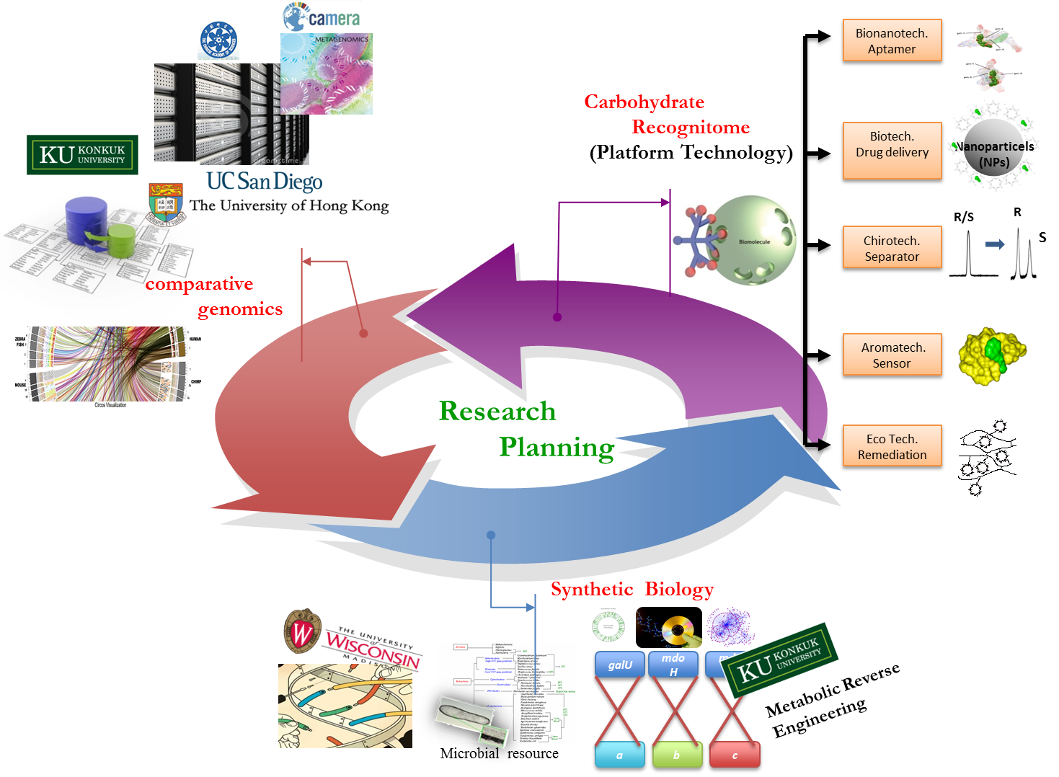
KU – Proposal #1
Notes:
I don’t believe that I can fully understand this proposal but I will try explain the concept of the proposal.
The proposal has three part. First they do comparative genomics research KU,UCSD,HKU collaborate on this research.
And then they select the useful metabolic pathway and create a optimized metabolic pathway using synthetic biology. KU and wisconsin Univ. will collaborate this research
Finally they want to make a bacteria that has the specific metabolic pathway to produce the chemical.

Slide 9
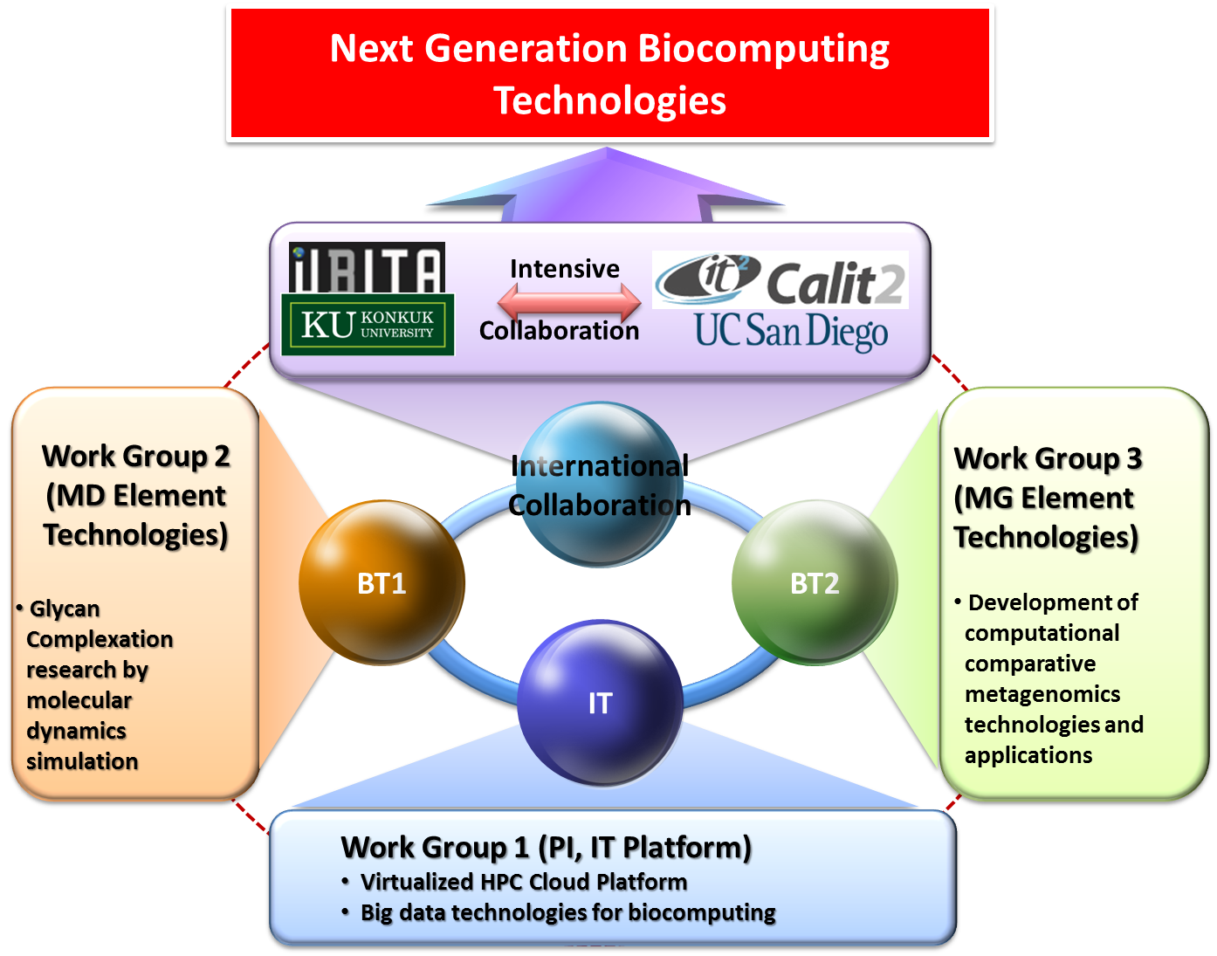
KU – Proposal #2
Notes:
Second project is about NG biocomputing technologies. UBITA and Calit2 is joined this project.

Slide 10
Collaboration
HKU – UI : computing resource and use of IMP database
KISTI - UTM : constructing a knowledge database using BioKnowledge Viewer

Slide 11
Breakout session
Computational Methods for Comparative Genomics (Dr. Jaebum Kim, KU)
insilicoCell (Dr. Seok Jong Yu, KISTI)
Introducing Eztaxon-e database and chunlab services ( Dr. Bong-su Kim , Chunlab Inc.)

