Slide 1

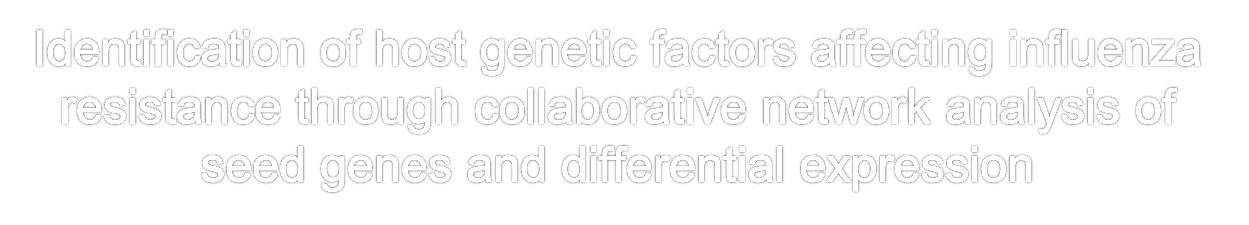
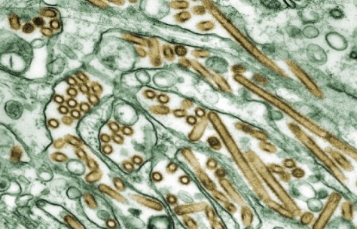
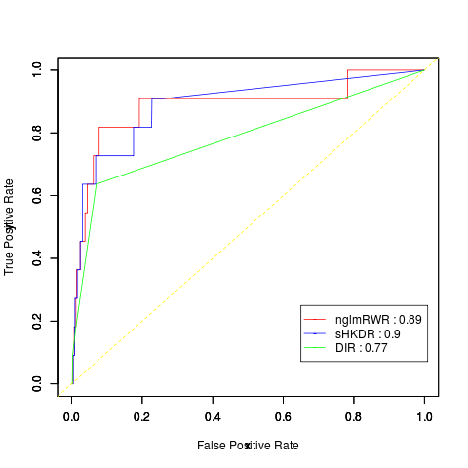
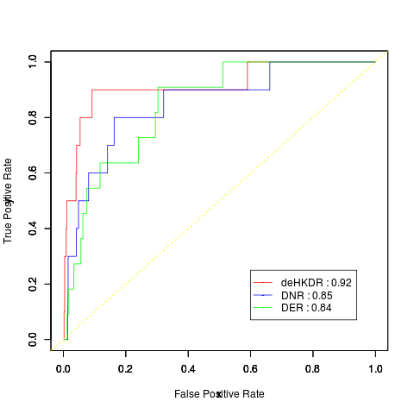
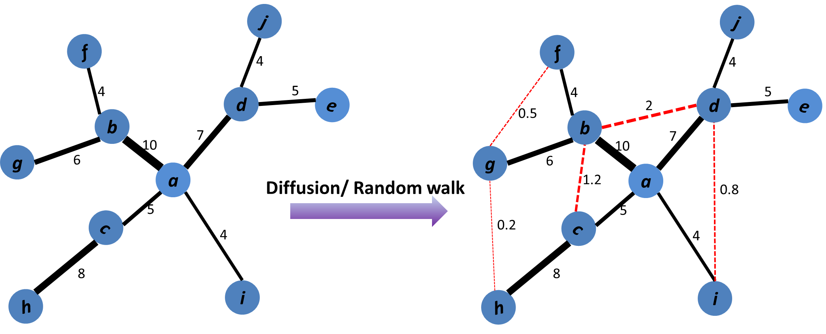
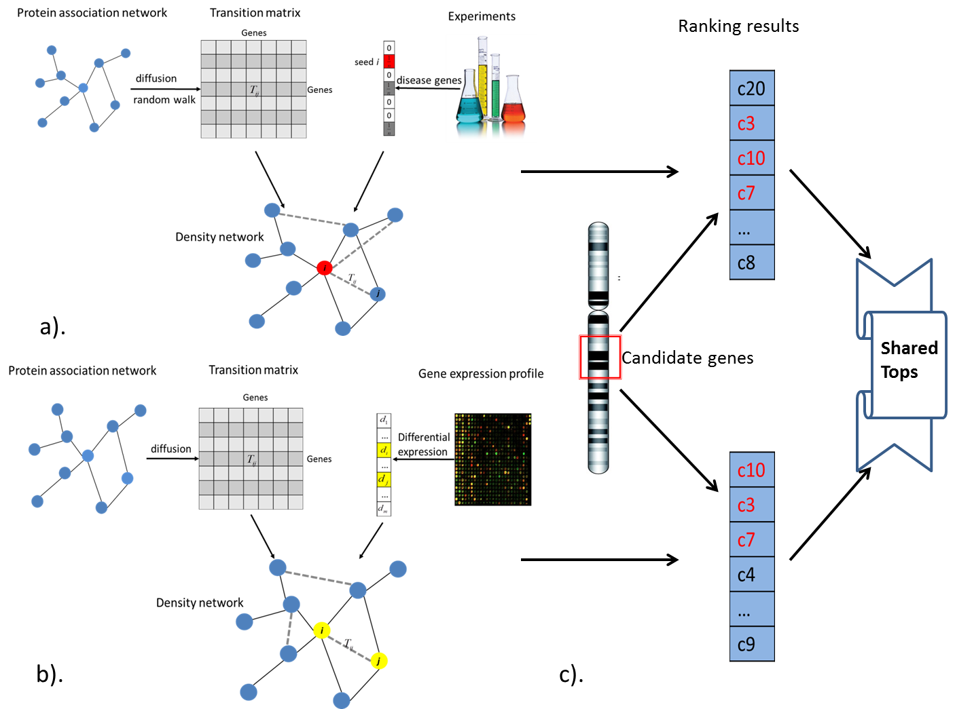
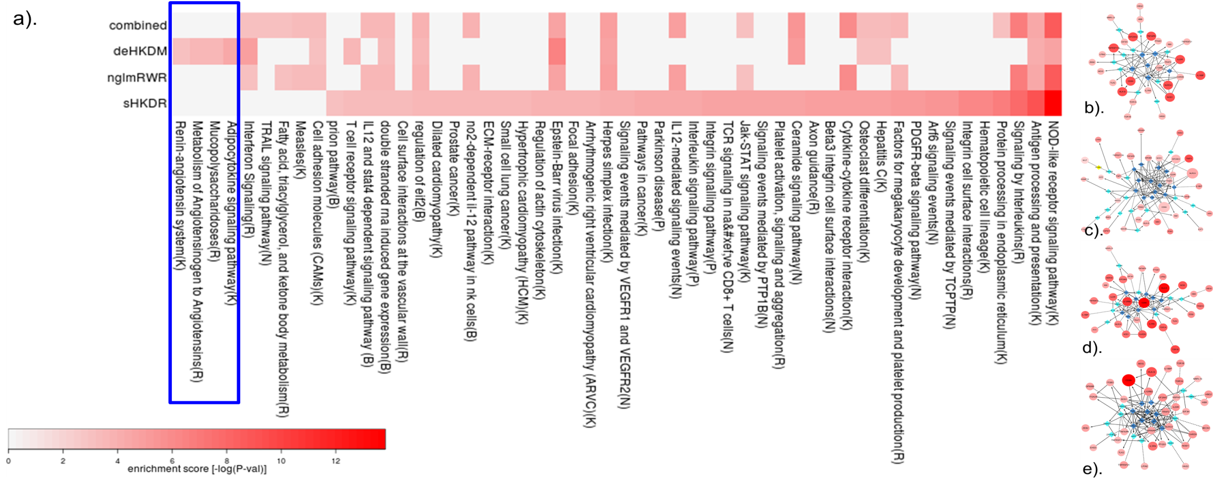
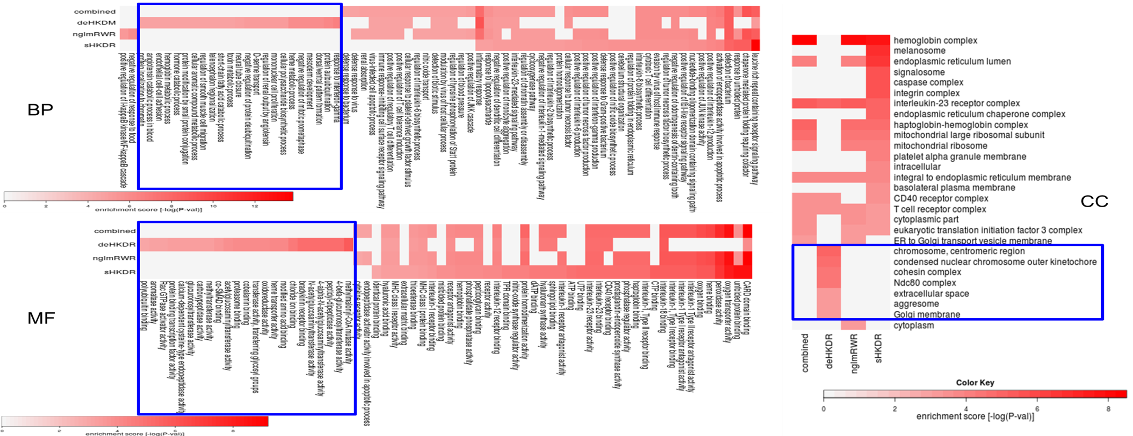
S Bao¹, X Zhou², L Zhang³, X Zhang², P Tang⁴, J Zhou⁵, Y Li⁶, K To⁵, YQ Song¹
¹Department of Biochemistry, The University of Hong Kong, Hong Kong
²Tsinghua National Laboratory of Information Science and Technology, Tsinghua University, Beijing
³College of Bioinformatics Science and Technology, Harbin Medical University, Harbin, China
⁴Genomics Core Facility, the Institute for Human Genetics, UCSF, USA
⁵Department of Microbiology, The University of Hong Kong, Hong Kong
⁶Chinese Academy of Sciences, Qindao, China
Introduction
Results
Host Genetics response to influenza resistance
Model performance
Figure 3. The performance of seeds-based and differential expression-based models
Influenza A virus: A threat to human health
Host genetic propensity for contracting the influenza virus
  Surveys of all variations within confirmed QTLs, time/money consuming
a). Evaluating the performance of seeds-based global network models using leave-one-out cross validation method b). The performance of differential expression-based global network models, measured byROC curve analysis
Photo Credit: Cynthia Goldsmith
Walking the interactome boosts disease candidates identification
Proteins response to similar disease phenotypes tend to be closely connected with each other [1]
Immune genes highly clustered in vertebrate genome[2]
Global network-similarity measures better capture disease candidates[3]
Network analysis on differential expression effectively predicts monogenic/ polygenic disease genes [4,5]
a).
b).
Prioritization results
Models | Combination of top 5 candidates within QTL | Candidates number
deHKDR, sHKDR, nglmRWR | TNFRSF11B, HLA-G, NLRC4, EIF2AK2, TNFAIP6, CD8A, NOD1, IL23R, IL18BP | 9
deHKDR, sHKDR | HAS2, TRAF2 | 2
deHKDR, nglmRWR | C1QL1, COLEC10, NMI | 3
sHKDR, nglmRWR | AOC2, TLK2, EIF3H, MRPL13, ZNRD1, MOG, TNFRSF21, LPIN2, IL1RN, TOR1A, CARD9, TOR1B, ZEB2, PTGS1, IL12RB2, HBG2, HBB | 17
deHKDR | IFI35, TMEM106A, FTSJ3, ACE, RAD21, EXT1, MUT, UBD, CAPN11, NFKBIE, NDC80, CYP1B1, TGIF1, IL36G, IL36A, GLT6D1, FCN1, LHX2, ARHGAP15, RND3, TNIP3, DFNA5, P4HA3, TRIM21, HPX, OR52E4 | 26
sHKDR | BECN1, ITGA2B, ITGB3, HSP90AB1, SOS1, EHD3, HSPA5, MRRF, GPNMB | 9
nglmRWR | VAT1, PYY, TRIM10, HNRPLL, VIT, SDCCAG3, TRAF1, HERC6 | 8
Figure 1. Construction of global network similarity measures
Black edges means physical interactions between proteins. After random walk through network or diffusion from source nodes, indirect interactions between previously unreachable nodes will be connected with relatively weaker scores, represented by red edges
Motivations
Seed gene-based network wandering approach for identifying host genetics
Can differential expression-based global network analysis also be effective for complex disease studies, e.g. host response to influenza infection ?
Methods
Functional analysis
Pipeline
Figure 2. Overview of collaborative network analysis of seed genes and differential expression
a). Seeds-based global network analysis b). Differential expression-based global network analysis c). Integrate results from the two models, top candidates within given QTL region, shared by both strategies were collected as promising disease genes.
Figure 4. Pathway enrichment and interaction network of top 5-candidates from combined model (winner genes), deHKDR, nglmRWR and sHKDR
a). Pathway enrichment of top 5-candidates shared by >=2 models (combined model), deHKDR, nglmRWR and sHKDR. The color of bars increase with enrichment score [–log(p-value)]. b), c), d) e). were Interaction network of top 5-candidates from combined model, deHKDR, nglmRWR and sHKDR respectively. Circles in figs were candidates and diamonds were neighbors linked to candidates. Linkers highly connected by candidate genes were colored by dark blue. Circles’ size and color tone in b). increased with the number of covered models. In c), circles’ color tone increased with gene’s differential level, and circles’ size increased with deHKDR score. The color tone and size of circles in d) and e) increased with nglmRWR score and sHKDR score respectively.
Materials
  Seeds: MX1, NCR1, CCR5, NLRP3, HLA-A,HLA-B, FCGR2A, RPAIN, C1QBP, IL10, IFNAR1
  Gene expression profile: GSE30506 (99 Influenza-infected pre-Collaborative Cross (CC) lines, among which 26 severely responsed to infection, 18 showed mild response)
  QTL candidates: genes within
    chr6: 48-75 Mb (Tith 1999)
    chr2:33-52 Mb, chr7:107-121 Mb, chr11:101-107 Mb, chr15:51-57 Mb, chr17:68-84 Mb (Boon 2009)
    chr2:24-38 Mb, chr17:37-48 Mb (Boivin 2012)
Figure 5. Go (BP, MF, CC) enrichment of top 5-candidates from combined model, deHKDR, nglmRWR, sHKDR
Models
Conclusion
Seeds-based network models:
  Normalized graph Laplician matrix-based Random Walk with Restart (nglmRWR)
  Seeds-based Heat Kernel Diffusion Ranking (sHKDR)
  Baseline: Direct Interaction Ranking (DIR)
  Differential expression-based network models:
  Differential expression-based Heat Kernel Diffusion Ranking (deHKDM)
  Comparison: Direct Neighborhood Ranking (DNR)
  Baseline: Differential Expression Ranking (DER)
Global network similarity measures for complex disease studies
Differential expression-based network analysis model for studying complex disease, e.g. infectious disease
Novel pathways and biological functions from de-network model
Reference
Performance measurement
[1]. Gandhi TK et al. Nat Genet. 2006 Mar;38(3):285-93.
[2]. Makino T et al. Mol Biol Evol. 2008 Sep;25(9):1855-62. Epub 2008 Jun 23.
[3]. Köhler S et al. Am J Hum Genet. 2008 Apr;82(4):949-58. Epub 2008 Mar 27.
[4]. Nitsch D et al. PLoS One. 2009;4(5):e5526. Epub 2009 May 13.
[5]. Nitsch D et al. BMC Bioinformatics. 2010 Sep 14;11:460.
Leave-one-out cross validation (LOOCV) for seeds-based models
ROC analysis for differential expression-based models

