Slide 1

PRAGMA Grid – Testbed For Collaborations
Cindy Zheng
Peter Arzberger
Philip Papadopoulos
Mason Katz
Pacific Rim Application and Grid Middleware Assembly
University of California, San Diego
http://www.pragma-grid.net
http://goc.pragma-grid.net

Slide 2
Overview
PRAGMA Grid
  Goal and approach
  Structures and resources
Collaborations in PRAGMA Grid
  Applications and middleware
  With science and technology teams
  Grid interoperation experiments
  Research publications
Collaboration benefit
  Form and leverage rich resources
  Form and leverage collaboration networks
  Enhance software quality and usability
  Enhance vision and involvement
  Enhance research visibility and software dissemination
  Enhance funding positions
Join us

Slide 3
Goals and Approaches
Routine-use experiments and testbed (2004 - )
Grass-roots
PRAGMA membership not necessary
Don’t have to be in pacific rim
Contribute work and resources (of local grids)
long term collaborations
Application driven
Issues, solutions, collaborations, interoperate
middleware interoperability
Make grid easier to use for scientists

Slide 4
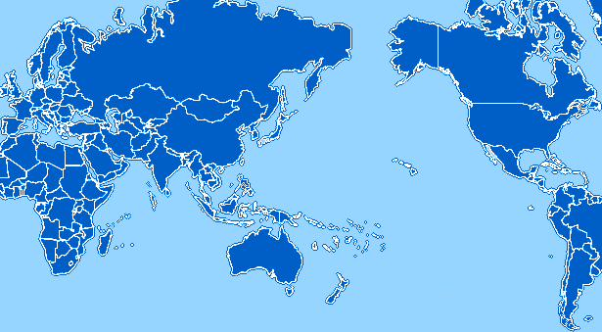
PRAGMA Grid Testbed
CNIC
GUCAS
China
JLU
China
AIST
OsakaU
UTsukuba
TITech
Japan
NCSA
USA
UZurich
Switzerland
CNIC
KISTI
Korea
AIST
BU
USA
UUtah
USA
SDSC
USA
SDSC
LZU
China
ASGC
NCHC
Taiwan
ASGC
CICESE
Mexico
UMC
USA
UoHyd
India
CUHK
HongKong
UNAM
Mexico
NECTEC
ThaiGrid
Thailand
NECTEC
ThaiGrid
IOIT-HCM
Vietnam
ASURC
Costa Rica
APAC
QUT
Australia
MIMOS
USM
Malaysia
BII
IHPC
NGO
Singapore
UCN
Chile
NGO
BESTGrid
New Zealand
MU
Australia
UChile
Chile
32 Clusters from 29 institutions in 14 countries/regions (+ 7 in preparation)
7 gfarm sites

Slide 5
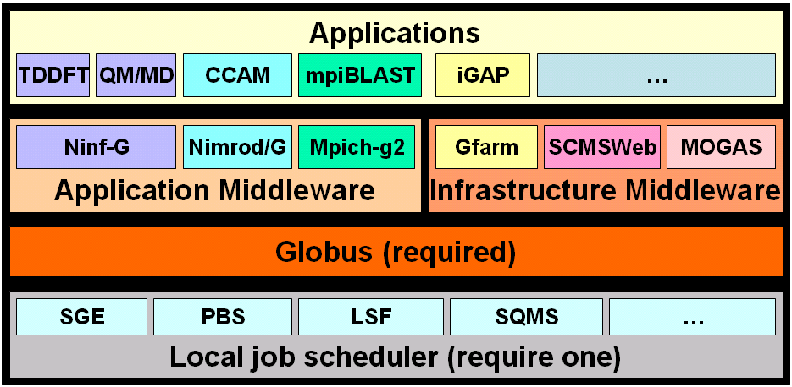
Software Layers
Heterogeneous environment
Minimal requirements
Globus 2, 3, 4
Moving recommendations

Slide 6
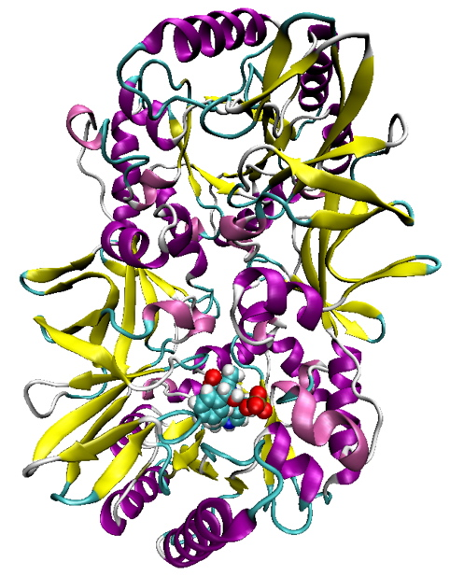

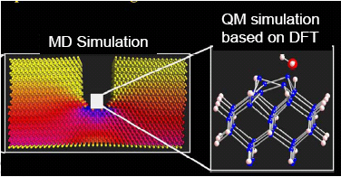
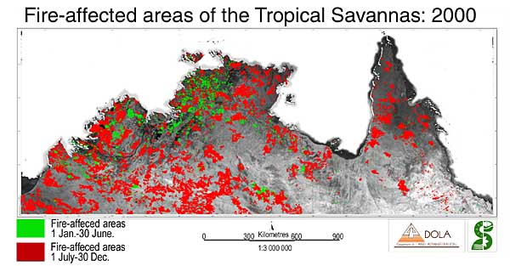
Applications and Middleware http://goc.pragma-grid.net/applications/default.html
Real science applications pair and drive middleware development
Achieve long-run and scientific results
Open to applications of all scientific disciplines
  Climate simulation
    Savannah/Nimrod (MU, Australia)
    MM5/Mpich-Gx (CICESE, Mexico; KISTI, Korea)
  Quantum-mechanics, quantum-chemistry:
    TDDFT, QM-MD, FMO/Ninf-G (AIST, Japan)
  Genomics
    iGAP/Gfarm/CSF (UCSD, USA; AIST, Japan; JLU, China)
    HPM: genomics (IOIT-HCM, Vietnam)
    mpiBlast/Mpich-G2 (ASGC, Taiwan)
  Organic chemistry
    Gamess-APBS/Nimrod (UZurich, Switzerland)
  Molecular simulation
    Siesta/Nimrod (UZurich, Switzerland; MU, Australia)
    Amber/Rsh ( USM, Malaysia)
  Computer Science
    Load Balancer (VAST-HCM, Vietnam)
    GriddLeS (MU, Australia)
  2 applications from Vietnam!

Slide 7







Application/Middleware Collaborations http://goc.pragma-grid.net/wiki
Mutually beneficial
Nimrod based Gamess-APBS
  Gamess-APBS: UZurich, Switzerland
  Nimrod: MU, Australia
Mpich-Gx based MM5 and WRF
  MM5 and WRF: CICESE, Mexico
  Mpich-Gx: KISTI, Korea
Test/develop Gfarm and CSF with iGAP
  Gfarm: AIST, Japan
  CSF: JLU, China
  iGAP: UCSD, USA
Notes:
Examples
Application easier to run on grid
Middleware fast improve

Slide 8



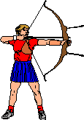





Technologies And Expertise
Rocks – cluster management and grid software integration (SDSC, USA)
Ninf-G – Grid-RPC (AIST, Japan)
Nimrod – parameter sweep (MU, Australia)
Mpich-Gx – Mpich-G2+ (KISTI, Korea)
SCMSWeb – grid monitoring (ThaiGrid, Thailand)
Gfarm – Grid file system (AIST/TsukubaU, Japan)
MOGAS – Grid accounting (NTU, Singapore)
CSF – Meta-scheduling (JLU, China)
Grid security – APGrid (IGTF), Naregi-CA
CSE-Online – cyber-environment (UUtah, USA)
OptIPuter – high Performance Networking
…

Slide 9
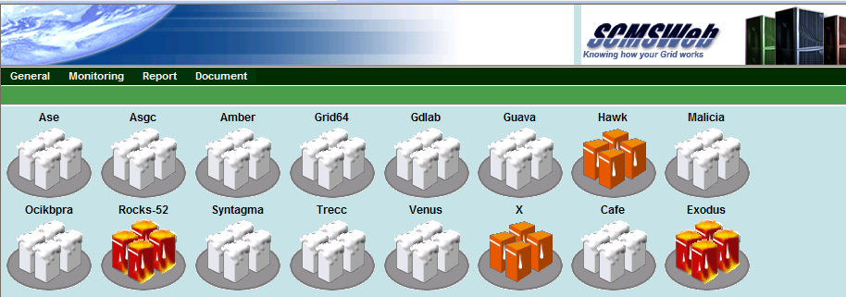
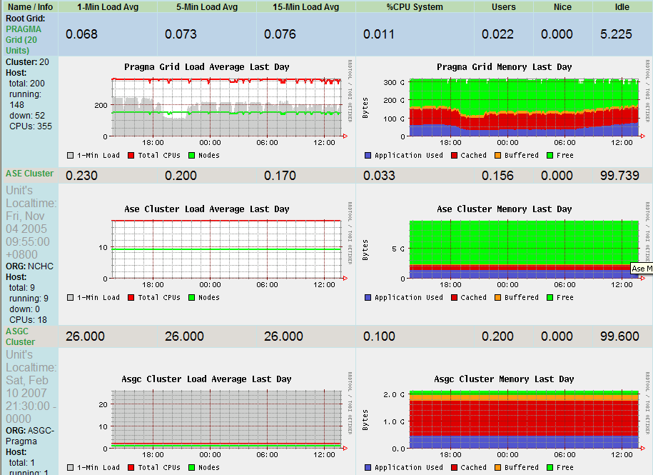
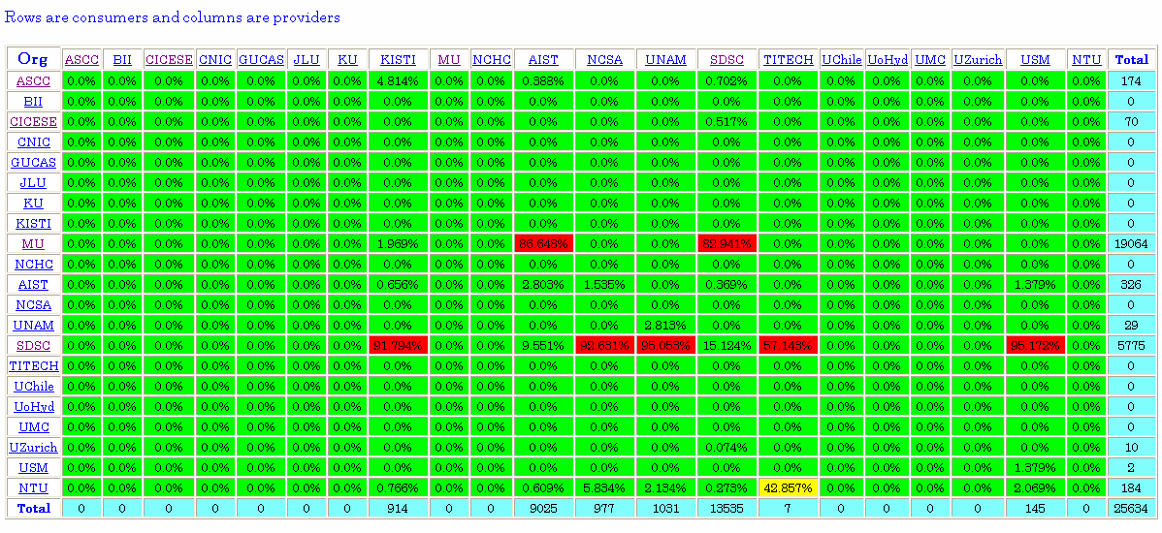

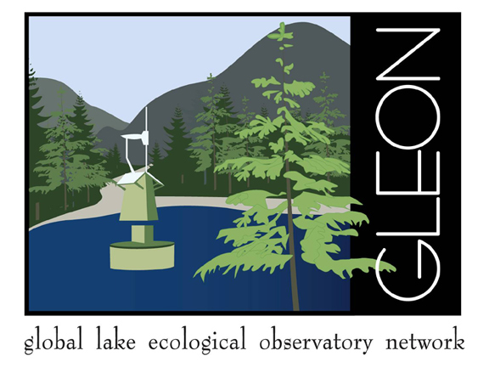
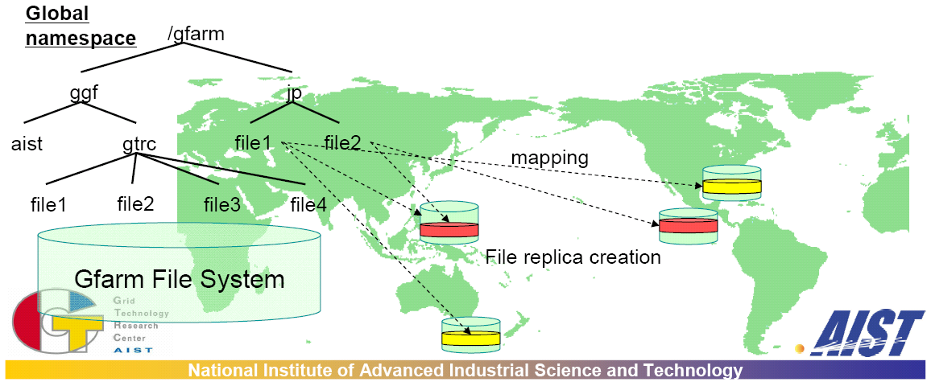
Collaborations With Science and Technology Teams
Grid security
  Naregi (Japan), APGrid, GAMA (SDSC, USA)
Grid monitoring
  Monitoring - SCMSWeb (ThaiGrid, Thailand)
  Accounting - MOGAS (NTU, Singapore)
  Gfarm (AIST/UTsukuta, Japan)
Cyber-environment
  Cyber-environment - CSE-Online (UUtah, USA)
  SCMSWeb (ThaiGrid, Thailand)
  Myproxy (APAC, Australia)
Rocks and middleware (SDSC, USA; …)
  Ninf-G, SCE, Gfarm, Bio, K*Rocks, Condor, …
Datagrid, sensor, network
  Gfarm-fuse (AIST, Japan)
  GEON data network
  GLEON sensor network
  OptIPuter
    High performance networked TDW
    Telescience

Slide 10
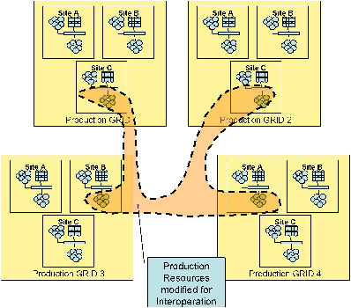





Grid Interoperation Experiments http://goc.pragma-grid.net/wiki/index.php/Main_Page#Grid_Inter-operations
OGF – Grid Interoperation Now (GIN), GIN-OPS
  GIN testbed (February, 2006 – on-going)
  TDDFT/Ninf-G (PRAGMA - AIST, Japan)
    PRAGMA, TeraGrid, OSG, NorduGrid; EGEE
  Savanah fire simulation (PRAGMA - MU, Australia)
    PRAGMA, TeraGrid, OSG
  Multi-Grid monitoring
    SCMSWeb probe matrix (PRAGMA - ThaiGrid, Thailand)
    Common schema (PRAGMA, TeraGrid, EGEE, NorduGrid)
Peer-grid interoperation experiments
  PRAGMA->TeraGrid (October, 2006 – on-going)
    PRAGMA member runs application across both grids
    QM/MD/Ninf-G (AIST, Japan)
    Manual reservation, 7 sites in PRAGMA, 3 sites in TeraGrid
  OSG<->PRAGMA (January, 2007 – on-going)
    Members from both grids run applications across both grids
    OSG - Spatial Interpolation (UIowa, USA)
    PRAGMA - FMO/Ninf-G (AIST, Japan)
    OSG - FermilabGrid
    PRAGMA – SDSC, USA; NECTEC, Thailand; NGO, Singapore; ThaiGrid, Thailand

Slide 11
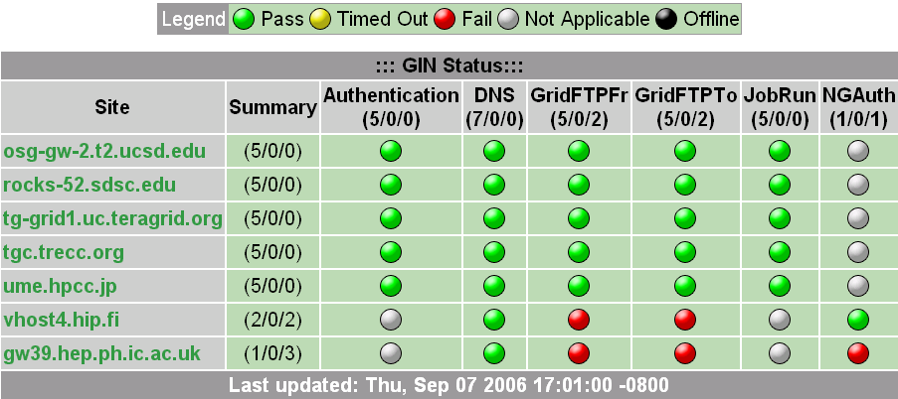
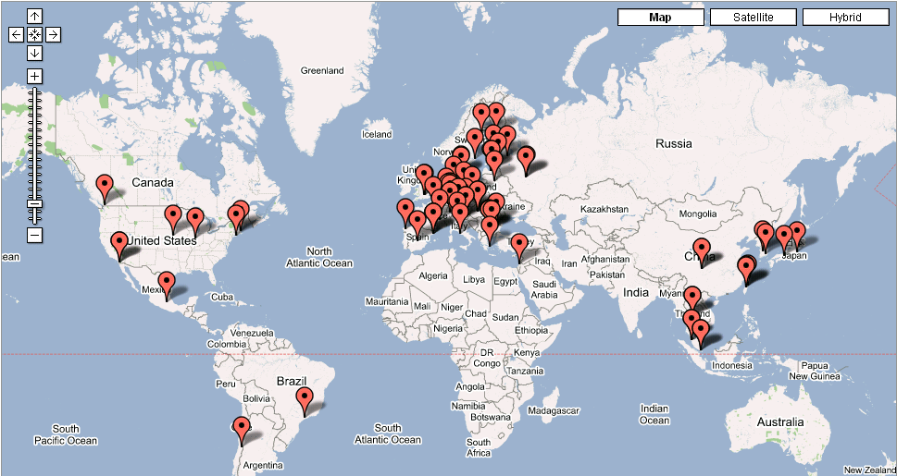

Grid Interoperation Now (GIN) http://forge.gridforum.org/sf/wiki/do/viewPage/projects.gin/wiki/GinOps
OGF – GIN-OPS
GIN testbed (February, 2006 – on-going)
TDDFT/Ninf-G (PRAGMA - AIST, Japan)
  PRAGMA, TeraGrid, OSG, NorduGrid; EGEE
Savanah fire simulation (PRAGMA - MU, Australia)
  PRAGMA, TeraGrid, OSG
Multi-Grid monitoring
  SCMSWeb probe matrix (PRAGMA - ThaiGrid, Thailand)
  Common schema (PRAGMA, TeraGrid, EGEE, NorduGrid)

Slide 12


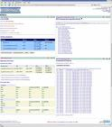
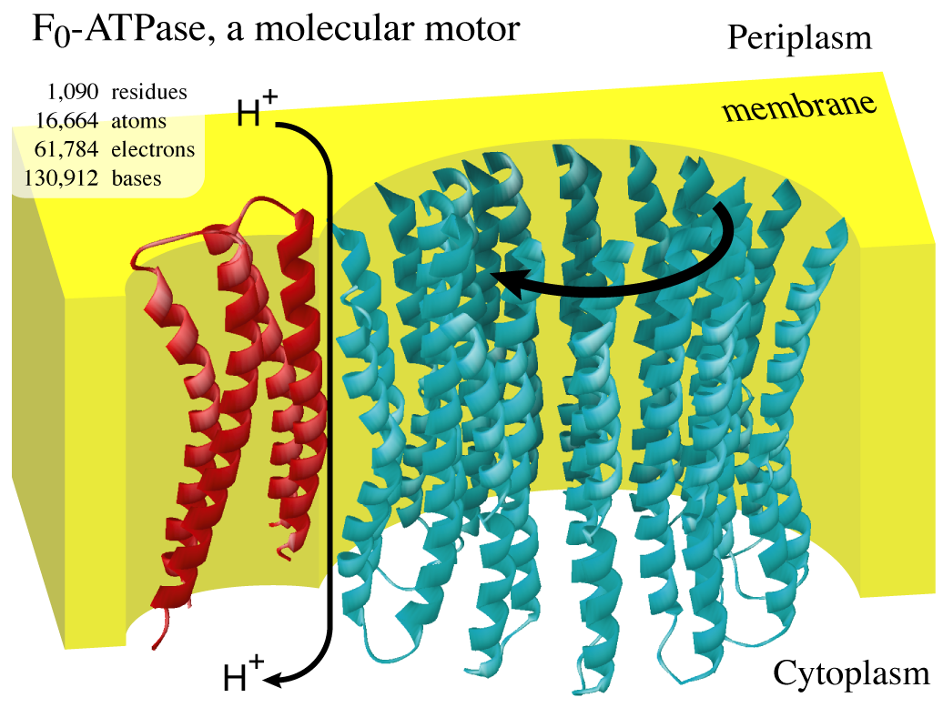
Peer-grid Interoperation Experiments http://goc.pragma-grid.net/wiki/index.php/Main_Page#Grid_Inter-operations
PRAGMA->TeraGrid (October, 2006 – on-going)
  PRAGMA member runs application across both grids
  QM/MD/Ninf-G (AIST, Japan)
  Manual reservation, 7 sites in PRAGMA, 3 sites in TeraGrid
OSG<->PRAGMA (January, 2007 – on-going)
  VDT and Rocks integration
  Members from both grids run applications across both grids

Slide 13
Collaborate in Publishing Research Results
Some published papers in 2006:
Arzberger P, Papadopoulos P. PRAGMA: Example of Grass-Roots Grid Promoting Collaborative EScience Teams. CTWatch. Vol 2, No. 1 Feb 2006. www.ctwatch.org/quarterly/articles/2006/02/pragmaexample-of-grass-roots-grid-promoting-collaborativee-science-teams
Abramson D, Lynch A, Takemiya H, Tanimura Y, Date S, Nakamura H, Jeong K, Hwang S, Zhu J, Lu Z, Amoreira C, Baldridge K, Lee H, Wang C, Shih HL, Molina T, Li, W, Arzberger P. Deploying Scientific Applications on the PRAGMA Grid testbed: Ways, Means and Lessons. IEEE/CCGRID International Workshop on Grid Computing, 2006, Singapore.
Lee B-S, Tang M, Zhang J, Soon O Y, Zheng C, Arzberger P. Analysis of Jobs on a Multi-Organizational Grid Testbed. IEEE/CCGRID Int’l Workshop on Grid Computing, 2006, Singapore.
Zheng C, Abramson D, Arzberger P, Ayuub S, Enticott C, Garic S, Katz M, Kwak J, Lee B S, Papadopoulos P, Phatanapherom S, Sriprayoonsakul S, Tanaka Y, Tanimura Y, Tatebe O, Uthayopas P. The PRAGMA Testbed: Building a Multi-Application International Grid. 2005 IEEE/CCGRID International Workshop on Grid Computing, 2006, Singapore.
Li WW, Arzberger PW, Yeo CL, Ang L, Tatebe O, Sekiguchi S, Jeong K, Wuang S, Date S, Kwak JH. Proteome Analysis Using iGAP in Gfarm. The Second International Life Science Grid Workshop 2005, Grid Asia 2005, Singapore 2005.
Wei X, Ding Z, Li W W, Tatebe O, Jiang J, et al. GDIA: A Scalable Grid Infrastructure for Data Intensive Applications. IEEE Int’l Conference on Hybrid Information Technology, ICHIT 2006, Cheju Island, Korea.
Krishnan S, Baldridge K K, Greenberg J. P, Stearn B, Bhatia K. An End-to-End Web Services-Based Infrastructure for Biomedical Applications. Proceedings of Grid 2005, 6th IEEE/ACM Int’l Workshop on Grid Computing, November 13-14, 2005, Seattle, WA, U.S.
…

Slide 14
PRAGMA Grid Collaborations Benefits
Form and leverage rich resources
Form and leverage collaboration networks
Enhance software quality and usability
Enhance vision and involvement
Enhance research visibility and software dissemination
Enhance funding positions

Slide 15
Form and Leverage Rich Resources
Heterogeneous global grid
  31 clusters, 28 institutions, 14 countries, >900 cpus, >900GB memory, >23TB user disk space
  Contribution big or small
  Access everything immediately
  Example: USM
Technologies and expertise
  Develop, test, integrate, collaborate
  Learn and adopt with best help
  Example: UChile
    Purchase, Rocks, Naregi-CA, SCMSWeb, Gfarm, …
    Organize, collaborate, CLGrid

Slide 16
Form and Leverage Collaboration Networks
Geosciences Network (GeoN)
  From US-based, going global
  PRAGMA grid geosciences sites
    AIST, Japan
    GUCAS, CNIC, China
    SDSC, USA
    UoHyd, India
  Geogrid workgroup
  Conjoint workshops
Global Lake Ecological Observetory Network (GLEON)
Community Cyberinfrastructure for Advanced Microbial Ecology Research and Analysis (CAMERA)

Slide 17
Enhance Software Quality and Usability
From familiar local grid environment to heterogeneous global grid
Feedbacks from diverse user communities
Fault-tolerance (ie. Ninf-g)
Deployment (ie. MOGAS)
Performance and interoperation (ie. Gfarm)
Functionalities and user friendly (ie. SCMSWeb)
Speed up development
Enhance middleware

Slide 18
Enhance Vision and Involvement
Learning and collaborating
  New possibilities
  New discoveries
  New directions
Example
  SCMSWeb
    Cluster -> grid -> multi-grid
    Integrate accounting, network performance, …
    Common schema among grid monitors

Slide 19
Enhance Research Visibility and Software Dissemination
Global exposure
Users learn/contribute hands-on
Local grids adopts quality software
  Naregi-ca
    APGrid, UCSD, Chile, …
  SCMSWeb
    GIN-OPS, Chile, …
  Gfarm
    Chile, Puerto Rico,

Slide 20
Enhance Funding Positions
PRAGMA’s track records and growth
Significant, effective, visible collaborations
Increase funding sources and prospects
Many sites got new or renewed fundings
  PRAGMA, Mexico, Chile, Thailand, …
In turn, help PRAGMA grow

Slide 21


























Join us
PRAGMA Grid
Run applications
Work on grid technologies
Grid interoperaton
http://goc.pragma-grid.net
http://goc.pragma-grid.net/wiki
Thank You

