Slide 1

The PRAGMA Testbed
Building a Multi-Application International Grid
San Diego Supercomputer Center / University of California, San Diego, USA
Cindy Zheng, Peter Arzberger, Mason J. Katz , Phil M. Papadopoulos
Monash University, Australia
David Abramson, Shahaan Ayyub, Colin Enticott, Slavisa Garic
National Institute of Advanced Industrial Science and Technology, Japan
Yoshio Tanaka, Yusuke Tanimura, Osamu Tatebe
Kasetsart University, Thailand
Putchong Uthayopas, Sugree Phatanapherom, Somsak Sriprayoonsakul
Nanyang Technological University, Singapore
Bu Sung Lee
Korea Instritute and Science and Technology Information, Korea
Jae-Hyuck Kwak
Pacific Rim Application and Grid Middleware Assembly
http://www.pragma-grid.net

Slide 2
PRAGMA and Testbed
PRAGMA (2002 - ) <http://www.pragma-grid.net>
  Open international organization
  Grid applications, practical issues
  Build international scientific collaborations
Resources working group
  middleware interoperability
  Global grid usability and productivity
Routine-use experiments and testbed (2004 - ) <http://goc.pragma-grid.net>
  Grass-roots, PRAGMA membership not necessary, work, long term
  Multiple real science applications run on routine-basis
    TDDFT, Savannah, QM-MD, iGAP, Gamess-APBS, Siesta, Amber, FMO, HPM (GEON, Sensor, … <data, sensor>)
    Ninf-G, Nimrod/G, Mpich-Gx, Gfarm, SCMSWeb, MOGAS
  Issues, solutions, collaborations, interoperate

Slide 3
Grid interoperation Now (GIN) http://goc.pragma-grid.net/gin
PRAGMA, TeraGrid, EGEE, …
Applications/Middleware
  TDDFT/Ninf-G
Lessons Learned
  Software interoperability
  Authentication
  Community Software Area
  Cross-Grid monitoring

Slide 4
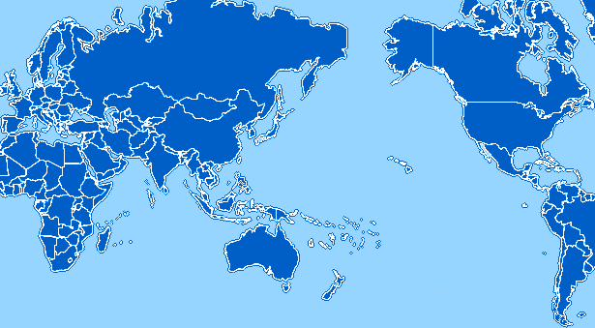
PRAGMA Grid Testbed
UZurich, Switzerland
KISTI, Korea
JLU, China
TITECH, Japan
NCSA, USA
CNIC, China
AIST, Japan
KU, Thailand
SDSC, USA
OSAKAU, Japan
UoHyd, India
NCHC, Taiwan
CICESE, Mexico
USM, Malaysia
ASCC, Taiwan
UNAM, Mexico
MIMOS, Malaysia
IOIT-HCM, Vietnam
BII, Singapore
QUT, Australia
NGO, Singapore
MU, Australia
UChile, Chile
5 continents, 14 countries, 25 organizations, 28 clusters

Slide 5
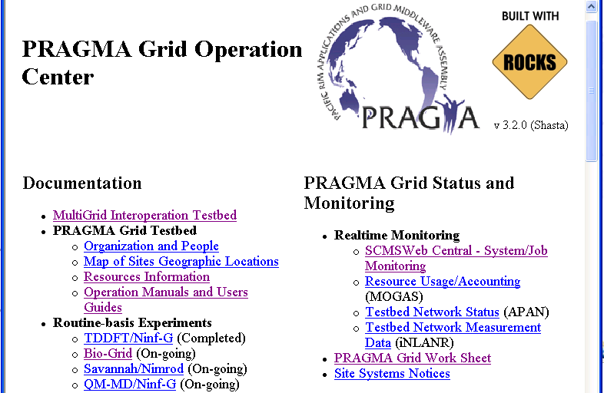
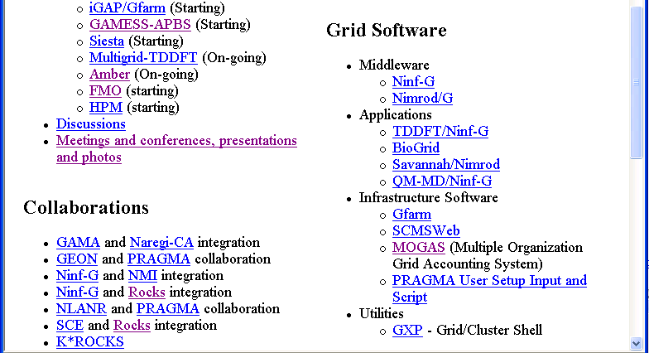
Lessons Learned
Heterogeneity
  fundings, policies, environments
Motivation
  learn, develop, test, interop
Communication
  email, VTC, Skype, workshop, timezone, language
Create operation procedures
  joining testbed
  running applications
http://goc.pragma-grid.net
  resources, contacts, instructions, monitoring, etc.

Slide 6
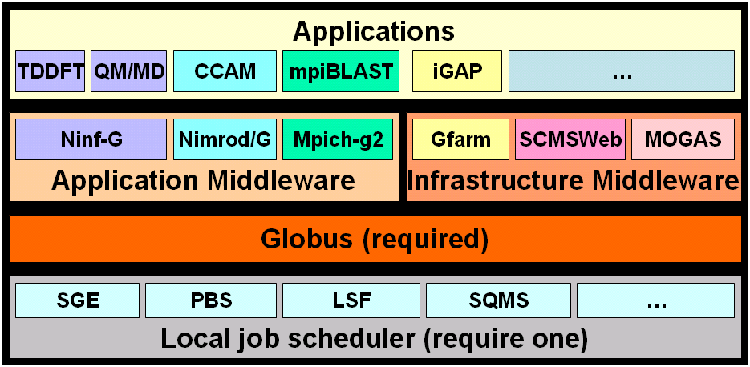
Software Layers and Trust
Trust all sites CAs
Experimental -> production
Grid Interoperation Now
APGRID PMA, IGTF (5 accr.)
PRAGMA CA
Community Software Area

Slide 7


Application Middleware
Ninf-G <http://ninf.apgrid.org>
  Support GridRPC model which will be a GGF standard
  Integrated to NMI release 8 (first non-US software in NMI)
  Ninf roll for Rocks 4.x is also available
  On PRAGMA testbed, TDDFT and QM/MD application achieved long time executions (1 week ~ 50 days runs).
Nimrod <http://www.csse.monash.edu.au/~davida/nimrod>
  Supports large scale parameter sweeps on Grid infrastructure
    Study the behaviour of some of the output variables against a range of different input scenarios.
    Computer parameters that optimize model output
    Computations are uncoupled (file transfer)
    Allows robust analysis and more realistic simulations
    Very wide range of applications from quantum chemistry to public health policy
  Climate experiment ran some 90 different scenarios of 6 weeks each

Slide 8
GridRPC: A Programming Model based on RPC
GridRPC API is a proposed recommendation at the GGF
Three components
  Information Manager - Manages and provides interface info
  Client Component - Manages remote executables via function handles
  Remote Executables - Dynamically generated on remote servers
Built on top of Globus Toolkit (MDS, GRAM, GSI)
Simple and easy-to-use programming interface
  Hiding complicated mechanism of the grid
  Providing RPC semantics
・・・・
Func. Handle
Server
・・・・
・・・・
Client
Compuer
・・・・
Server
Client
Component
・・・・
・・・・
Server
Info. Manager
Remote Executables

Slide 9
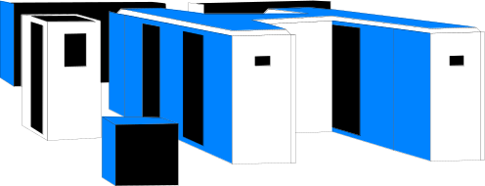


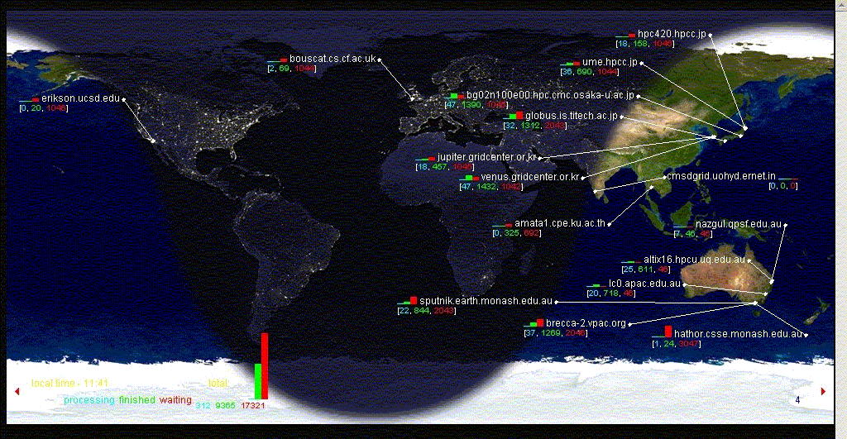
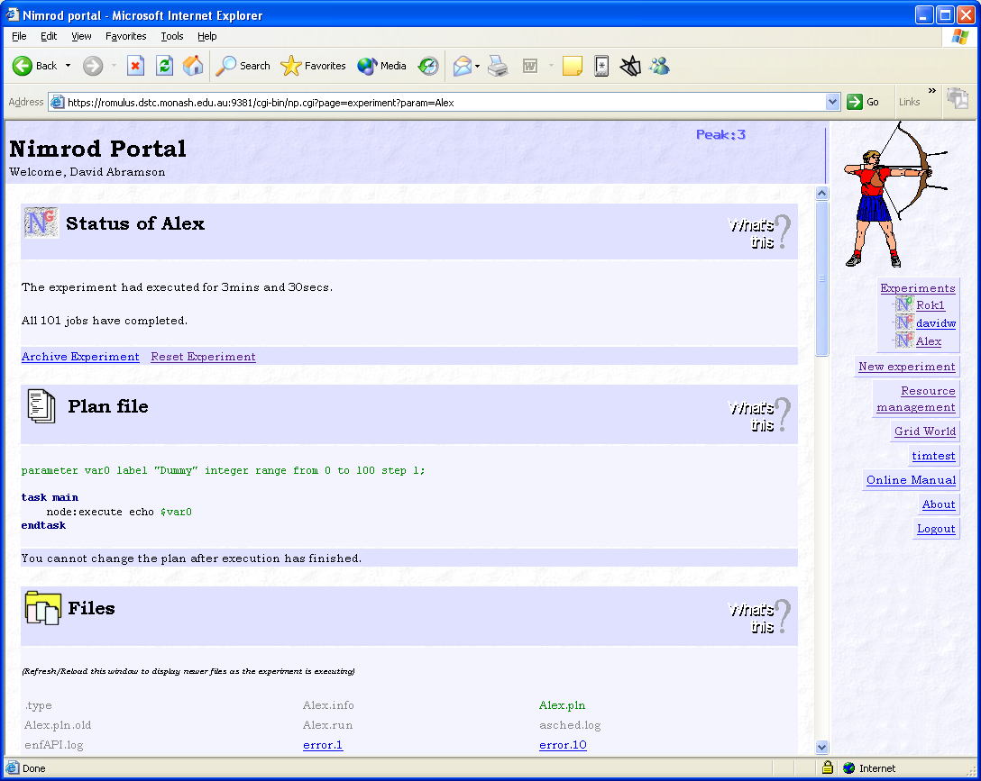

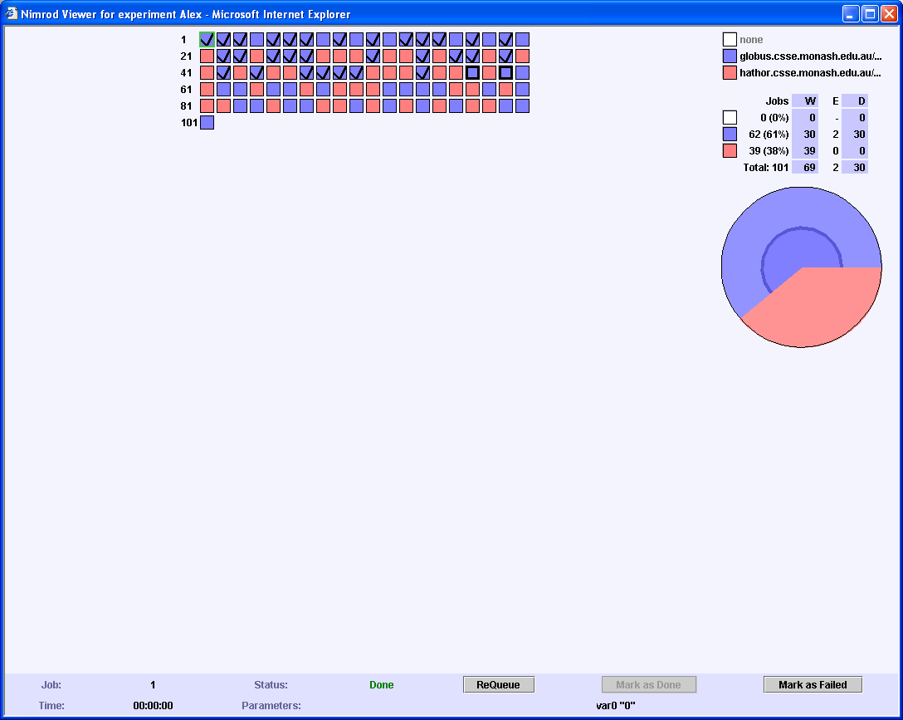
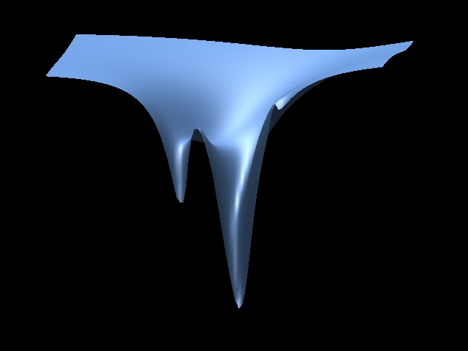

Nimrod Development Cycle
Sent to available machines
Prepare Jobs using Portal
Results displayed & interpreted
Jobs Scheduled Executed Dynamically

Slide 10
Fault-Tolerance Enhanced
Ninf-G monitors each RPC call
  Return error code for failures
    Explicit Faults : Server down, Disconnection of network
    Implicit Faults : Jobs not activated, unknown faults
    Timeout - grpc_wait*()
  Retry/restart
Nimrod/G monitors remote services and restarts failed jobs
  Long jobs are split into many sequentially dependent jobs which can be restarted
    using sequential parameters called seqameters
Improvement in the routine-basis experiment
  developers test code on heterogeneous global grid
  results guide developers to improve detection and handle faults

Slide 11
Application Setup and Resource Management
Heterogeneous platforms
  Manual build, deploy applications, manage resources
    Labor intensive, time consuming, tidious
Middleware solutions
  For deployment
    Automatic distribution of executables use staging functions
  For resource management
    Ninf-G client configuration allow description of server attributes
      Port number of the Globus gatekeeper
      Local scheduler type
      Queue name for submitting jobs
      Protocol for data transfer
      Library path for dynamic linking
    Nimrod/G portal allows a user to generate a testbed and helps maintain information about resources, including use of different certificates.

Slide 12
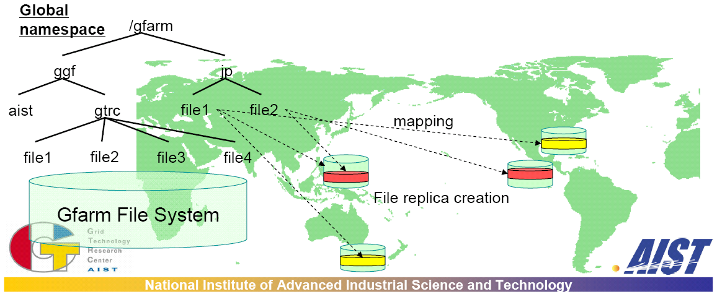
Gfarm in PRAGMA Testbed http://datafarm.apgrid.org
High performance Grid file system that federates file systems in multiple cluster nodes
  SDSC (US) 60GB (10 I/O nodes, local disk)
  NCSA (US) 1444GB (13 I/O nodes, NFS)
  AIST (Japan) 1512GB (28 I/O nodes, local disk)
  KISTI (Korea) 570GB (15 I/O nodes, local disk)
  SINICA (Taiwan) 189GB (3 I/O nodes, local disk)
  NCHC (Taiwan) 11GB (1 I/O node, local disk)
  Total : 3786 GBytes, 1527 MB/sec (70 I/O nodes)

Slide 13
Application Benefit
No modification required
  Existing legacy application can access files in Gfarm file system without any modification
Easy application deployment
  Install Application in Gfarm file system, run everywhere
    It supports binary execution and shared library loading
    Different kinds of binaries can be stored at the same pathname, which will be automatically selected depending on client architecture
Fault tolerance
  Automatic selection of file replicas in access time tolerates disk and network failure
File sharing – Community Software Area

Slide 14
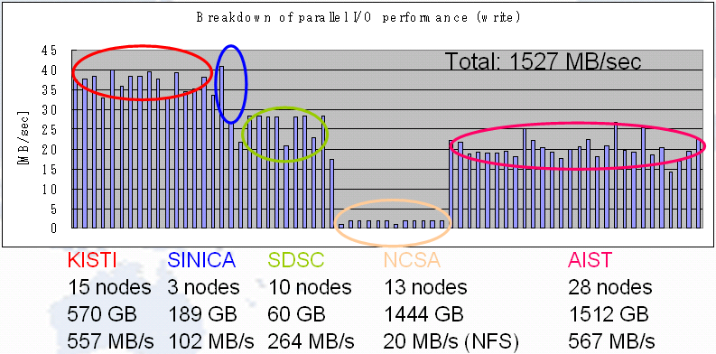
Performance Enhancements
Directory listing of 16,393 files
Performance for small files
Improve meta-cache management
add meta-cache server
Original | Improved metadata management | W/ metadata cache server
44.0 | 3.54 | 1.69

Slide 15
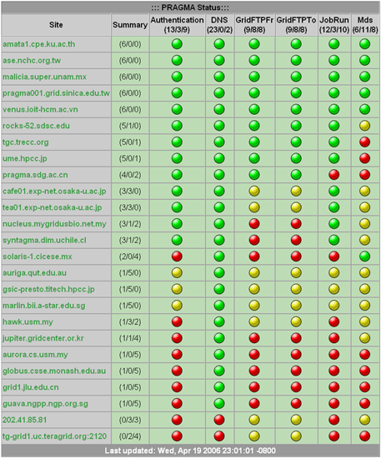
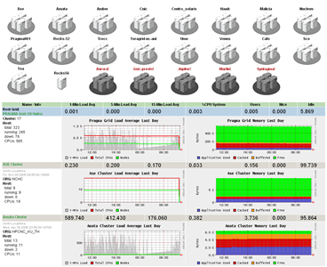
SCMSWeb http://www.opensce.org/components/SCMSWeb
Web-based monitoring system for clusters and grid
  System usage
  Performance metrics
Reliability
  Grid service monitoring
  Spot problems at a glance

Slide 16
PRAGMA-Driven Development
Heterogeneity
  Add platform support
    Solaris (CICESE, Mexico)
    IA64 (CNIC, China)
Software deployment
  NPACI Rocks Roll
    Support ROCKS 3.3.0 – 4.1
  Native Linux RPM for various Linux platform
Enhancement
  Hierarchical monitoring on large scale Grid
  Compress data exchange between Grid side
    For some site with slow network
  Better and cleaner graphics user interfaces
Standardize & more collaboration
  GRMAP (Grid Resource Management & Account Project) – Collaboration between NTU and TNGC
  GIN (Grid Interoperation Now) Monitoring – standardize data exchange between monitoring softwares

Slide 17
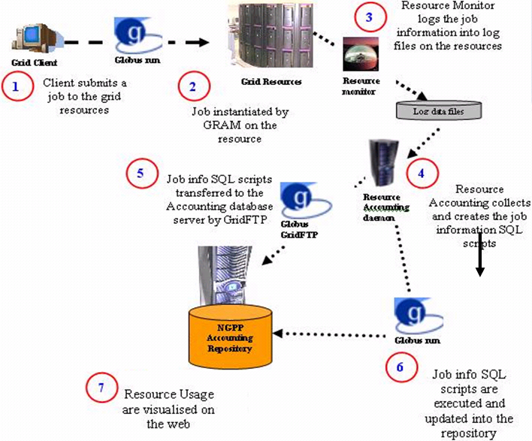
Multi-organisation Grid Accounting System http://ntu-cg.ntu.edu.sg/pragma

Slide 18
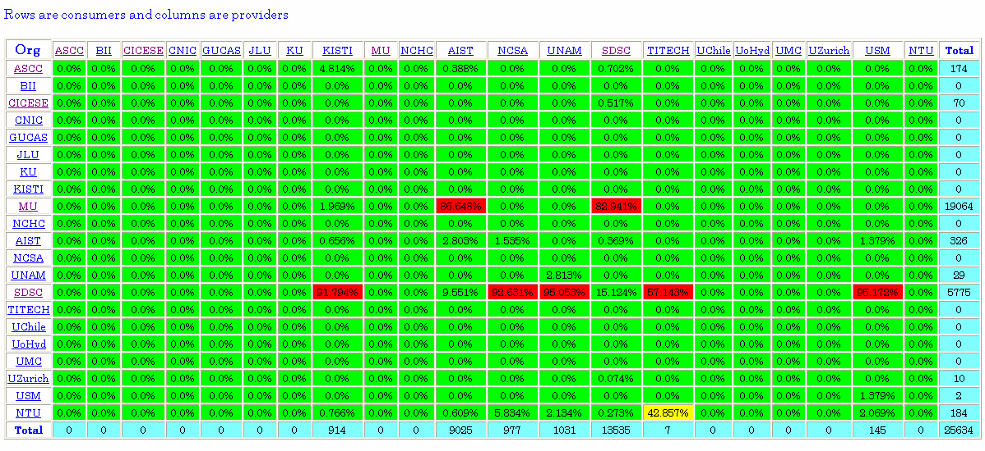
MOGAS Web information
Information for grid resource managers/administrators:
  Resource usage based on organization
  Daily, weekly, monthly, yearly records
  Resource usage based on project/individual/organisation
  Individual log of jobs
  Metering and charging tool, can decide a pricing system, e.g.
  Price = f(hardware specifications, software license, usage measurement)

Slide 19
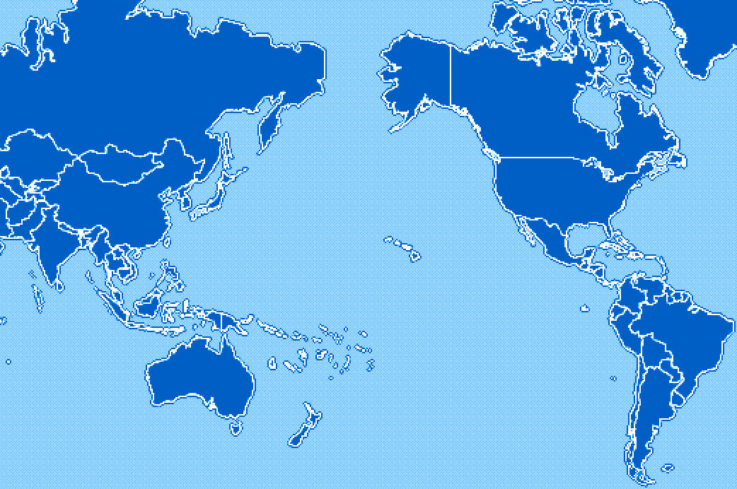
PRAGMA MOGAS status
(27/3/2006)
KISTI, Korea
NCSA, USA
CNIC, China
AIST, Japan
SDSC, USA
TITECH, Japan
UoHyd, India
NCHC, Taiwan
CICESE, Mexico
ASCC, Taiwan
KU, Thailand
UNAM, Mexico
IOIT-HCM
USM, Malaysia
MIMOS
BII, Singapore
QUT
UChile, Chile
MU, Australia
NGO, Singapore
GT4
GT2
Cindy Zheng, GGF13, 3/14/05 modified by A/Prof. Bu-Sung Lee

Slide 20

























Thank You
Pointers
PRAGMA: http://www.pragma-grid.net
PRAGMA Testbed: http://goc.pragma-grid.net
“PRAGMA: Example of Grass-Roots Grid Promoting Collaborative e-science Teams. CTWatch. Vol 2, No. 1 Feb 2006
“The PRAGMA testbed – Building a Multi-application International Grid”, CCGrid2006
“Deploying Scientific Applications to the PRAGMA Grid Testbed: Strategies and Lessons”, CCGrid2006
MOGAS: “Analysis of Job in a Multi-Organizational Grid Test-bed”, CCGrid2006

Slide 21
Q & A
PRAGMA testbed – Cindy Zheng
Middleware: Ninf-G – Yoshio Tanaka
Grid file system: Gfarm – Osamu Tatebe
Grid monitoring: SCMSWeb – Somsak Sriprayoonsakul
Grid accounting: MOGAS – Francis Lee

