Slide 1

Building the PRAGMA Grid
Through Routine-basis Experiments
Cindy Zheng, SDSC, USA
Yusuke Tanimura, AIST, Japan
Pacific Rim Application Grid Middleware Assembly
http://pragma-goc.rocksclusters.org

Slide 2
Overview
PRAGMA
Routine-basis experiments
PRAGMA Grid testbed
Grid applications
Lessons learned
Technologies tested/deployed/planned
Case study: First experiment
By Yusuke Tanimura at AIST, Japan
Cindy Zheng, GGF13, 3/14/05

Slide 3

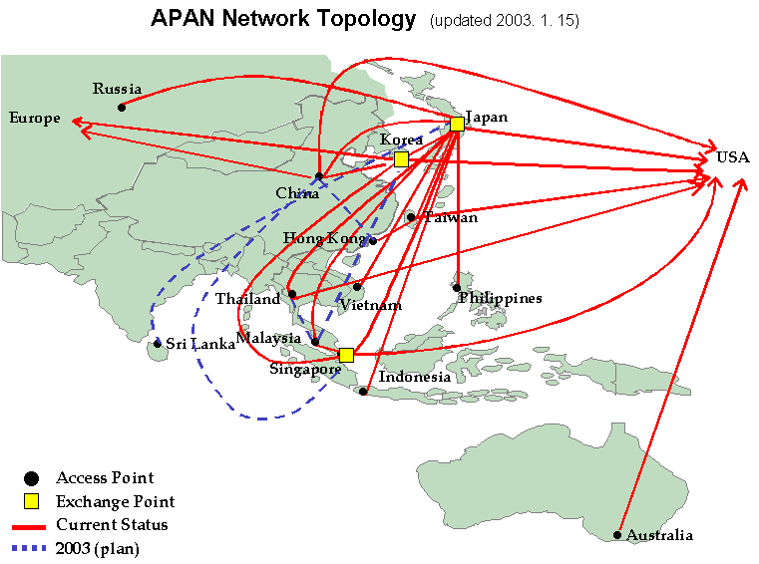






















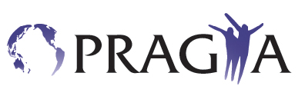






PRAGMA PARTNERS
Affiliate Member

Slide 4
PRAGMA Overarching Goals
Establish sustained collaborations
and
Advance the use of the grid technologies for applications
among a community of investigators working with leading institutions around the Pacific Rim
Working closely with established activities
that promote grid activities or the underlying infrastructure,
both in the Pacific Rim and globally.
Cindy Zheng, GGF13, 3/14/05
Source: Peter Arzberger & Yoshio Tanaka
Notes:
Advance scientific applications
Contribute to the international development of the Grid
More productive and effective use of the Grid by researchers in the Pacific Rim
Increased collaboration on the Grid in the Pacific Rim
Greater interoperability of grid middleware
“And this global connectivity allows scientists like Mark Ellisman to control and obtain information from a microscopy in Japan”. Actually, Mark has been a pioneer in telescience, leading the charge to take advantage of the network and the larger microscopes in Japan to advance our science.”
Science, Technology, And Research Transit Access Point, or STAR TAP,
Europeans are pursuing building the internet infrastructure very aggresively
The Pacific Rim will be accelerating their growth in this arena.
About STAR TAP The Science, Technology, And Research Transit Access Point, or STAR TAP, is a proving ground for long-term interconnection and interoperability of advanced international networking. STAR TAP is made possible by major funding from the US National Science Foundation to the University of Illinois at Chicago. See: http://www.startap.net

Slide 5
Key Activities and Outcomes
Encourage and conduct joint (multilateral) projects that promote development of grid facilities and technologies
Share resources to ensure project success
Conduct multi-site training
Exchange researchers
Advance scientific applications
Create grid testbeds for regional e-science projects
Contribute to the international grid development efforts
Increase interoperability of grid middleware in Pacific Rim and throughout the world
Activities
Outcomes
Cindy Zheng, GGF13, 3/14/05
Source: Peter Arzberger & Yoshio Tanaka

Slide 6
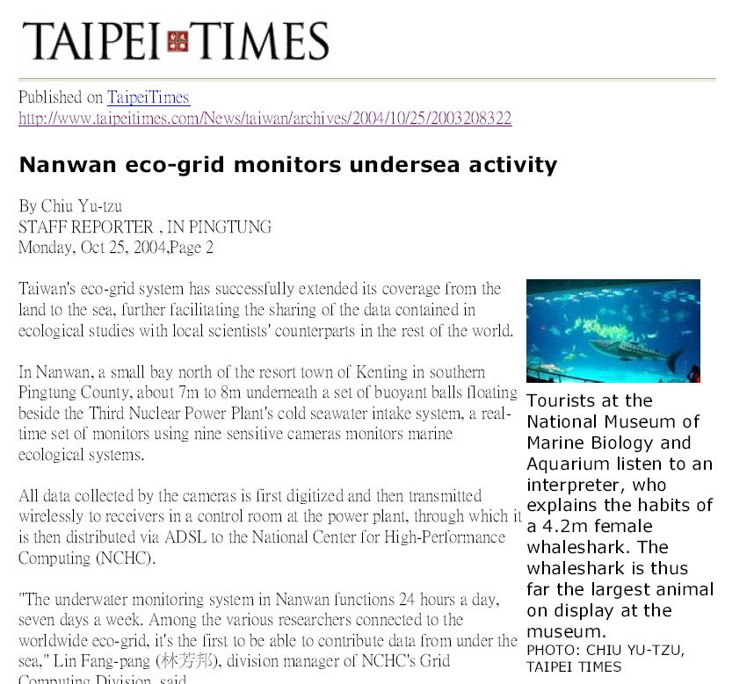
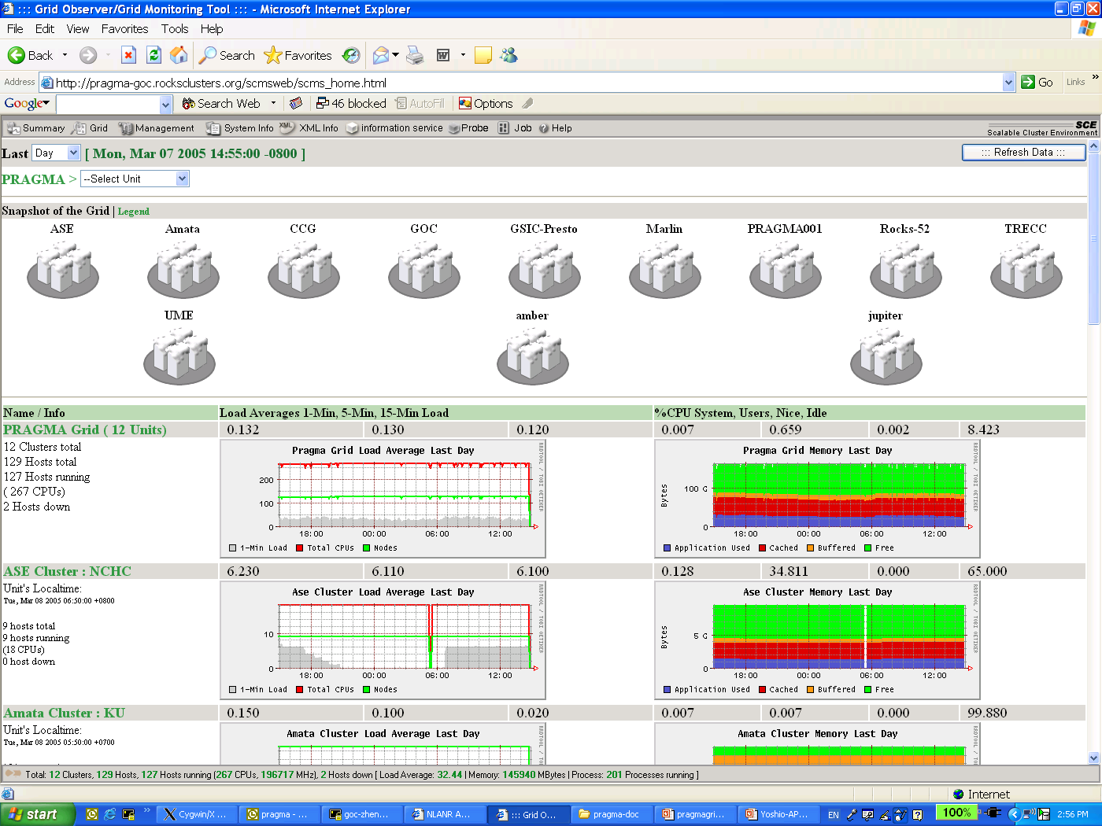
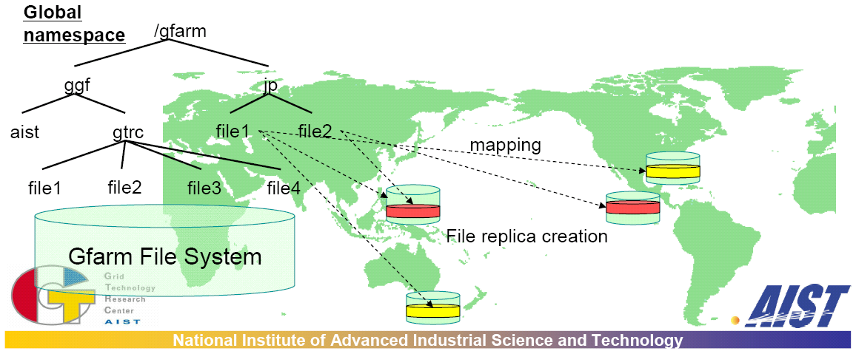
Working Groups: Integrating PRAGMA’s Diversity
Telescience – including Ecogrid
Biological Sciences:
  Proteome Analysis using iGAP in Gfarm
Data Computing
  Online Data Processing of KEKB/Belle Experimentation in Gfarm
Resources
  Grid Operations center
Cindy Zheng, GGF13, 3/14/05

Slide 7
PRAGMA Workshops
Semi-annual workshops
  USA, Korea, Japan, Australia, Taiwan, China
  May 2-4, Singapore (also Grid Asia 2005)
  October 20-23, India
Show results
Work on issues and problems
Make key decisions
Set a plan and mile stones for next ½ year

Slide 8
Interested in Join or Work with PRAGMA?
Come to PRAGMA workshop
  Learn about PRAGMA community
  Talk to the leaders
Work with some PRAGMA members (“established”)
  Join PRAGMA testbed
  Setup a project with some PRAGMA member institutions
Long term commitment (“sustained”)

Slide 9
Why Routine-basis Experiments?
Resources group Missions and goals
  Improve interoperability of Grid middleware
  Improve usability and productivity of global grid
PRAGMA from March, 2002 to May, 2004
  Computation resources
  10 countries/regions, 26 institutions, 27 clusters, 889 CPUs
  Technologies (Ninf-G, Nimrod, SCE, Gfarm, etc.)
  Collaboration projects (Gamess, EOL, etc.)
  Grid is still hard to use, especially global grid
How to make a global grid easy to use?
  More organized testbed operation
  Full-scale and integrated testing/research
  Long daily application runs
  Find problems, develop/research/test solutions
Cindy Zheng, GGF13, 3/14/05

Slide 10
Routine-basis Experiments
Initiated in May 2004 PRAGMA6 workshop
Testbed
  Voluntary contribution (8 -> 17)
  Computational resources first
  Production grid is the goal
Exercise with long-running sample applications
  TDDFT, mpiBlast-g2, Savannah,
  iGAP over Gfarm, (start soon)
  Ocean science, Geoscience (proposed)
Learn requirements/issues
Research/implement solutions
Improve application/middleware/infrastructure integrations
Collaboration, coordination, consensus
Cindy Zheng, GGF13, 3/14/05

Slide 11
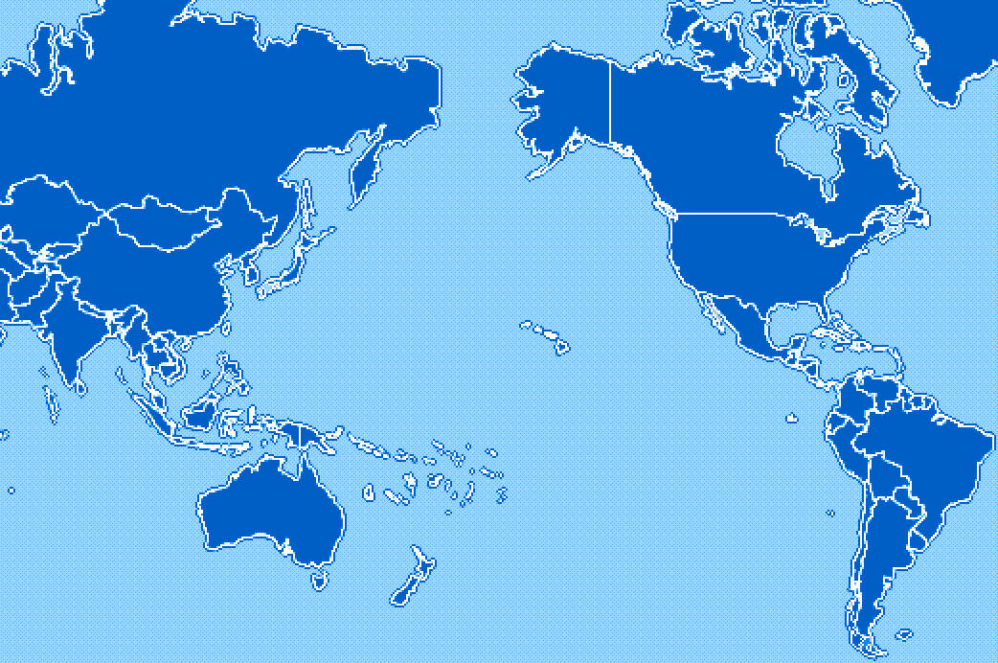
PRAGMA Grid Testbed
KISTI, Korea
NCSA, USA
CNIC, China
AIST, Japan
SDSC, USA
TITECH, Japan
UoHyd, India
NCHC, Taiwan
CICESE, Mexico
ASCC, Taiwan
KU, Thailand
UNAM, Mexico
USM, Malaysia
BII, Singapore
MU, Australia
UChile, Chile
Cindy Zheng, GGF13, 3/14/05

Slide 12
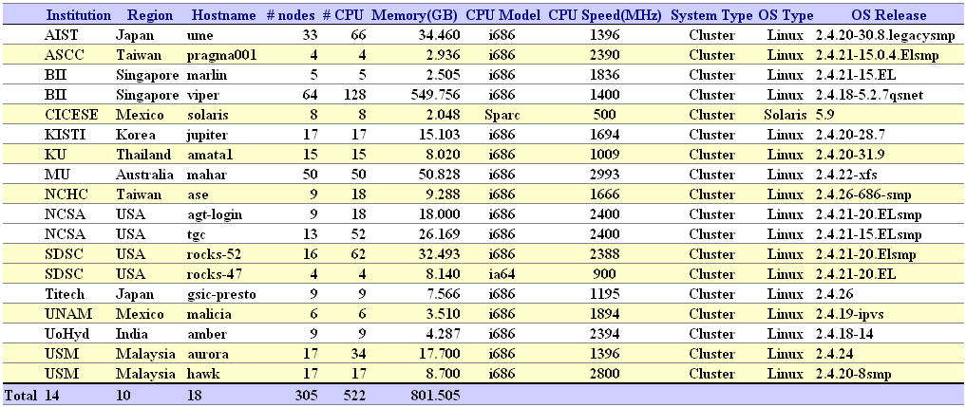
PRAGMA Grid resources http://pragma-goc.rocksclusters.org/pragma-doc/resources.html
Cindy Zheng, GGF13, 3/14/05

Slide 13
PRAGMA Grid Testbed – unique features –
Physical resources
  Most contributed resources are small-scale clusters
  Networking is there, however some bandwidth is not enough
Truly (naturally) multi national/political/institutional VO beyond boundaries
  Not an application-dedicated testbed – general platform
  Diversity of languages, culture, policy, interests, …
Grid BYO – Grass roots approach
  Each institution contributes his resources for sharing
  Not a single source funded for the development
We can
  have experiences on running international VO
  verify the feasibility of this approach for the testbed development
Source: Peter Arzberger & Yoshio Tanaka

Slide 14
Interested in join PRAGMA Testbed?
Does not have to be a PRAGMA member institution
Long term commitment
Contribute
  Computational resources
  Human resources
  Other
Share
Collaborate
Contact Cindy Zheng (zhengc@sdsc.edu)

Slide 15
Progress at a Glance
May
June
July
Aug
Sep
Oct
Nov
Dec
Jan
2 sites
5 sites
8 sites
10 sites
12 sites
14 sites
2nd user start executions
3rd App. start
1st App. start
1st App. end
2nd App. start
Setup Resource Monitor (SCMSWeb)
PRAGMA6
Setup Grid
Operation Center
PRAGMA7
SC’04
On-going works
1. Site admins install required software
2. Site admins create users accounts (CA, DN, SSH, firewall)
3. Users test access
4. Users deploy application codes
5. Users perform simple tests at local sites
6. Users perform simple tests between 2 sites
Join in the main executions (long runs) after all’s done

Slide 16

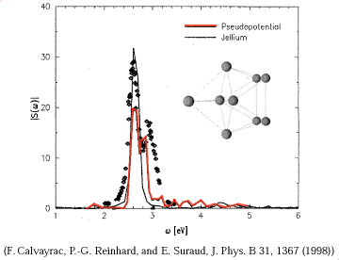

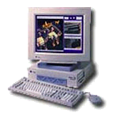

1st application
Time-Dependent Density Functional Theory (TDDFT)
Computational quantum chemistry application
Driver: Yusuke Tanimura (AIST, Japan)
Require GT2, Fortran 7 or 8, Ninf-G
6/1/04 ~ 8/31/04
gatekeeper
Cluster 1
Sequential program
Exec func() on backends
Client
Server
tddft_func()
Client program of TDDFT
main(){
:
grpc_function_handle_default(
&server, “tddft_func”);
:
grpc_call(&server, input, result);
:
4.87MB
3.25MB
Cluster 2
GridRPC
Cluster 3
Cluster 4
user
http://pragma-goc.rocksclusters.org/tddft/default.html

Slide 17

2nd Application – mpiBLAST-g2
A DNA and Protein sequence/database alignment tool
Drivers: Hurng-Chun Lee, Chi-Wei Wong (ASCC, Taiwan)
Application requirements
  Globus
  Mpich-g2
  NCBI est_human, toolbox library
  Public ip for all nodes
Started 9/20/04
SC04 demo
Automate installation/setup/testing
http://pragma-goc.rocksclusters.org/biogrid/default.html
Notes:
How many people knows the BLAST? It’s should be a very famous application in biology.
Think about the question … if you have a very large DNA sequence composed by four characters, say A, G, C, and T. and you have no any other information about this DNA. How will you do to identify the genes on it? The solution here is very simple. The researchers can do a lot of experiments to sequence a lot of the known gene fragments from cells. These fragments are collected to be a EST database. Then they do the alignment between the DNA sequence and the EST database. and BLAST is the tool to give us the help!!
So blast is …
<The first two items>
Because biologists may need to do the BLAST alignment everyday and they may send it multiple sequences for alignment. Throughput is the key issue for providing services
The original BLAST can be run only on single machine, so it has some limitations, such as:
- Not scalable
- Low throughput
- Unable to handle large dataset

Slide 18
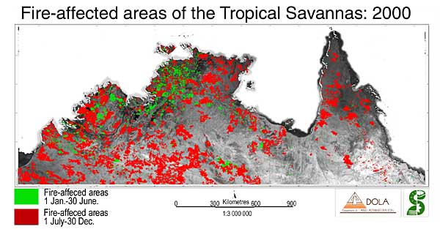
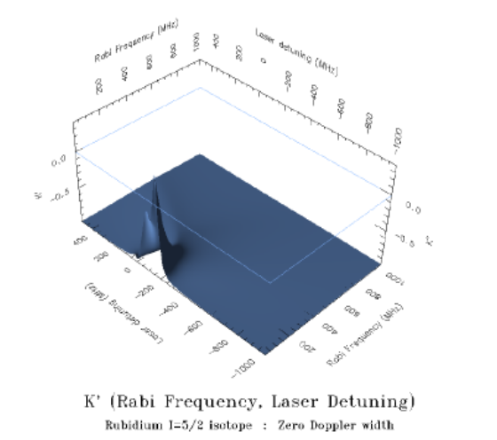
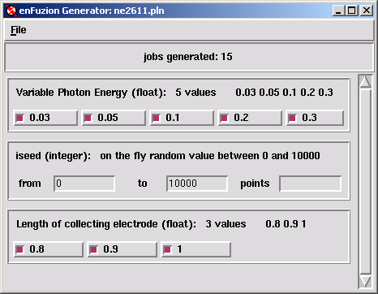
3rd Application – Savannah Case Study
Study of Savannah fire impact on northern Australian climate
- Climate simulation model
- 1.5 month CPU * 90 experiments
- Started 1/3/05
- Driver: Colin Enticott (Monash University, Australia)
- Requires GT2
- Based on Nimrod/G
Job 1
Job 2
Job 3
Job 4
Job 5
Job 6
Job 7
Job 8
Job 9
Description
of Parameters
PLAN FILE
Job 10
Job 11
Job 12
Job 13
Job 14
Job 15
Job 16
Job 17
Job 18
http://pragma-goc.rocksclusters.org/savannah/default.html

Slide 19
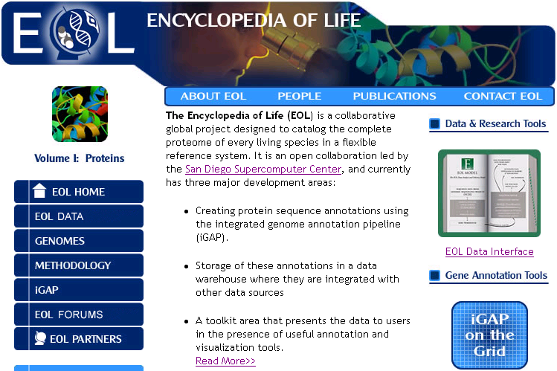
4th Application – iGAP/Gfarm
iGAP and EOL (SDSC, USA)
  Genome annotation pipeline
Gfarm – Grid file system (AIST, Japan)
Demo in SC04 (SDSC, AIST, BII)
Plan to start in testbed February 2005

Slide 20
More Applications
Proposed applications
  Ocean Science
  Geoscience
Lack of grid-enabled scientific applications
  Hands-on training (users + middleware developers)
  Access to grid testbed
  Middleware needs improvement
Interested in running applications in PRAGMA testbed?
  We like to hear, email zhengc@sdsc.edu
    Application descriptions/requirements
    Resources can be committed to testbed
  Decisions are not made by PRAGMA leaders
  http://pragma-goc.rocksclusters.org/pragma-doc/userguide/join.html

Slide 21
Lessons Learned http://pragma-goc.rocksclusters.org/tddft/Lessons.htm
Information sharing
Trust and access (Naregi-CA, Gridsphere)
Grid software installation (Rocks)
Resource requirements (NCSA script, INCA)
User/application environment (Gfarm)
Job submission (Portal/service/middleware)
System/job monitoring (SCMSWeb)
Network monitoring (APAN, NLANR)
Resource/job accounting (NTU)
Fault tolerance (Ninf-G, Nimrod)
Collaborations

Slide 22

Ninf-G
A reference implementation of the standard GridRPC API
http://ninf.apgrid.org
Sequential program
Server
Lead by AIST, Japan
Enable applications for Grid Computing
Adapts effectively to wide variety of applications, system environments
Built on the Globus Toolkit
Support most UNIX flavors
Easy and simple API
Improved fault-tolerance
Soon to be included in NMI, Rocks distributions
Client
gatekeeper
Cluster 1
Exec func() on backends
client_func()
Cluster 2
Client
program
GridRPC
Cluster 3
Cluster 4
user

Slide 23

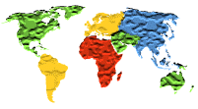
Nimrod/G http://www.csse.monash.edu.au/~davida/nimrod
- Lead by Monash University, Australia
- Enable applications for grid computing
- Distributed parametric modeling
  Generate parameter sweep
  Manage job distribution
  Monitor jobs
  Collate results
- Built on the Globus Toolkit
- Support Linux, Solaris, Darwin
- Well automated
- Robust, portable, restart
Description
of Parameters
PLAN FILE
Job 1
Job 2
Job 3
Job 4
Job 5
Job 6
Job 7
Job 8
Job 9
Job 10
Job 11
Job 12
Job 13
Job 14
Job 15
Job 16
Job 17
Job 18

Slide 24

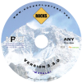
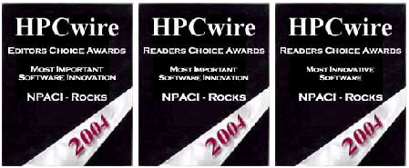










Rocks
Open Source High Performance Linux Cluster Solution http://www.rocksclusters.org
Make clusters easy. Scientists can do it.
A cluster on a CD
  Red Hat Linux, Clustering software (PBS, SGE, Ganglia, NMI)
  Highly programmatic software configuration management
  x86, x86_64 (Opteron, Nacona), Itanium
Korea localized version: KROCKS (KISTI)
http://krocks.cluster.or.kr/Rocks/
Optional/integrated software rolls
  Scalable Computing Environment (SCE) Roll (Kasetsart University, Thailand)
  Ninf-G (AIST, Japan)
  Gfarm (AIST, Japan)
  BIRN, CTBP, EOL, GEON, NBCR, OptIPuter
Production Quality
  First release in 2000, current 3.3.0
  Worldwide installations
  4 installations in testbed
HPCWire Awards (2004)
  Most Important Software Innovation - Editors Choice
  Most Important Software Innovation - Readers Choice
  Most Innovative Software - Readers Choice
Source: Mason Katz

Slide 25
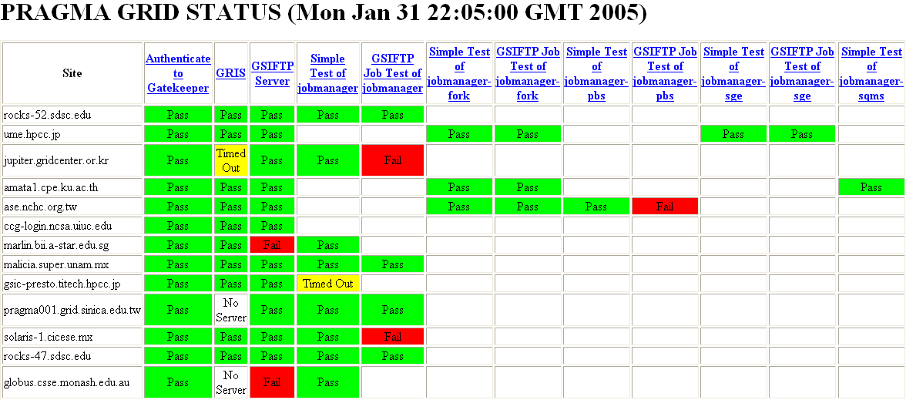
System Requirement Realtime Monitoring
NCSA, Perl script, http://grid.ncsa.uiuc.edu/test/grid-status-test/
Modify, run as a cron job.
Simple, quick
http://rocks-52.sdsc.edu/pragma-grid-status.html

Slide 26
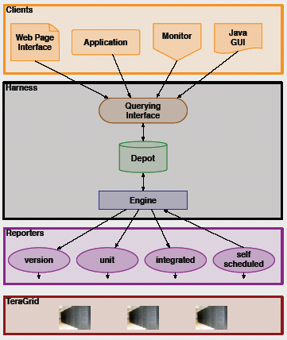
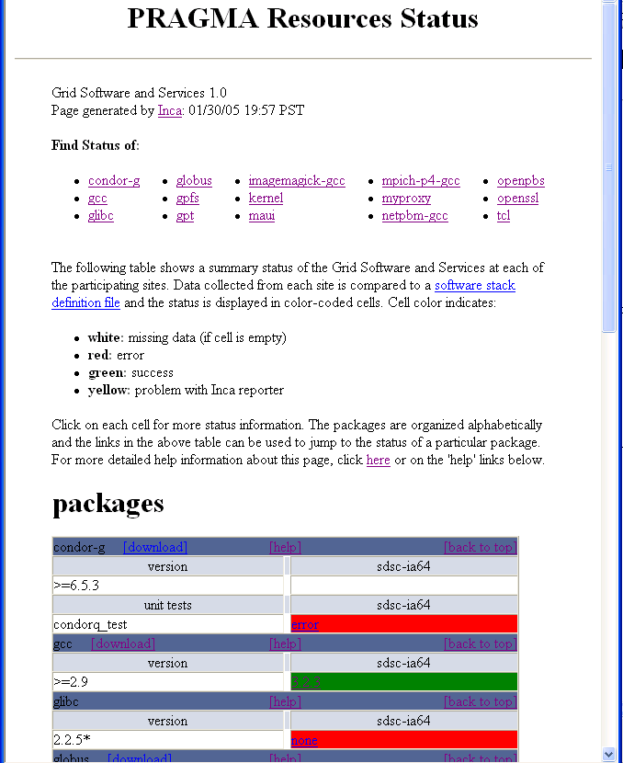
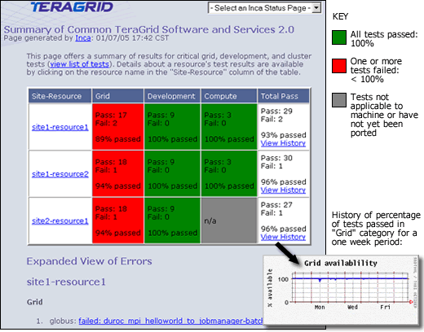
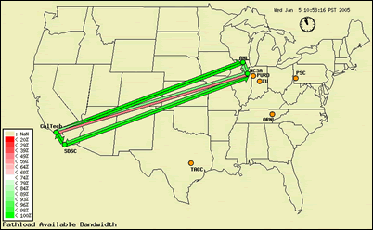
INCA
Framework for automated Grid testing/monitoring http://inca.sdsc.edu/
- Part of TeraGrid Project, by SDSC
- Full-mesh testing, reporting, web display
- Can include any tests
- Flexibility and configurability
- Run in user space
- Currently in beta testing
- Require Perl, Java
- Being tested on a few testbed systems

Slide 27
Gfarm – Grid Virtual File System http://datafarm.apgrid.org/
Lead by AIST, Japan
High transfer rate (parallel transfer, localization)
Scalable
File replication – user/application setup, fault tolerance
Support Linux, Solaris; also scp, gridftp, SMB
POSIX compliant
Require public IP for file system node

Slide 28
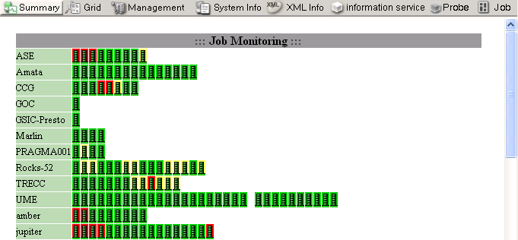
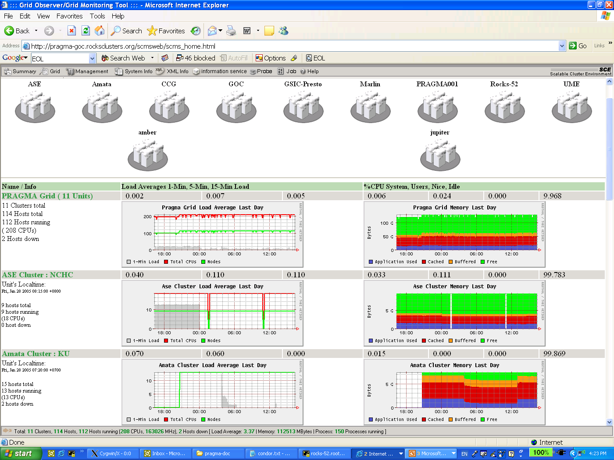
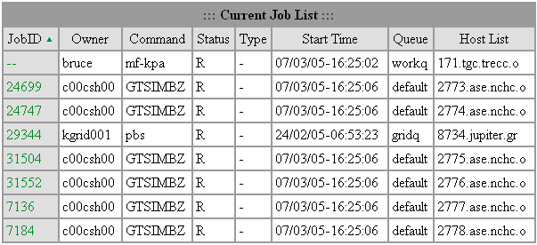
SCMSWeb
Grid Systems/Jobs Real-time Monitoring http://www.opensce.org
Part of SCE project in Thailand
Lead by Kasetsart University, Thailand
CPU, memory, jobs info/status/usage
Easy meta server/view
Support SQMS, SGE, PBS, LSF
Also a Rocks roll
Requires Linux
Porting to Solaris
Deployed in testbed
Building ganglia interface

Slide 29
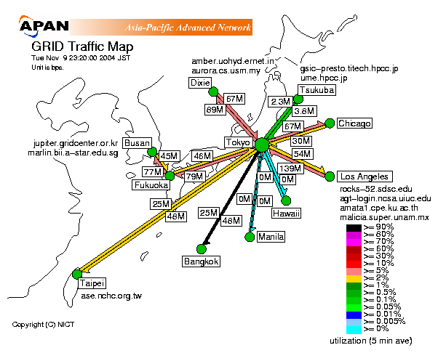
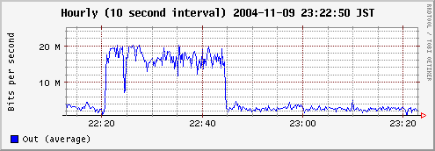
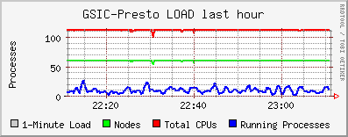
Collaboration with APAN
http://mrtg.koganei.itrc.net/mmap/grid.html
Thanks: Dr. Hirabaru and APAN Tokyo NOC team

Slide 30
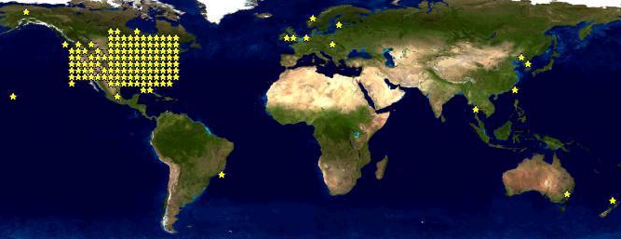
Collaboration with NLANR http://www.nlanr.net
Need data to locate problems, propose solutions
Network realtime measurements
  AMP, inexpensive solution
  Widely deployed
  Full mesh
  Round trip time (RTT)
  Packet loss
  Topology
  Throughput (user/event driven)
Joined proposal
  AMP near every testbed site
    AMP sites: Australia, China, Korea, Japan, Mexico, Thailand, Taiwan, USA
    In progress: Singapore, Chile, Malaysia
    Proposed: India
  Customizable network full mesh realtime monitoring

Slide 31
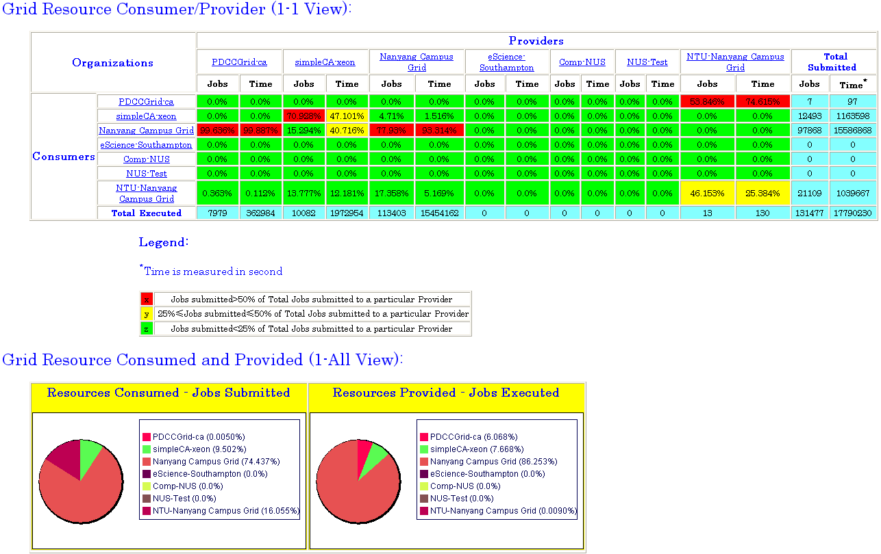
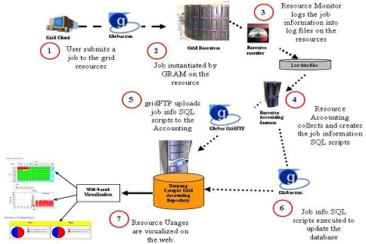
NTU Grid Accounting System http://ntu-cg.ntu.edu.sg/cgi-bin/acc.cgi
Lead by NanYang University, funded by National Grid Office in Singapore
Support SGE, PBS
Build on globus core (gridftp, GRAM, GSI)
Job/user/cluster/OU/grid levels usages
Fully tested in campus grid
Intended for global grid
Show at PRAMA8 in May, Singapore
Only usages now, next phase add billing
Will test in our testbed in May

Slide 32
Collaboration
Non-technical, most important
Different funding sources
How to get enough resources
How to get people to act, together
Mutual interests, collective goals
Cultivate collaborative spirit
Key to PRAGMA’s success

Slide 33
Case Study: First Application in the Routine-basis Experiments
Yusuke Tanimura (AIST, Japan)
yusuke.tanimura@aist.go.jp

Slide 34
Overview of 1st Application
Application: TDDFT Equation
  Original program is written in Fortran 90.
  A hotspot is divided into multiple tasks and processed in parallel.
  Task-parallel part is implemented with Ninf-G which is a reference implementation of the GridRPC.
Experiment
  Schedule: June 1, 2004 ~ August 31, 2004 (For 3 months)
  Participants: 10 Sites (in 8 countries): AIST, SDSC, KU, KISTI, NCHC, USM, BII, NCSA, TITECH, UNAM
  Resource: 198 CPUs (on 106 nodes)
GridRPC server side
TDDFT program
Independent tasks
Cluster 1
main(){
:
:
:
:
:
・・
Numerical integration part
Cluster 2
・・
5000 iterations

Slide 35
GOC’s and Sys-Admin’s Work
Meet Common Requirements
  Installation of the Globus 2.x or 3.x
    Build all SDK bundles from the source bundles, with the same flavor
    Install shared library on both frontend and compute nodes
  Installation of the latest Ninf-G
    cf. Ninf-G is based on the Globus.
Meet Special Requirement
  Installation of Intel Fortran Compiler 6.0, 7.0 or the latest (bug-fixed) 8.0
    Install shared library on both frontend and compute nodes
PRAGMA GOC
System administrator
Application user
System administrator
Requirements
To each site
System administrator
System administrator

Slide 36
Application User’s Work
Develop a client program by modifying the parallel part from the original code
  Link to the Ninf-G library which provides the GridRPC API
Deploy a server-side program (Hard!)
  1. Upload a server-side program source
  2. Generate an information file of implemented functions
  3. Compile and link it to the Ninf-G library
  4. Download the information file to the client node
GRAM job submission
Client program
Server-side executable
Read
TDDFT part
Interface definition of
server-side function
Dowonload

Slide 37
Application User’s Work
Test & Troubleshooting (Hard!)
  1. Point-to-point test with one client and one server
  2. Multiple sites test
Execute application practically

Slide 38
Trouble in Deployment and Test
Most trouble
  Authentication failure in GRAM job submission, SSH login or the local scheduler’s job submission using RSH/SSH
    Cause: Mostly operation mistake
  Requirements are not met enough.
    Ex. Some packages are installed on only frontend
    Cause: Lack of understanding the application and the requirements
  Inappropriate queue configuration of the local scheduler (pbs, sge and lsf)
    Ex. A job was queued but never run.
    Cause: Mistake of the scheduler’s configuration
    Ex. Multiple jobs was started on the single node.
    Cause: Inappropriate configuration of the jobmanager-* script

Slide 39
Difficulty in Execution
Network instability between AIST and some sites
  A user can’t run its application on the site.
  The client can’t keep the TCP connection for a long time because throughput would go down to the very low level.
Hard to know why the job failed
  Ninf-G returns the error code.
  Application was implemented to output the error log.
  A user can know what problem happened but… can’t know what was a reason of the problem immediately.
  Both user and system administrator need to analyze their logs to find cause of the problem, later.

Slide 40
Middleware Improvement
Ninf-G achieved a long execution (7 days), on the real Grid environment.
Heartbeat function that the Ninf-G sever sends a packet to the client was improved to prevent a client from being dead locked.
  Useful to find the TCP disconnection
Prototype of the fault-tolerant mechanism was implemented in the application level and tested. This is a step for implementing Fault-tolerant function in the higher layer of the GridRPC.
Notes:
Test error codes of the GridRPC APIs

Slide 41
Thank you
http://pragma-goc.rocksclusters.org

