Slide 1



PRAGMA – TeraGrid – AIST Interoperation Testing
Philip Papadopoulos

Slide 2


































PRAGMA
Overarching Goals
Establish sustained collaborations
Advance the use of the grid technologies for applications
Build community of application scientists and Technologists from leading institutions around the Pacific Rim
(Learn by doing – bottom up grid)
.
http://www.pragma-grid.net
Notes:
CIRCLED SITES had demonstrations at IGRID – 18 of 49 Demos were PRAGMA members
Partnership: relationship (between individuals or groups) characterized by mutual cooperation and responsibility
Collaboration: work together, especially in a joint intellectual effort

Slide 3
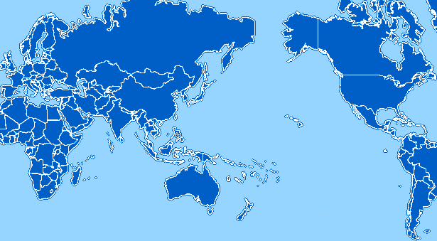
PRAGMA Grid Testbed
JLU, China
KISTI, Korea
NCSA, USA
UZurich, Switzerland
OsakaU, Japan
CNIC, China
UMC, USA
GUCAS, China
AIST, Japan
IoIT, Vietnam
TITECH, Japan
SDSC, USA
UoHyd, India
NCHC, Taiwan
CICESE, Mexico
KU, Thailand
ASCC, Taiwan
UNAM, Mexico
USM, Malaysia
BII, Singapore
NGO, Singapore
MU, Australia
UChile, Chile
http://pragma-goc.rocksclusters.org

Slide 4
Approach
Established with Inaugural workshop in March 2002
Series of workshops (#10 in Australia – March 2006)
Identify applications areas
  Multi-way collaborations
  Drive which technologies to be evaluated
  Open culture of sharing SW technologies
Routine-basis use laboratory/testbed
  Not a production facility.
  Each endpoint is administered/configured by local institution
  Basic agreements of Interoperation
    Subsets of endpoints will deploy specialized SW to support particular applications
  Centralized point for information: http://pragma-goc.rocksclusters.org

Slide 5
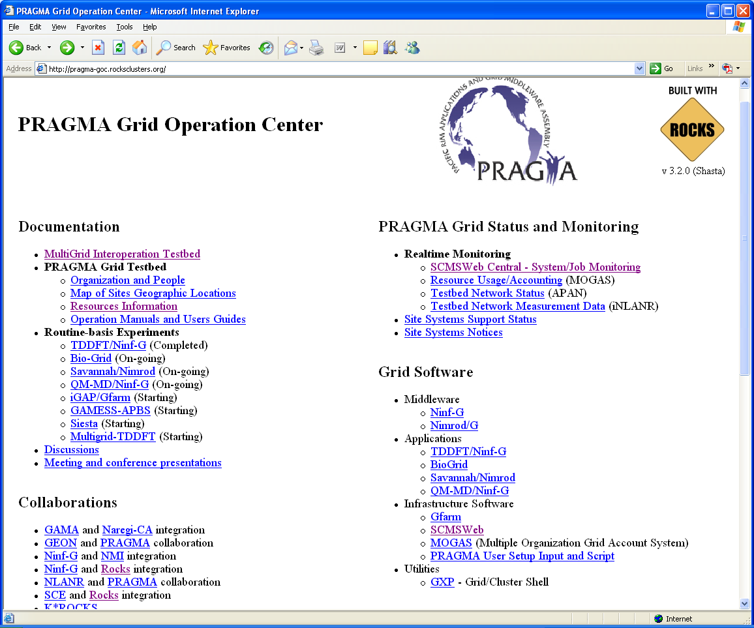
Technical Entry Point

Slide 6
PRAGMA-TeraGrid-AIST Interoperation
Goal
  Test interoperation by running a “simple” physics application across PRAGMA Testbed and TeraGrid
    TDDFT was first application run on PRAGMA testbed to work out its interoperability issues
Assumptions
  As few as possible!
  Teragrid Endpoint must run the Teragrid software stack
    Modified only to allow for interoperation
  PRAGMA Endpoints already running their site-local policies and stacks

Slide 7
People
Important people
  Cindy Zheng – PRAGMA/UCSD
  JP Navarro, Dane Skow – Teragrid/ANL
  Yusuke Tanimura, Yoshio Tanaka – AIST
  Somsak Sriprayoonsakul – Kasetsart U. (Thailand)
  (Charlie Catlett, Philip Papadopoulos, Peter Arzberger, Fang-Pang Lin)

Slide 8
Timeline
11/17/05 - 01/20/06 | High-level discussions and commitment to the Multi-Grid Interoperation experiment
01/20/06 - 01/26/06 | Select and agree on the first application
01/26/06 - 02/03/06 | Each grid allocates resources and designates technical support/contact and application drivers
01/27/06 - 01/31/06 | Application drivers prepare and publish application requirements
02/03/06 - 02/04/06 | Application drivers apply for user accounts on each grid
01/31/06 - 02/04/06 | each site setup user accounts
01/31/06 - 02/08/06 | each site implements the application requirements
02/01/06 - 02/08/06 | Application drivers test user account access on each site
02/01/06 - 02/08/06 | Application drivers deploy then test the application on each site
02/09/06 - 02/09/06 | Application drivers start the application run**** (Interoperation)
02/09/06 - | Start discussion and deployment of grid monitoring software - SCMSWeb, for cross grid monitoring
More than 200 emails to accomplish the above

Slide 9
High-Level Lessons Learned
Tanimura’s AIST production cert accepted at ANL Teragrid Cluster. IGTF certs form a rational set of interoperable authentication chits.
The hybrid cluster (IA64 gatekeeper, ia32 nodes) at ANL is a configuration that was “new”. However, this is "natural“. The gatekeeper can be completely different architecture/OS from the presented resource
The provisioning of "other software" to support and application (In this case Ninf-G and Intel Compilers) is an interesting issue for interoperation. One could propose condor as a solution to carry these elements of your environment with you
  This most straightforward foray into running an application as interoperable, cannot be solved by a single "all-encompassing" software stack.
  (Software may need to be delivered as Packages and Source)
User’s want to monitor their job using tools they know. Work needs to progress on how an endpoint monitored with one system (eg. Ganglia) could be presented in another (e.g SCMSWeb)
(Timezones are still challenging)

Slide 10
Extending
Dedicated contacts at sites paramount for progress
PRAGMA testbed approach is a good one for testing interoperability
  Sites keep autonomy – can manage/provision just like their production resources
  Can test candidate methods for interoperability without sacrificing stability on production resources
  Many Production Grids in Pacific Rim already have members in PRAGMA (and nodes on the testbed)
  (You don’t have to live on the Pacific Rim to “play”, Uni. Zurich is an active PRAGMA member)
When testing yields positive results, integrated as part of testbed and production systems

Slide 11
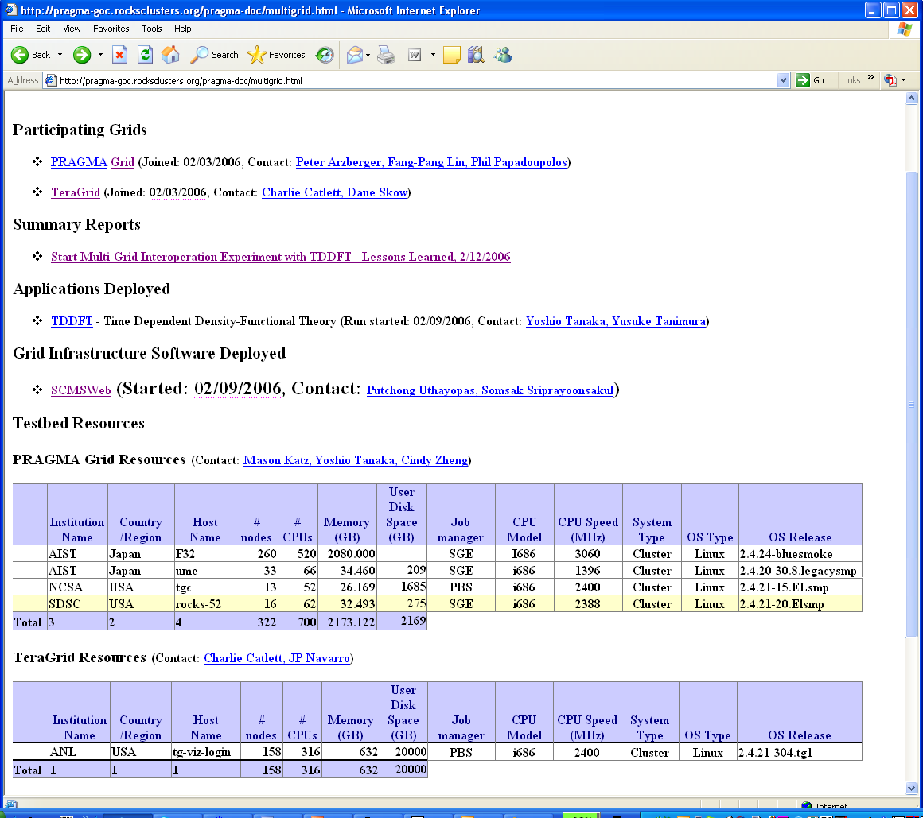
Multi-Grid Interoperation Testbed

