Slide 1

PRIME 2005
A visualization of network measurements
John C.Y. Lee
9/26/05

Slide 2
Content
A Very Brief Introduction
Thanks
Life in Beijing
The end of Prime 2005
Structures
Future improvements
Demo

Slide 3
Brief Introduction
This project is to visualize the network measurements within all the amp machines around the world…
The idea was bought up by Tony McGregor and Ronn Ritke

Slide 4
Thanks
Special thanks to NSF
  A grant from NSF that provide us this opportunity to research aboard
Thanks to CNIC particularly R&D and 超级计算
  A very welcoming host which gave us a memorable trip.
Special thanks to Dr. Peter Arzberger
  The person who introduced this internship to me
Thanks to Dr. Tony McGregor and Dr. Ronn Ritke
  Without the idea, I won’t be able to make this program
Thanks again to Cindy Zheng & Jeremy Kallstrom & Chen Qi
  Without them, this program will not be here today
Thanks to Ms. Teri Simas
  The person who send us all kinds of emails about the PRIME program that we need to care about.

Slide 5
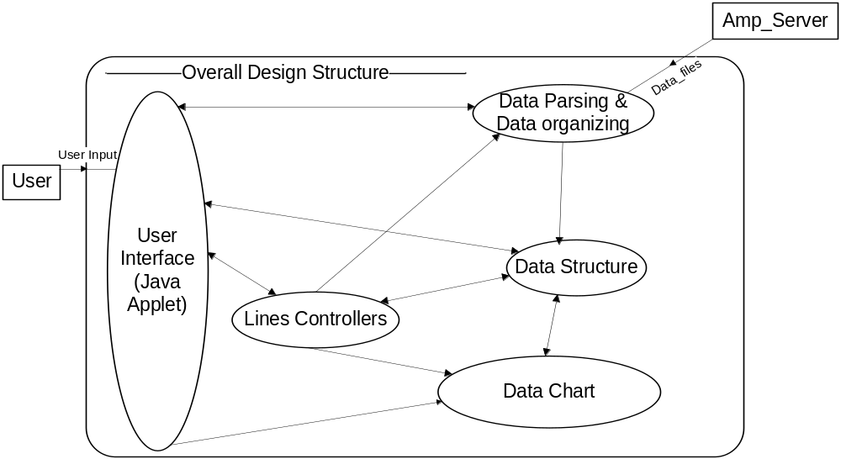
Structures I
Overall Structure
This is the overall structure of the project
It could mainly divided into 5 parts
  User Interface
  Lines Controllers (the heart of this program)
  Data Parsing & Data organizing
  Data Structure
  Data Chart (Detailed network measurements chart)

Slide 6
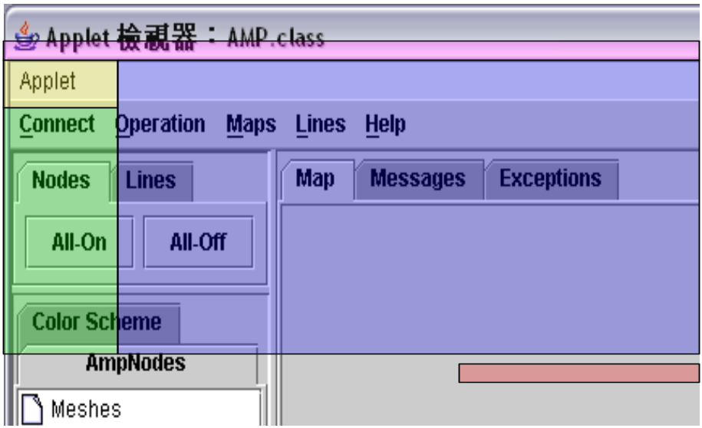
User Interface
AMP (extends JApplet)
  The Swing-based Java applet that contains all the components to make this project works
MenuBar (Purple)
  The menu that provides options for users to choose from
Nodes Button, Lines Button (Yellow)
  The buttons which could make all the nodes and lines appear or disappear from the map
List of AmpSite, List of Color (Green)
  The Tree based components which shows the list of Amp sites and list of colors
    (Double click on the folder-liked icon in order to show the sites and the colors)
Map, Internet Messages (Message), Exceptions (Blue)
  Almost all of the actions will take place on the Map pane
  Message pane will be providing messages from Internet so that users would be able to know if there is any problems from the server
  Exception pane will provides the exceptions message from java so that the code developers will be able to find out where will be the problems more easily
The Time, ElapsedSec (Red)
  A component which lets the user and the program knows if it is time to refresh and if the program hangs. XD

Slide 7
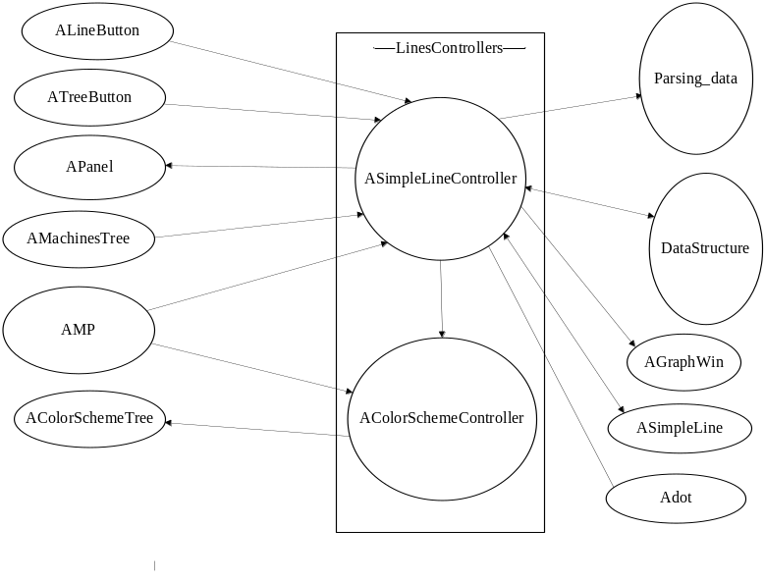
Lines Controllers
The lines and the colors of the lines are controlled by these 2 controllers
This picture is showing the classes that are related to the lines controllers
However, it is not quite possible to understand how this thing works without having sequence diagrams
For the sake of god, I won’t go through any of the sequence diagrams here. XD
If anyone of you are interested, please let me know. ^^”a (I do have a menu for this program (very rough..))

Slide 8
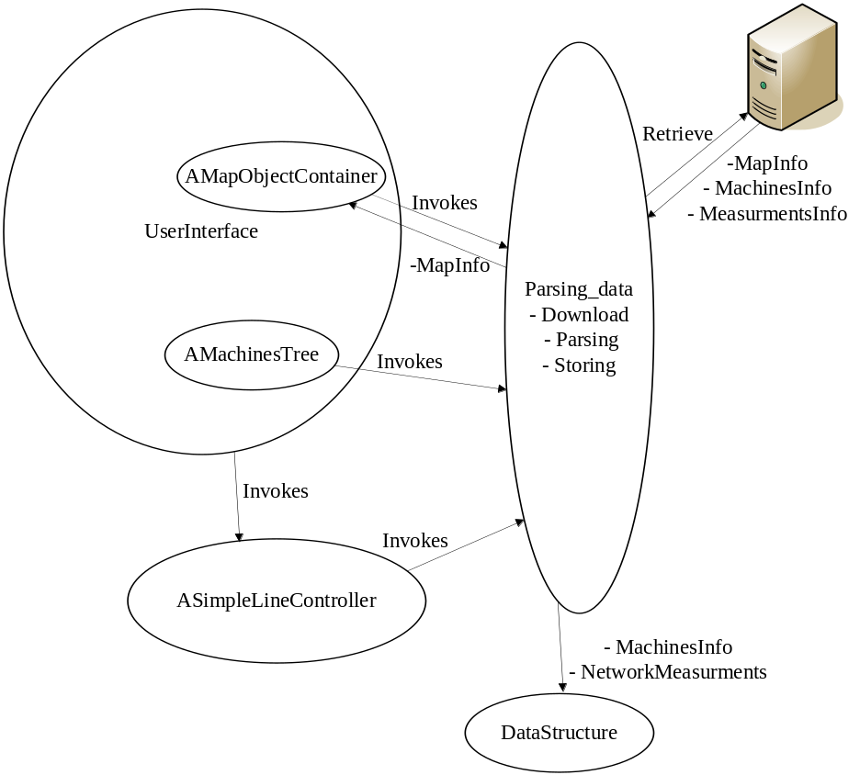
Data Parsing &
Data organizing
This is the part where downloading and parsing take place.
The diagram on the right shows how the functions are called and the data are going to.

Slide 9
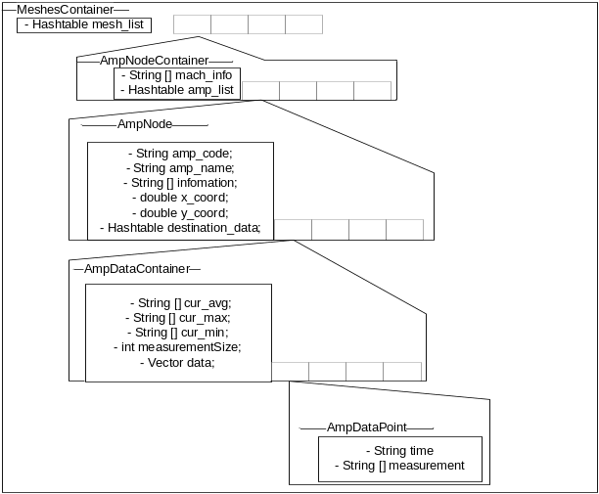
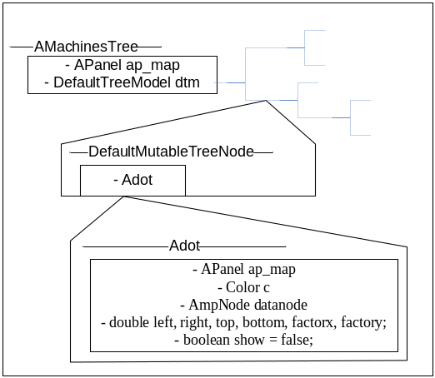
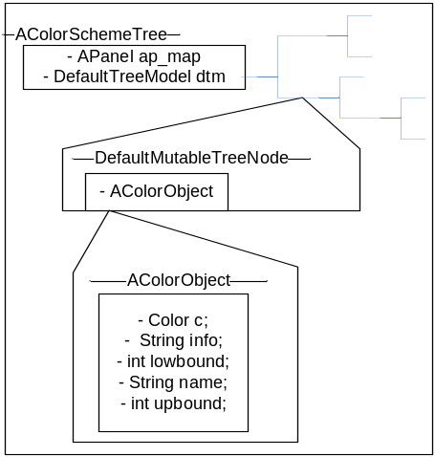
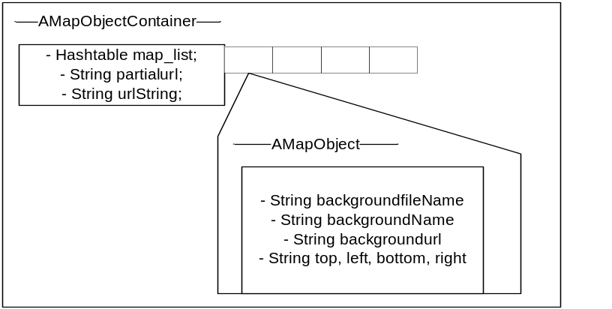
Data Structures
These are the data structures that was used for the project
The one on the top right is responsible for all the network measurements
The one on the right is responsible for the list of amp sites (Green)
The one on the bottom right is responsible for the list of colors (Green)
Finally the one on the bottom is responsible for holding the maps from the server (purple)

Slide 10
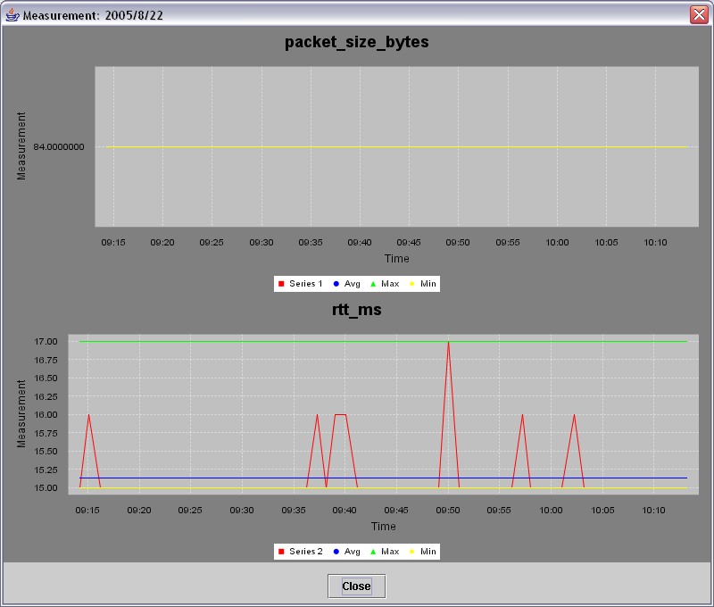
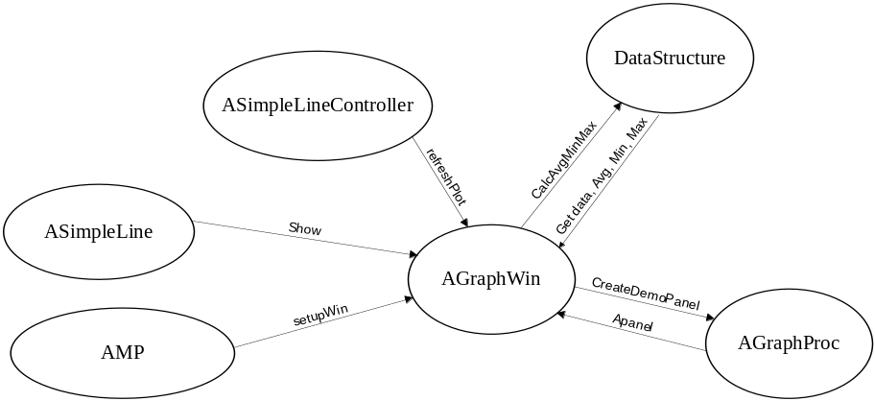
Data Chart by
Chen qi
This is the chart that could provide the network measurements in detail
The bottom right is the diagram that shows how the functions are called and data transferred

Slide 11
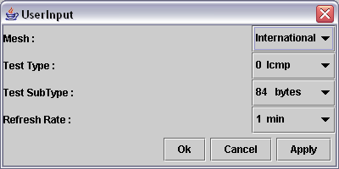
User Input
User Input
Mesh ➔ International
TestType ➔ 0 Icmp, 2 Http, 3 Ipert, 4 Tput
TestSubType ➔ 84, 700, 1400, Rand Bytes
RefreshRate ➔ 1min, 2mins, 5mins, 10mins
Test Measurements Explaination
0 Icmp 2 Packet_size_bytes, rtt_ms
2 Http 2 Latency_ms, sizes_bytes
3 Iput 4 Latency_out(in)_ms, bandwidth_out(in)_kbps
4 tput 2 Bytes, transfer_time_ms
A mesh contains a set of amp machine. It only has one mesh right now.
RefreshRate will be used to refresh the map area where the lines are located
The user input will be used to determine the kind of network measurement, and amp machines are going to display on the program.

Slide 12
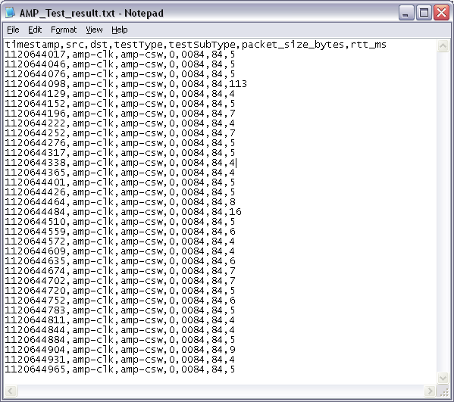
Amp Server &
Sample Data_files_x000b_
The program will be using only one server for downloading all the infomations such as maps, maps_info, site_info, etc
http://jeremyk.nlanr.net/amp/java_data.php?date=YY-MM-DD&time=HH:MM:SS&duration=x&testType=0&testSubType=0084&src=amp-xxx&dst=amp-xxx
The one on the top right is the sample data
The first 5 columns of data will be fixed for all the tests.
The only thing that varies for now will be the measurements which are the columns after testSubType.

Slide 13
Future improvements
Improve the UI
Improve the outlook
Improve the coloring so that it is automated
Improve …

Slide 14
Demo

