Slide 1

Building the PRAGMA Grid
Through Routine-basis Experiments
Cindy Zheng
Pacific Rim Application and Grid Middleware Assembly
San Diego Supercomputer Center
University of California, San Diego
http://pragma-goc.rocksclusters.org

Slide 2
Overview
Why routine-basis experiments
PRAGMA Grid testbed
Routine-basis experiments
  TDDFT, BioGrid, Savannah case study, iGAP/EOL
Lessons learned
Technologies tested/deployed
  Ninf-G, Nimrod, Rocks, Grid-status-test, INCA, Gfarm, SCMSWeb, NTU Grid accounting, APAN, NLANR
Cindy Zheng, Mardi Gras conference, 2/5/05

Slide 3
Why Routine-basis Experiments?
Resources group Missions and goals
  Improve interoperability of Grid middleware
  Improve usability and productivity of global grid
Status in May, 2004
  Computation resources
  10 countries/regions, 26 institutions, 27 clusters, 889 CPUs
  Technologies (Ninf-G, Nimrod, SCE, Gfarm, etc.)
  Collaboration projects (Gamess, EOL, etc.)
  Grid is still hard to use, especially global grid
How to make a global grid easy to use?
  More organized testbed operation
  Full-scale and integrated testing/research
  Long daily application runs
  Find problems, develop/research/test solutions
Cindy Zheng, Mardi Gras conference, 2/5/05

Slide 4
Routine-basis Experiments
Initiated in May 2004 PRAGMA6 workshop
Testbed
  Voluntary contribution ( 8 -> 17 sites)
  Computational resources first
  Production grid is the goal
Exercise with long-running sample applications
  Ninf-G based TDDFT, (6/1/04 ~ 8/31/04)
  http://pragma-goc.rocksclusters.org/tddft/default.html
  BioGrid, (9/20 ~ on-going)
  http://pragma-goc.rocksclusters.org/biogrid/default.html
  Nimrod based Savannah case study, (started)
  http://pragma-goc.rocksclusters.org/savannah/default.html
  iGAP over Gfarm, (start soon)
Learn requirements/issues
Research/implement solutions
Improve application/middleware/infrastructure integrations
Collaboration, coordination, consensus
Cindy Zheng, Mardi Gras conference, 2/5/05

Slide 5
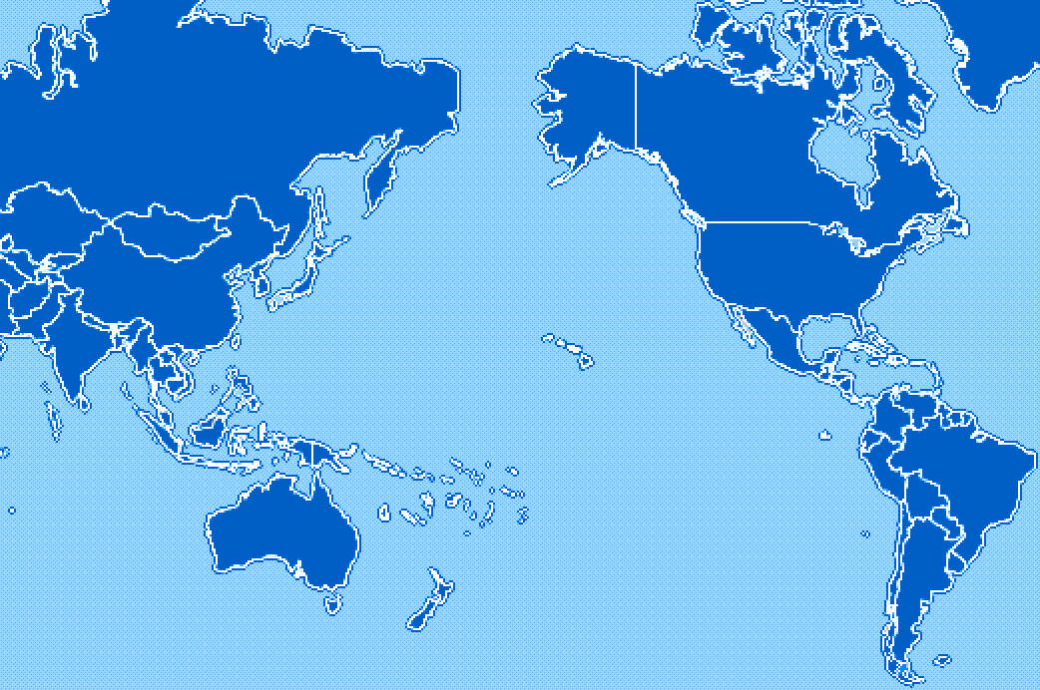
PRAGMA Grid Testbed
KISTI, Korea
NCSA, USA
CNIC, China
AIST, Japan
SDSC, USA
TITECH, Japan
UoHyd, India
NCHC, Taiwan
CICESE, Mexico
ASCC, Taiwan
KU, Thailand
UNAM, Mexico
USM, Malaysia
BII, Singapore
MU, Australia
UChile, Chile
Cindy Zheng, Mardi Gras conference, 2/5/05

Slide 6
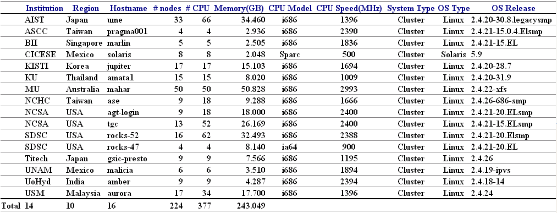
PRAGMA Grid resources http://pragma-goc.rocksclusters.org/pragma-doc/resources.html
Cindy Zheng, Mardi Gras conference, 2/5/05

Slide 7
PRAGMA Grid Testbed – unique features –
Physical resources
  Most contributed resources are small-scale clusters
  Networking is there, however some bandwidth is not enough
Truly (naturally) multi national/political/institutional VO beyond boundaries
  Not an application-dedicated testbed – general platform
  Diversity of languages, culture, policy, interests, …
Grid BYO – Grass roots approach
  Each institution contributes his resources for sharing
  Not a single source funded for the development
We can
  have experiences on running international VO
  verify the feasibility of this approach for the testbed development
Cindy Zheng, Mardi Gras conference, 2/5/05
Source: Peter Arzberger & Yoshio Tanaka

Slide 8
Progress at a Glance
May
June
July
Aug
Sep
Oct
Nov
Dec
Jan
2 sites
5 sites
8 sites
10 sites
12 sites
14 sites
2nd user start executions
3rd App. start
1st App. start
1st App. end
2nd App. start
Setup Resource Monitor (SCMSWeb)
PRAGMA6
Setup Grid
Operation Center
PRAGMA7
SC’04
“These works were continued during 3 months.”
1. Site admin install GT2, Fortran, Ninf-G
2. User apply account (CA, DN, SSH, firewall)
3. Deploy application codes
4. Simple test at local site
5. Simple test between 2 sites (Globus, Ninf-G, TDDFT)
Join in the main executions (long runs) after all’s done
Cindy Zheng, Mardi Gras conference, 2/5/05
Source: Yusuke Taminura & Cindy Zheng

Slide 9

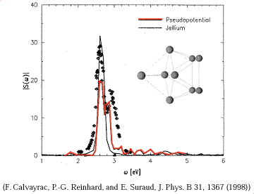



1st application
Time-Dependent Density Functional Theory (TDDFT)
- Computational quantum chemistry application
- Simulate how the electronic system evolves in time after excitation
- Grid-enabled by Nobusada (IMS), Yabana (Tsukuba Univ.) and Yusuke Tanimura (AIST) using Ninf-G
gatekeeper
Cluster 1
Sequential program
Exec func() on backends
Client
Server
tddft_func()
Client program of TDDFT
main(){
:
grpc_function_handle_default(
&server, “tddft_func”);
:
grpc_call(&server, input, result);
:
3.25MB
Cluster 2
4.87MB
GridRPC
Cluster 3
Cluster 4
user
Source: Yusuke Tanimura
Cindy Zheng, Mardi Gras conference, 2/5/05

Slide 10
TDDFT Run
  Driver: Yusuke Taminura (AIST)
  Number of major executions by two users: 43
  Execution time (Total): 1210 hours (50.4 days)
  (Max) : 164 hours (6.8 days)
  (Ave) : 28.14 hours (1.2 days)
  Number of RPCs (Total): more than 2,500,000
  Number of RPC failures: more than 1,600
  (Error rate is about 0.064 %)
http://pragma-goc.rocksclusters.org/tddft/default.html
Cindy Zheng, Mardi Gras conference, 2/5/05
Source: Yusuke Tanimura

Slide 11
Problems Encountered
  Poor network performance in parts of Asia
  Instability of clusters (by NFS, heat or power supply)
  Incomplete configuration of jobmanager-{pbs/sge/lsf/sqms}
  Missing GT and Fortran libraries on compute nodes
  It takes average 8.3 days to get TDDFT started after getting account
  It takes average 3.9 days and 4 emails to complete one troubleshooting
  Manual work one site at a time
    User account/environment setup
    System requirement check
    Application setup
    …
  Access setup problems
  Queue and its permission setup problems
Cindy Zheng, Mardi Gras conference, 2/5/05
Source: Yusuke Tanimura

Slide 12
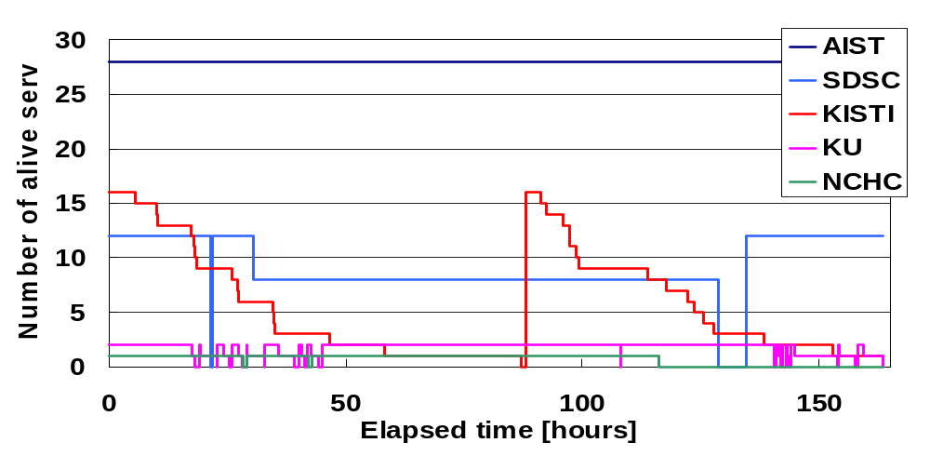
Server and Network Stability
The longest run using 59 servers over 5 sites
Unstable network between KU (in Thailand) and AIST
Slow network between USM (in Malaysia) and AIST
Cindy Zheng, Mardi Gras conference, 2/5/05
Source: Yusuke Tanimura

Slide 13

2nd Application - mpiBLAST
A DNA and Protein sequence/database alignment tool
Driver: Hurng-Chun Lee (ASCC, Taiwan)
Application requirements
  Globus
  Mpich-g2
  NCBI est_human, toolbox library
  Public ip for all nodes
Started 9/20/04
SC04 demo
Automate installation/setup/testing
http://pragma-goc.rocksclusters.org/biogrid/default.html
Cindy Zheng, Mardi Gras conference, 2/5/05
Notes:
How many people knows the BLAST? It’s should be a very famous application in biology.
Think about the question … if you have a very large DNA sequence composed by four characters, say A, G, C, and T. and you have no any other information about this DNA. How will you do to identify the genes on it? The solution here is very simple. The researchers can do a lot of experiments to sequence a lot of the known gene fragments from cells. These fragments are collected to be a EST database. Then they do the alignment between the DNA sequence and the EST database. and BLAST is the tool to give us the help!!
So blast is …
<The first two items>
Because biologists may need to do the BLAST alignment everyday and they may send it multiple sequences for alignment. Throughput is the key issue for providing services
The original BLAST can be run only on single machine, so it has some limitations, such as:
- Not scalable
- Low throughput
- Unable to handle large dataset

Slide 14
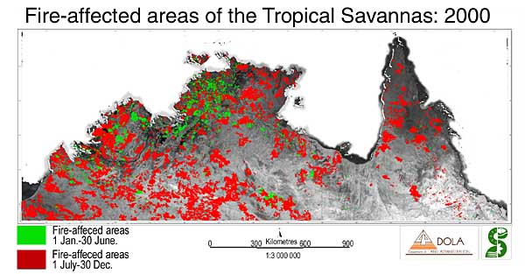
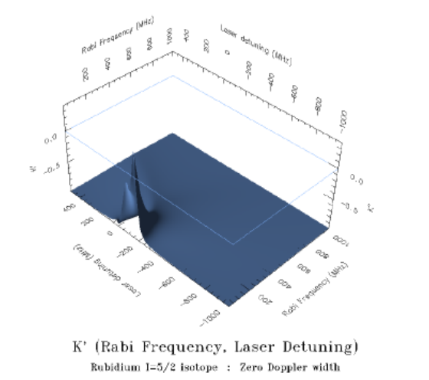
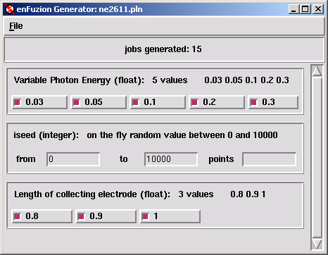
3rd Application – Savannah Case Study
Study of Savannah fire impact on northern Australian climate
- Climate simulation model
- 1.5 month CPU * 90 experiments
- Started 12/3/04
- Driver: Colin Enticott (Monash University, Australia)
- Requires GT2
- Based on Nimrod/G
Job 1
Job 2
Job 3
Job 4
Job 5
Job 6
Job 7
Job 8
Job 9
Description
of Parameters
PLAN FILE
Job 10
Job 11
Job 12
Job 13
Job 14
Job 15
Job 16
Job 17
Job 18
http://pragma-goc.rocksclusters.org/savannah/default.html
Cindy Zheng, Mardi Gras conference, 2/5/05

Slide 15

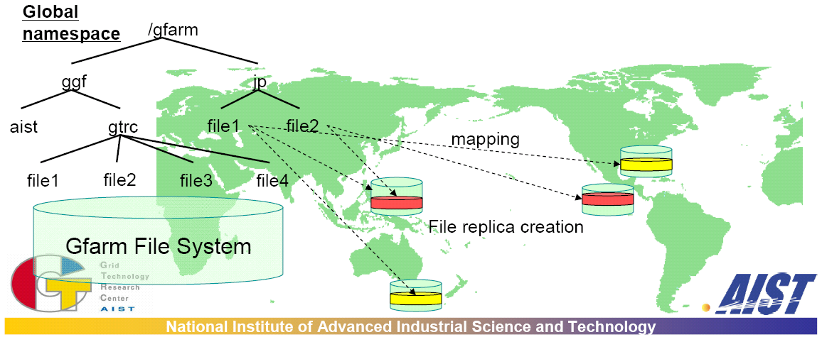
4th Application – iGAP/Gfarm
iGAP and EOL (SDSC, USA)
  Genome annotation pipeline
Gfarm – Grid file system (AIST, Japan)
Demo in SC04 (SDSC, AIST, BII)
Plan to start in testbed February 2005
Cindy Zheng, Mardi Gras conference, 2/5/05

Slide 16
Lessons Learned http://pragma-goc.rocksclusters.org/tddft/Lessons.htm
Information sharing
Trust and access (Naregi-CA, Gridsphere)
Resource requirements (NCSA script, INCA)
User/application environment (Gfarm)
Job submission (Portal/service/middleware)
Resource/job monitoring (SCMSWeb, APAN, NLANR)
Resource/job accounting (NTU)
Fault tolerance (Ninf-G, Nimrod)
Cindy Zheng, Mardi Gras conference, 2/5/05

Slide 17

Ninf-G
A reference implementation of the standard GridRPC API
http://ninf.apgrid.org
Sequential program
Server
Lead by AIST, Japan
Enable applications for Grid Computing
Adapts effectively to wide variety of applications, system environments
Built on the Globus Toolkit
Support most UNIX flavors
Easy and simple API
Improved fault-tolerance
Soon to be include in NMI, Rocks distributions
Client
gatekeeper
Cluster 1
Exec func() on backends
client_func()
Cluster 2
Client program
GridRPC
Cluster 3
Cluster 4
user
Cindy Zheng, Mardi Gras conference, 2/5/05

Slide 18

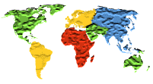
Nimrod/G http://www.csse.monash.edu.au/~davida/nimrod
- Lead by Monash University, Australia
- Enable applications for grid computing
- Distributed parametric modeling
  Generate parameter sweep
  Manage job distribution
  Monitor jobs
  Collate results
- Built on the Globus Toolkit
- Support Linux, Solaris, Darwin
- Well automated
- Robust, portable, restart
Description
of Parameters
PLAN FILE
Job 1
Job 2
Job 3
Job 4
Job 5
Job 6
Job 7
Job 8
Job 9
Job 10
Job 11
Job 12
Job 13
Job 14
Job 15
Job 16
Job 17
Job 18
Cindy Zheng, Mardi Gras conference, 2/5/05

Slide 19

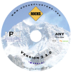
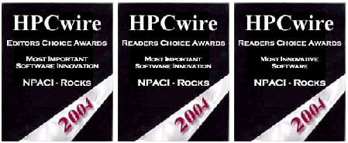










Rocks
Open Source High Performance Linux Cluster Solution http://www.rocksclusters.org
Make clusters easy. Scientists can do it.
A cluster on a CD
  Red Hat Linux, Clustering software (PBS, SGE, Ganglia, NMI)
  Highly programmatic software configuration management
  x86, x86_64 (Opteron, Nacona), Itanium
Korea localized version: KROCKS (KISTI)
http://krocks.cluster.or.kr/Rocks/
Optional/integrated software rolls
  Scalable Computing Environment (SCE) Roll (Kasetsart University, Thailand)
  Ninf-G (AIST, Japan)
  Gfarm (AIST, Japan)
  BIRN, CTBP, EOL, GEON, NBCR, OptIPuter
Production Quality
  First release in 2000, current 3.3.0
  Worldwide installations
  4 installations in testbed
HPCWire Awards (2004)
  Most Important Software Innovation - Editors Choice
  Most Important Software Innovation - Readers Choice
  Most Innovative Software - Readers Choice
Cindy Zheng, Mardi Gras conference, 2/5/05
Source: Mason Katz

Slide 20
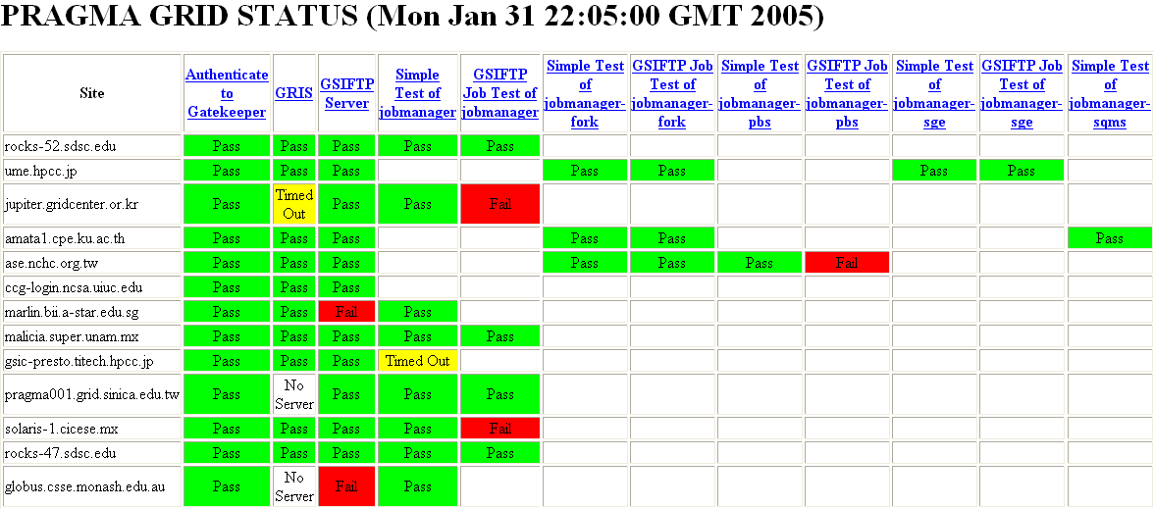
System Requirement Realtime Monitoring
NCSA, Perl script, http://grid.ncsa.uiuc.edu/test/grid-status-test/
Modify, run as a cron job.
Simple, quick
http://rocks-52.sdsc.edu/pragma-grid-status.html
Cindy Zheng, Mardi Gras conference, 2/5/05

Slide 21
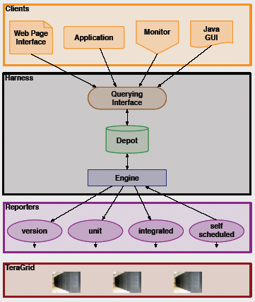
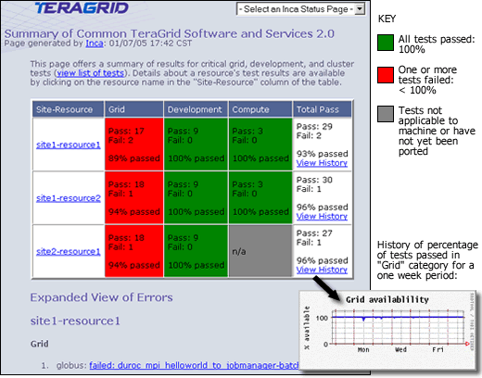
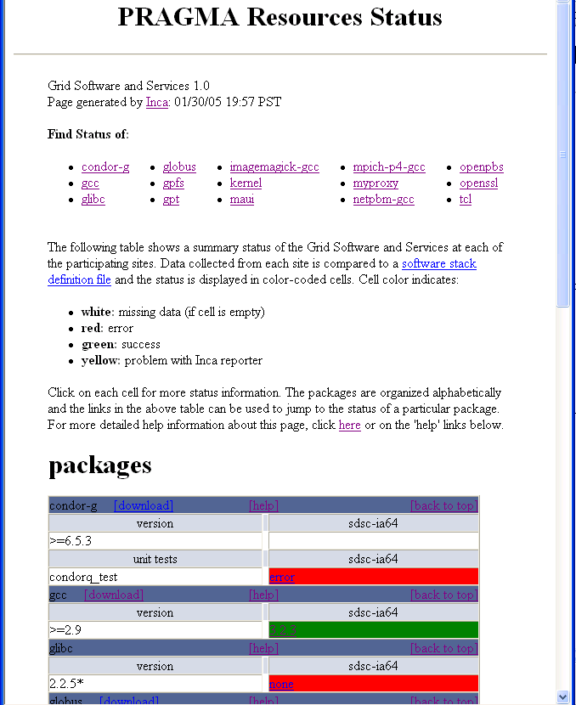
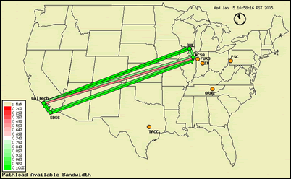
INCA
Framework for automated Grid testing/monitoring http://inca.sdsc.edu/
- Part of TeraGrid Project, by SDSC
- Full-mesh testing, reporting, web display
- Can include any tests
- Flexibility and configurability
- Run in user space
- Currently in beta testing
- Require Perl, Java
- Being tested on a few testbed systems
Cindy Zheng, Mardi Gras conference, 2/5/05

Slide 22
Gfarm – Grid Virtual File System http://datafarm.apgrid.org/
Lead by AIST, Japan
High transfer rate (parallel transfer, localization)
Scalable
File replication – user/application setup, fault tolerance
Support Linux, Solaris; also scp, gridftp, SMB
Require public IP for file system node
Cindy Zheng, Mardi Gras conference, 2/5/05

Slide 23
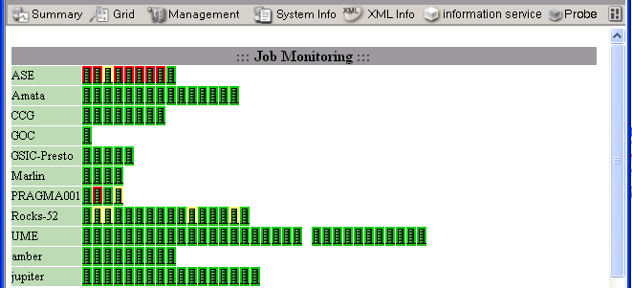
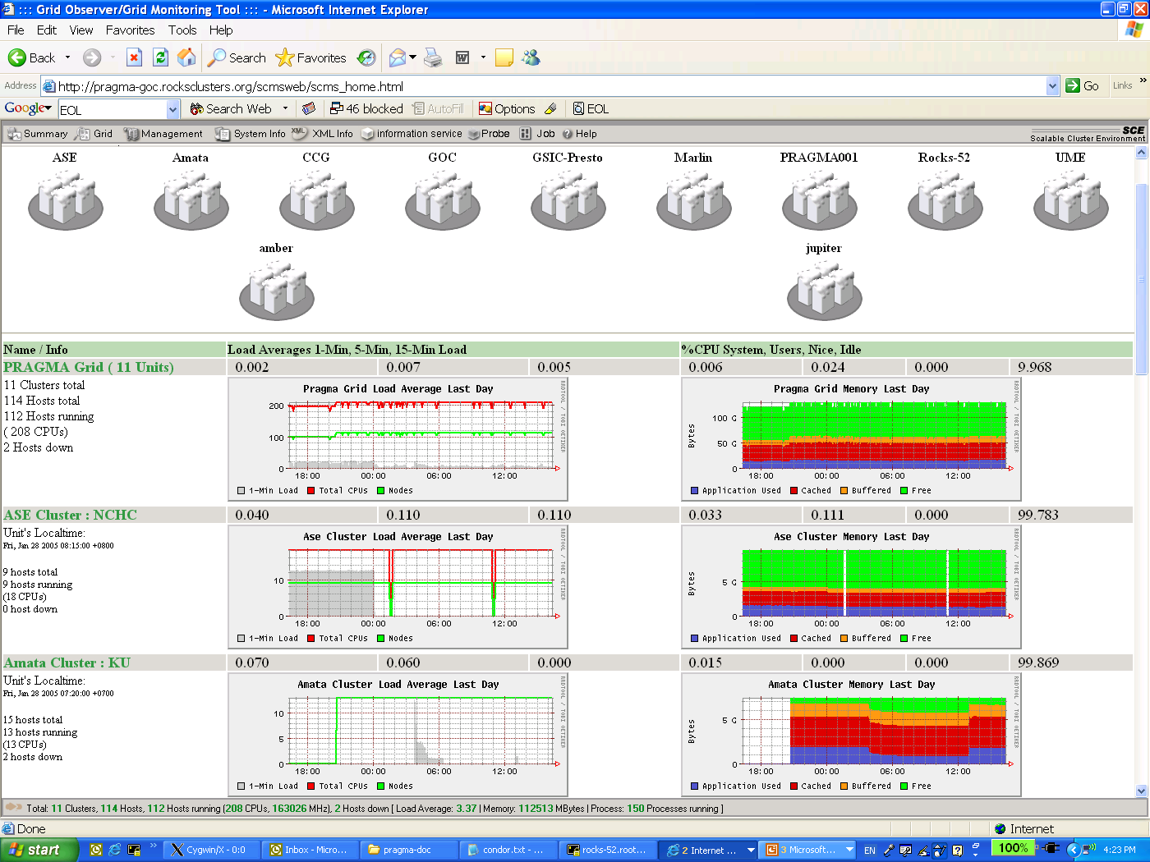
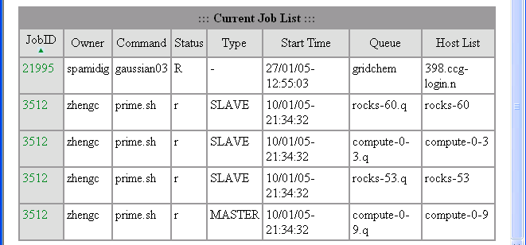
SCMSWeb
Grid Systems/Jobs Real-time Monitoring http://www.opensce.org
Part of SCE project in Thailand
Lead by Kasetsart University, Thailand
CPU, memory, jobs info/status/usage
Meta server/view
Support SQMS, SGE, PBS, LSF
Rocks roll
Requires Linux
Deployed in testbed
Cindy Zheng, Mardi Gras conference, 2/5/05

Slide 24
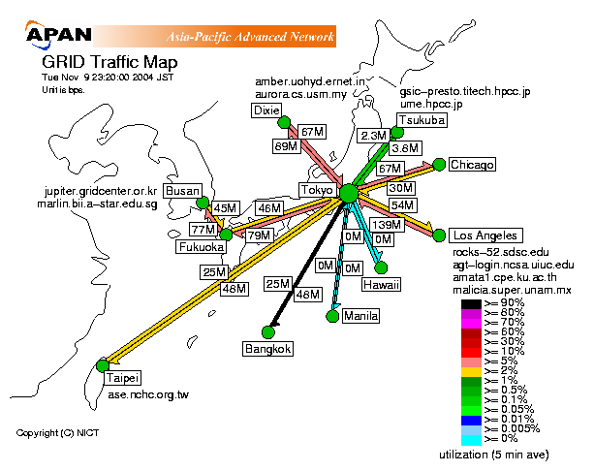
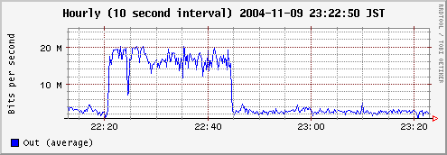
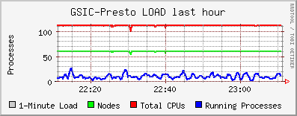
Collaboration with APAN
http://mrtg.koganei.itrc.net/mmap/grid.html
Thanks: Dr. Hirabaru and APAN Tokyo NOC team
Cindy Zheng, Mardi Gras conference, 2/5/05

Slide 25
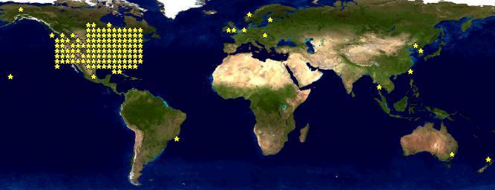
Collaboration with NLANR http://www.nlanr.net
Network realtime measurements
  AMP, inexpensive solution
  Widely deployed
  Full mesh
  Round trip time (RTT)
  Packet loss
  Topology
  Throughput (user/event driven)
Joined proposal
  AMP near every testbed site
    AMP sites: Australia, China, Korea, Japan, Mexico, Thailand, Taiwan, USA
    In progress: Singapore, Chile
    Proposed: Malaysia, India
  Customizable network full mesh realtime monitoring
Cindy Zheng, Mardi Gras conference, 2/5/05

Slide 26
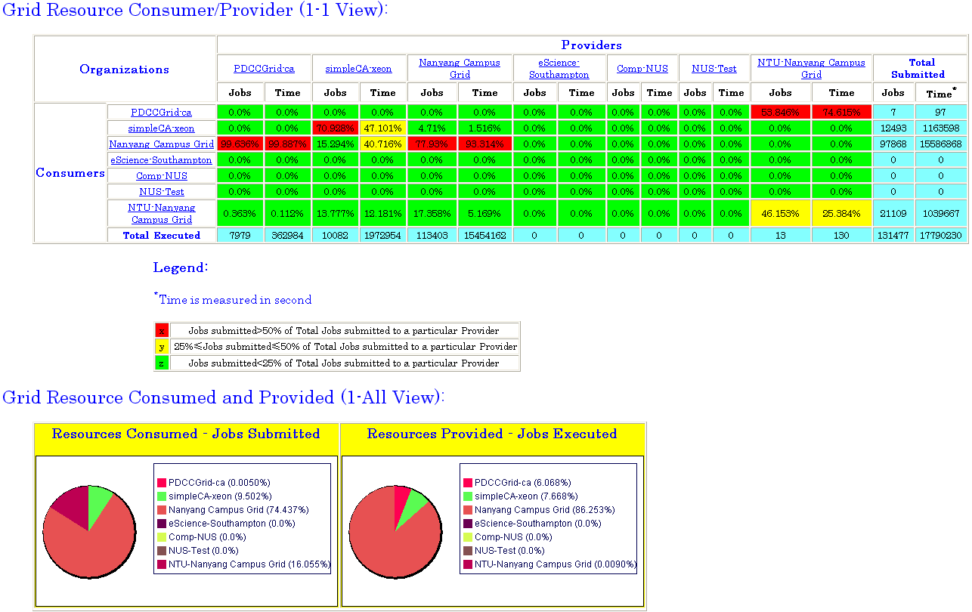
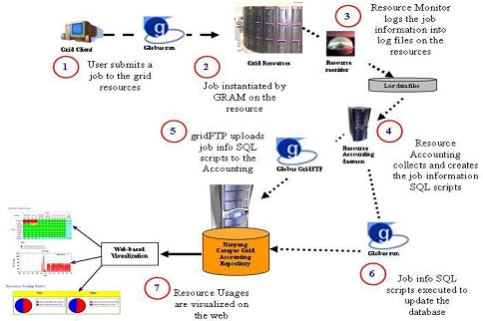
NTU Grid Accounting System http://ntu-cg.ntu.edu.sg/cgi-bin/acc.cgi
Lead by NanYang University, funded by National Grid Office in Singapore
Support SGE, PBS
Build on globus core (gridftp, GRAM, GSI)
Job/user/cluster/OU/grid levels usages
Fully tested in campus grid
Intended for global grid
Only usages now, next phase add billing
Start testing in our testbed soon
Cindy Zheng, Mardi Gras conference, 2/5/05

Slide 27
Thank you
http://pragma-goc.rocksclusters.org
Cindy Zheng, Mardi Gras conference, 2/5/05

