Slide 1







Running BLAST on the cluster system over the Pacific Rim
Notes:
Good afternoon everybody, Thank you for your coming … I am Hurng-Chun Lee from ASCC, Taiwan. I am in charge of Bioinformatics and Grid Computing. Today I will demo a gridified bioinformatics application which is called mpiBLAST-g2. This demo is a collaboration work of (Pacific Rim Application and Grid Middleware Assembling) PRAGMA members, such as ASCC in Taiwan, AIST in Japan, BII in Singapore, KISTI in Korea and SDSC in United States.

Slide 2
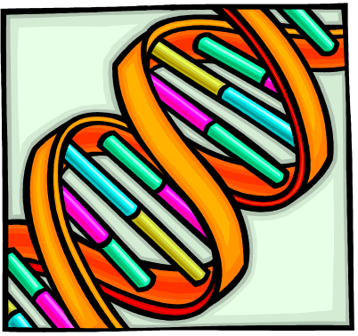

What is BLAST?
A DNA and Protein sequence/database alignment tool
Developed by NCBI (National Center for Biotechnology Information), US.
Throughput is the key issue of providing service
Running in single machine
  Not scalable
  Low throughput
  Unable to handle large dataset
Notes:
How many people knows the BLAST? It’s should be a very famous application in biology.
Think about the question … if you have a very large DNA sequence composed by four characters, say A, G, C, and T. and you have no any other information about this DNA. How will you do to identify the genes on it? The solution here is very simple. The researchers can do a lot of experiments to sequence a lot of the known gene fragments from cells. These fragments are collected to be a EST database. Then they do the alignment between the DNA sequence and the EST database. and BLAST is the tool to give us the help!!
So blast is …
<The first two items>
Because biologists may need to do the BLAST alignment everyday and they may send it multiple sequences for alignment. Throughput is the key issue for providing services
The original BLAST can be run only on single machine, so it has some limitations, such as:
- Not scalable
- Low throughput
- Unable to handle large dataset

Slide 3

The challenges of large genomic sequence alignment
Problem Complexity – O(NxM)
  N: Query (DNA) size
  M: Database (EST/Protein DB) size
Limited computing power
Limited data storage
Database sharing
Private data protection
Notes:
Let’s look at the challenges of large genomic sequence alignment:
The complexity of BLAST program is in the order of NxM where N is the Query sequence Size and M is the EST or Protein database size.
So if you have both factors very large. You are required to have very large computing powers for this alignment.
According to the record of NCBI, the EST database size will be doubled per 6 month. So storing the fast growing databases is another issue.
Furthermore, in the research collaboration environment, collaborators may not really own the database … they must share other’s databases for some reason. So database sharing and private data protection mechanism are also required in biology communities.

Slide 4

BLAST goes into parallel - mpiBLAST
A parallel BLAST runs in single cluster
Developed by Los Alamos National Lab.
Splitting large database into small fragments
Performing master-worker scheme of job running
Notes:
Biologists are lucky! In 2002, Los Alamos National Lab. released a MPI-based BLAST which can do the large database alignments in parallel.
It performs the master-worker model which is very useful for load balancing.
Before the alignment, mpiBlast will splits databases into several chunks. At runtime, each worker will fetch some chunk and do the normal blast as usual then return the output to master as the partial results of the whole alignment. After all chunks are scanned, the master will integrate all partial results to generate the final report.

Slide 5
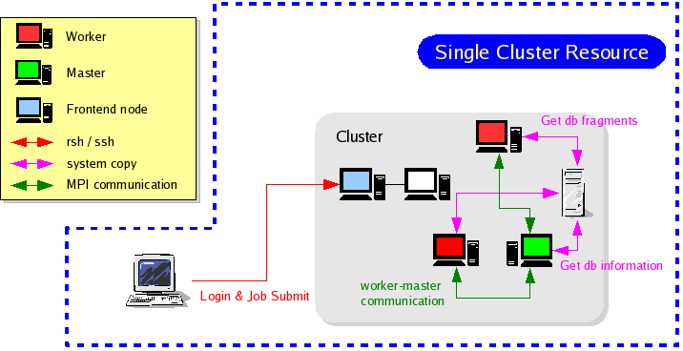
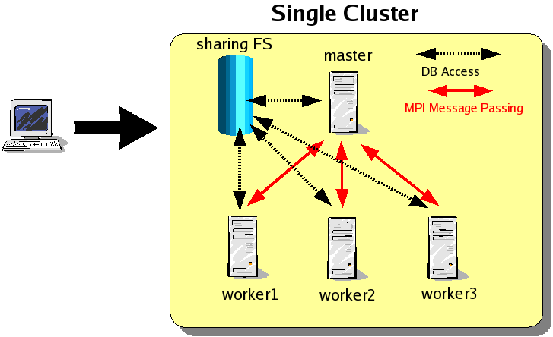
mpiBLAST
Advantages
  High throughput
  Load Balancing
Running in local cluster
  Performance and Problem size still be limited by local computing power
  Simultaneous I/O to centralized database causes the performance bottleneck
  Database sharing is still difficult
Notes:
So … here is the scenario of mpiBLAST
With this mpiBLAST, we have several advantages:
- High throughput
- Load Balancing
But since we can only run this mpiBLAST in cluster level, it still have some limitations
- Performance and Problem size still be limited
- In cluster, we usually setup a sharing filesystem for database storage. This would cause the performance bottleneck if we let too many processors to fetch the same database simultaneously.
- Sharing other’s database is still difficult or even dangerous.

Slide 6

BLAST goes into Grid – mpiBLAST-g2
A parallel BLAST runs on Grid
The enhancement from mpiBLAST by ASCC
Using GT2 GASSCOPY API and MPICH-g2
Performing cross cluster scheme of job execution
Performing remote database sharing
Notes:
Now we have grid! What can grid do for this application? From 2003, ASCC started to port the popular bioinformatics applications on GRID. In this example, we made some extension from LANL’s work. We replaced data transfers protocol with GT2-GASSCOPY and recompile this program with MPICH-G2 so that we can get more benefits than mpiBLAST does.

Slide 7
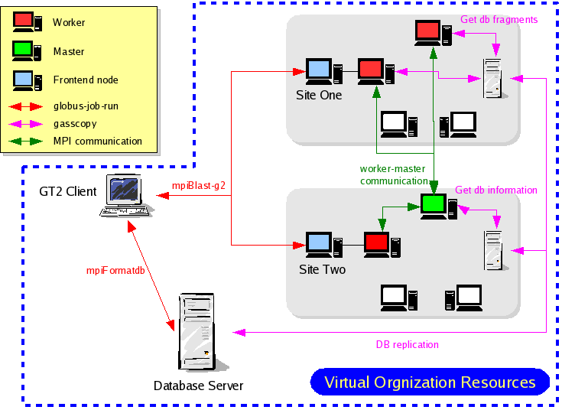
mpiBLAST-g2

Slide 8
Advantages of mpiBLAST-g2
Sharing idle resources in Virtual Organization (VO)
  Solving problems larger than before
Fetching database from remote site in secured mode
  Reducing the load of local database server
  Protecting private data
Providing tools for database replication
  Simplifying the management work

Slide 9
Grid resources
Resources are from PRAGMA
  ASCC, Taiwan
  AIST, Japan
  BII, Singapore
  KISTI, Korea
  SDSC, U.S.

Slide 10
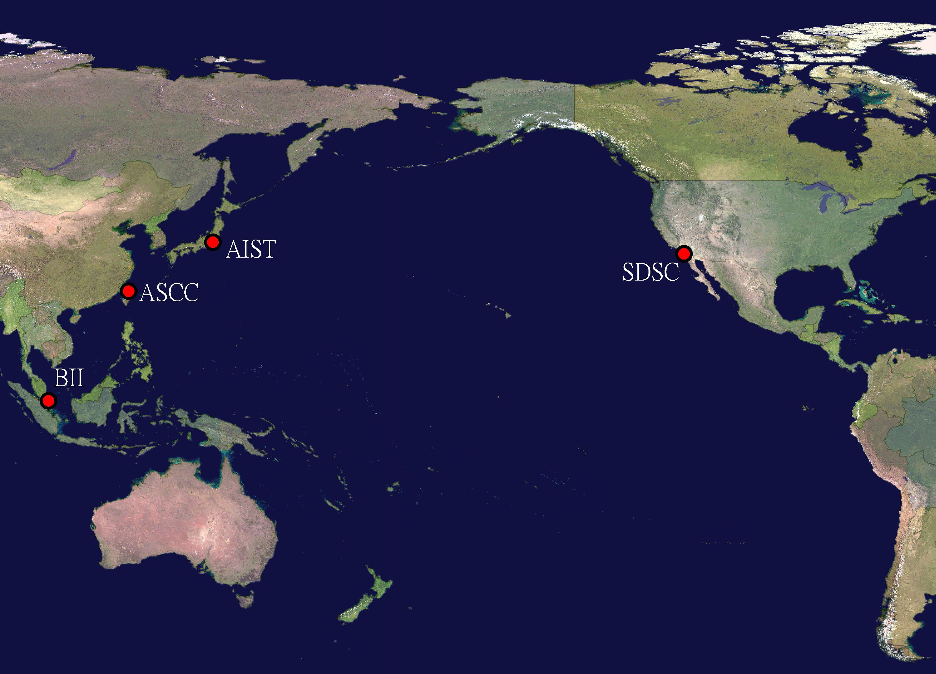
Grid Resources
kISTI

Slide 11
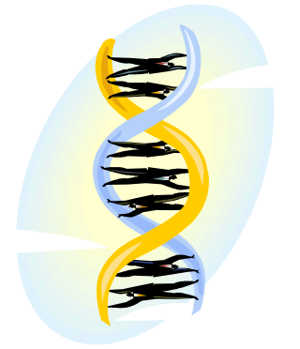
Demonstration cases
Query – Arabidopsis Chr4 contig (600 Kbps)
Database – Arabidopsis cDNA (~50 Mbps)

Slide 12
Thanks for your attention!

Slide 13
Testing results

