Slide 1
Routine-Basis Experiments in PRAGMA Grid Testbed
Yusuke Tanimura
yusuke.tanimura@aist.go.jp
Grid Technology Research Center
National Institute of AIST
Notes:
I will introduce a Ninf-G application. TDDFT is one of our applications. We evaluate new features of Ninf-G Ver.2 using TDDFT and perform the PRAGMA routine-basis experiments.

Slide 2
Agenda
Past status of PRAGMA testbed
    Discussions in PRAGMA 6 in May, 2004
Routine-basis experiments
  Result of 1st application
    Technical results
    Lessons learned
  Future plans
Current works toward the production grid
    Activity as Grid Operation Center
    Cooperation with other working groups

Slide 3

Status of Testbed in May, 2004
Computational resource
  26 organizations (10 countries)
  27 clusters (889 CPUs)
  Network performance is getting better.
Architecture, technology
  Based on Globus Toolkit (mostly version 2)
  Ninf-G (GridRPC programming)
  Nimrod-G (parametric modeling system)
  SCMSWeb (resource monitoring)
  Grid Data FArm (Grid File System), etc.
Operation policy
  Distributed management (No Grid Operation Center)
  Volunteer-based administration
    Less duty, less formality and less document

Slide 4
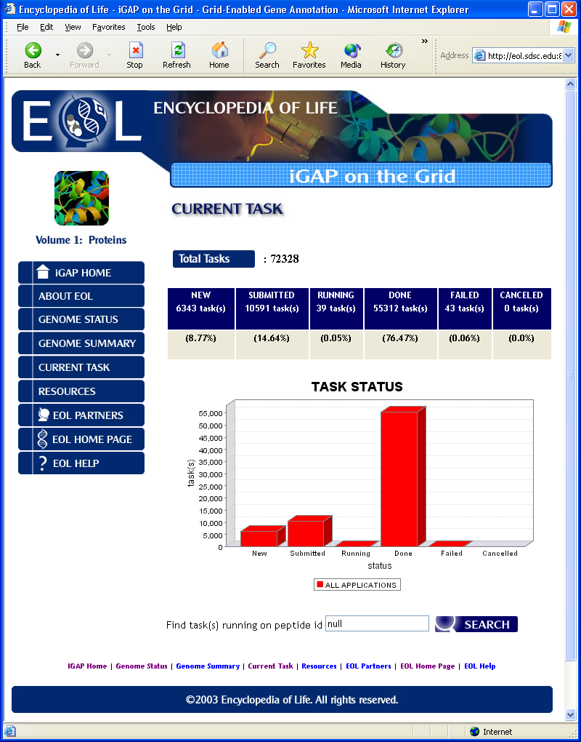
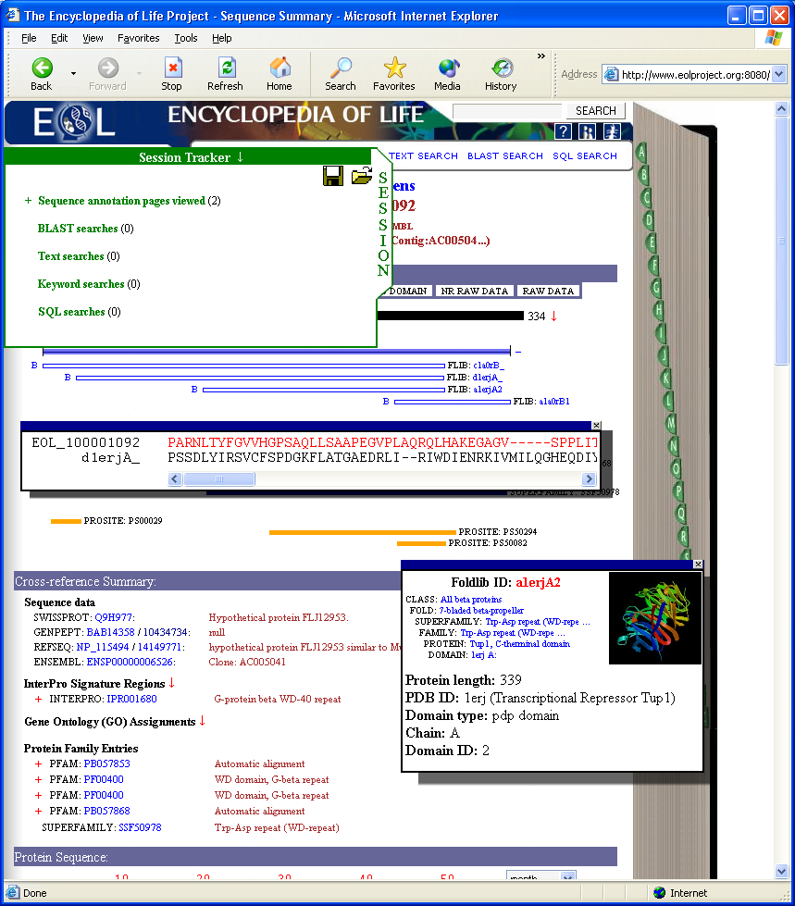
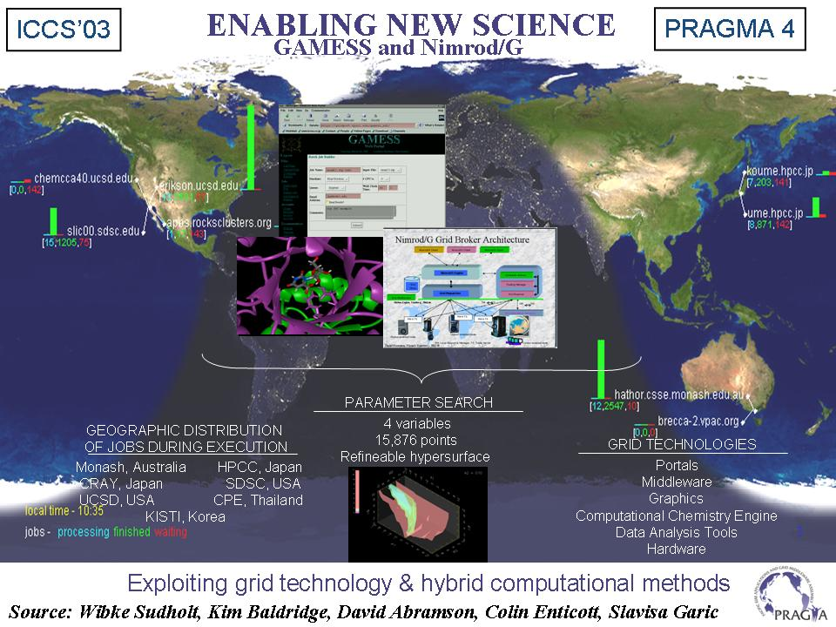
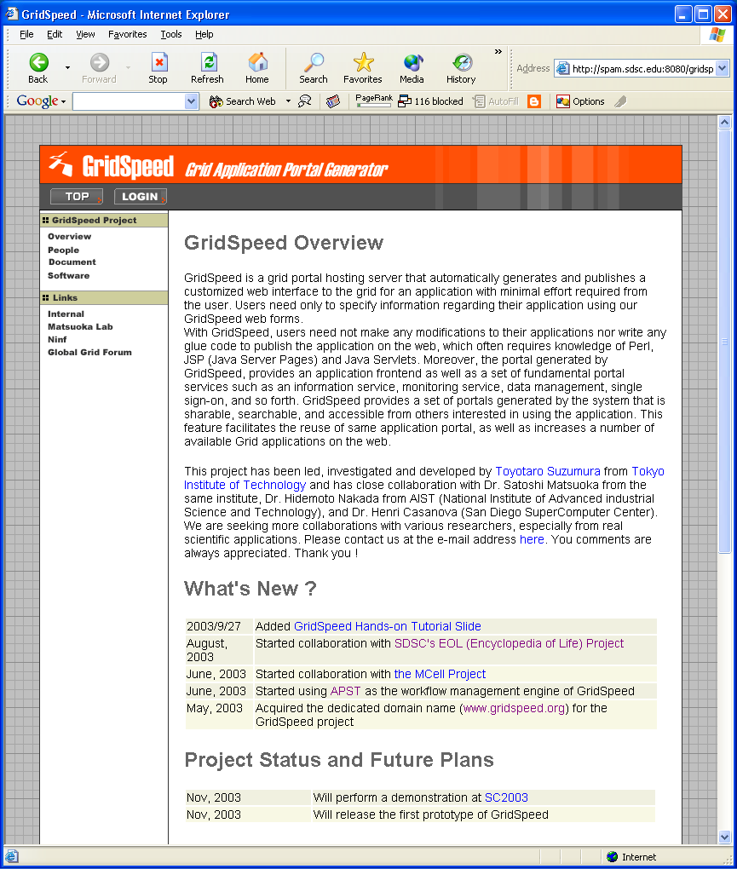
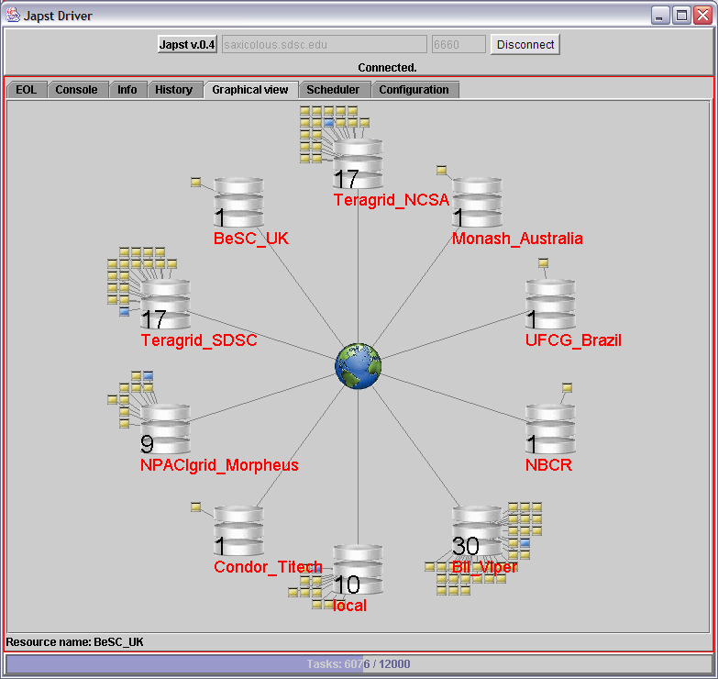
Status of Testbed in May, 2004
Questions???
  Ready for real science application?
    Easy to use for every user?
    Reliable environment?
    Middleware stability?
    Plenty document?
    Enough security?
    and etc.
Direction of PRAGMA Resource Working Group
  Do “Routine-basis Experiments”
    Try daily application runs for a long term
    Find out any problems and difficulty
    Learn what is necessary for the production grid?

Slide 5
Overview of Routine-Basis Exp.
Purpose
  By daily runs of a sample application on PRAGMA testbed
  Find out and understand issues of the testbed operation for the real science application
Case of 1st application
  Application
    Time-Dependent Density Functional Theory (TDDFT)
    Software requirements of TDDFT are Ninf-G, Globus and Intel Fortran Compiler.
  Schedule
    June 1, 2004 ~ August 31, 2004 (For 3 months)
  Participants
    10 Sites (in 8 countries): AIST, SDSC, KU, KISTI, NCHC, USM, BII, NCSA, TITECH, UNAM
    193 CPUs (on 106 nodes)

Slide 6
Rough Schedule
May
June
July
Aug
Sep
Oct
Nov
2 sites
5 sites
8 sites
10 sites
SC’04
Setup Resource Monitor (SCMSWeb)
2nd user start executions
2nd App. start
PRAGMA6
PRAGMA7
1st App. start
1st App. end
“These works were continued during 3 months.”
1. Apply account
2. Deploy application codes
3. Simple test at local site
4. Simple test between 2 sites
Join in the main executions after all’s done

Slide 7

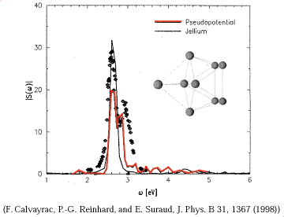
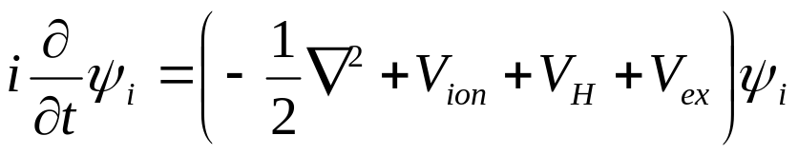
Details of Application (1)
TDDFT: Time-Dependent Density Functional Theory
    By Nobusada (IMS) and Yabana (Tsukuba Univ.)
  Application of the computational quantum chemistry
  Simulate how the electronic system evolves in time after excitation
Time dependent N-electron wave function is
which is approximated and transformed to
then applied to numerical integration.
A spectrum graph by calculated real-time dipole moments
Notes:
TDDFT is Time-Dependent Density Functional Theory by Nobusada and Yabana. This is an application of computational quantum chemistry. This simulates how the electronic system evolves in time after excitation. The excitation is caused by irradiation of laser pulse. When this happens, the electron which exists as a kind of cloud or filed has some energy. I heard scientists in quantum chemistry would like to know this behavior. The calculation is performed by solving this equation. The result is converted to the spectrum of real-time dipole moments and then this graph is utilized for its application research.

Slide 8


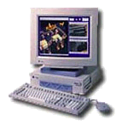

Details of Application (2)
GridRPC model using Ninf-G
  Execute some partial calculations on multiple servers in parallel
Sequential program
Cluster 1
Server
gatekeeper
Client
Exec func() on backends
Client program of TDDFT
tddft_func()
main(){
:
grpc_function_handle_default(
&server, “tddft_func”);
:
grpc_call(&server, input, result);
:
Cluster 2
GridRPC
Cluster 3
Cluster 4
user

Slide 9
Details of Application (3)
Parallelism: Suitable to GridRPC framework
Real Science: Long-time run, Large data
  Require 6.1 millions of RPCs (Take about 1 week)
Client program
Cluster 1
main(){
:
:
:
:
:
1~2 sec calc.
4.87 MB
212 MB file
Numerical integration part
3.25 MB
122 RPCs
Cluster 2
5000 iterations
Cluster 3
user
Ex. the legand-protected Au₁₃ molecule
Cluster 4

Slide 10
Fault-Tolerant Mechanism
Management of the server’s status
  Status: Down, Idle, Busy (calculating or initializing)
  Error detection (ex. heartbeat from servers)
Reboot a down server
  Periodical work (ex. 1 trial per hour)
Finished task
Error
Idle
Start
Down
Busy
Restart
Error
Submitted task by RPC

Slide 11
Experiment Procedure (1)
Application of user account
  Account application (Usual procedure)
  Installation of AIST GTRC CA’s certificate
  Update of grid-mapfile
  (In some cases) Update of access permission on firewalls
Deployment of TDDFT application
  Software requirement:
    Installation of Globus version 2.x
    Intel Fortran Compiler version 6, 7 or latest 8
  Installation of Ninf-G
    Some sites prepared Ninf-G for the experiment
  Installation of TDDFT server
    Upload source code and compile them ← Real user’s work

Slide 12
Experiment Procedure (2)
Test
  Globus level test
    globusrun –a –r <HOST>
    globus-job-run <HOST>/jobmanager-fork /bin/hostname
    globus-job-run <HOST>/jobmanager-pbs –np 4 /bin/hostname
  Ninf-G level test
    It could be confirmed by calling a sample server.
  Application level test
    Run TDDFT with short-run parameters on 2 sites (client & server)
Start experiment
  Run TDDFT with long-run parameters
  Monitor status of the run
    Task-throughput, Fault, Communication performance and etc.

Slide 13
Troubles for a user
Authentication failure
  SSH login, Globus GRAM, Access to compute nodes
  CA/CRL, UID/GID had a problem.
Job submission failure on each cluster
  A job was queued and never run.
  Incomplete configuration of jobmanager-{pbs/sge/lsf/sqms}
Globus-related failure
  Globus installtion seemed to be incomplete.
Application (TDDFT) failure
  No shared libraries of GT and Intel compiler on compute nodes
  Poor network performance in Asia
  Instability of clusters (by NFS, heat or power supply)

Slide 14
Numerical Results (1)
Application user’s work
  How long does it take time to run TDDFT after getting account?
  8.3 days (in average)
  How much work is necessary for one troubleshooting?
  3.9 days and 4 e-mails (in average)
Executions
  Number of major executions by two users: 43
  Execution time (Total): 1210 hours (50.4 days)
  (Max) : 164 hours (6.8 days)
  (Ave) : 28.14 hours (1.2 days)
  Number of RPCs (Total): more than 2,500,000
  Number of RPC failures: more than 1,600
  (Error rate is about 0.064 %)

Slide 15
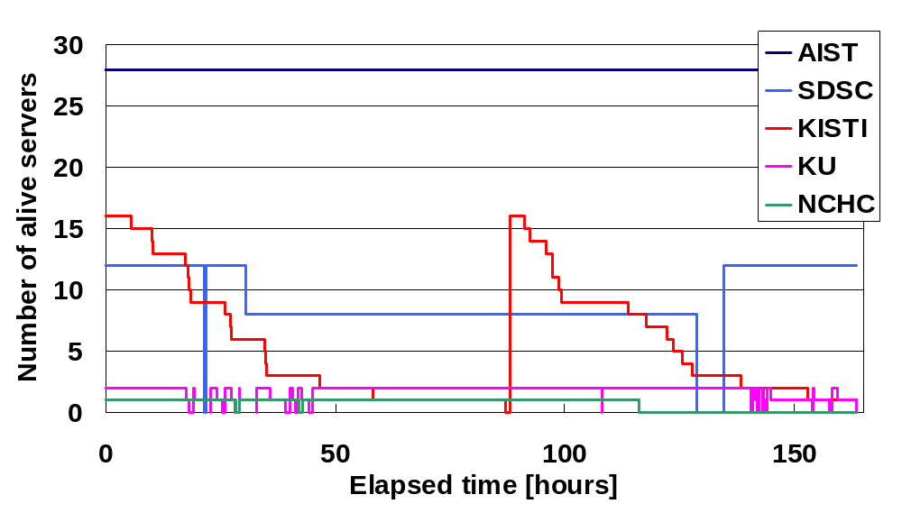
Result (2) : Server’s stability
The longest run using 59 servers over 5 sites
Unstable network between KU (in Thailand) and AIST

Slide 16
Summary
Found out the following issues
  In deployment and tests
    Need much user’s work
    Need self-trouble shooting
  In execution
    Unstable network
    Hard to know each cluster’s status
      Maintenance or troubling?
    Need some middleware improvement
Details of lessons learned
Current works toward the production grid
Next. Please keep staying here.

Slide 17
Credits
KISTI (Jysoo Lee, Jae-Hyuck Kwak)
KU (Sugree Phatanapherom, Somsak Sriprayoonsakul)
USM (Nazarul Annuar Nasirin, Bukhary Ikhwan Ismail)
TITECH (Satoshi Matsuoka, Shirose Ken'ichiro)
NCHC (Fang-Pang Lin, WeiCheng Huang, Yu-Chung Chen)
NCSA (Radha Nandkumar, Tom Roney)
BII (Kishore Sakharkar, Nigel Teow)
UNAM (Jose Luis Gordillo Ruiz, Eduardo Murrieta Leon)
UCSD/SDSC (Peter Arzberger, Phil Papadopoulos, Mason Katz, Teri Simas, Cindy Zheng)
AIST (Yoshio Tanaka, Yusuke Tanimura)
and other PRAGMA members

Slide 19
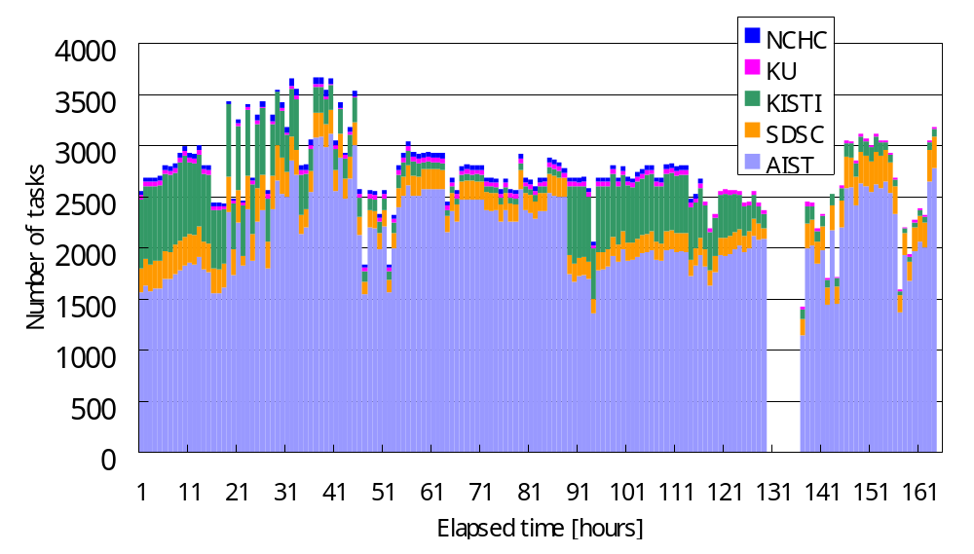
Result (3) : Task throughput / hour
Reason of instability
  Waiting for some slow server and timeout from other servers
  Discussing about better fault detection and recovery mechanism
0 10 20 30 40 50 60 70 80 90 100 110 120 130 140 150 160

Slide 20

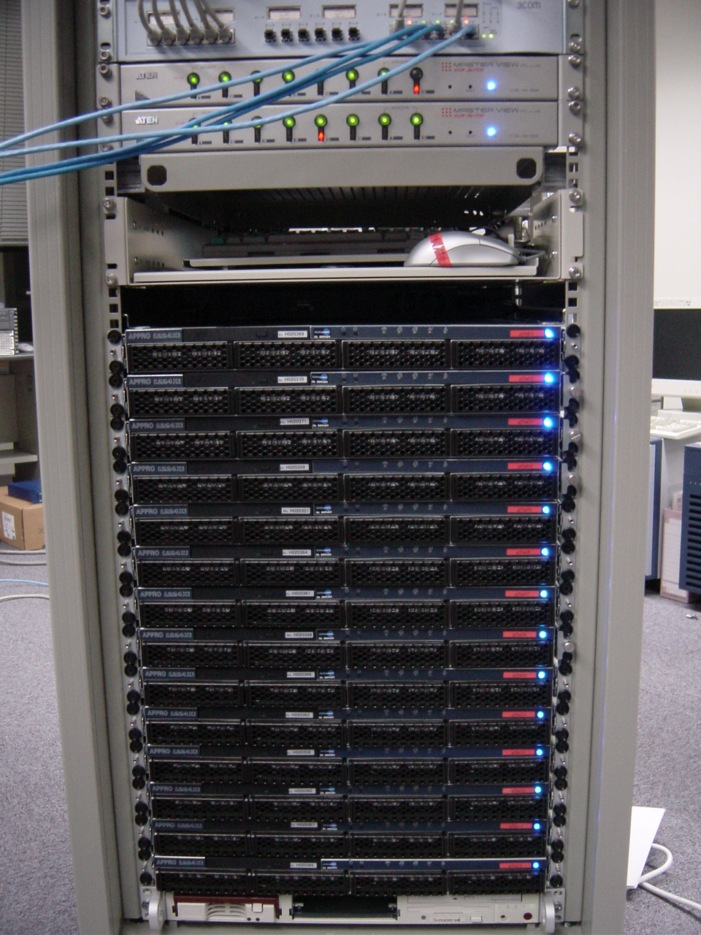
Ninf-G
Grid middleware to develop and execute scientific application
Support GridRPC API (Discussed on GGF’s APME working group)
Built on Globus Toolkit 2.x, 3.0 and 3.2
May, 2004: Version 2.1.0 Release
Executable
func()
main(){
:
grpc_function_handle_default(
&handle, “func_name”);
:
grpc_call(&handle, A, B, C);
:
Server
Server
globus-gatekeeper
( job-manager )
func()
user
Use backend of a cluster
func()
Compute node

Slide 21
New Features of Ninf-G Ver.2 in Impl.
Remote object
  Objectification
    Server has multiple methods.
    Server keeps internal data and share it between sessions.
  Effect
    To reduce extra calculations and communications
    To improve programmability
Error handling and heartbeat function
  Return appropriate code for any errors
    Discussing GridRPC API standard
  Heartbeat function
    Servers send a packet to the client periodically.
    When heartbeat does not reach to the client for a certain time, GridRPC wait() function will be error.

