Slide 1

Testbeds For Collaborations
Cindy Zheng
PRAGMA Grid Testbed Coordinator
Pacific Rim Application and Grid Middleware Assembly
San Diego Supercomputer Center
University of California, San Diego
http://www.pragma-grid.net
http://goc.pragma-grid.net

Slide 2
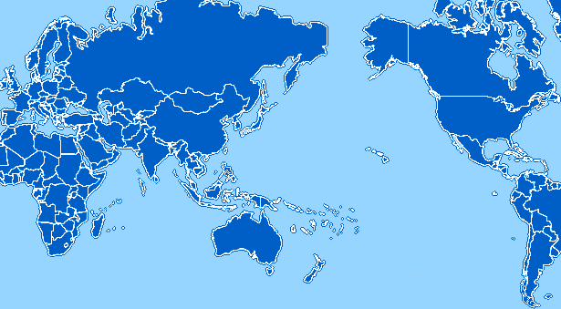
PRAGMA Grid Testbed
UZurich
Switzerland
CNIC
GUCAS
China
JLU
China
AIST
OsakaU
UTsukuba
TITech
Japan
NCSA
USA
KISTI
Korea
BU
USA
UUtah
USA
SDSC
USA
KU
NECTEC
Thailand
ASGC
NCHC
Taiwan
CICESE
Mexico
UMC
USA
UoHyd
India
CUHK
HongKong
UNAM
Mexico
MIMOS
USM
Malaysia
IOIT-HCM
Vietnam
ASURC
Costa Rica
APAC
QUT
Australia
BII
IHPC
NGO
Singapore
UCN
Chile
BESTGrid
New Zealand
MU
Australia
UChile
Chile
29 Clusters from 26 institutions in 14 countries/regions (+9 in preparation)
Notes:
This image will be kept up-to-date at http://goc.pragma-grid.net/pragma-doc/testbed.JPG
The PRAGMA Grid Testbed was established in May of 2004 to conduct routine-use experiments,
improve grid middleware and application interoperabilities, and to make the grid easier to use for
researchers and scientists. All resources and contributions are voluntary and are submitted from
both PRAGMA member and non-member sites.
In the past 2 years, the PRAGMA Grid Testbed has grown to include 26 sites in 14 countries,
with a total of 726 CPUs, more than half a terabyte of memory, and 13.2 terabytes of online storage.
We have 12 applications running in the testbed (is this current tense or past tense?), and have tested
and improved 3 major application middleware types --- Ninf-G, Nimrod and Mpich-gx. We have also
tested and incorporated 3 major grid infrastructure middleware –
SCMSWeb (grid monitoring), MOGAS (grid accounting) and Gfarm (grid file system), and continue
to expand in size with additional sites added on an ongoing basis.
More significantly, the PRAGMA Grid Testbed is transforming itself from a computational-only grid into
a computational+data+sensor network grid. We strive to understand the issues and requirements in running
applications, with the goals of developing/testing various grid services, that ultimately solve the issues
of making the grid easier to use.

Slide 3
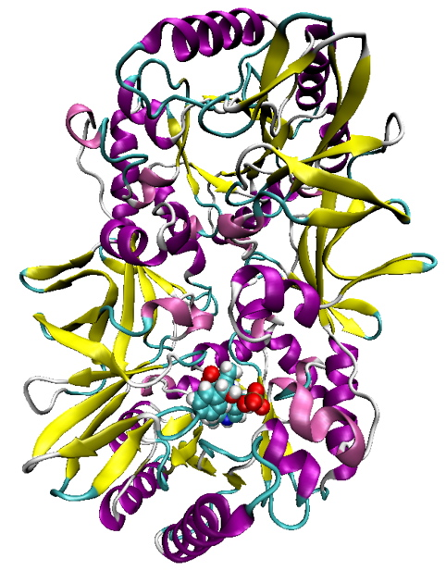
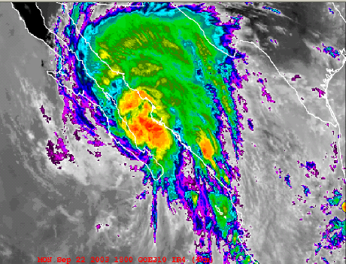
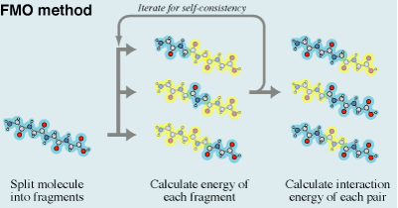
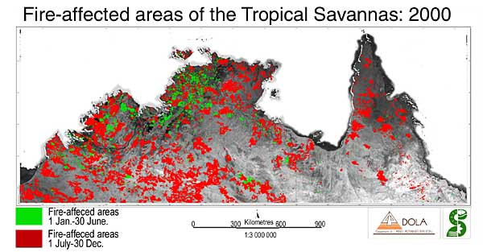
Applications http://goc.pragma-grid.net
Achieved long run and scientific results
  Savannah/Nimrod, MU, Australia
  TDDFT/Ninf-G, FMO/Ninf-G, AIST, Japan
Successful run
  MM5/Mpich-Gx, CICESE/KISTI, Mexico/Korea
12 applications continue run in testbed, each with a specific middleware
  Savannah/Nimrod: climate model, MU, Australia
  MM5/Mpich-Gx: climate model, CICESE, Mexico
  QM-MD, FMO/Ninf-G: quantum-mechanics, AIST, Japan
  iGAP/Gfarm/CSF: genomics, UCSD, USA
  HPM: genomics, IOIT-HCM, Vietnam
  mpiBlast/Mpich-G2: genomics, ASGC, Taiwan
  Gamess-APBS/Nimrod: organic chemistry, UZurich, Switzerland
  Siesta/Nimrod: molecular simulation, UZurich, Switzerland
  Amber/Rsh: molecular simulation, USM, Malaysia
Notes:
Application drive issue discovery, middleware development and enhancement
Each application paired with a specific middleware

Slide 4










Application/Middleware Collaborations
Mpich-Gx based MM5 and WRF
  MM5 and WRF: CICESE, Mexico
  Mpich-Gx: KISTI, Korea
Test/develop Gfarm and CSF with iGAP
  Gfarm: AIST, Japan
  CSF: JLU, China
  iGAP: UCSD, USA
Testbed going datagrid with Gfarm-fuse
  Big file system nodes
    AIST – 1.5 TB
    SDSC – 400 GB
  Start deployment after SC06
  All applications can benefit
Rocks and middleware
  Ninf-G, SCE, Bio, GEON, … (AIST, ThaiGrid, NBCR, GEON, …)
  Rocks: SDSC, USA

Slide 5



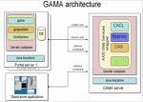
Grid Security
IGTF (OGF) accreditation
  APGrid PMA, http://www.apgridpma.org/
  5 site-CAs are IGTF accredited
    AIST, ASGC, CNIC, KISTI, NCSA
  PRAGMA CA, catch-all, use/test Naregi-CA
GSI credential management
  Naregi-CA, https://www.naregi.org/ca/
    APGrid, UChile, …
  GAMA, http://grid-devel.sdsc.edu/gridsphere/gridsphere?cid=gama
  User private key issue: working with APGrid PMA and IGTF on new authentication profile

Slide 6







Data and Sensor Network Collaborations
PRAGMA and GEON/iGEON collaboration
  Sharing data, software know-how, interoperate grids
  CNIC (China)
    Is setting up a GEON data node in PRAGMA testbed
  UoHyd (India)
    has setup a GEON node, will join PRAGMA testbed
  Geoscience workgroup established at PRAGMA11
  AIST Geogrid (Japan) plan
    Share data with GEON
    Interoperate with PRAGMA testbed
  GUCAS (China)
    Setup a GEON node in PRAGMA testbed
  UMC (USA) and GUCAS
    Preparing a GEON application to run in PRAGMA testbed
Sensor network collaboration
  BU (USA)
    Joining PRAGMA grid testbed
    Preparing a sensor network application to run in the testbed
  NCHC (Taiwan)
    preparing a sensor application to run in testbed
  GLEON
    link GLEON sites to PRAGMA testbed computing and data grids

Slide 7
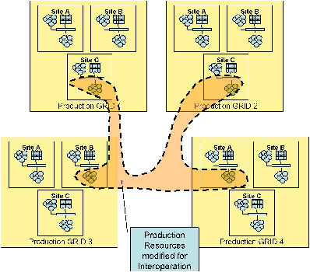




Grid Interoperation Now (GIN) http://forge.gridforum.org/sf/wiki/do/viewPage/projects.gin/wiki/GinOps
GIN testbed (started Feb. 2006)
  PRAGMA, TeraGrid, EGEE, OSG, NorduGrid
Applications
  TDDFT/Ninf-G
    Yoshio Tanaka, Yusuke Tanimura (AIST, Japan)
    Deployed and run
      PRAGMA - AIST, NCSA, SDSC
      TeraGrid – ANL
      OSG – UCSD
      NorduGrid
    Working on deployment to EGEE
  Savanah Study (data intensive)
    Colin Enticott (MU, Australia)
    Ready to start

Slide 8

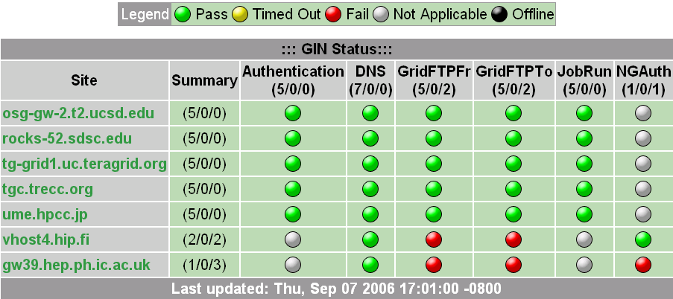
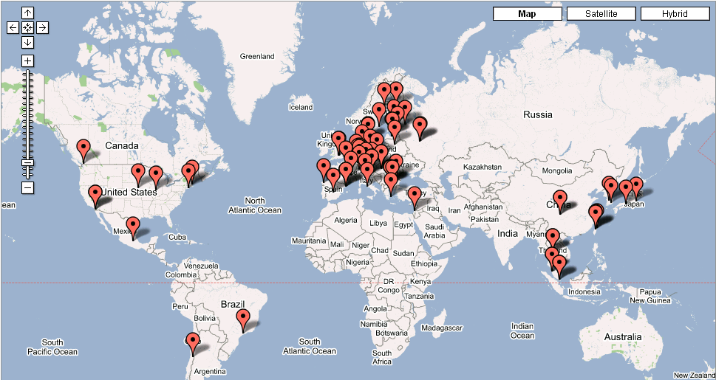
GIN Testbed Monitoring http://forge.gridforum.org/sf/wiki/do/viewPage/projects.gin/wiki/GinOps
Infrastructure testing matrix
  http://goc.pragma-grid.net/cgi-bin/scmsweb/probe.cgi
  SCMSWeb (by Thaigrid)
  Working with PRAGMA Grid, TeraGrid, OSG, NorduGrid, EGEE
  New version to handle various grid service configurations/tests
GIN map http://maps.google.com/maps?q=http://lfield.home.cern.ch/lfield/gin.kml
  Implemented a XML-> LDIF translator for GIN map
  Collaboration of ThaiGrid and CERN
Cross-grid monitoring - Common schema
  http://wiki.pragma-grid.net/index.php?title=GIN_%28Grid_Inter-operation_Now%29_Monitoring
  Working with PRAGMA Grid, TeraGrid, OSG, NorduGrid, EGEE

Slide 9
























Thank You
http://www.pragma-grid.net
http://goc.pragma-grid.net
Notes:
28 Members from around the Pacific Rim.
STEERING COMMITTEE MEMBERS designated by *
academia sinica computing centre (ascc)
Simon Lin, sclin@gate.sinica.edu.tw; Eric Yen, eric@sinica.edu.tw
asia-pacific advanced network (apan)
Seishi Ninomiya, snino@affrc.go.jp; Kento Aida, aida@ip.titech.ac.jp
australian partnership for advanced computing (apac)
John O’Callaghan,* john.ocallaghan@apac.edu.au; David
Abramson,* davida@csse.monash.edu.au; Bernard Pailthorpe,*
bap@acmc.uq.edu.au
bioinformatics institute, singapore (bii)
Santosh Mishra*, santosh_mishra@bii.a-star.edu.sg
center for computational sciences (ccs), university of
tsukuba
Mitsuhisa Sato, msato@cs.tsukuba.ac.jp; Taisuke Boku,
taisuke@cs.tsukuba.ac.jp
college of computer science and technology (ccst), jilin
university (jlu)
Xiaohui Wei, weixh@jlu.edu.cn
computer network information center (cnic), chinese
academy of sciences (cas)
Baoping Yan,* ybp@cnic.ac.cn; Kai Nan,* nankai@cnic.ac.cn
cray inc.
Geert Wenes, geertw@cray.com; Kazunori Mikami, mikami@cray.com
cybermedia center (cmc) and research center for ultrahigh
voltage electron microscopy, osaka university
Shinji Shimojo,* shimojo@cmc.osaka-u.ac.jp; Susumu Date,*
date@ais.cmc.osaka-u.ac.jp
global scientific information and computing center
(gsic), tokyo institute of technology (titech)
Satoshi Matsuoka,* matsu@is.titech.ac.jp; Hidemoto Nakada, hidenakada@
aist.go.jp
grid technology research center (gtrc), national institute
of advanced industrial science and technology (aist)
Satoshi Sekiguchi,* sekiguchi@m.aist.go.jp; Yoshio Tanaka,*
yoshio.tanaka@aist.go.jp
kasetsart university (ku)
Surasak Sanguanpong, Surasak.S@ku.ac.th; Putchong Uthayopas,
pu@ku.ac.th
korea basic science institute (kbsi)
Inho Gim, inhogim@kbsi.re.kr; Jung-Eok Gu, jekoo@kbsi.re.kr
korea institute of science and technology information
(kisti)
Jysoo Lee,* jysoo@kisti.re.kr, Kum Won Cho,* ckw@kisti.re.kr
national agriculture research center (narc)
Seishi Ninomiya, snino@affrc.go.jp; Masayuki Hirafuji,
hirafuji@affrc.go.jp
national center for high-performance computing
(nchc), national applied research laboratories
Whey-Fone Tsai,* c00wft00@nchc.org.tw; Fang-Pang Lin,*
fplin@nchc.org.tw
national center for supercomputing applications (ncsa),
university of illinois at urbana-champaign (uiuc)
Radha Nandkumar, radha@ncsa.uiuc.edu; Danny Powell,
danny@ncsa.uiuc.edu
national electronics and computer technology center
(nectec)
Piyawut Srichaikul,* piyawut.srichaikul@nectec.or.th, Chalermpol
Charnsripinyo,* chalermpol.charnsripinyo@nectec.or.th, Sornthep
Vannarat, sornthep.vannarat@nectec.or.th
national grid office (ngo), singapore
Lawrence Wong, lwong@i2r.a-star.edu.sg; Hing Yan Lee,
hingyan@ngp.org.sg
pacific northwest gigapop (pnwgp)
Jacqueline Brown, jbrown@cac.washington.edu
star tap/starlight initiative
Maxine Brown,* maxine@uic.edu; Tom DeFanti, tom@uic.edu
transpac, indiana university
James Williams,* william@indiana.edu; Donald McMullen,*
mcmullen@indiana.edu; John Hicks, jhicks@iupui.edu
universiti sains malaysia (usm)
Ahmad Yusoff Hassan,* cio@usm.my; Habibah A. Wahab,*
habibahw@usm.my
university of california, san diego (ucsd), including Calit2,
San Diego Supercomputer Center (SDSC), Center for Research in
Biological Systems (CRBS), National Center for Microscopy and
Imaging Research (NCMIR), and National Laboratory for Applied
Network Research (NLANR); Peter Arzberger,* parzberg@ucsd.edu;
Philip Papadopoulos,* phil@sdsc.edu; Mason Katz, mjk@sdsc.edu;
Teri Simas, simast@sdsc.edu
university of hyderabad (uoh)
Arun Agarwal,* aruncs@uohyd.ernet.
New Members
Institute of High Performance Computing (iHPC) Terrance Hung
Centro de Investigacion Cientifica y de Educacion Superior de Ensenada (CICESE) Raul Hazas Izquierdo
Malaysian Institute of Microelectronic Systems (MIMOS) Mashkuri Yaacob
CIRCLED SITES had demonstrations at IGRID – 18 of 49 Demos were PRAGMA members
Partnership: relationship (between individuals or groups) characterized by mutual cooperation and responsibility
Collaboration: work together, especially in a joint intellectual effort

