Slide 1

Jerry Tsai
PRIME 2011
Melbourne, Australia, Monash University
Mentors: Dr. Johan Hake, Dr. David Abramson
Week 2

Slide 2
Background
The goal of this project is to investigate the Calcium dynamics within a cardiac cell. Since Calcium movement is responsible for the EC coupling in our heart, the scientists may come up with better treatments for cardiac diseases by expanding the knowledge of the Calcium movements within the cardiac cell. Even though the idea of EC coupling seems simple, it is actually a result of many nonlinear interactions between buffers and proteins. As it is difficult to perform experiments directly onto humans and animals, a computer model becomes essential.

Slide 3
Outline
The first task is to develop a mathematical model from the published experimental data on Calcium movements.
Using the developed subcell model of a rat myocyte, we can answer some questions regarding local Ca dynamics through parameter sweeps on Nimrod/G and Nimrod/O:
1) Where should the Serca Pump be located?
2) What caused the Ca diffusion within the SR network to be slower compared to Ca diffusion elsewhere?
3) What is the magnitude of the local Ca concentration at the nearby sarcolemmal proteins during Calcium release?

Slide 4
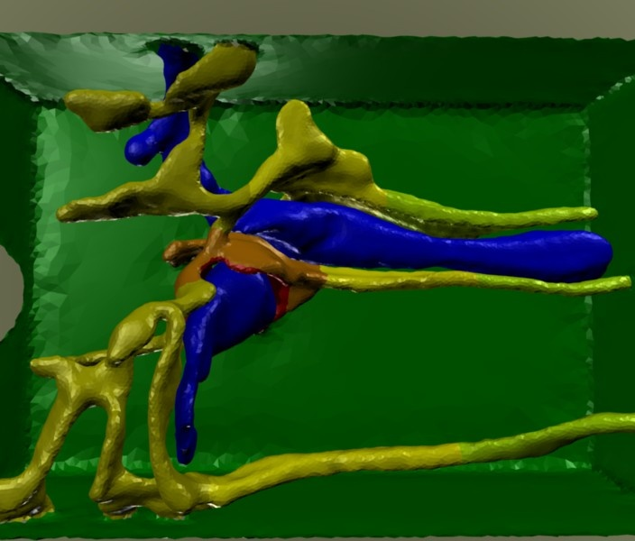
The SR Mesh

Slide 5
Progress in the past
Created a mathematical model of the SR compartments using the SR mesh generated by Dr. Johan Hake
  The volumes of the compartments, the area of the boundaries, and the distances between the compartments were declared according to the mesh
  The species contained in the compartments, the fluxes between each compartments, and the buffers and their concentrations in the model were implanted from solving some differential equations and from previous experimental data
Started learning Nimrod; the passive refilling and releasing experiments were run
  All Serca Pumps were blocked to mimic the experiments done by Cheng
  The buffer concentration and other parameters were set up according to the experiments done by Zima
Notes:
*

Slide 6
Progress in the past(2)
Reviewed some papers regarding Calcium movements in cardiac cells.
Analysed the data obtained from the refilling experiments
  The Sigma_SR_scale and nSRBulk.dx were determined to be 0.33 and 1600 nm from parameter sweeps
  The total run time was 500 ms and dt was set to be 10 ms
T-tubule currents were added, currently debugging the model

Slide 7
Future Plans
  jSRBoundaryRel.dx still needs to be determined so that the release can last 10+ seconds
Use the parameters that fit the experimental values the best in the calcium release experiment
Add Serca pumps onto the model and start doing experiments with the newly added currents and fluxes.

Slide 8
Acknowledgments
UCSD PRIME
  Dr. Gabriele Wienhausen, PRIME Principal Investigator
  Dr. Peter Arzberger, PRAGMA Principal Investigator
  Teri Simas, UCSD PRIME program manager
  Tricia Taylor, AIP
UCSD Cardiac Mechanics Laboratory
  Dr. Johan Hake, mentor
  Dr. Andrew McCulloch, faculty advisor
Monash University MESSAGE lab/DSSE
  Blaire Bethwaite, Nimrod support
  Dr. David Abramson, faculty advisor

Slide 9
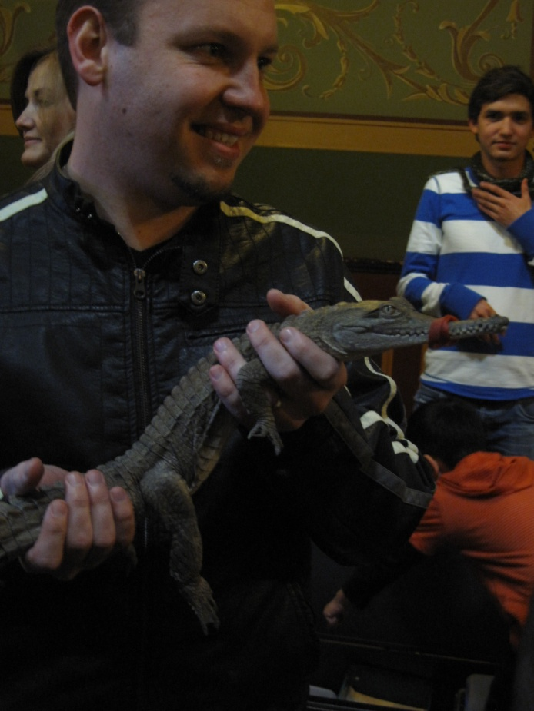
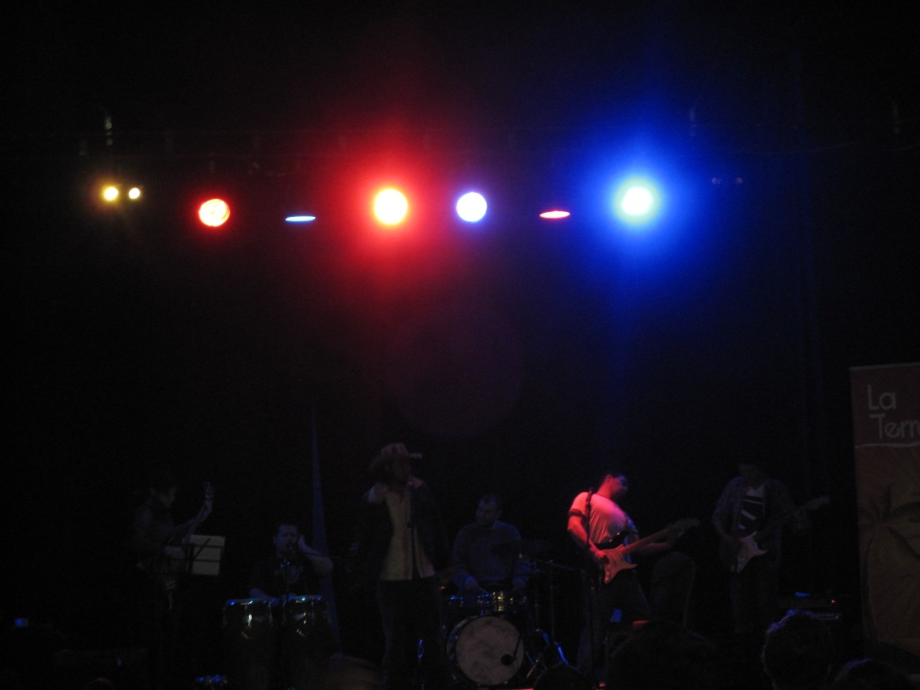
Cultural Experience
Apparently doing that to a crocodile is common in Australia
Australian concert

Slide 10
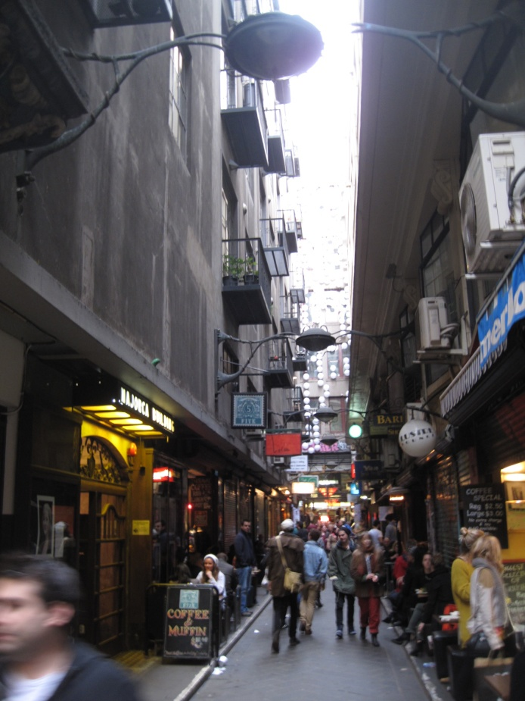
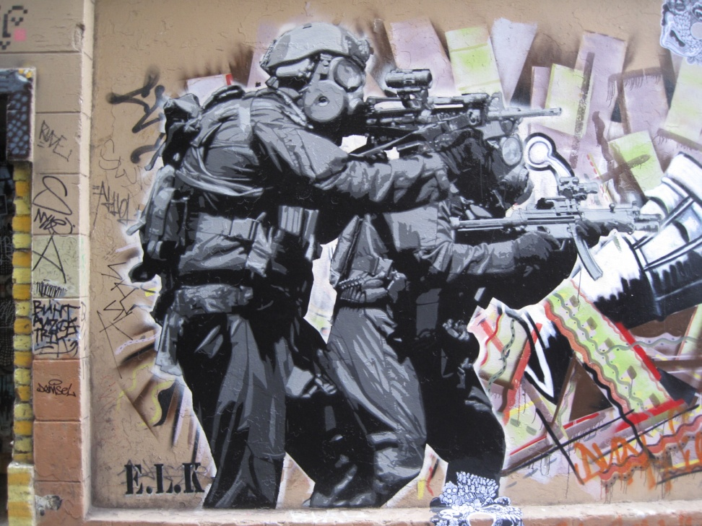
Cultural Experience
Flinder’s lane- famous for coffee shops
A lot of graffitis in Melbourne

