Slide 1
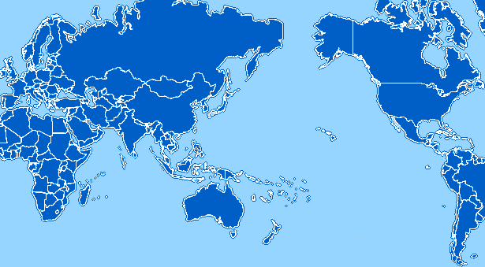
PRAGMA Grid
UZH
Switzerland
UZH
Switzerland
AIST
OsakaU
UTsukuba
TITech
Japan
CNIC
GUCAS
China
JLU
China
NCSA
USA
KISTI
Korea
BU
USA
UUtah
USA
LZU
China
LZU
China
SDSC
USA
ASGC
NCHC
Taiwan
CUHK
HongKong
UPRM
Puerto Rico
UoHyd
India
CICESE
Mexico
ASTI
Philippines
UNAM
Mexico
NECTEC
ThaiGrid
Thailand
HCMUT
HUT
IOIT-HCM
Vietnam
CeNAT-ITCR
Costa Rica
SKU
UI
Indonesia
MIMOS
USM
Malaysia
APAC
MU
QUT
Australia
BII
IHPC
NGO
NTU
Singapore
MU
Australia
BESTGrid
New Zealand
UChile
Chile
34 institutions in 17 countries/regions, 28 compute sites (+ 8 in preparation)

