Slide 1
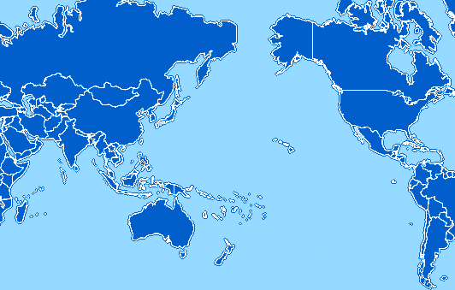
PRAGMA Member Institutions
JLU
China
KBSI
KISTI
Konkuk
Korea
CNIC
China
AIST
CCS
CMC
NARC
OsakaU
TITech
Japan
CalIT2
CRBS
SDSC
UCSD
USA
CRAY
PNWG
USA
UoHyd
India
NCSA
StarLight
TransPAC2
USA
ASGCC
NCHC
Taiwan
CICESE
Mexico
KU
NECTEC
TNGC
Thailand
APAN
USA
BII
IHPC
NGO
Singapore
APAC
Australia
MIMOS
USM
Malaysia
MU
Australia

