Slide 1

Dynamic Resource Management for Virtualization HPC Environments
Xiaohui Wei
College of Computer Science and Technology
Jilin University, China.
2011-10-19
PRAGMA 21 Workshop, Sapporo, Hokkaido, Japan on October 17-20

Slide 2
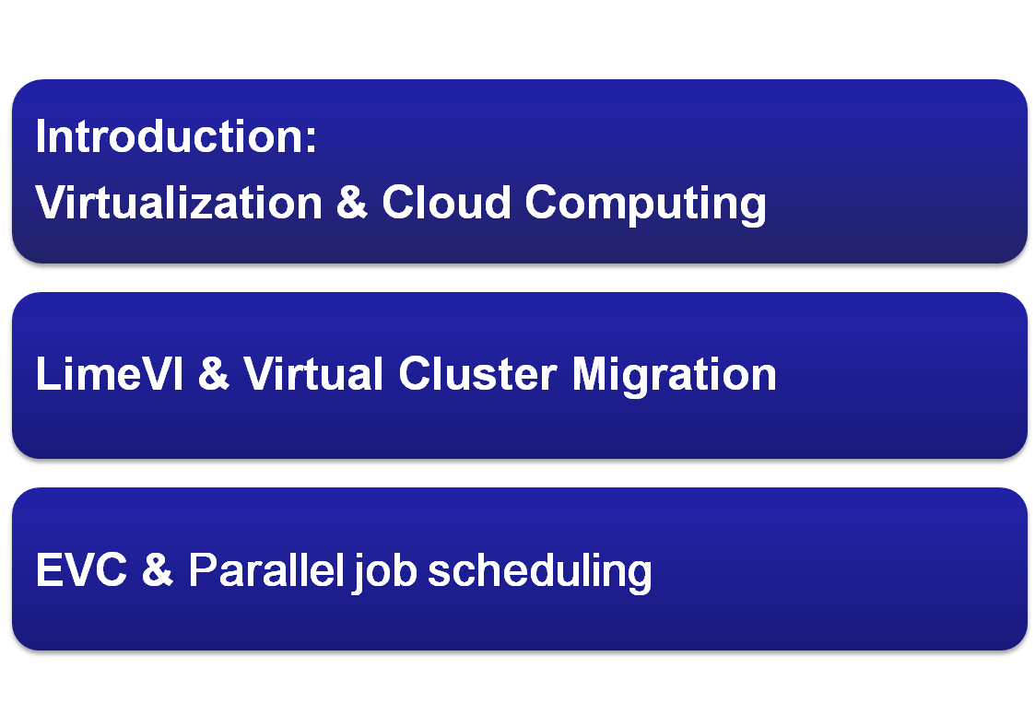
2011-10-19
PRAGMA 21 Workshop, Sapporo, Hokkaido, Japan on October 17-20
Notes:
Here is the content of this presentation.
First I’ll introduce the background of this work. Then is the design of elastic virtual cluster model.
After that, is the hyper concurrent live migration protcol, which is the main contribution of this paper.
Finally, I will conclude this presentation and present some future plans.

Slide 3

2011-10-19
PRAGMA 21 Workshop, Sapporo, Hokkaido, Japan on October 17-20
Notes:
First, background.

Slide 4
Introduction
Virtualization technology
  “Most application and system software will be running on Virtual Machines (VMs) instead of physical machines in the near future.” ----Technical Report of UC Berkeley on cloud computing, 2009
Different levels
  OS-level virtualization
    Virtual Machine Monitor (VMM): Xen, VMWare, Virtual Box
  High level component virtualization (Virtual infrastructure)
    Virtual network, Virtual cluster, Virtual resource manager.
2011-10-19
PRAGMA 21 Workshop, Sapporo, Hokkaido, Japan on October 17-20
Notes:
Recent years, with the rapid development of modern virtualization technology, virtual infrastructure is becoming a promising way to facilitate new generation HPC systems. According to TR of UCB on cloud computing, “”
Based on OS-level virtualization, which is virtual machine monitors, researchers are focusing on high level component virtualization, such as virtual network, virtual cluster, virtual resource managers. Since virtual clusters are the fundamental support of large-scale parallel applications, dynamic management of virtual clusters become a popular topic nowadays.

Slide 5
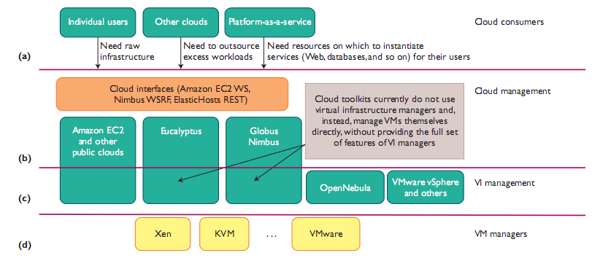
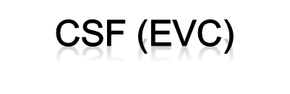


Virtualization in Clouds
Resource scheduling (Virtual resource and traditional resource)
2011-10-19
PRAGMA 21 Workshop, Sapporo, Hokkaido, Japan on October 17-20

Slide 6
Summary of Our Works
Virtual infrastructure management
  LIve Migration-Enabled Virtual Infrastructure (LimeVI)
    Virtual network
    Virtual cluster live migration
    Concurrent migration protocol
Cloud management
  Elastic Virtual Cluster (EVC)
    Support per-job Virtual Cluster
    Integrated with CSF
    Parallel Job Scheduling
2011-10-19
PRAGMA 21 Workshop, Sapporo, Hokkaido, Japan on October 17-20

Slide 7


2011-10-19
PRAGMA 21 Workshop, Sapporo, Hokkaido, Japan on October 17-20
Notes:
First, background.

Slide 8
Dynamic Virtual Cluster
Dynamic Virtual Cluster management
  Dynamic in the construction phase (customization)
    Network topology, scale, OS type, cluster software, application software.
  Expansion and shrinkage in scale
  Existing researches focus on dynamic VC management in the construction phase, little work has been done to ensure reconfiguration of VC topology in runtime.
  Virtual cluster live migration
    Under-developed, lack of concurrent support.
2011-10-19
PRAGMA 21 Workshop, Sapporo, Hokkaido, Japan on October 17-20
Notes:
Most of the existing researches force on VC management in the construction phase. Such as VC customization. VC network topology, scale, os , software. Some work even support expansion and shrinkage in scale.
However, little work has been done to ensure reconfiguration of VC topology in runtime. The mapping relashionship of VMs and P machines.
So virtual cluster live migration is under-developed

Slide 9
Parallel Job Migration
Runtime status migration
  Memory status migration
    Process migration (Condor checkpoint library)
    Virtual machine live migration (VMware-VMotion, XEN-live migration)
  File system status migration (image, WAN)
Communication status migration
  Stop-and-wait model (MPICH-G-DM, CoCheck, MPI-Mitten)
  Message-logging model (MPICH-GF, MPICH-V)
2011-10-19
PRAGMA 21 Workshop, Sapporo, Hokkaido, Japan on October 17-20
Notes:
Virtual cluster migration will also solve these two problem in traditional parallel job migration, which are:
Runtime status migration & communication status migration.
The former one is solved by VMM, while the later one is what we focused in this paper
Researchers has been dedicated their efforts to build usable and flexible distributed systems for about 3 decades. Most of these works are based on parallel job migration. Concerning virtual hpc environment. There’re two critical issues. Runtime status migration and communication status migration. Among these two, the latter one is more important. There are to commonly used methods concerning communication status migration , which are stop and wait model and message-logging model. Our work is based on ML model.
Current virtual environment migration studies only support single VM live migration. However, there is still potential package loss during migration downtime.

Slide 10
Objectives and Innovation
Existing problem of related works
  Communication status inconsistency;
  Single VM live migration prolong virtual cluster migration.
Objectives
  Fexible virtual infrastructure (LimeVI)
  Concurrent LIve Migration Protocol (CLIMP)
    Preserve communication status consistency (message buffering)
    Concurrent Virtual Cluster live migration
2011-10-19
PRAGMA 21 Workshop, Sapporo, Hokkaido, Japan on October 17-20
Notes:
As discussed, there are two major shortcomings of related works. Potential package loss will lead to communication status inconsistency; when you have to migration multiple VMs or even the entire vc, cur sinlge VM migration will prolong the migration process.
As a result, we focused on virtual cluster live migration, we propose a EVC to enhance the fleciblility of Vis. And a CLIMP to control VC migrations. CLIMP is based on VN support and message bufferring mechnism to support concurrent live migraion.

Slide 11
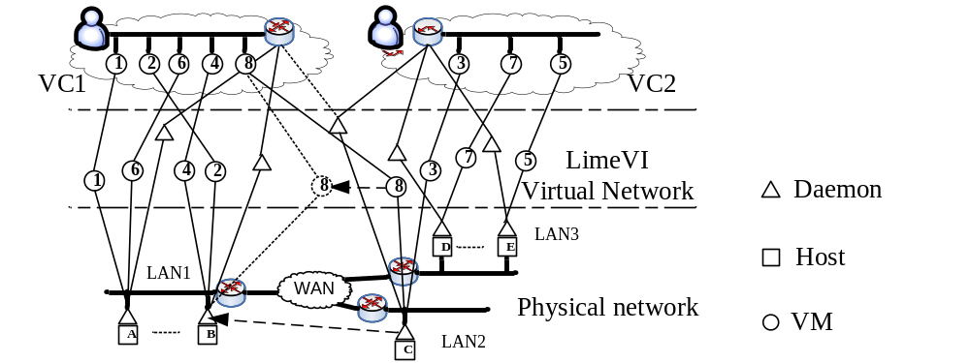
Live Migration-Enabled Virtual Infrastructure (LimeVI)
Flexible WAN Virtual Infrastructure (VI)
Daemon
  package filtering, virtual routing, tunneling;
  package buffering ,Migration protocol
VM8 on hostC is migrating to hostB to peruse better integer network performance.
2011-10-19
PRAGMA 21 Workshop, Sapporo, Hokkaido, Japan on October 17-20
Notes:
LimeVI is a typical overlay network.
There several virtual machines located on three physical LANs.
Each virtual cluster consists of a set of VMs.
The physical hosts and network is transparent from end-user.
There is a daemon running one each hosts to maintain communication relationship among VMs
Live migration example: VM8 migrates to peruse network performance

Slide 12
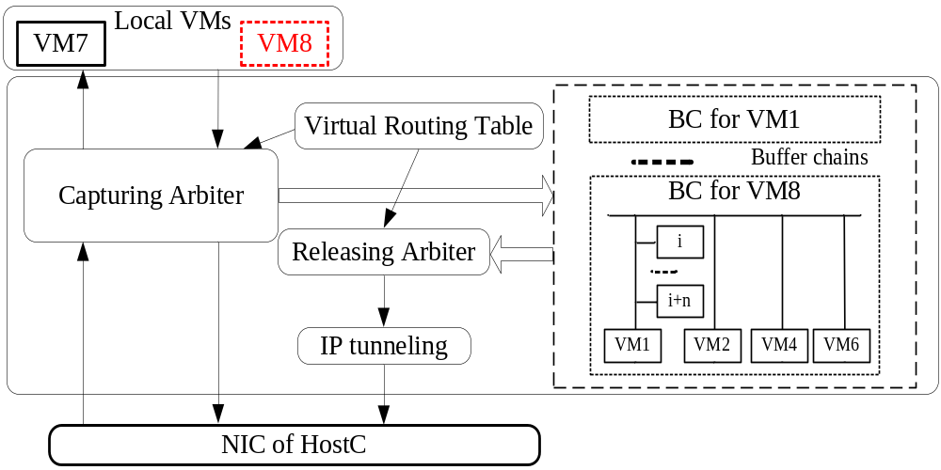
LimeVI Daemon
Buffer Chain (BC): store packages for migrating VMs
  Every Daemon maintains one buffer chain for each migrating VM;
  Related VMs;
  Only logically belongs to local Daemon.
2011-10-19
PRAGMA 21 Workshop, Sapporo, Hokkaido, Japan on October 17-20
Notes:
Several modules in Daemon:
Maintain a Buffer chain for each migrating VM

Slide 13
CLIMP: Concurrent Live Migration Protocol
Solutions
  Coordinated distributed Daemons
  Logical BCs among related LimeVI Daemons
  Complete block and bufferring during migration
2011-10-19
PRAGMA 21 Workshop, Sapporo, Hokkaido, Japan on October 17-20

Slide 14
Elastic Virtual Cluster
LimeVI : virtualized network and VC live migration
CSF – meta-scheduler : resource allocation/reallocation for virtual clusters (parallel jobs)
CSF : scheduling plugin
2011-10-19
PRAGMA 21 Workshop, Sapporo, Hokkaido, Japan on October 17-20

Slide 15
THANK YOU!
2011-10-19
PRAGMA 21 Workshop, Sapporo, Hokkaido, Japan on October 17-20

