Slide 1







Progress from PRAGMA 7
PRAGMA 8 Workshop
3 May 2005
Singapore
Bioinformatics Institute
Notes:
http://www.bii.a-star.edu.sg/Pragma8/ - get image

Slide 2
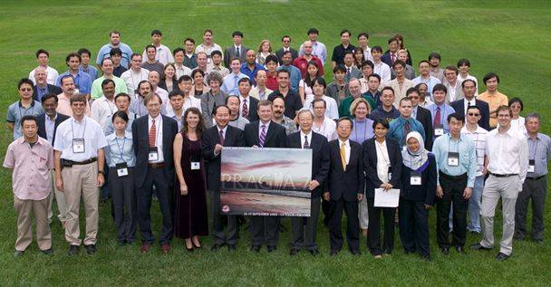
PRAGMA 7 September 2004 San Diego

Slide 3
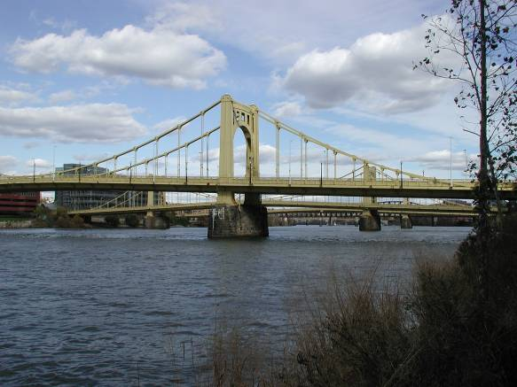
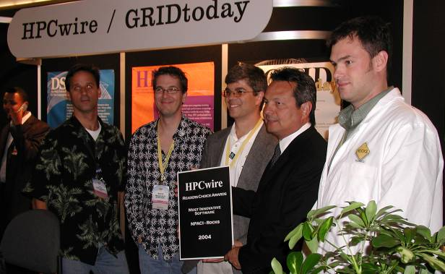
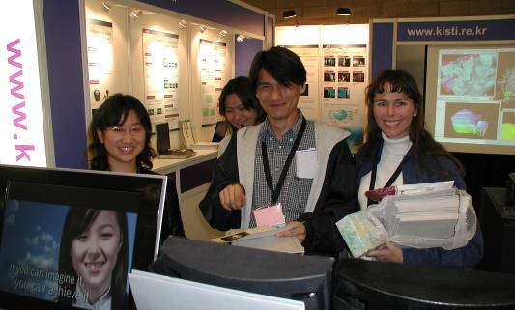
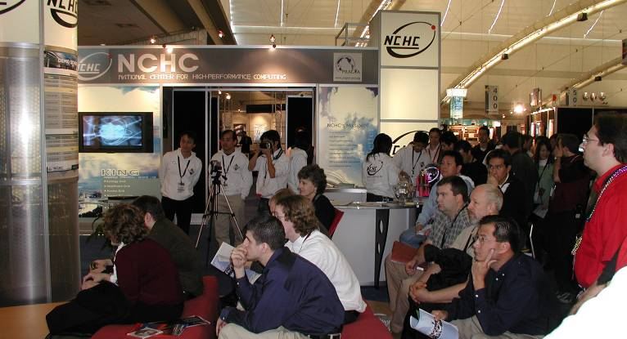
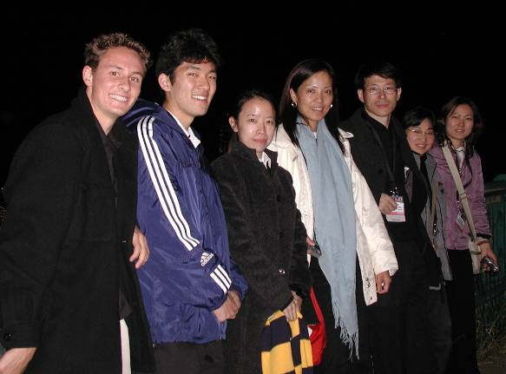
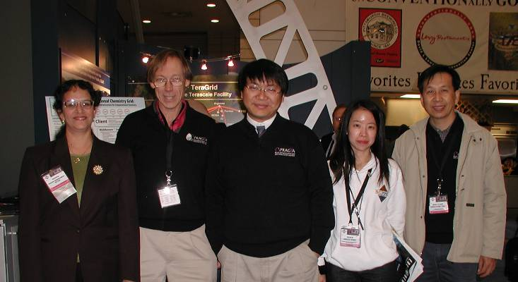
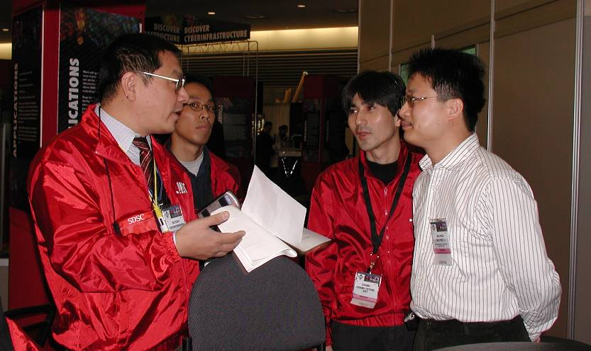
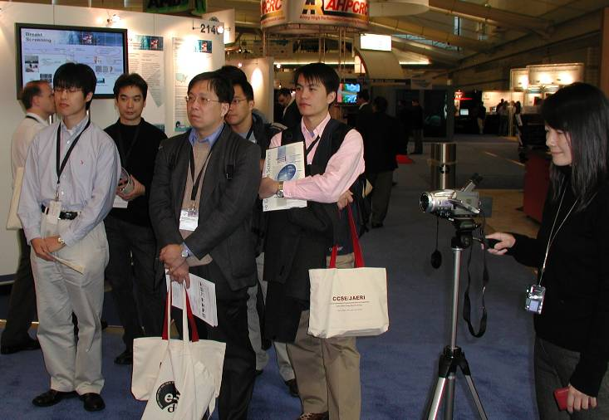
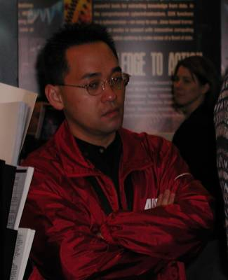
PRAGMA at SC04

Slide 4
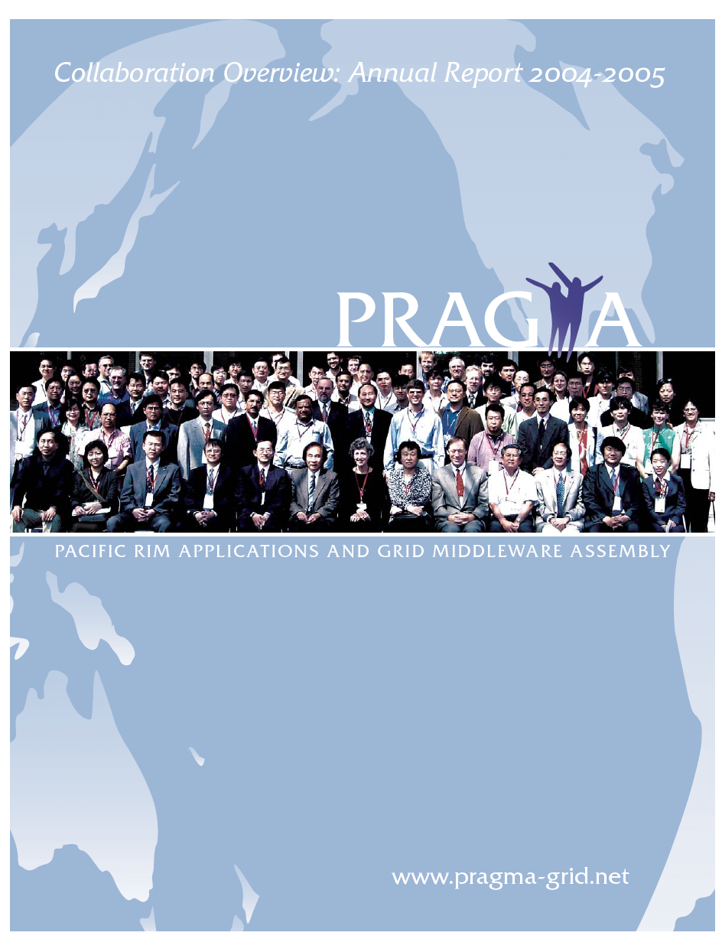
Contents:
2004-2005
Overview
Accomplishments
PRIME
Working Groups
Institutions
References
Opportunities
Sponsors
http://www.pragma-grid.net
Notes:
FOUR MORE PAGES
Institutions & Contacts . . . . . . . . . . . . . . . . . . . . . . . . . . . . . . . . . . . . . . . . . . . . . . . . 2
Overview: Promoting Global Collaboration Through Cyberinfrastructure. . . . . 4
Accomplishments: Achieving Success Through Partnership . . . . . . . . . . . . . . . . 5
PRIME: Preparing Undergraduates for the Global Workforce . . . . . . . . . . . . . . . 8
Working Groups: Integrating PRAGMA’s Diversity . . . . . . . . . . . . . . . . . . . . . . . . 10
Members: Providing Expertise, Tools, & Resources. . . . . . . . . . . . . . . . . . . . . . . . 13
Schedule of Workshops . . . . . . . . . . . . . . . . . . . . . . . . . . . . . . . . . . . . . . . . . . . . . . . 21
References . . . . . . . . . . . . . . . . . . . . . . . . . . . . . . . . . . . . . . . . . . . . . . . . . . . . . . . . . . . 22
Sponsors. . . . . . . . . . . . . . . . . . . . . . . . . . . . . . . . . . . . . . . . . . . . . . . . . . . . . . . . . . . . . 23
Opportunities for Students. . . . . . . . . . . . . . . . . . . . . . . . . . . . . . . . . . . . . . . . . . . . . 23
Broader Community Interactions. . . . . . . . . . . . . . . . . . . . . . . . . . . . . . . . . . . . . . . . 23

Slide 5

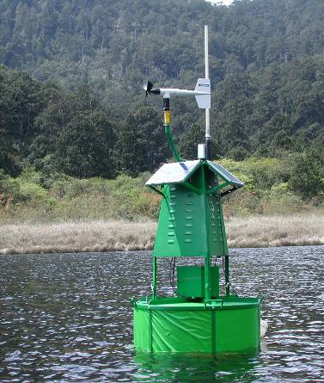

Accomplishments:
Achieving Success through Partnership
Telescience: KBSI, Software for camera
Computational Chemistry: Nimrod/GAMESS- APBS/Kepler (ligand protein docking)
EcoGrid and Lake Metabolism
  Prototype International Lake Observatory
  Coral Reef Sensing
  Meeting on 20 -21 September 2004 (plan global lake observatory network; link coral reef experts)
  Follow-on meeting March 2005
Gfarm and iGAP
  Middleware Integration
  Proteome Analysis
Bandwidth Challenge Awards from SC03
  Distributed Infrastructure (Gfarm)
  Application (Telescience)
Middleware Interoperability
  Rock Rolls, Ninf-G, Gfarm
  KRocks krocks.cluster.or.kr
KROCK 3.3.0
22 Nov 04

Slide 6
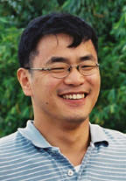
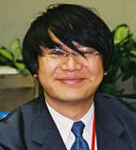
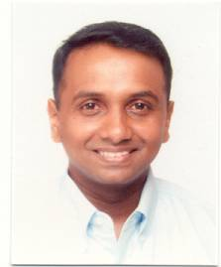
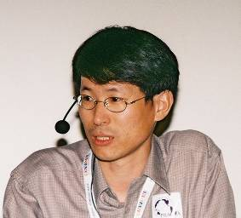
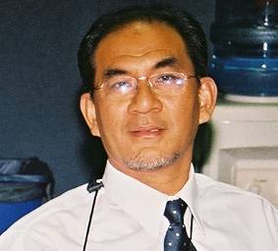
People
Deputy Chair
  Huge thanks to Jysoo Lee
    Job well done
  Huge thanks to Fang-Pang Lin
    More to do
Steering Committee
  BII: Arun Krishnan
  KISTI: Kum Won Cho
  USM: Yussof Hassan Admad

Slide 7
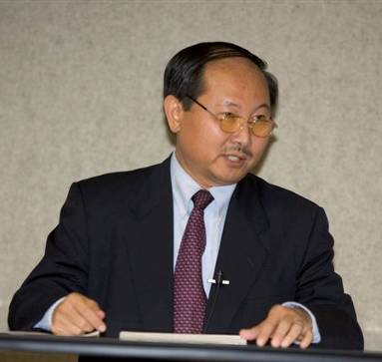
Bill Chang
NSF Changes
  Bill Chang, Head, Beijing Office, NSF

Slide 8
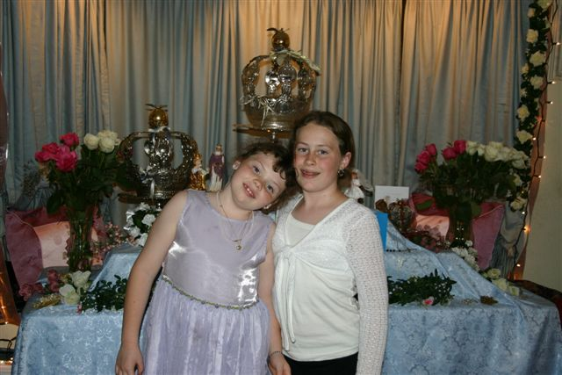
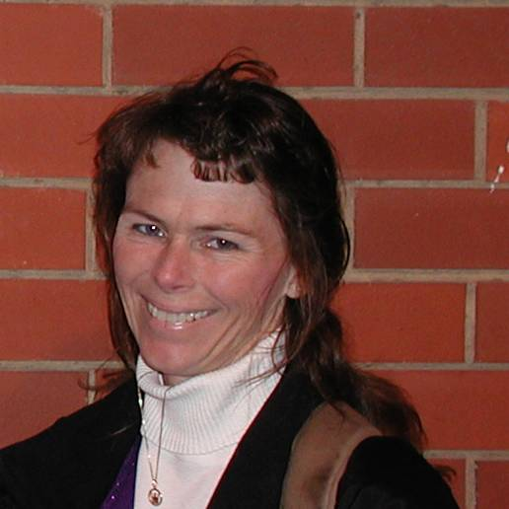
Teri Simas

Slide 9

Routine Use
Tremendous Steps Forward!
Testbed of several sites
  http://pragma-goc.rocksclusters.org/pragma-grid-status/setup.html
    15 Institutions
Five applications
  Time-Dependent Density Functional Theory (TDDFT)
  mpiBLAST, QM-MD, Savannah Case Study
  iGAP – Gfarm
Lessons learned
  Time to disseminate results to broader community via publications

Slide 10
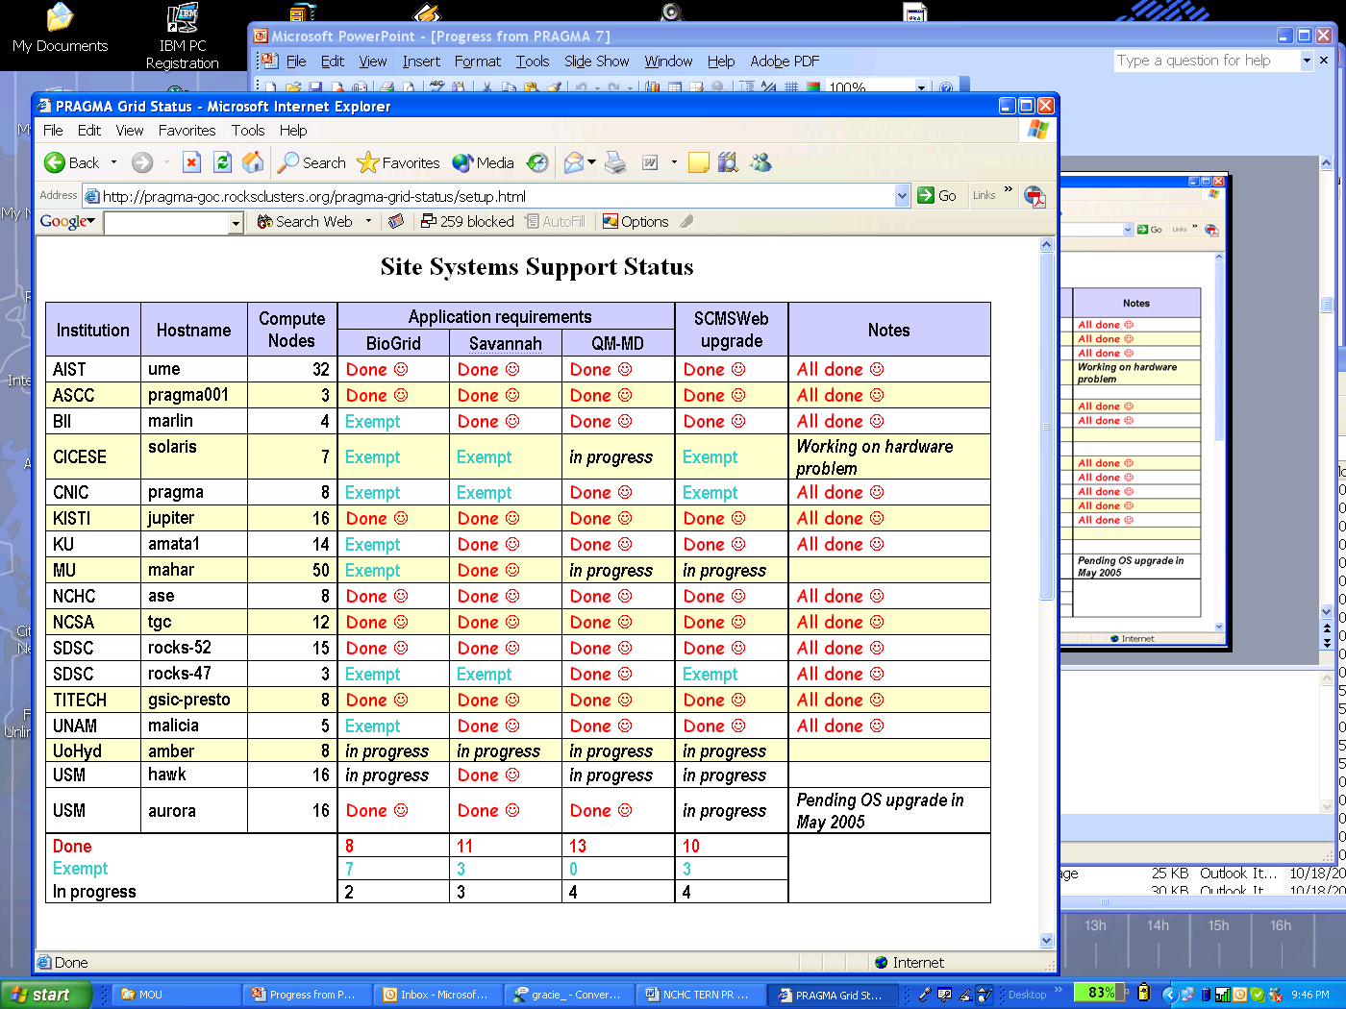
28 April 2005
Notes:
http://pragma-goc.rocksclusters.org/pragma-grid-status/setup.html
28 April 2005

Slide 11
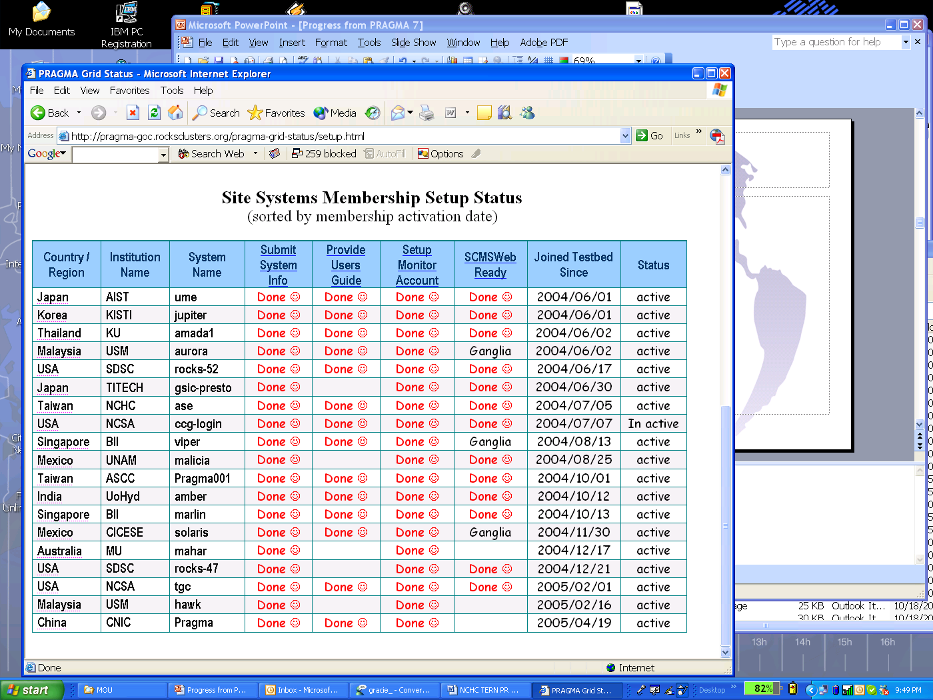
28 April 2005

Slide 12
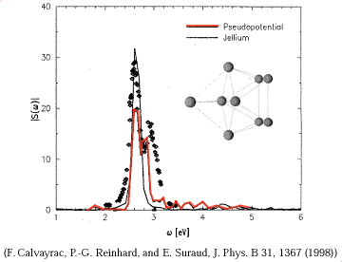
1st application
Time-Dependent Density Functional Theory (TDDFT)
Computational quantum chemistry application
Grid-enabled by Nobusada (IMS), Yabana (Tsukuba Univ.) and Yusuke Tanimura (AIST) using Ninf-G
Experiment ran 6/1/04 ~ 8/31/04
10 sites, 8 countries, 198 CPUs
Driver: Yusuke and Cindy
  # of major executions: 43
  Total execution time: 1210 hours (50.4 days)
  Longest run: 164 hours (6.8 days)
  Average length of run: 28.14 hours (1.2 days)
Major enhancements to the application
Major enhancements to ninf-G
http://pragma-goc.rocksclusters.org/tddft/default.html

Slide 13
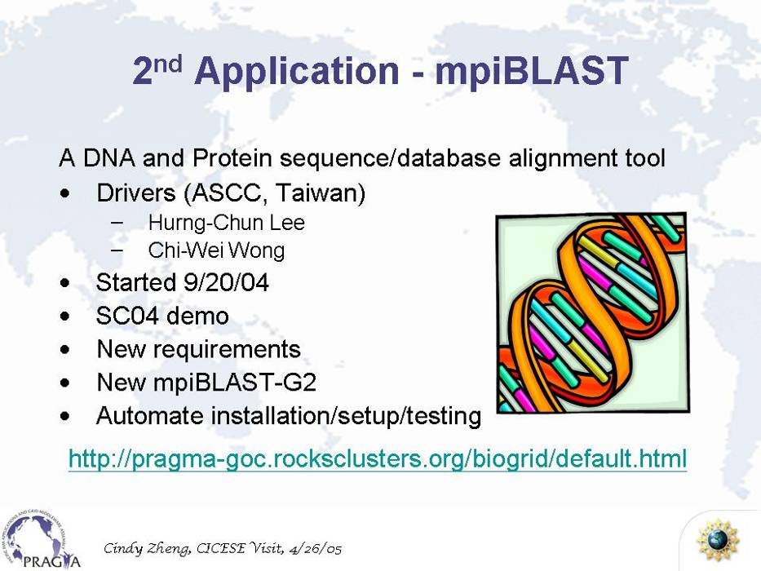
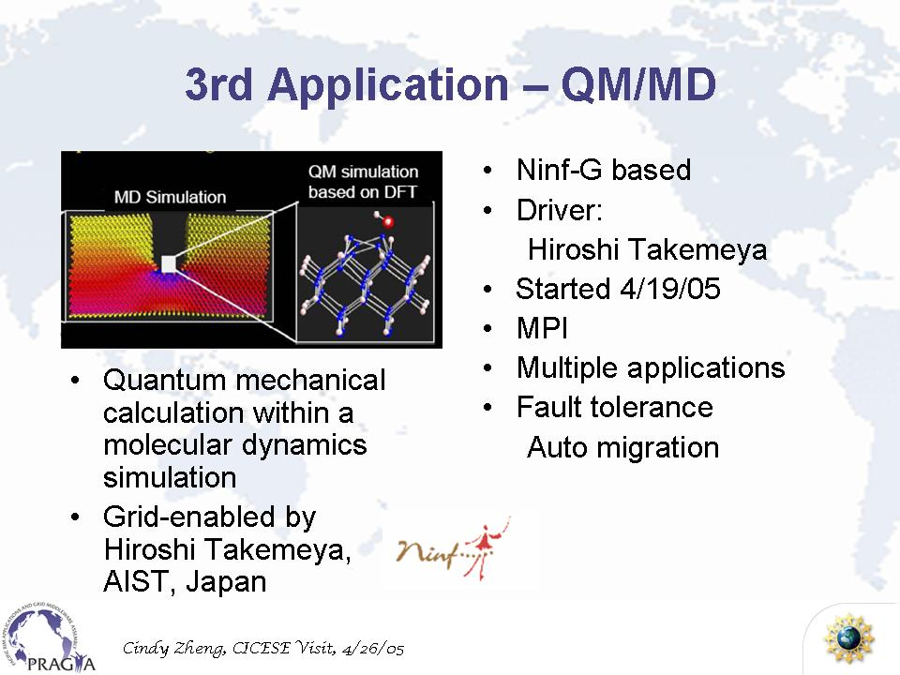
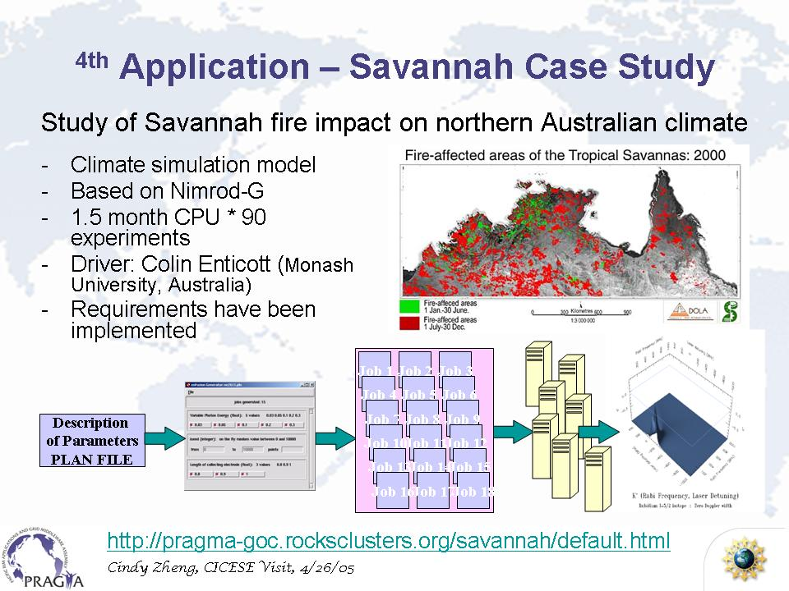
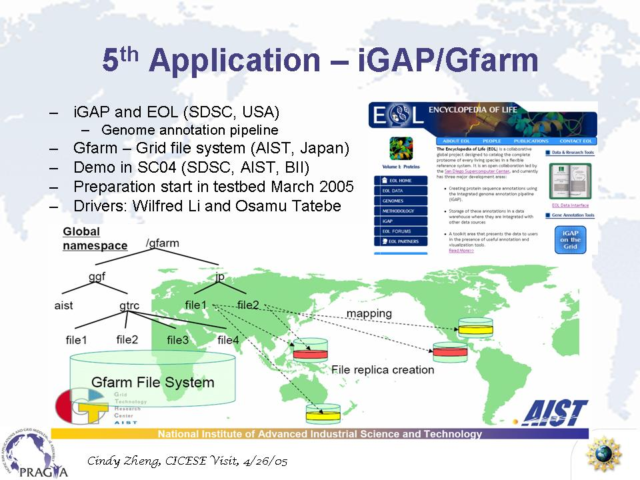
Routine Use Applications

Slide 14
Resources and Networking
Gfarm Roll for clusters (part of Rocks distribution)
New Internet Links via TransPAC
  LA - Tokyo: OC192 (25 April)
  Tokyo - Hongkong: OC48
  Singapore … (plan by September)
National Lambda Rail started recently
  10GE links San Diego-Seattle, LA – Seattle, Chicago – Seattle
PNWGP
  2.5 Gig to Korea (soon to be 10 G)
  2.5 Gig to Taiwan
Notes:
We have
two 10 Gig connections to Abilene (Internet2),
NLR connections:
- 10GE Seattle-LA pwave
- 10GE Seattle-San Diego cavewave
- 10GE Seattle-Chicago cavewave
- OC192 Seattle-Portland sxtransport
- OC192 Seattle-Portland (not actively used, intended for gpop backhaul)
- OC192 Seattle-Portland (not actively used, intended for gpop backhaul)
- OC192 Portland-Sunnyvale
10G connection to AARNet
10G IEEAF connection to Tokyo (WIDE)
2.5 Gig to Korea (soon to be 10G)
2.5 G to Taiwan
OC-3 to Singapore (soon to be upgraded)
I think that's most of it at this point. Remember also that any Los Angeles is the same as being connected to Seattle and the PNWGP viz Transpac2.
Is this what you need?
Best,
Dear Peter,
The NLR circuits were turned over to us within within the last three months.
The Taiwan upgrade happened within the last two months. The Korea upgrade should happen within the next few months.
(By the way, I also forgot a 2.5G circuit to Canarie).
Do you expect me to make a presentation in Singapore? If so, when and how long?
Best,

Slide 15
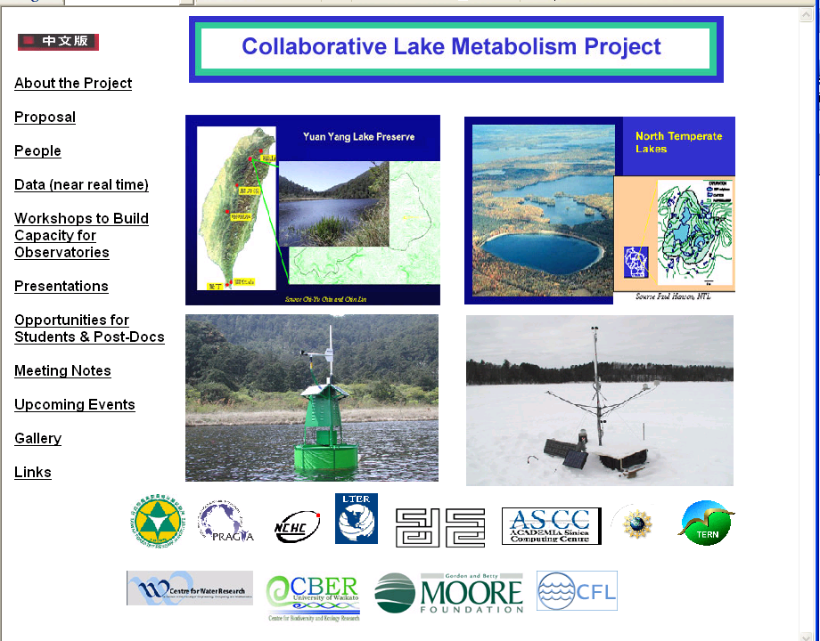
Lake Metabolism Website
http://lakemetabolism.org

Slide 16
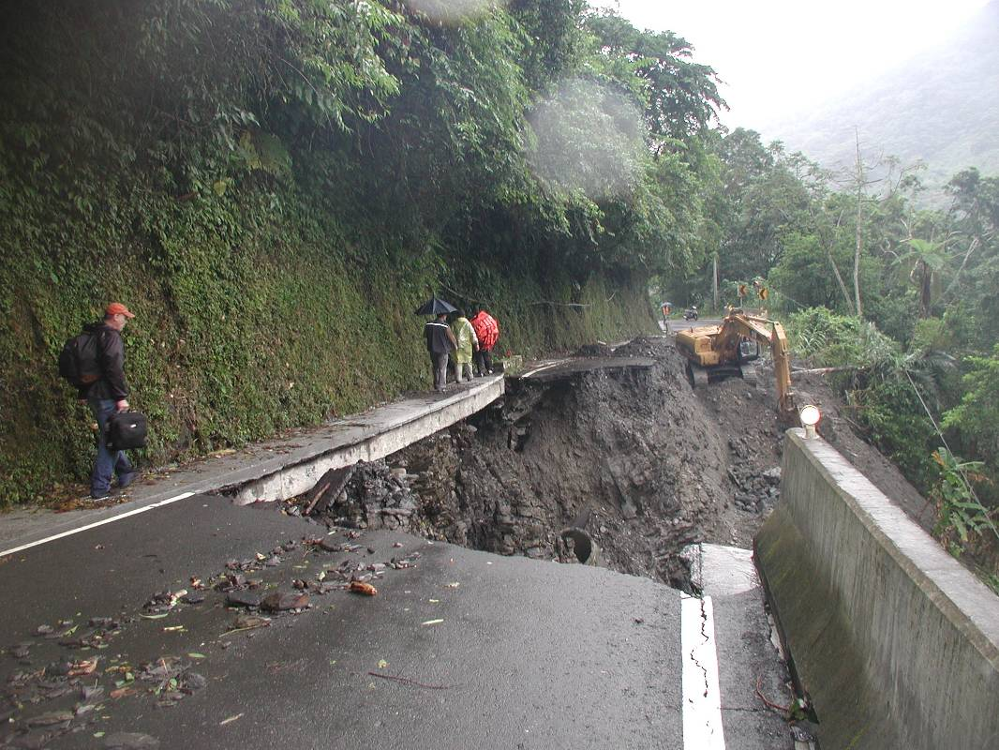
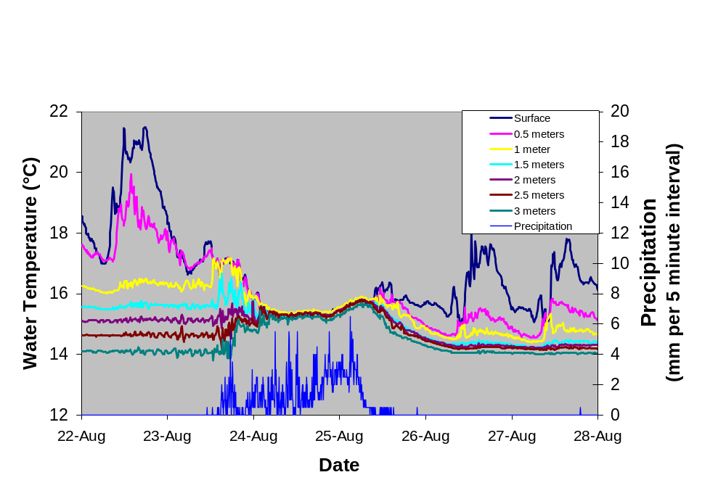
An example of episodic events and threshold dynamics
Access can be difficult during the most interesting times
Yuan Yang Lake, Taiwan – August 2004
Used by NSF Director Feb 2005
Typhoon
Photo by Peter Arzberger, October 2004
Part of a growing global lake observatory network - http://lakemetabolism.org
Notes:
Given we have been able to do this – we are thinking of going Global … hopefully we can discuss at the next meeting in October
Presented by Arden Bement
4 Feb 2005
"From New Sight to Foresight: The Long View on the Environment"
Address to National Council for Science and the Environment
http://www.nsf.gov/news/speeches/bement/05/alb050204_ncse.jsp
“Our tools and methodologies often change our perception of what we are studying. A revolution in environmental sensors is already underway. Researchers at one LTER site--a Wisconsin lake--have teamed up with counterparts at a lake in Taiwan. Both lakes are fitted with sensors. This graph shows the metabolism of the Taiwanese lake during a typhoon--a quick, episodic event that would have been missed without the autonomous sensors in place. “

Slide 17
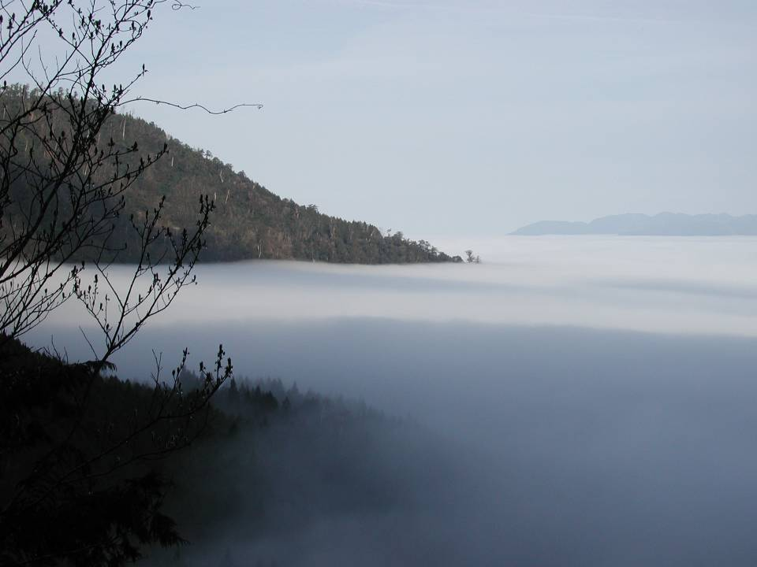
Taiwan’s Natural Beauty

Slide 18

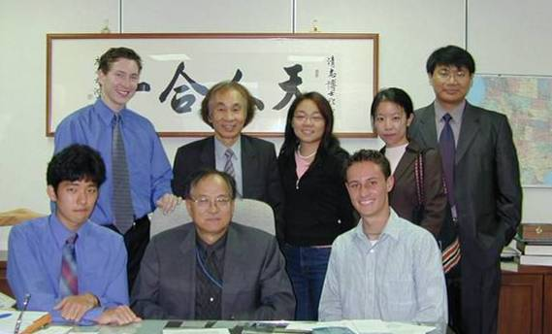


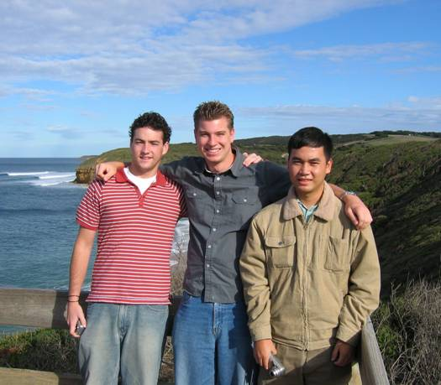
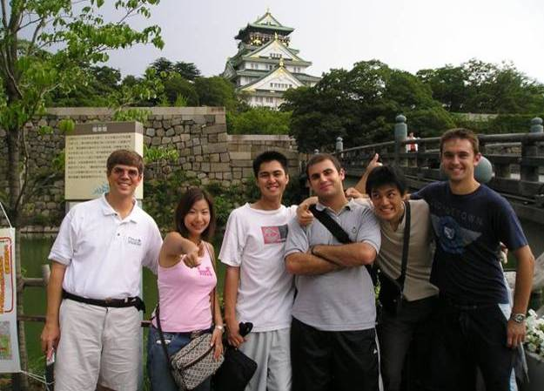

PRIME 2004
Notes:
Brochure and pictures

Slide 19
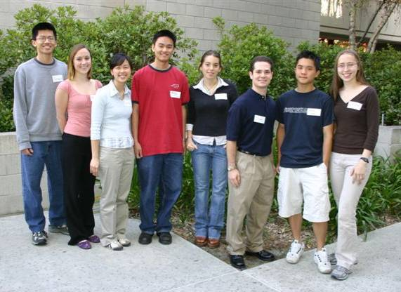
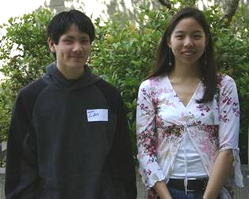
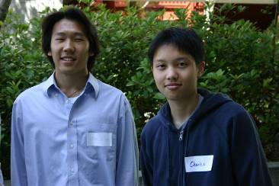

PRIME 2005
Osaka University
  Three students: Telescience, Biogrid
NCHC
  Four students: Ecogrid, Optiputer, Systems Biology (one from Wisconsin)
Monash University
  Five students: Computational Chemistry, Bioinformatics, Cardiac Modeling
CNIC
  Two students: Networking Analysis, Protein Structure Analysis
Looking at ways to enhance the students cultural competency
Notes:
Pictures from Teri

Slide 20
Publications Since Oct 2004 incomplete
Telescience, Sensors, and Ecogrid.
  Juncai Ma, Shoji Hatano, Shinji Shimojo, “Implementation of field monitoring system by IPv6 and GRID Authentication on the Loess Plateau”, Agricultural Information Research, 13(4), (in japanese) pp.281-290, 2004
  Toyokazu Akiyama, Kazunori Nozaki, Seiichi Kato, Shinji Shimojo, Steven T. Peltier, Abel Lin, Tomas Molina, George Yang, David Lee, Mark Ellisman, Sei Naito, Atsushi Koike, Shuichi Matsumoto, Kiyokazu Yoshida, Hirotaro Mori, "Scientific Grid Activities in Cybermedia Center, Osaka University", 5-th IEEE/ACM CCGrid proceedings (BioGrid'05 Workshop), 2005 (to appear) .
  Porter, J.H, Arzberger, P,, Braun, H-W, Bryant, P., Gage, S, Hansen, T, Hanson, P, Lin, F-P, Lin, C-C, Kratz, T, Michener, W, Shapiro, S, and Williams, T., 2005 Wireless Sensor Networks for Ecology, Biosciences. (accepted for publication). 2005
  Sensors for Environmental Observations, NSF Workshop Report
Life Sciences
  Yoshiyuki Kido, Susumu Date, Shingo Takeda, Shoji Hatano, Juncai Ma, Shinji Shimojo, and Hideo Matsuda, "Architecture of a Grid-enabled research platform with location-transparency for bioinformatics", Genome Informatics Vol. 15, No. 2, pp. 3- 12, 2004
  Baldridge, K.K.*; Sudholt, W.; Greenberg, J.P.; Amoreira, C.; Potier, Y.; Altintas, I.; Birnbaum, A.; Abramson, D.; Enticott, C.; Slavisa, G. Cluster and Grid Infrastructure for Computational Chemistry and Biochemistry. In Parallel Computing for Bioinformatics (Invited Book Chapter), A. Y. Zomaya (Ed.), John Wiiley & Sons, 2005, in press.
  Sudholt, W.; Baldridge, K.; Abramson, D.; Enticott, C.; Garic, S.; Kondric, C.; Nguyen, D. Application of Grid Computing to Parameter Sweeps and Optimizations in Molecular Modeling. Future Generation Computer Systems (Invited), 2005. 21, 27-35.
  Shahab, A., D. Chuon, T. Suzumura, W. W. Li, R. W. Byrnes, K. Tanaka, L. Ang, S. Matsuoka, P. E. Bourne, M. A. Miller, & P. W. Arzberger. Grid Portal Interface for Interactive Use and Monitoring of High-Throughput Proteome Annotation. Lecture Notes in Computer Science. Vol.3370. pp 53-67. 2005.
  Wei, X, W. W. Li, O. Tatebe, G. Xu, H. Liang & J. Ju. (2005). Implementing data aware scheduling in Gfarm using LSFTM scheduler plugin mechanism. Proceedings of the 2005 International Conference on Grid Computing and Applications (GCA'05). Las Vegas. In press.
  Li, W, C.L Yeo, L.Ang, O.Tatebe, S. Sekiguchi, K Jeong, S. Hwang, S. Date, J-H Kwak. Protein Analysis using iGAP in Gfarm. Presented Life Science Grid 2005.
Resources
  Tanaka Y, Takemiya H, Nakada H, and Sekiguchi S. Design, implementation and performance evaluation of GridRPC programming middleware for a large-scale computational Grid, Proceedings of the 5th IEEE/ACM International Workshop on Grid Computing, 298-305, Nov. 2004, Pittsburgh, USA.
Notes:
13. Li, W.W. , R.W. Byrnes, J. Hayes, A. Birnbaum, V.M. Reyes, A.
Shahab, C. Mosley, D. Pekurovsky, G.B. Quinn, I.N. Shindyalov, H.
Casanova, L. Ang, F. Berman, P.W. Arzberger, M. A. Miller, and P.E.
Bourne. (2004). The Encyclopedia of Life Project: Grid Software and Deployment. New Generation Computing. 22: 127-136.
14. Bourne, P.E., C.K.J. Allerston, W. Krebs, W.W. Li, I.N.
Shindyalov, A. Godzik, I. Friedberg, T. Liu, D. Wild, S. Hwang, Z.
Ghahramani, L. Chen, and J. Westbrook. (2004). The Status of Structural Genomics Defined Through the Analysis of Current Targets and Structures.
pp375-386. In Pacific Symposium on Biocomputing. Altman et al, eds.
World Scientific, New Jersey.
15. Birnbaum, A., J. Hayes, W. W. Li, M. A. Miller, P.W. Arzberger,
P. E. Bourne, & H. Casanova. (2004). Grid Workflow Software for High-Throughput Proteome Annotation Pipeline. Lecture Notes in Computer Science. 3370:. 68-81
16. Shahab, A., D. Chuon, T. Suzumura, W. W. Li, R. W. Byrnes, K.
Tanaka, L. Ang, S. Matsuoka, P. E. Bourne, M. A. Miller, & P. W.
Arzberger. (2004). Grid Portal Interface for Interactive Use and Monitoring of High-Throughput Proteome Annotation. Lecture Notes in Computer Science. 3370: 53-67.
17. Wei, X, W. W. Li, O. Tatebe, G. Xu, H. Liang & J. Ju. (2005).
Implementing data aware scheduling in Gfarm using LSFTM scheduler plugin mechanism. Proceedings of the 2005 International Conference on Grid Computing and Applications (GCA'05). Las Vegas. In press.
18. Li, W.W., C.L. Yeo, O. Tatebe, K. Jeong, S. Hwang, S. Date, J.
Kwak, S. Sekiguchi, L. Ang and P. W. Arzberger. (2005). Proteome Analysis using iGAP in Gfarm. Proceedings of the 2nd Life Sciences Grid Workshop. Singapore. In press.

Slide 21
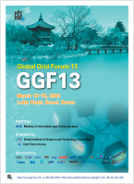

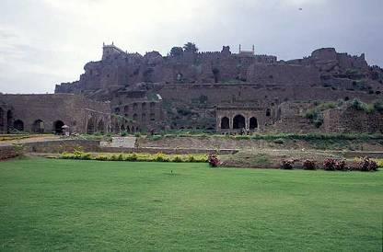

Key Events
November 2004 - SC04 (Pittsburgh)
March 2005 - GGF13 (Seoul)
May 2005 – Grid Asia 2005
  PRAGMA 8 (2 – 4 May)
  NEESit Meeting (5 May)
  Life Science Grid 2005 (5 – 6 May)
September 2005 - iGRID 2005 (San Diego)
September 2005 – APAC 2005 (Gold Coast)
October 2005 – PRAGMA 9 (Hyderabad)
November 2005 – SC05 (Seattle)
Notes:
APAN 23 – 27 August 2005, Taipei, Taiwan
APAN 22- 26 January 2006, Tokyo, Japan
GLIF 11-12 Sept 2006 Tokyo (GLIF participants only); 13 Sept 2006 Tokyo (public meeting)
http://www.startap.net/igrid2005/
http://www.apac.edu/au/apac05/,

Slide 22


PRAGMA Institutions at iGRID 2005
“45 demos, from 18 countries. Pacific Rim demonstrations from Australia, China, Japan, Korea, Taiwan, US, Canada and Mexico”
World’s First Demonstration of X GRID Application Switching using User Controlled Lightpaths:
  KISTI, NCHC, Institutions in Canada and Spain
Real Time Observational Multiple Data Streaming and Machine Learning for Environmental Research using Lightpath
  NCHC, others
Great Wall Cultural Heritage
  CNIC, others
Coordination of Grid Scheduler and Lambda Path Service over GMPLS: Toward Commercial Lambda Path Service
  AIST, Osaka, Titech
From Federal Express to Lambdas: Transporting Sloan Digital Sky Survey (SDSS) Data Using UDT
  KISTI, CNIC, APAC, Starlight
Real-time Multi-scale Brain Data Acquisition, Assembly, and Analysis using an End-to-End OptIPuter
  Osaka, KISTI, NCHC, UCSD, Starlight
Global Lambda Visualization Facility
  KISTI, Starlight, NCSA
iGRID APAC
  APAC, Starlight, PNWGP

Slide 23

Steering Committee Agenda
Review Application for Membership
  Pacific Northwest Gigapop (Wednesday)
Review Application to Host PRAGMA 10
  Queensland and APAC in March/April 2006 (Wed)
Plan activities for iGRID2005, SC05, PRAGMA Brochure 2005 - 2006
Discuss and outline plans and strategies for several years into future
  Including multi-institutional proposal to a variety of funding agencies
Discuss outcomes of study done at PRAGMA 7

Slide 24
Pilot Study: PRAGMA
Conducted by Lyn Headley, UCSD
Background: Based on 11 interview at PRAGMA 7
  Understanding the social interactions needed for success of a virtual organization
  Understanding view of success and challenges to date (for a path forward)
Highlights:
  Successes
    Built a collaborative network, trust, openness, based on shared vision
    Exchange information and technology that have benefited participants
    Make things happen, make things function
    Spun off other activities and collaborations
  Challenges
    Balance growth without losing tight collaborations
    Balance and harness the diversity of interests
    Maturity of national, large-scale grid (PRAGMA’s Role)
    Move beyond demo mode to persistence and broader usability
    Development of applications
  Future
    That is what we create

Slide 25
“Expanding Routine Use”
Challenges for Resource Working Group
Publish lessons learned, including observations of shortcoming of grid software
  Conference Papers will force PRAGMA to think critically about these issues
Continue to evolve deployed infrastructure, to make it deemed persistent
  Move beyond daily use demos such as at SC05 or iGRID2005 demo, to a system usable post event
  Make testbed usable by others, allowing multiple users
Notes:
Disseminate the lessons learned (conference proceedings)",
Maybe we can just assemble some people to talk about this during
PRAGMA8 and lay out for a joint paper? I'm willing to contribute, but
I'm not experienced with this, so will need a lot of help from others.
I think the paper should include you, Phil, Mason, Yoshio and Yusuke.
Anyone else?
Make the infrastructure usable in a persistent fashion
Not just for a PRAGMA or SC05 or iGRID2005 demo
Not just by the people who are driving it now"
How about to discuss this in resource group meeting? I will also try
to emphasize this to new application drivers when they join in. This
will help to make it clear in everyone's mind.
We can also make it a requirement that an application must run
continueously over certain length of time. We can encourage the
presentation of data/results of long-running applications in our meetings.
We can discuss how to get more people to learn and run applicaitons.
There are some immediate technical issues need to be resolved to make
multiple user/application runs possible and easier: one is resource
allocation policies and technologies, two is died processes clean-ups.
We can discuss these in our resource group meeting as well.
About "Applications on Testbeds
Use the infrastructure to produce scientific results [Can we run a job long enough to gain insight into a driving, underlying problem?]"
How about to alert all PRAGMA8 attendees with this? I think we need
everyone to help identify "real science" applications, then we can all
try to help to produce meaningful results in our testbed.
Just some thoughts,
Peter, these need to be backgrounded with "look how far we have come together".
Pragma is able to put things together and function in a way that many explicitly funded groups
are unable to do. This comes from a common and shared understanding of "making things work"
Some possible wordsmithing...
Challenges to Resources Group
- Publishing of lessons learned, observations of shortcomings in grid software, and other issues. Conference
Papers are an excellent way of forcing PRAGMA to think critically about these issues.
- Continue to evolve the deployed infrastructure to where it can be deemed persistent. Great strides have been made
with the "Daily Use Experiments" , but we need to continually examine how to make it easier for scientists to utilize the infrastructure. It takes consistent work to make sure that distributed infrastructure does not disintegrate
Applications Groups
- Help define what is needed in the testbed infrastructure to make it part of your daily use
- Define challenge "runs" that will fundamentally lead to new results. Challenge runs need to be fashioned as
stretch goals - high-bars, but achievable.
eg. A complete Genome through the iGap Pipeline
We have folks who are both in the Resources group and Applications groups -- what is needed so that others can replicate your experiments. Replicability is a fundmental tenet of good science.
Ok, Peter and Phil :-) It's loud and clear.
One more thought regarding the challenge which I'm not sure of.
To have more users to run those applications in our testbed,
we need to make the application setup easy. This is not
my experience when I tried to run as the second user of
TDDFT. Both Yusuke and I failed in trying to setup TDDFT
for me on our cluster. Finally, Yusuke had to set TDDFT up
in my account on AIST's cluster.
So, perhaps, making grid easy to use should also
includes making application easy to use, which will require
application developers to package the application setups,
so that it will work for different users and on most systems.
But this means a lot of work. Should we do this?
Cindy
I think it's really necessary to make applications easy to setup and run. But this means additional requirements and works for application developers/drivers, so I want to make sure that you support this as something we are chartered to do.
I'm adding this to my issue list for resource group discussions.

Slide 26
“Expanding Routine Use”
Challenges for Application Working Groups
Help define the testbed infrastructure, to make it part of your daily use
Define challenging “runs” that will lead to fundamentally new results
  E.g. Run a complete genome through the iGAP pipeline
Notes:
Disseminate the lessons learned (conference proceedings)",
Maybe we can just assemble some people to talk about this during
PRAGMA8 and lay out for a joint paper? I'm willing to contribute, but
I'm not experienced with this, so will need a lot of help from others.
I think the paper should include you, Phil, Mason, Yoshio and Yusuke.
Anyone else?
Make the infrastructure usable in a persistent fashion
Not just for a PRAGMA or SC05 or iGRID2005 demo
Not just by the people who are driving it now"
How about to discuss this in resource group meeting? I will also try
to emphasize this to new application drivers when they join in. This
will help to make it clear in everyone's mind.
We can also make it a requirement that an application must run
continueously over certain length of time. We can encourage the
presentation of data/results of long-running applications in our meetings.
We can discuss how to get more people to learn and run applicaitons.
There are some immediate technical issues need to be resolved to make
multiple user/application runs possible and easier: one is resource
allocation policies and technologies, two is died processes clean-ups.
We can discuss these in our resource group meeting as well.
About "Applications on Testbeds
Use the infrastructure to produce scientific results [Can we run a job long enough to gain insight into a driving, underlying problem?]"
How about to alert all PRAGMA8 attendees with this? I think we need
everyone to help identify "real science" applications, then we can all
try to help to produce meaningful results in our testbed.
Just some thoughts,
Peter, these need to be backgrounded with "look how far we have come together".
Pragma is able to put things together and function in a way that many explicitly funded groups
are unable to do. This comes from a common and shared understanding of "making things work"
Some possible wordsmithing...
Challenges to Resources Group
- Publishing of lessons learned, observations of shortcomings in grid software, and other issues. Conference
Papers are an excellent way of forcing PRAGMA to think critically about these issues.
- Continue to evolve the deployed infrastructure to where it can be deemed persistent. Great strides have been made
with the "Daily Use Experiments" , but we need to continually examine how to make it easier for scientists to utilize the infrastructure. It takes consistent work to make sure that distributed infrastructure does not disintegrate
Applications Groups
- Help define what is needed in the testbed infrastructure to make it part of your daily use
- Define challenge "runs" that will fundamentally lead to new results. Challenge runs need to be fashioned as
stretch goals - high-bars, but achievable.
eg. A complete Genome through the iGap Pipeline
We have folks who are both in the Resources group and Applications groups -- what is needed so that others can replicate your experiments. Replicability is a fundmental tenet of good science.
Ok, Peter and Phil :-) It's loud and clear.
One more thought regarding the challenge which I'm not sure of.
To have more users to run those applications in our testbed,
we need to make the application setup easy. This is not
my experience when I tried to run as the second user of
TDDFT. Both Yusuke and I failed in trying to setup TDDFT
for me on our cluster. Finally, Yusuke had to set TDDFT up
in my account on AIST's cluster.
So, perhaps, making grid easy to use should also
includes making application easy to use, which will require
application developers to package the application setups,
so that it will work for different users and on most systems.
But this means a lot of work. Should we do this?
Cindy
I think it's really necessary to make applications easy to setup and run. But this means additional requirements and works for application developers/drivers, so I want to make sure that you support this as something we are chartered to do.
I'm adding this to my issue list for resource group discussions.

Slide 27
“Expanding Routine Use”
PRAGMA is about making things work
PRAGMA has made strides to make routine the use of the grid.
Make these experiments so that they can be replicated
  More than just the experts, the drivers, the developers
  More than just for the meeting
  More than just for the original application
“Replicatibility is a fundamental tenet of good science.”
  Phil Papadopoulos
Notes:
Disseminate the lessons learned (conference proceedings)",
Maybe we can just assemble some people to talk about this during
PRAGMA8 and lay out for a joint paper? I'm willing to contribute, but
I'm not experienced with this, so will need a lot of help from others.
I think the paper should include you, Phil, Mason, Yoshio and Yusuke.
Anyone else?
Make the infrastructure usable in a persistent fashion
Not just for a PRAGMA or SC05 or iGRID2005 demo
Not just by the people who are driving it now"
How about to discuss this in resource group meeting? I will also try
to emphasize this to new application drivers when they join in. This
will help to make it clear in everyone's mind.
We can also make it a requirement that an application must run
continueously over certain length of time. We can encourage the
presentation of data/results of long-running applications in our meetings.
We can discuss how to get more people to learn and run applicaitons.
There are some immediate technical issues need to be resolved to make
multiple user/application runs possible and easier: one is resource
allocation policies and technologies, two is died processes clean-ups.
We can discuss these in our resource group meeting as well.
About "Applications on Testbeds
Use the infrastructure to produce scientific results [Can we run a job long enough to gain insight into a driving, underlying problem?]"
How about to alert all PRAGMA8 attendees with this? I think we need
everyone to help identify "real science" applications, then we can all
try to help to produce meaningful results in our testbed.
Just some thoughts,
Peter, these need to be backgrounded with "look how far we have come together".
Pragma is able to put things together and function in a way that many explicitly funded groups
are unable to do. This comes from a common and shared understanding of "making things work"
Some possible wordsmithing...
Challenges to Resources Group
- Publishing of lessons learned, observations of shortcomings in grid software, and other issues. Conference
Papers are an excellent way of forcing PRAGMA to think critically about these issues.
- Continue to evolve the deployed infrastructure to where it can be deemed persistent. Great strides have been made
with the "Daily Use Experiments" , but we need to continually examine how to make it easier for scientists to utilize the infrastructure. It takes consistent work to make sure that distributed infrastructure does not disintegrate
Applications Groups
- Help define what is needed in the testbed infrastructure to make it part of your daily use
- Define challenge "runs" that will fundamentally lead to new results. Challenge runs need to be fashioned as
stretch goals - high-bars, but achievable.
eg. A complete Genome through the iGap Pipeline
We have folks who are both in the Resources group and Applications groups -- what is needed so that others can replicate your experiments. Replicability is a fundmental tenet of good science.
Ok, Peter and Phil :-) It's loud and clear.
One more thought regarding the challenge which I'm not sure of.
To have more users to run those applications in our testbed,
we need to make the application setup easy. This is not
my experience when I tried to run as the second user of
TDDFT. Both Yusuke and I failed in trying to setup TDDFT
for me on our cluster. Finally, Yusuke had to set TDDFT up
in my account on AIST's cluster.
So, perhaps, making grid easy to use should also
includes making application easy to use, which will require
application developers to package the application setups,
so that it will work for different users and on most systems.
But this means a lot of work. Should we do this?
Cindy
I think it's really necessary to make applications easy to setup and run. But this means additional requirements and works for application developers/drivers, so I want to make sure that you support this as something we are chartered to do.
I'm adding this to my issue list for resource group discussions.

Slide 28
Welcome
PRAGMA 8 Workshop
3 May 2005
Singapore
Bioinformatics Institute
Notes:
http://www.bii.a-star.edu.sg/Pragma8/ - get image
Name of Flower
Vanda Miss Joaquim – for Agnes Joaquim (1893)
Hybrid Orchid
Singapore’s National Flower

