Slide 1
Slides
Please send to Arun
  arun@bii-sg.org

Slide 2
NEESit
9 am, Thursday 5 May 2005
Seventh floor
Ask for Angela

Slide 3
Summary of Steering Committee Meeting

Slide 4
New Members of the Steering Committee
Arun Agarwal, U Hyderabad
Chalermpol Charnsripinyo, NECTEC
Kishore Sakharkar, BII

Slide 5

New Member
Pacific Northwest Gigapop

Slide 6
PRAGMA 10
Hosting by University of Queensland (QPSF), Australian Partnerships for Advanced Computing (APAC), James Cook University (JCU), AIMS
  Townsville
  Dates: TBD
    End of March, Beginning of April, 2006
    End of April, Beginning of May 2006
Beyond PRAGMA 10

Slide 7
Future
“Grid is too hard to use”
Master Proposal
  Dedicate support for institutions
  Common core of text
NSF Award: integrate international middleware (Ninf-G) into US NMI stack
Interaction with Teragrid
  Attend meeting in GGF14
Study from PRAGMA 7
  Will be released in about 3 weeks

Slide 8
Thank You’s
All of you
Karpjoo Jeong
Grace Hong
BII: Arun, Angela, Li Na, Elise, Christine, Mark, Kenny, Danny

Slide 9
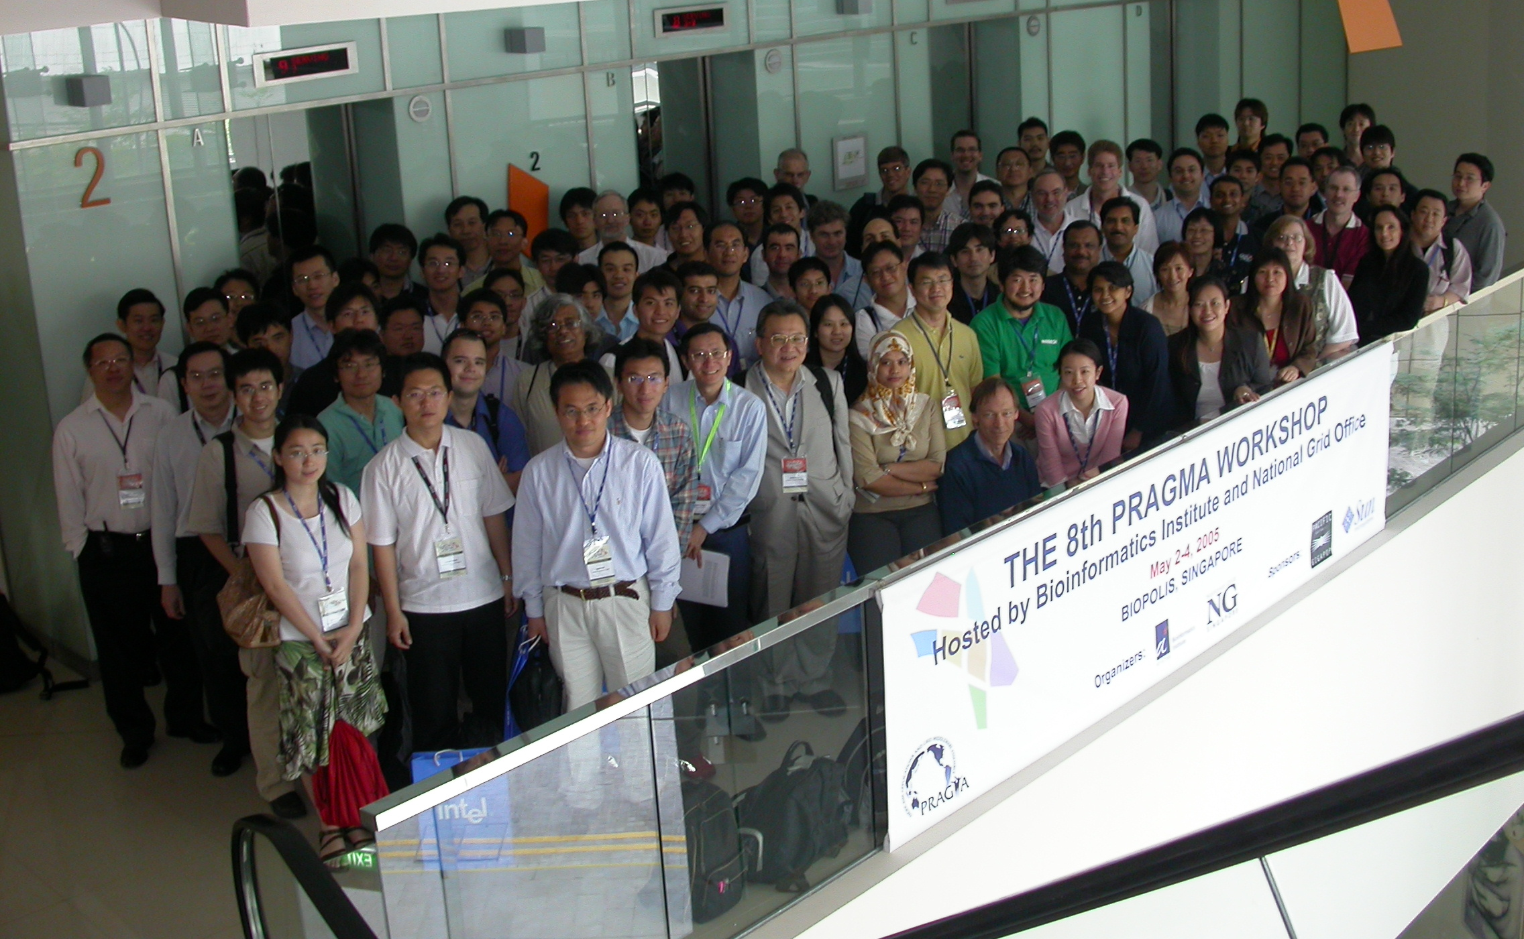
The Group
http://bii.a-star.edu.sg/Pragma8/photo.asp

Slide 10
Activities in 2005
iGRID2005
  AIST, KISTI, NCHC, CNIC, Osaka, Starlight, PNWGP, UCSD, NCSA, Titech, APAC
APAC2005
SC’05
  AIST, Osaka, KISTI, NCHC, NBCR/UCSD, SDSC, NCSA

Slide 11


PRAGMA Institutions at iGRID 2005
“45 demos, from 18 countries. Pacific Rim demonstrations from Australia, China, Japan, Korea, Taiwan, US, Canada and Mexico”
World’s First Demonstration of X GRID Application Switching using User Controlled Lightpaths:
  KISTI, NCHC, Institutions in Canada and Spain
Real Time Observational Multiple Data Streaming and Machine Learning for Environmental Research using Lightpath
  NCHC, others
Great Wall Cultural Heritage
  CNIC, others
Coordination of Grid Scheduler and Lambda Path Service over GMPLS: Toward Commercial Lambda Path Service
  AIST, Osaka, Titech
From Federal Express to Lambdas: Transporting Sloan Digital Sky Survey (SDSS) Data Using UDT
  KISTI, CNIC, APAC, Starlight
Real-time Multi-scale Brain Data Acquisition, Assembly, and Analysis using an End-to-End OptIPuter
  Osaka, KISTI, NCHC, UCSD, Starlight
Global Lambda Visualization Facility
  KISTI, Starlight, NCSA
iGRID APAC
  APAC, Starlight, PNWGP

