Slide 1
Update on Internships
Pacific Rim Undergraduate Experiences
prime.ucsd.edu

Slide 2
e-science
Highest Priority
Collaboration: Science is a Team Activity
  Multidisciplinary, Multi-institutional, International
Education: Build tomorrows scientists
  With tomorrow’s tools
Applications: Focus development
  Gain understanding
Technology: Tools for scientists
  Driven by their needs
Infrastructure: Platform for science
  Needs to be persistent

Slide 3
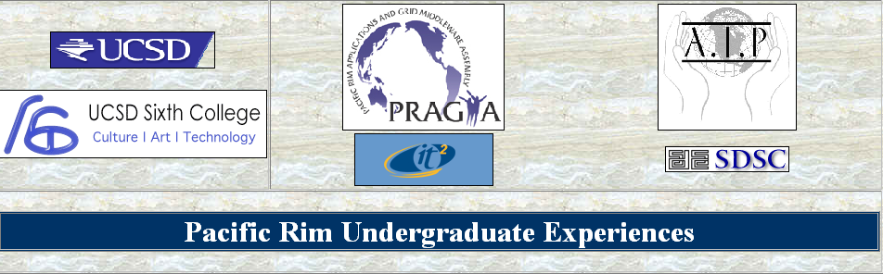
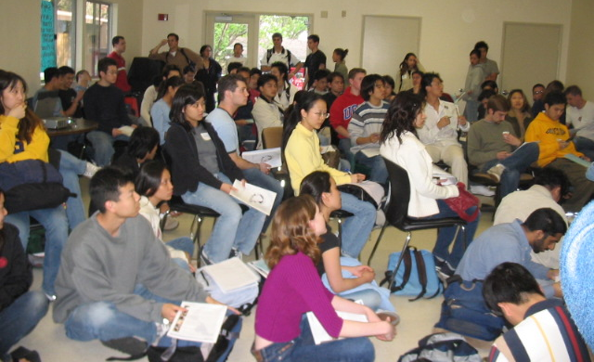

Pacific RIM Experiences for Undergraduates
Started 5 April 2004; three years of funding; six students per year
Research and Cultural Experience
Three Initial Institutions
  Cybermedia Center, Osaka University
  National Center for High-Performance Computing, Hsinchu
  Computer Science Department, Monash University, Melbourne, part of APAC
Hope to expand program to Thailand, CNIC and other sites
Found funds for three
students per site
Will present at
PRAGMA7
http://prime.ucsd.edu
Supported by NSF INT 0407508

Slide 4
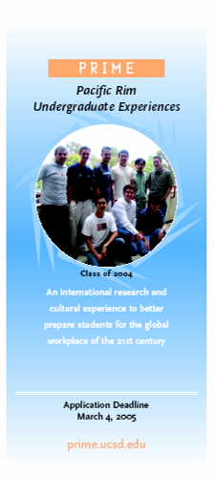
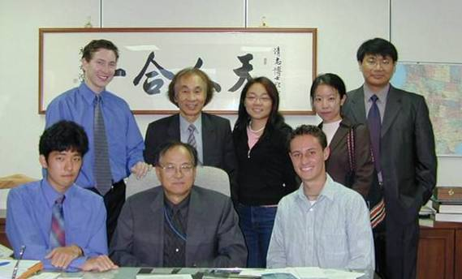


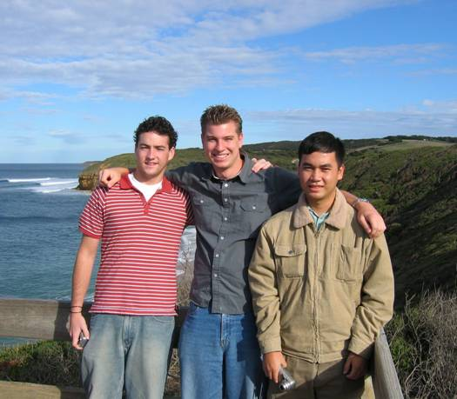
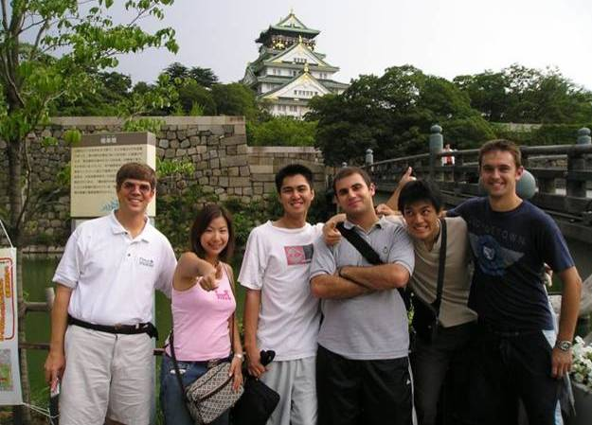

PRIME 2004
Notes:
Brochure and pictures

Slide 5
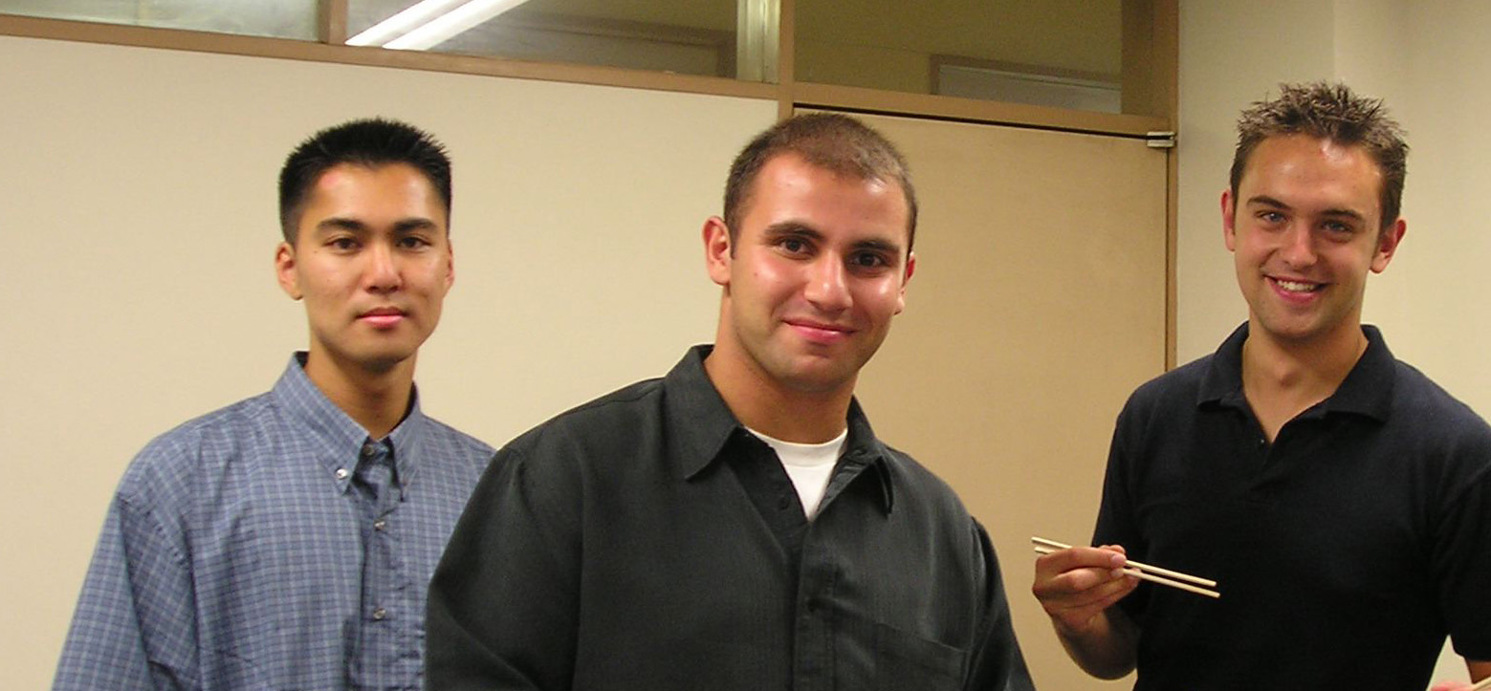
Takumi Takahashi, Ramsin Khoshabeh and Stephen Geist
Osaka, Japan
Migrate code for Tietz digital imaging system from NCMIR to Osaka microscope: Stephen Geist, Toyokazu Akiyama
  Preliminary Steps to migrate code taken
Explore IPv6 implementing for key components of the telescience infrastructure: Ramsin Koshabah, Toyokazu Akiyama
  Set up machines for testing codes
Adopt tools to integrate data from different genomic databases relevant to cell function: Takume Takahashi, Susumu Date
  Learned technology, positioned to apply to microarray data

Slide 6
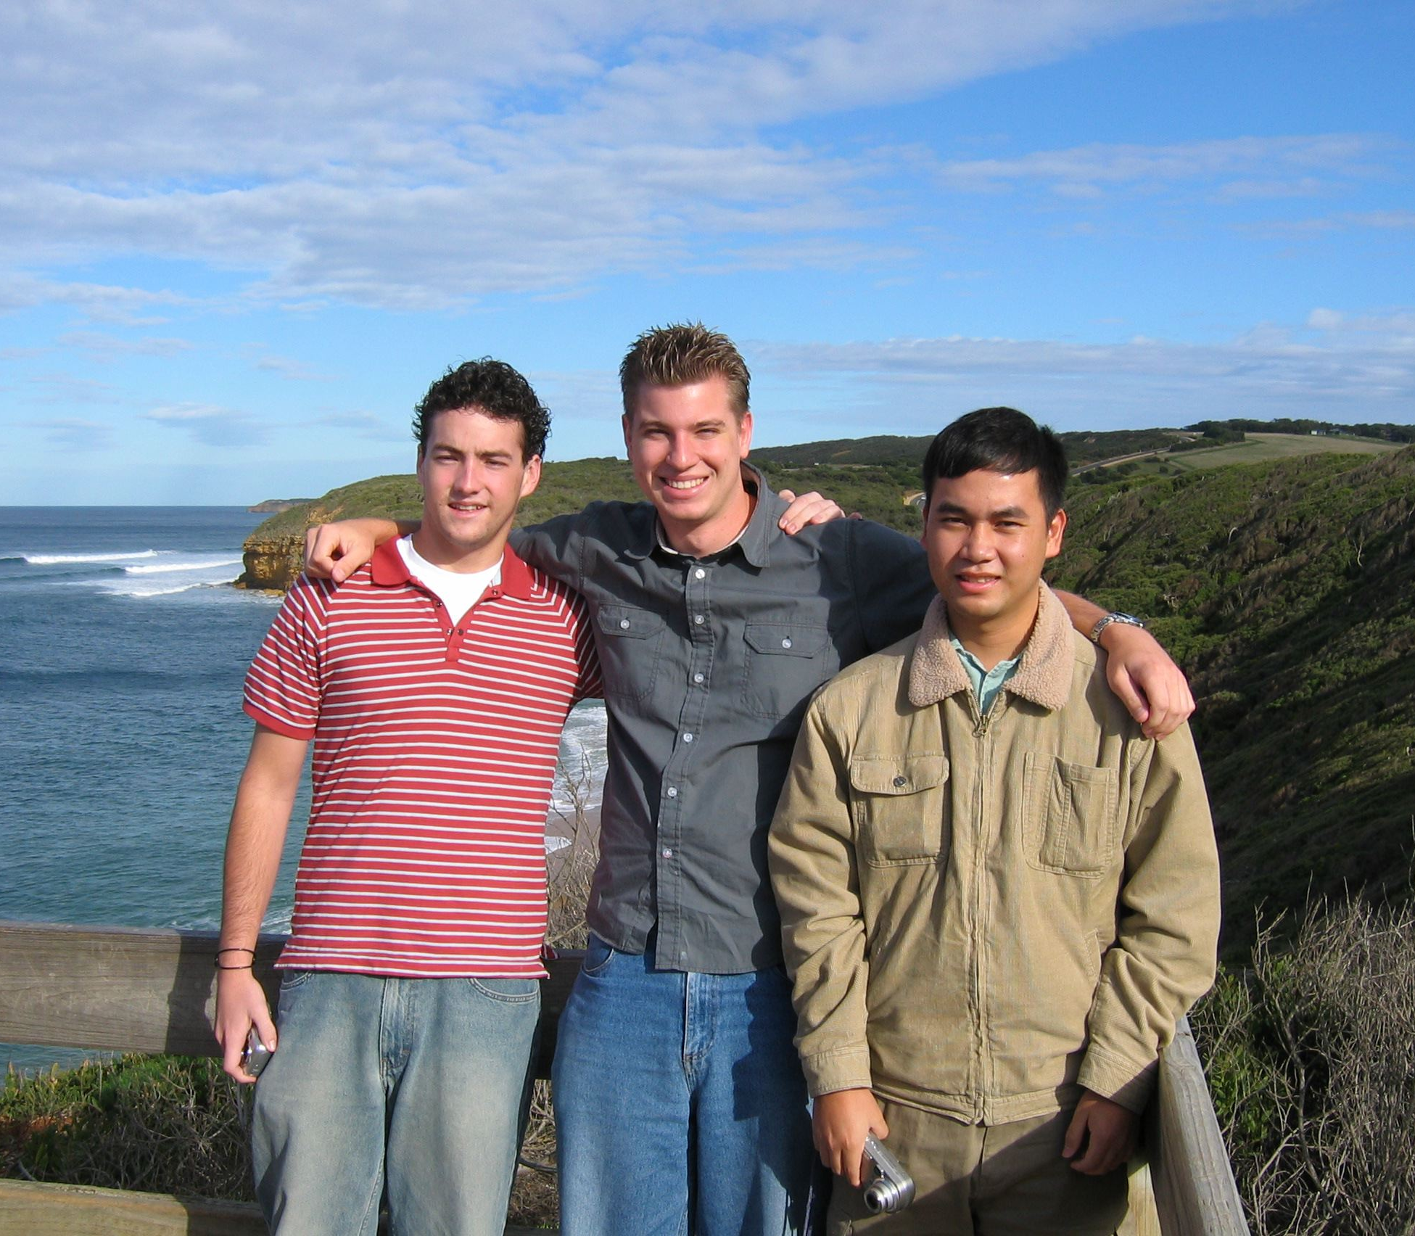
John Colby, Chris Kondrick and Duy Nguyen
Melbourne, Australia
Interface Rocks, Gamess and Nimrod: Duy Nguyen
  Installed Nimrod on a Rocks cluster
Apply workflow tools in quantum chemistry: Chris Kondrick
  Installed software, run some simulations
Employ Nimrod and Continuity to study the impact temporal and spatial distribution of two pacemakers around the heart to understand therapeutic optimizations: John Colby, David Abramson
  Run preliminary test at low resolutions with Nimrod
Monash University

Slide 7
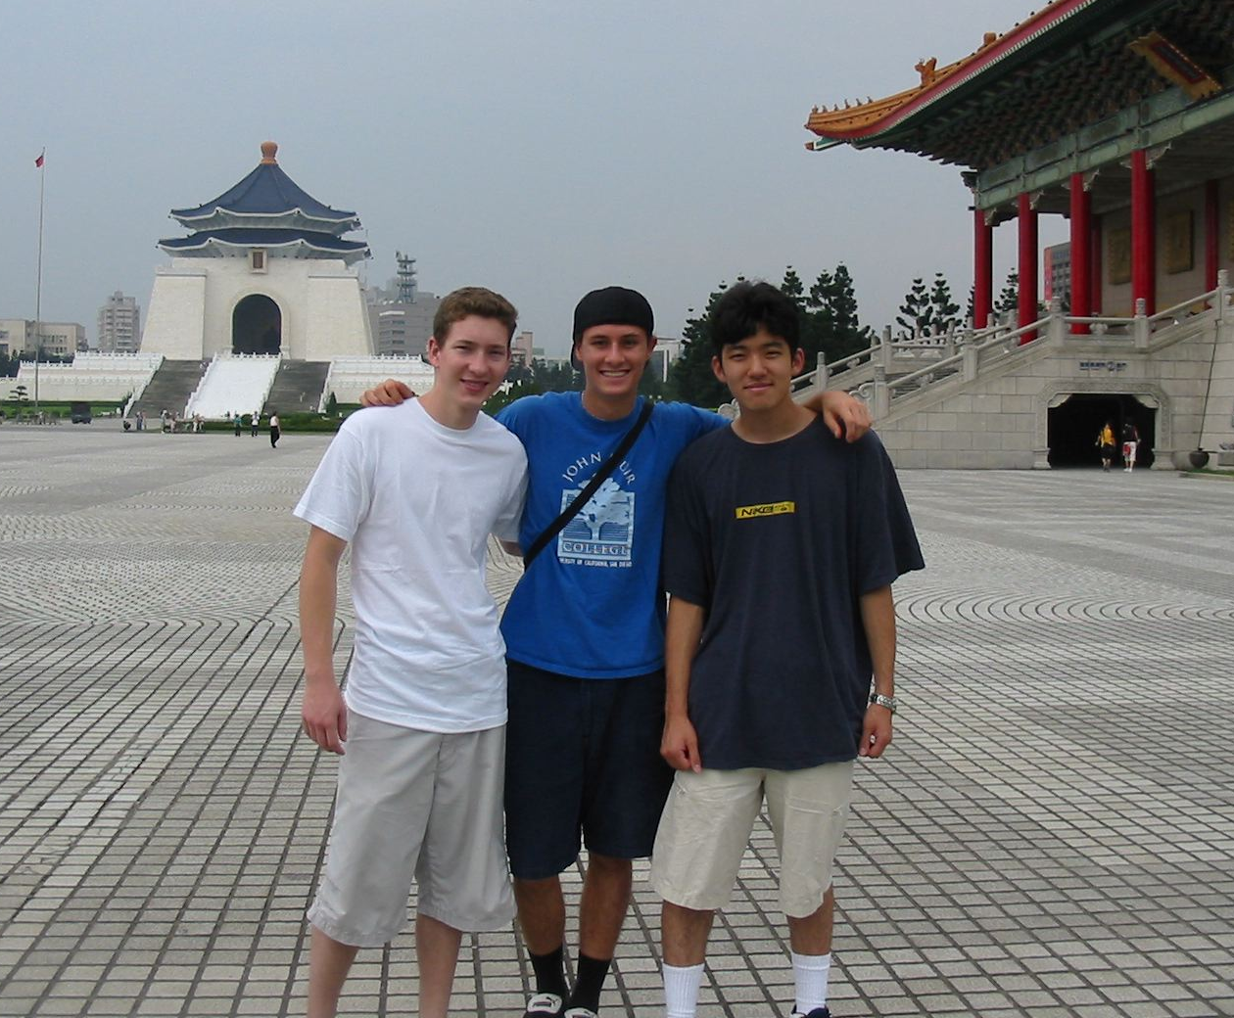
Jared Bell, Brandon Smith and Robert Ikeda
Taiwan
Extend Ecogrid to other Taiwan's Ecological Parks: Brandon Smith, Fang-Pang Lin
  Sensor Network – Data Validation
Develop GUI for systems biology tool Cytoscape: Robert Ikeda, Sun-In Lin, Shi-Wei Lo, Fang-pang Lin
  3D Stereo Hyperbolic Graph for Protein-Protein/Protein-DNAPathway Network
Apply and improve tools for an internet-based virtual laboratory testing earthquake resistance structures: Jared Bell, K.C. Tsai, Fang-Pang Lin
  Internet-based Simulation for Earthquake Engineering

Slide 8
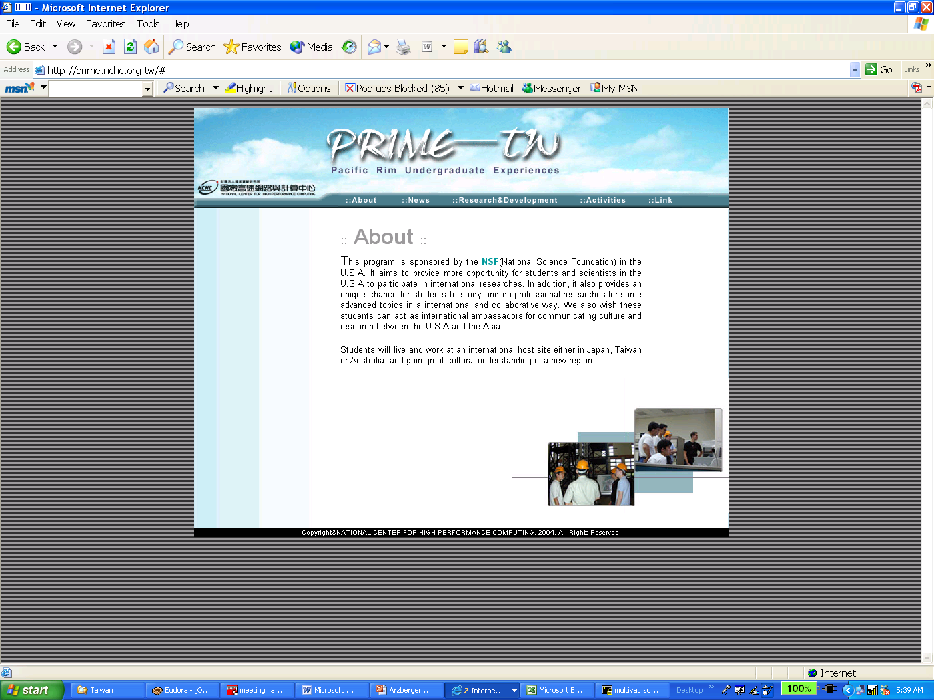
PRIME - TW
http://prime.nchc.org.tw/

Slide 9
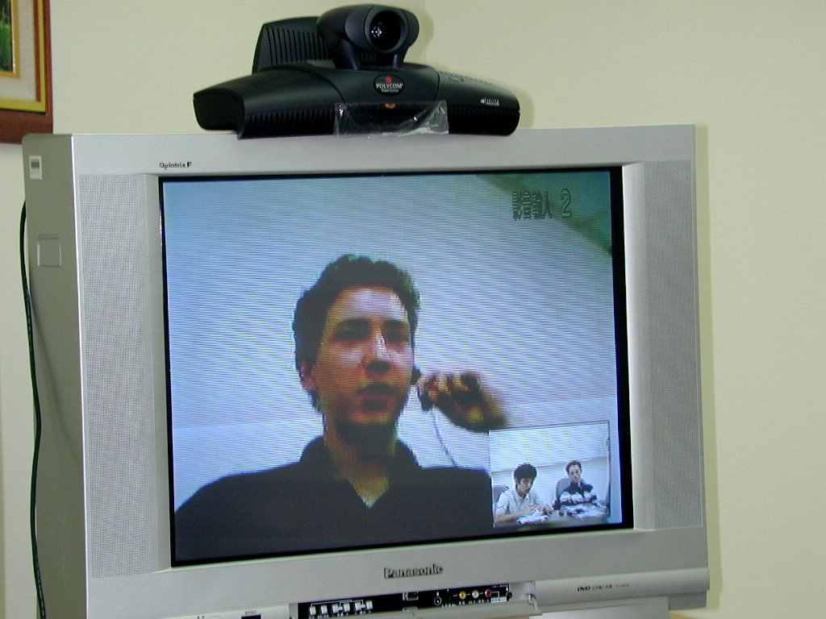
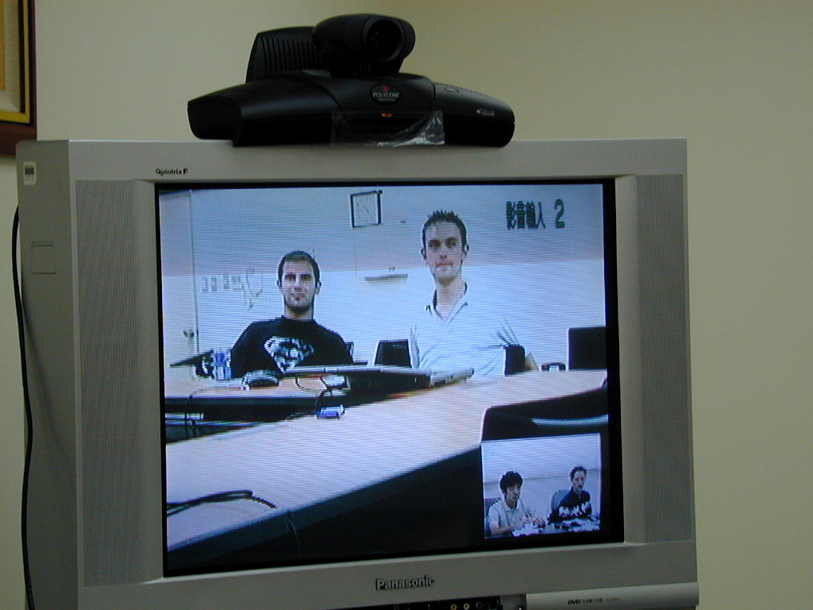
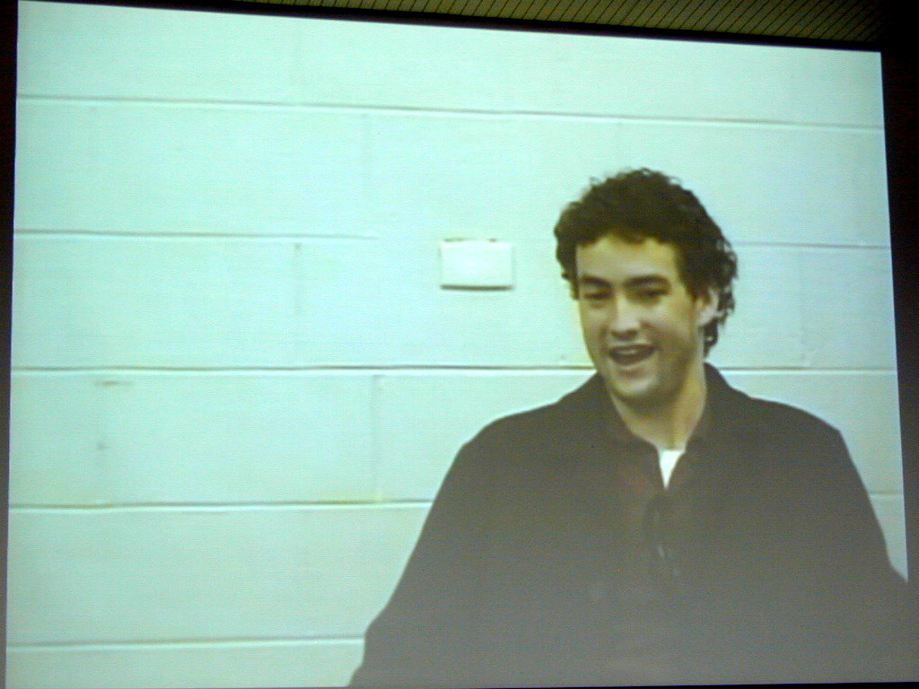
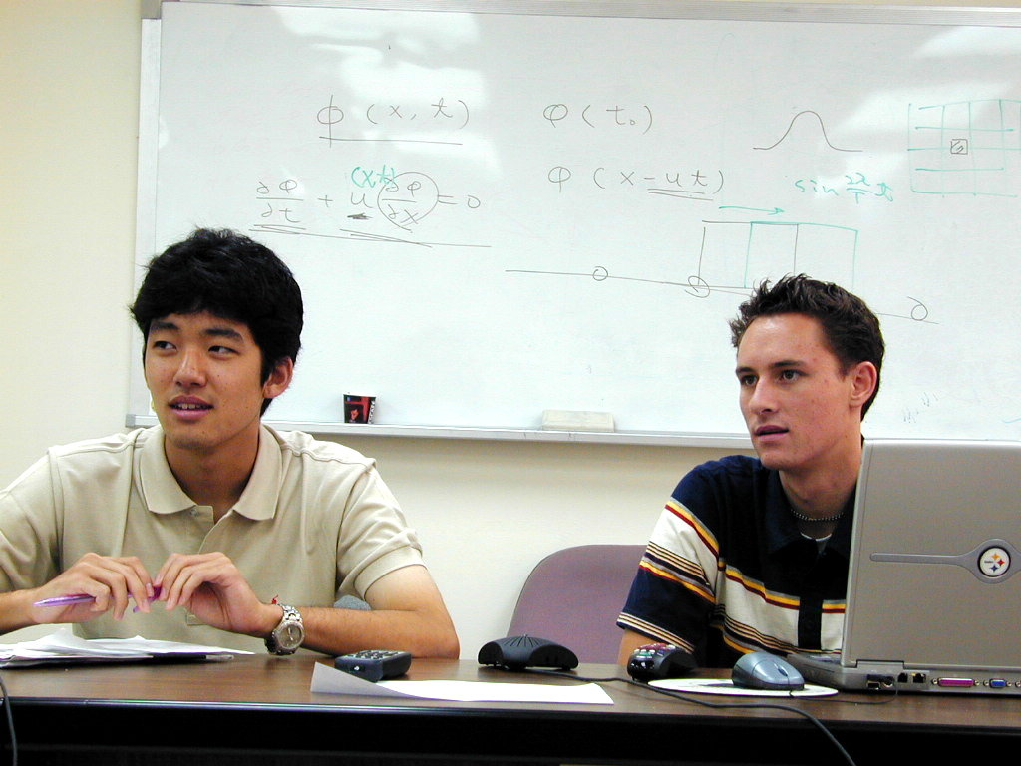
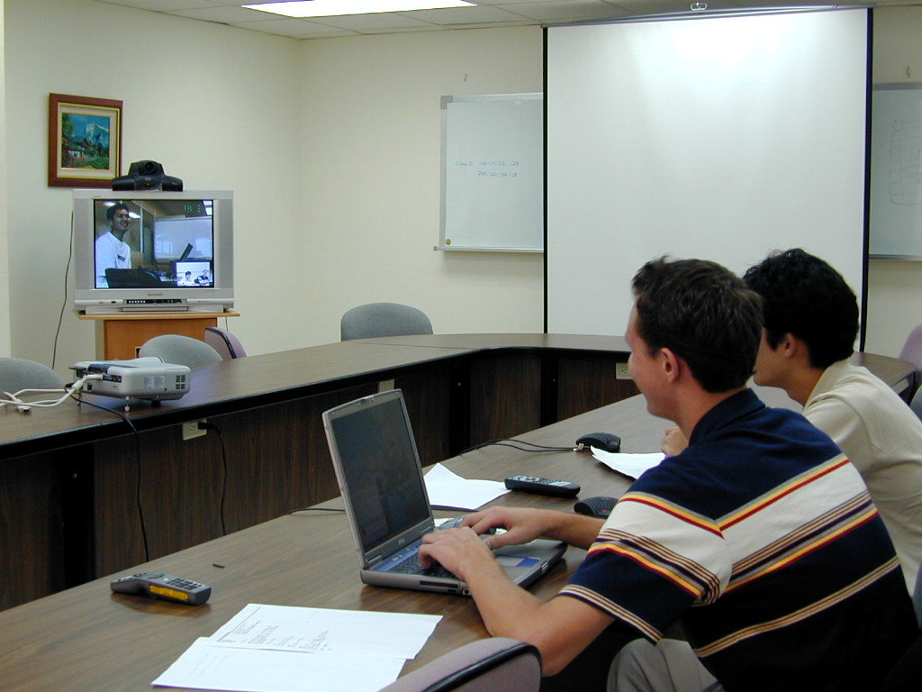
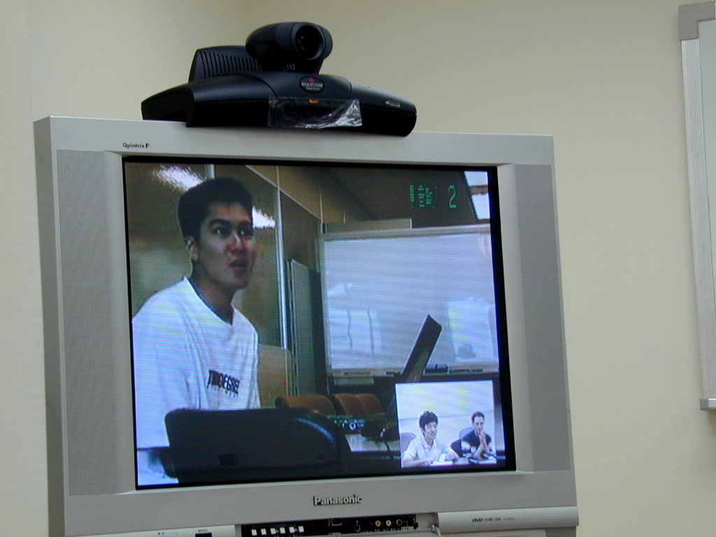
Group VTC of All PRIME Students on August 19, 2004
Jared Bell, NCREE, Taipei (Taiwan)
↘
note
Robert Ikeda, Brandon Smith, NCHC, Hsinchu (Taiwan) ↓
↗
←
Ramsin Khoshabeh, Stephen Geist, Cybermedia Center, Osaka Univ (Japan)
Takumi Takahashi, Bio Grid Center, Osaka (Japan) →
NCHC: Colby, Nguyen, Kondrick from Australia were online but not seen or heard from the other sites… (cont.)

Slide 10
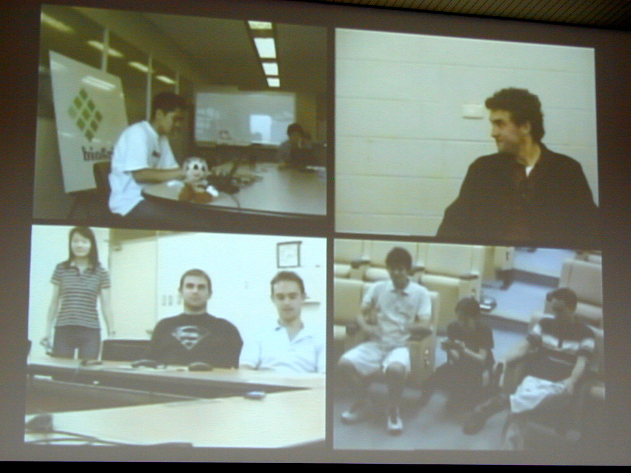
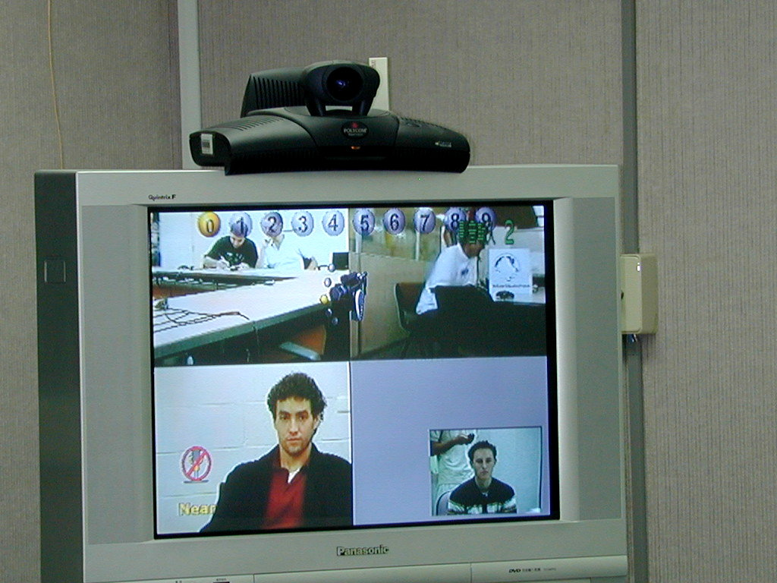
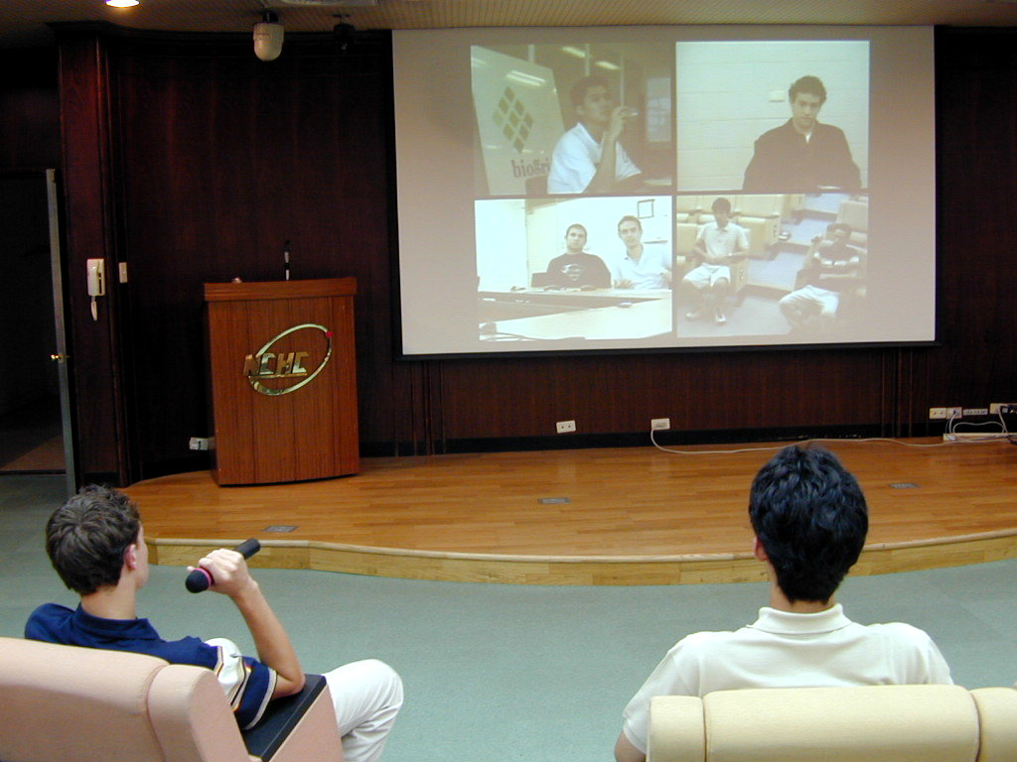
Group VTC of All PRIME Students on August 19, 2004 ii
NCHC: Australia was online in the morning but not seen or heard, so we tried connecting every site again with another MCU in the afternoon. It worked! (Sorry that the Accord system was not able to bring NetMeeting in for Jared...)
Takumi, Bio Grid Center (Osaka)↓
John Colby, Monash Univ. (Melbourne)↙
Tomomi Takao, ↑ Ramsin Khashabeh, Stephen Geist, Cybermedia Center (Osaka)
Robert Ikeda, ↖ Grace Hong, Brandon Smith, NCHC (Hsinchu)

Slide 11
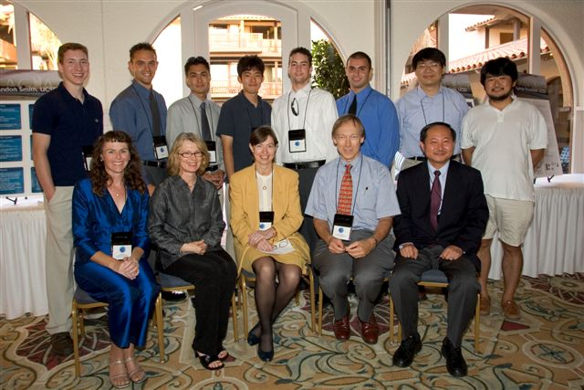
PRAGMA 7

Slide 12
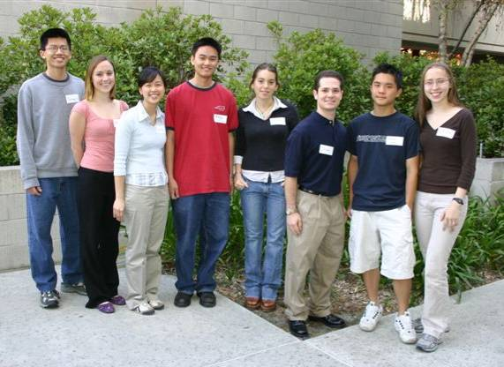
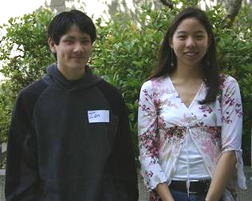
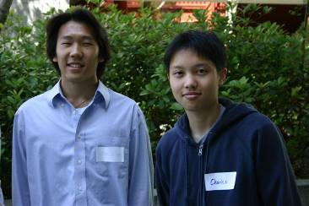

PRIME 2005
Osaka University
  Three students: Telescience, Biogrid
NCHC
  Four students: Ecogrid, Optiputer, Systems Biology (one from Wisconsin)
Monash University
  Five students: Computational Chemistry, Bioinformatics, Cardiac Modeling
CNIC
  Two students: Networking Analysis, Protein Structure Analysis
Looking at ways to enhance the students cultural competency
Notes:
Pictures from Teri

Slide 13
Lessons Learned
Pilot Project
For the students
  Knowing language helps
  Involving student in daily life
  Starting earlier with students doing work
  Linking them together from various sites
For the program
  Students are bridges between researchers
  Previous students act as mentors for new students
    And as great recruiters for the program

Slide 14
Additional Comments
Concerted effort undertaking to recruit women to program
Additional funding sought and received from NSF and Calit2

Slide 15
Plans for the Future
Expand to more host sites
  We expanded this year to CNIC
Expand to more US institutions
  We are sending one from Wisconsin to NCHC
Start having students come to the US
  We will start this summer with one from Jilin University
Expand the type of applications
  We’d really like structural engineering, geosciences in addition to all of the current activities.
Expand to graduate students and postdocs
  NSF has funding for this to various places now

Slide 16
Evaluation
Logical aspects
  http://prime.ucsd.edu/components_of_the_program.htm
Research
Cultural Competency
  http://www3.uop.edu/sis/culture/

Slide 17
Thanks
Teri Simas – Project Coordinator
Host Sites
  Osaka
    Shinji Shimojo, Susumu Date, Toyokazu Akiyama, Kazunori Nozaki
    Tomomi Takao
  NCHC
    Fang-Pang Lin, Hsui-Mei Chou, Sun-In Lin, Shi-Wei Lo
    Grace Hong
  Monash University
    David Abramson, Colin Enticott, Slavisa Garic
    Rob Gray
  CNIC
    Kai Nan, Zhong-hau Lu
    Haiyan Xu
UCSD
  Mentors:
    Tomas Molina, Philip Papadopoulos, Kim Baldridge, many others
    Tony McGregor, Cindy Zheng
  PI, co-PI: Gabriele Wienhausen, Linda Feldman

