Slide 1
mpiBLAST-g2 and the routine experience
Hurng-Chun Lee and Chi-Wei Wang
Academia Sinica Computing Centre, Taiwan

Slide 2
Outline
What is BLAST?
The distributed BLAST – mpiBLAST
The Grid-enabled BLAST – mpiBLAST-g2
Future works
Routine experience

Slide 3


What is BLAST?
A DNA and Protein sequence/database alignment tool
Essential component for sequence analysis in Life Science applications
Developed by NCBI (National Center for Biotechnology Information), US.
Throughput is the key issue of providing service
Complexity ~ O(S_{q}xS_{d})
  S_{q} : Query size
  S_{d} : Database size
Running in single machine
  Not scalable
  Low throughput
  Unable to handle large dataset

Slide 4
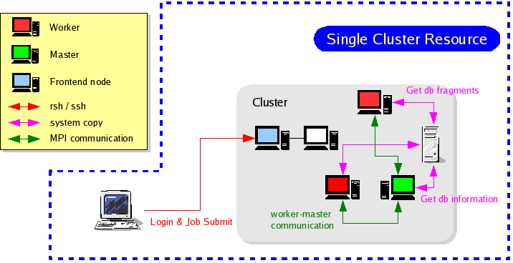

mpiBLAST
Database splitting scheme
The MPI implementation of BLAST master-worker model
  Developed by LANL, U.S.
  Independent tasks
Advantages
  High throughput
  Load Balancing
Running in local cluster
  Performance and Problem size still be limited by local computing power
  Simultaneous I/O to centralized database causes the performance bottleneck
  Database sharing is still difficult
Database
Master
Task list
formatdb
Result merging
BioSeq fetching
blast search
DB Fragments
Job requesting
workers

Slide 5
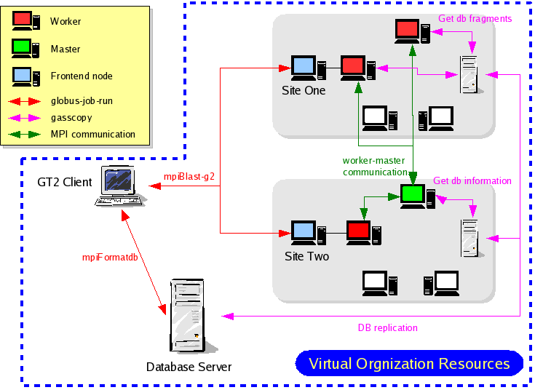
mpiBLAST-g2
A GT2-enabled parallel BLAST runs on Grid
  GT2 GASSCOPY API
  MPICH-g2
The enhancement from mpiBLAST by ASCC
Performing cross cluster scheme of job execution
Performing remote database sharing
Close link with mpiBLAST development team
  The new patches of mpiBLAST can be quickly applied in mpiBLAST-g2
Help Tools for
  database replication
  automatic resource specification and job submission (with static resource table)
  multi-query job splitting and result merging

Slide 6
mpiBLAST-g2 (Cont.)
The use cases
  Single cluster + local database
  Single cluster + remote database
  Cross cluster + local database
  Cross cluster + remote database
  Outbound connectivity is required on each worker for cross cluster mode

Slide 7
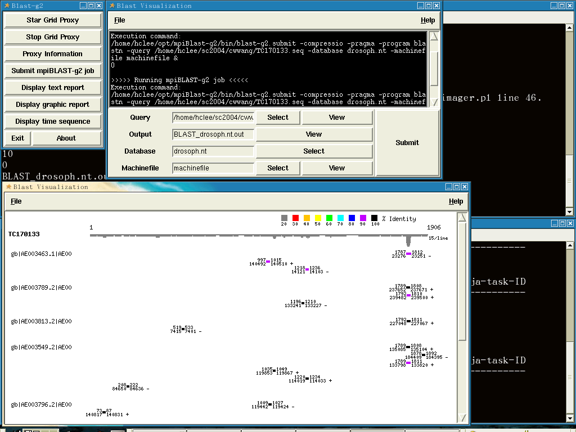
mpiBLAST-g2 (Cont.)
Graphic User Interface
Grid proxy handling
Job submission
Result visualization

Slide 8






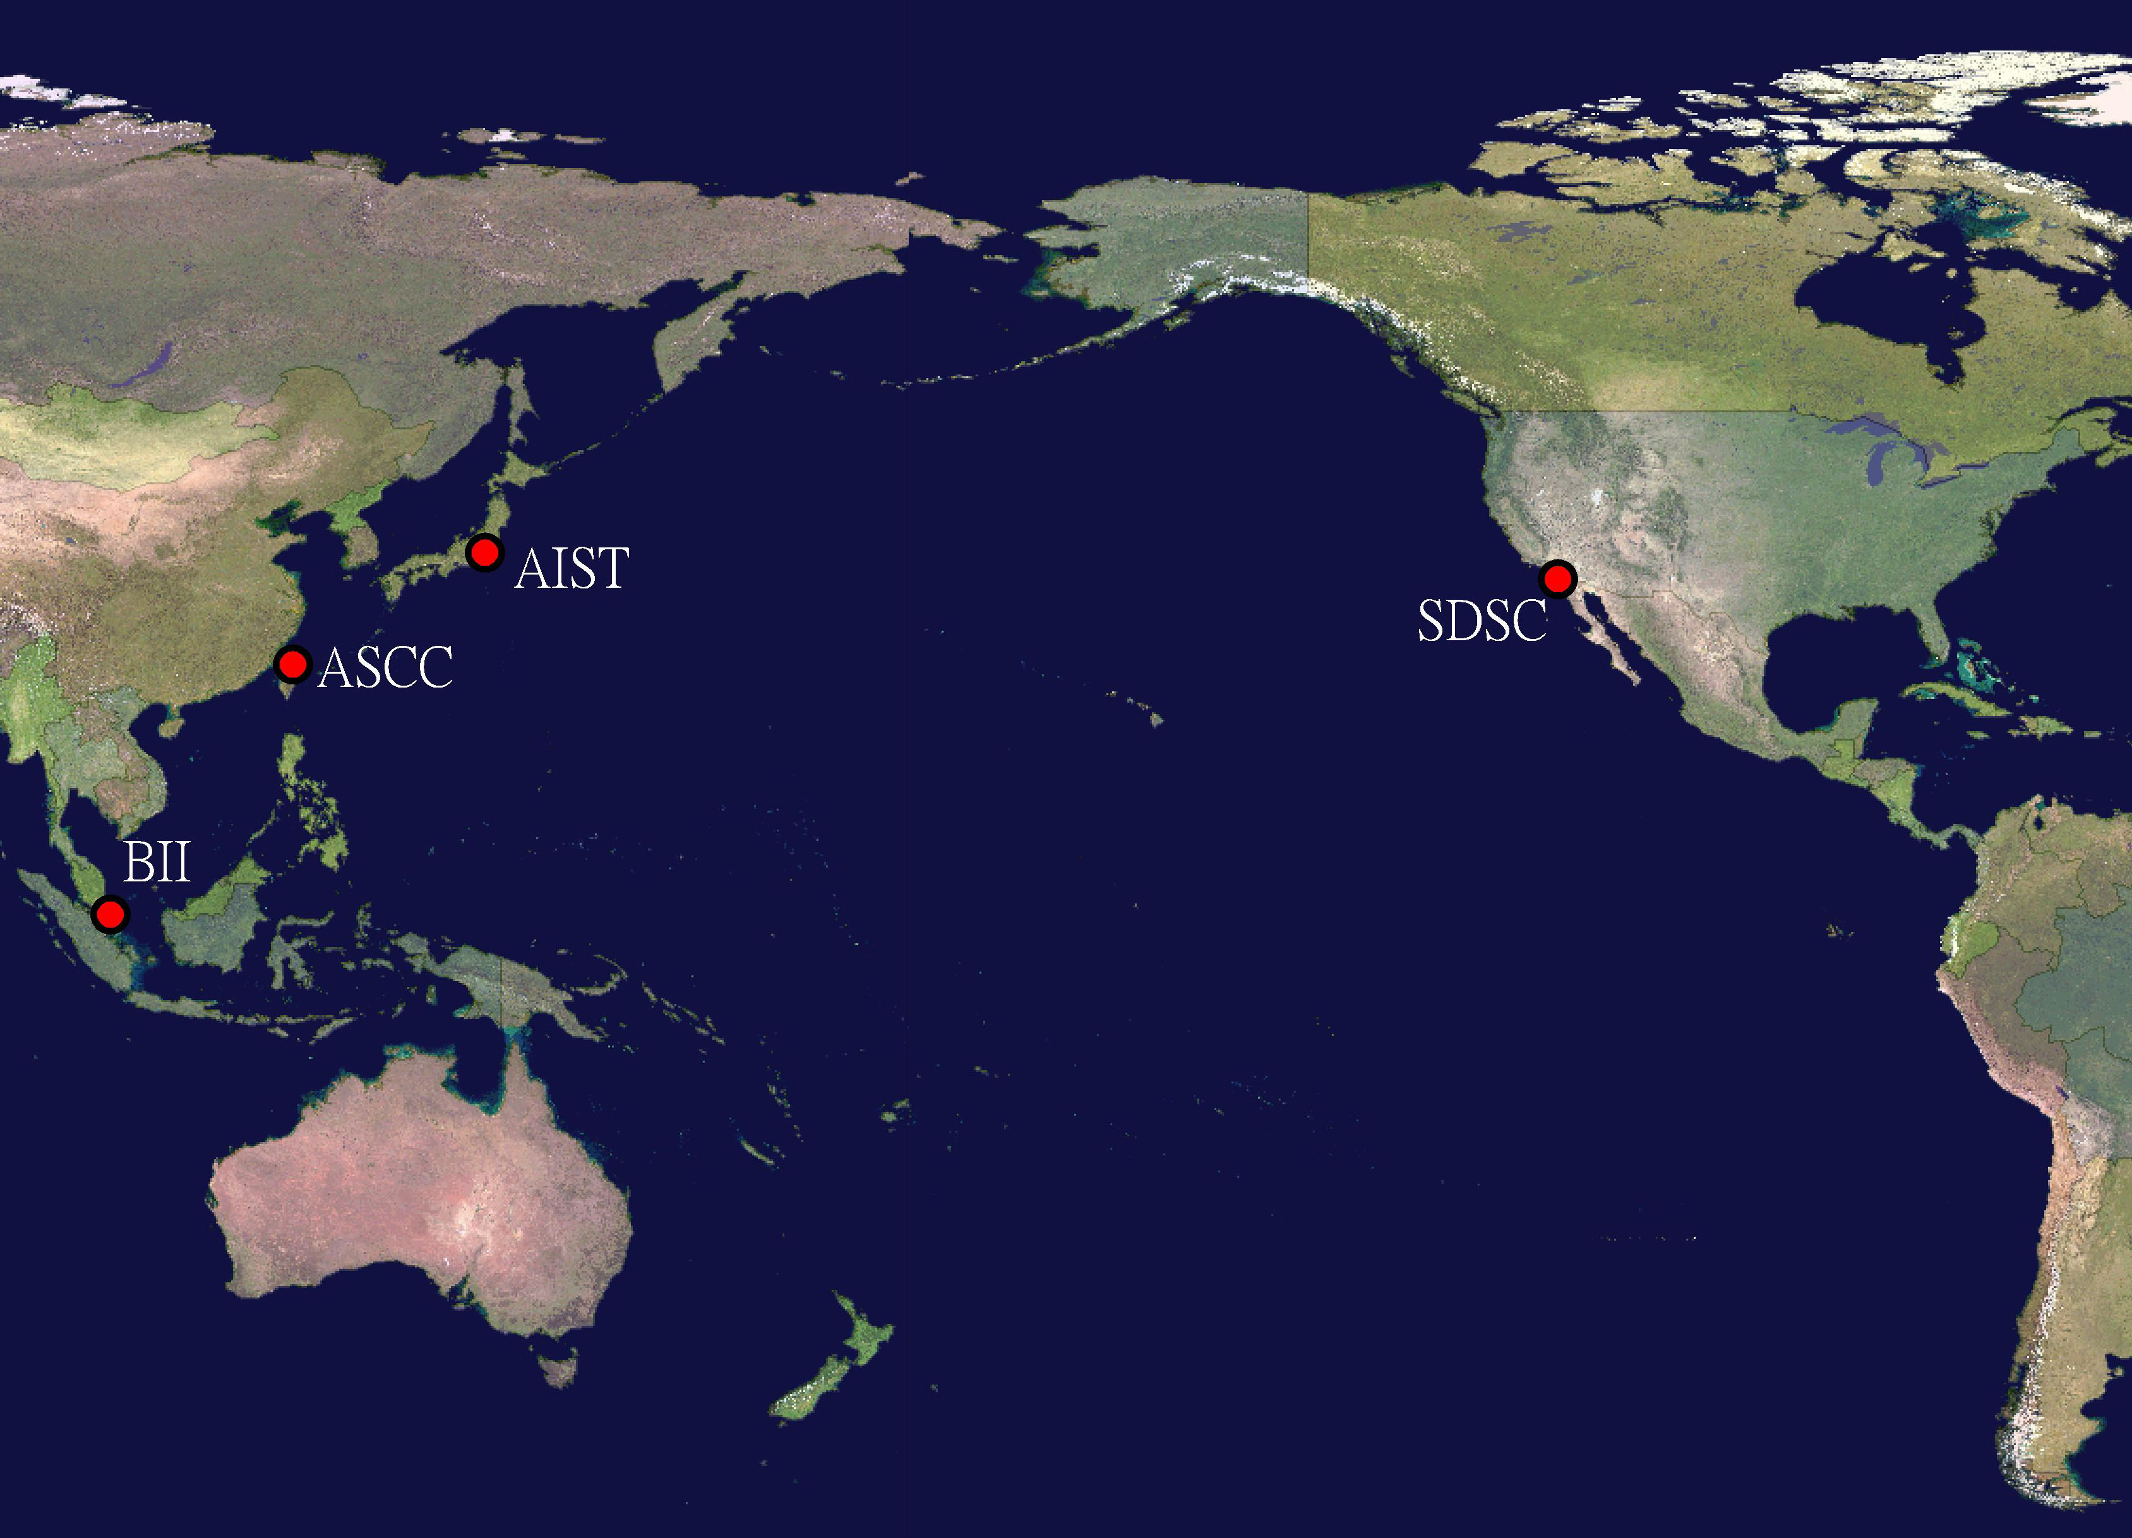
SC2004 demonstration
First deployment on PRAGMA clusters
First successful demonstration of mpiBLAST-g2
Collaborating cross-cluster resources for sequence alignment
KISTI

Slide 9
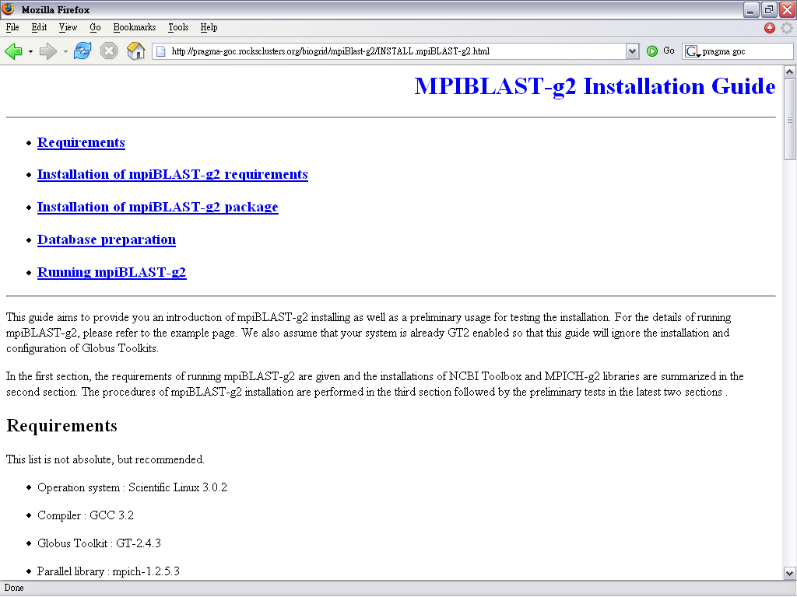
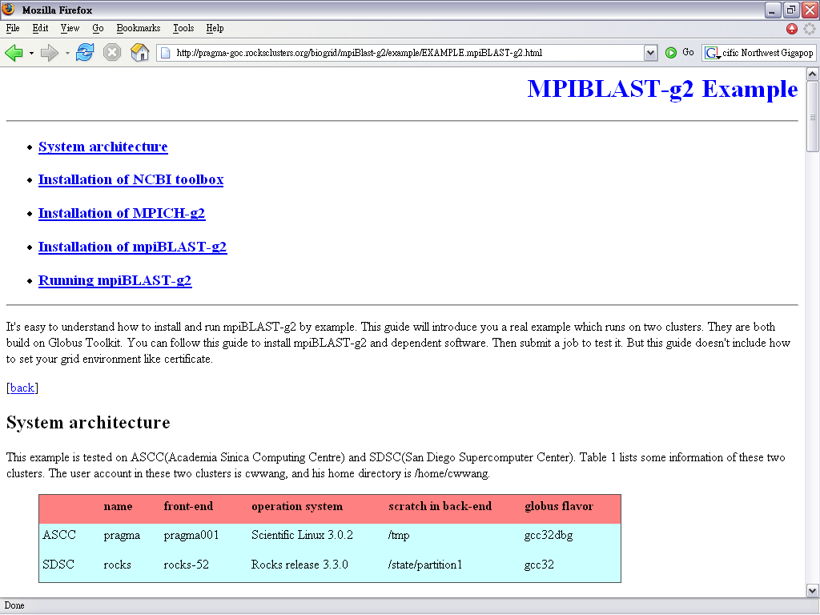
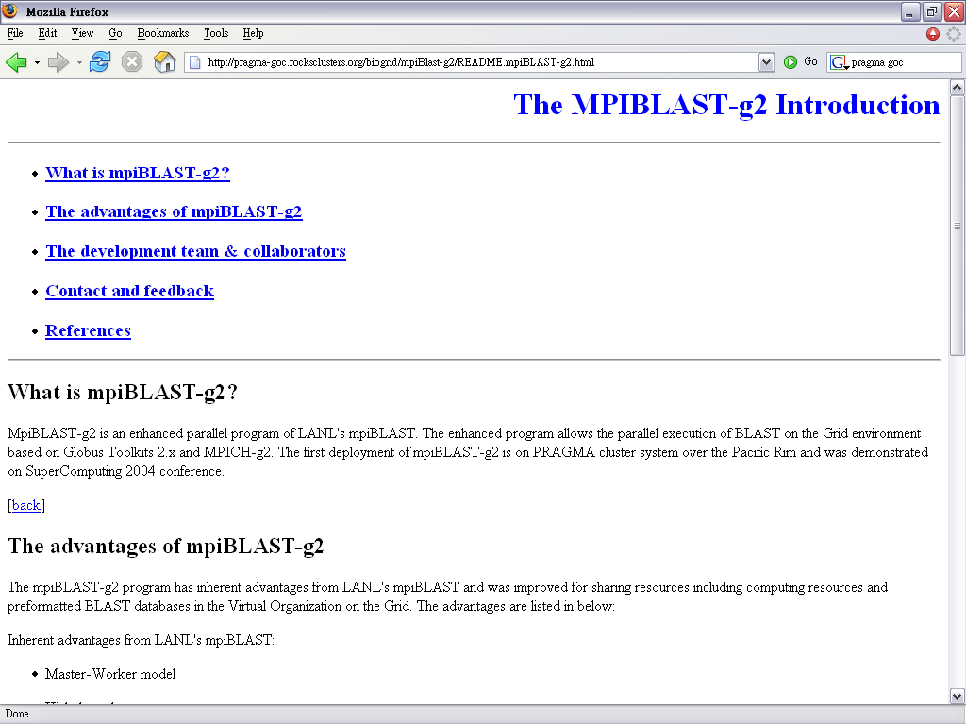
mpiBLAST-g2 (Cont.)
Package and documents
  http://pragma-goc.rocksclusters.org/biogrid/default.html
Notes:
For making this usable and easy to hands-on … we prepared the documents of Introduction, Installation as well as the Example in the same format

Slide 10
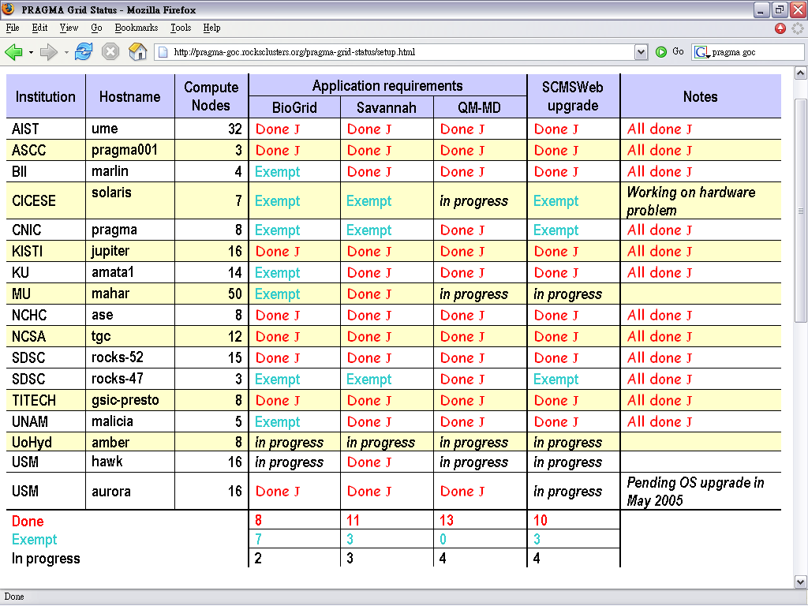
mpiBLAST-g2 PRAGMA deployment
Over 200 CPUs available on PRAGMA testbed
Solaris worker nodes
Private IP on worker nodes
IA64 worker nodes
-- From PRAGMA GOC http://pragma-goc.rocksclusters.org

Slide 11
Future works
Database update
Database server synchronization
Dynamic resource allocation
Porting on IA64 clusters
More deployments on PRAGMA testbed
Code synchronization with mpiBLAST

Slide 12
Routine experience

Slide 13

How to start for a new user?
Apply local account for each site
  Certificate DN
  SSH public key
  Local user id
  Detail user information: email, institute and etc.
  Firewall configuration for SSH access
Setup local environment for each site
Any other means to speed up this procedure?

Slide 14
Problem encountered
Application
  packaging mistakes
Site configuration
  Globus configuration
    Exp: Lack of CA certificates/sign_policy and GT2 libraries in the backend nodes
  Different version of default GCC libraries
  Local queue configuration
    Exp: improper configuration of using rcp in PBS
  …
Need to deal with the problems site by site
How to verify the GT2 installation of backend nodes?
Do we need a common way to configure the application runtime environment?
Notes:
Lack of CA certificate: NCHC, NCSA
Lack of

Slide 15
Application releasing
Issues
  Package manager?
  Code repository?
  Code version control?
Current status
  Source code released in tarball format
  Autoconfig & make for installation
  Documentations for installation and usage

Slide 16
Application deployment
Issues
  Application installation & update
Current solution
  Notifications are broadcasted through the mailing list

Slide 17
Application running
Issues
  How to add new users?
  How to

