Slide 1
NAREGI CA BoF
Summary

Slide 2
Production CA Service
Leads
  Shinichi Mineo
  Okuno Takuto
Three security levels
  Anonymous (none, good for testbed)
  Password
  License
Easy to install
Easy to run
Production Level Replacement for SimpleCA

Slide 3
Results
PRAGMA CA
  Might be the right tool for a PRAGMA CA
  Resource WG has thought about this for a few meetings
  Not a single CA, just an option for sites without their own
Rocks GAMA Roll
  Turnkey CA system deployment
  Install a GAMA server and you are ready for web services
  Can also run a SOAP-client to request a certificate (command line, or web)
  Based on SDSC’s CACL system
    Minor improvement from SimpleCA
  NAREGI CA may be a good replacement for CACL

Slide 4
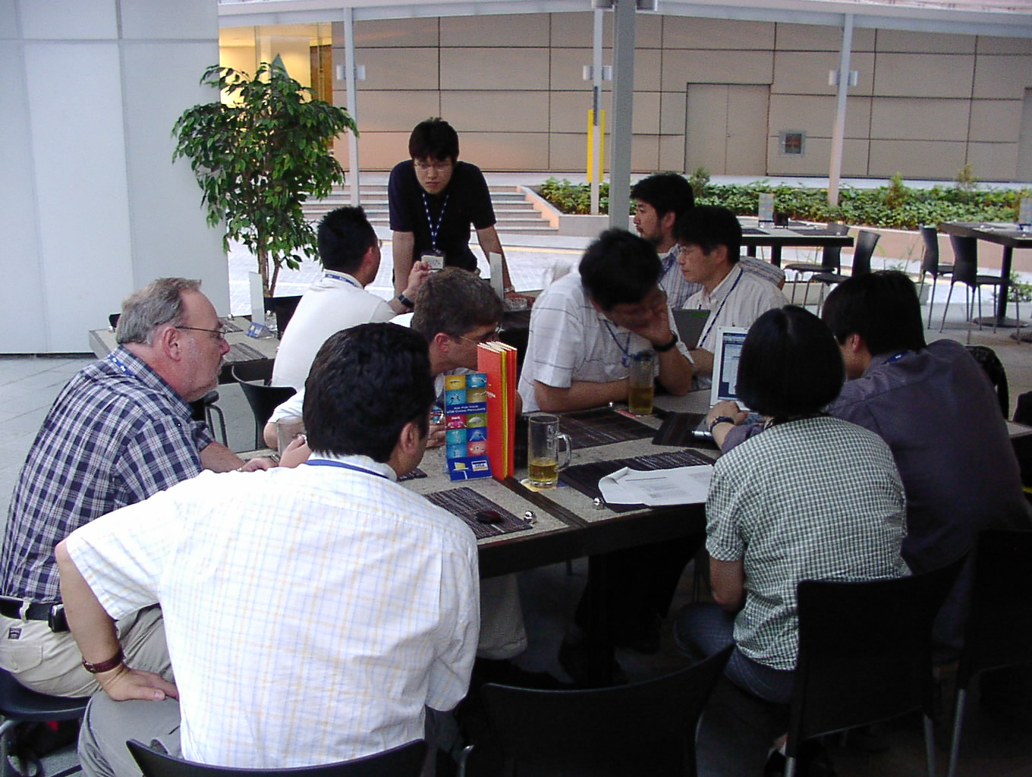
Working Hard

Slide 5
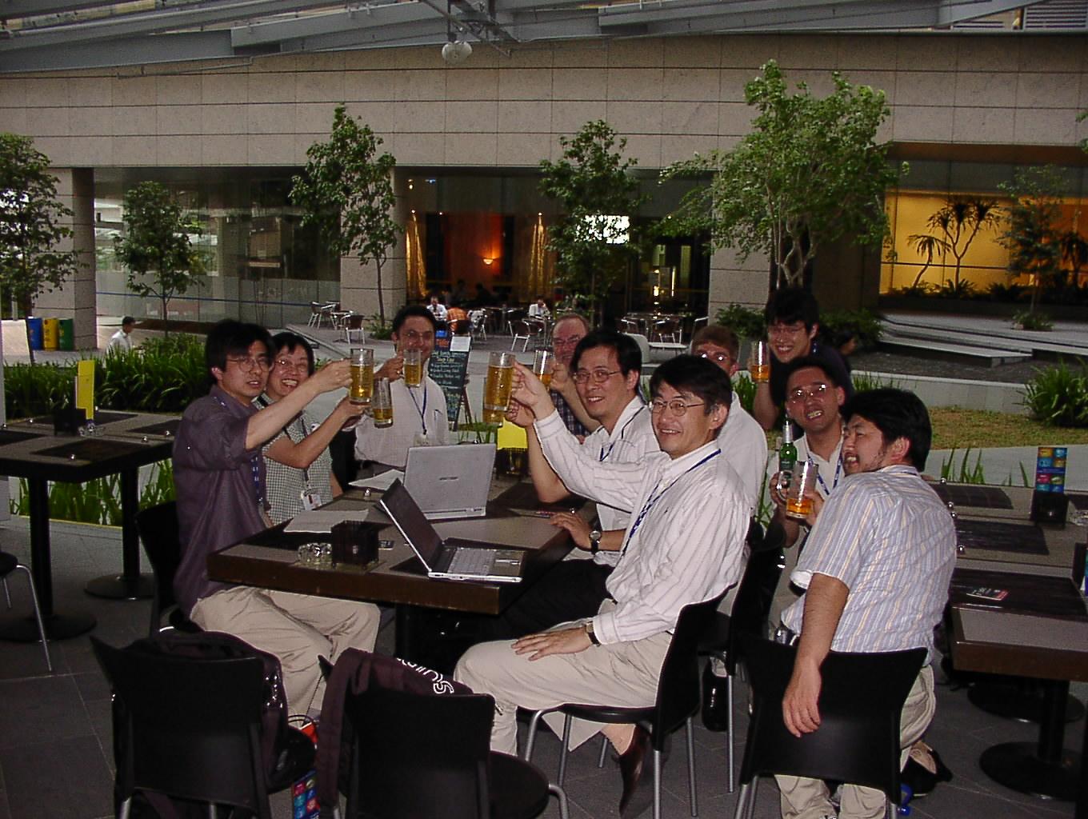
Still Working Hard

Slide 6
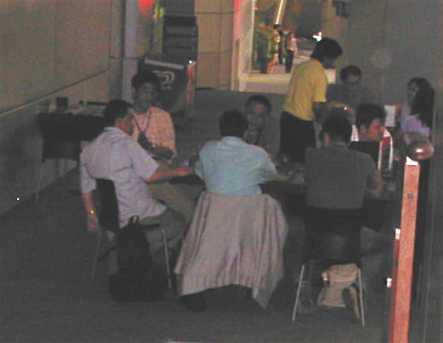
Other BoFs?

