Slide 1
Resource WG Update
PRAGMA 8
Singapore

Slide 2
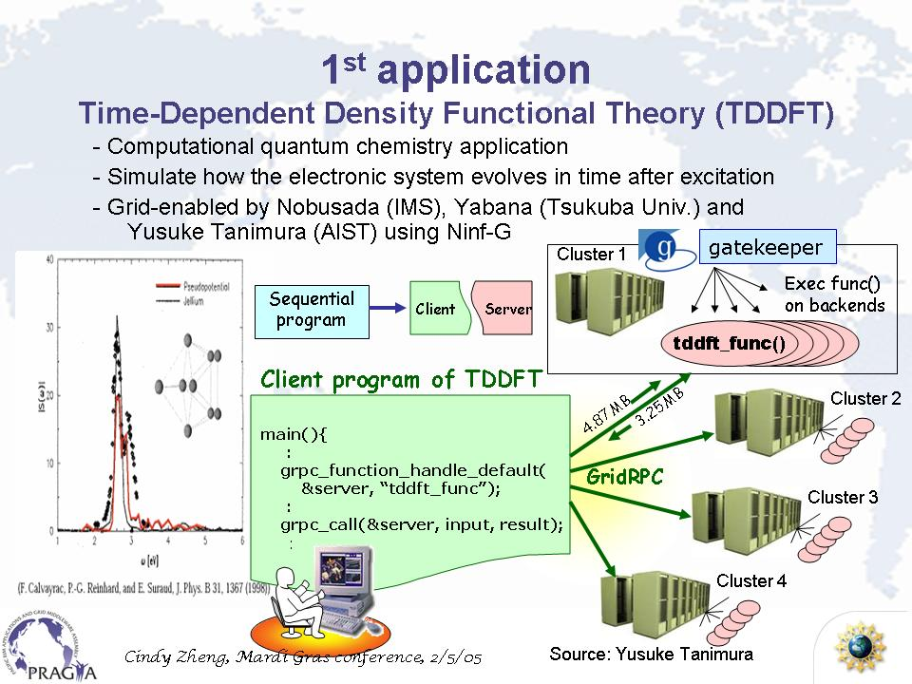
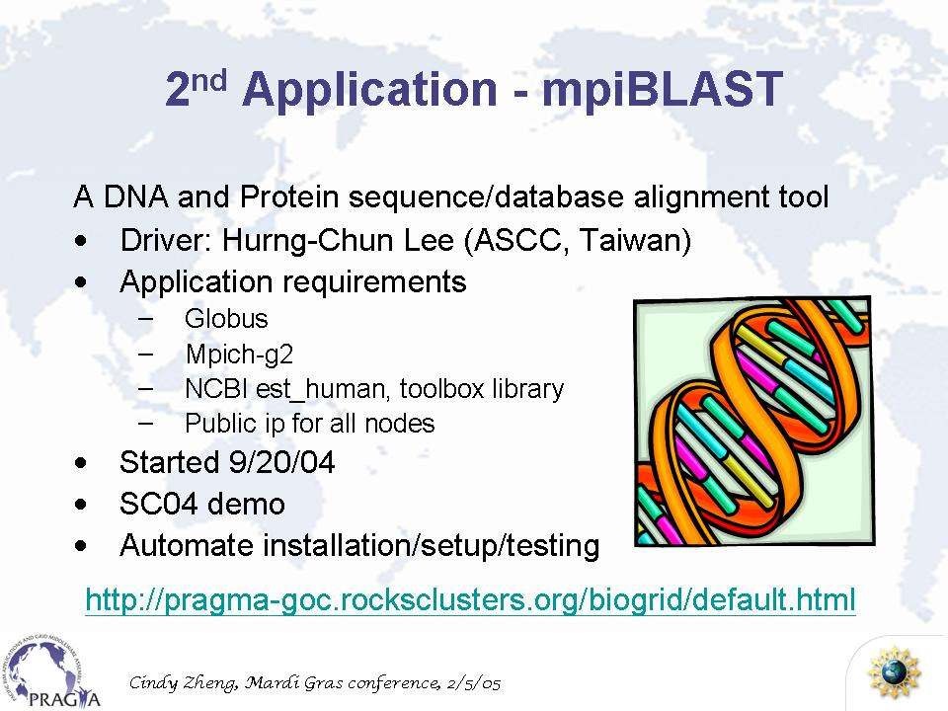
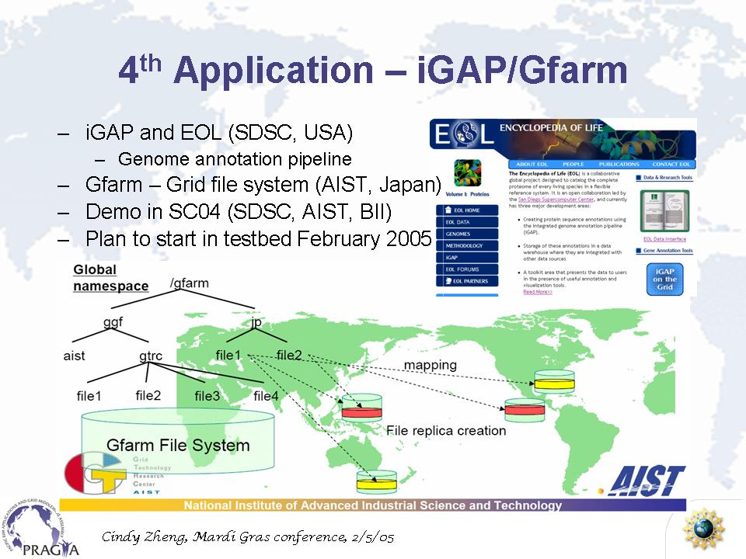
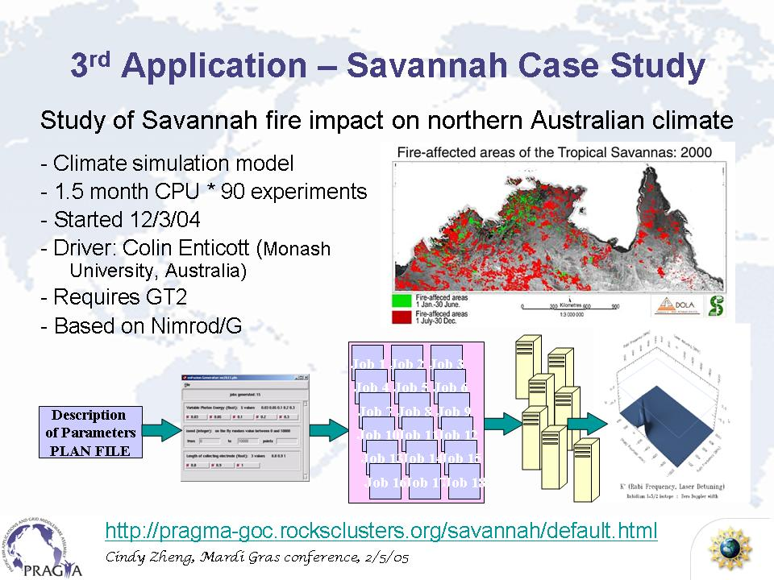
Routine Use - Users make a system work

Slide 3
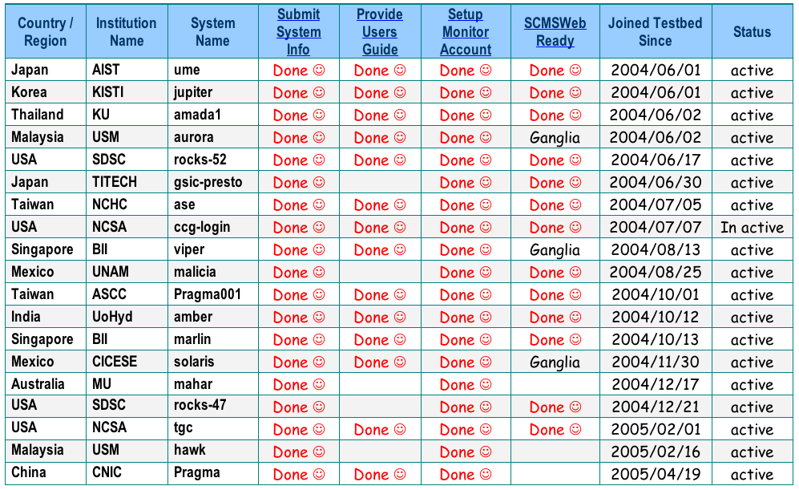
Current Status of Resources (Clusters)

Slide 4
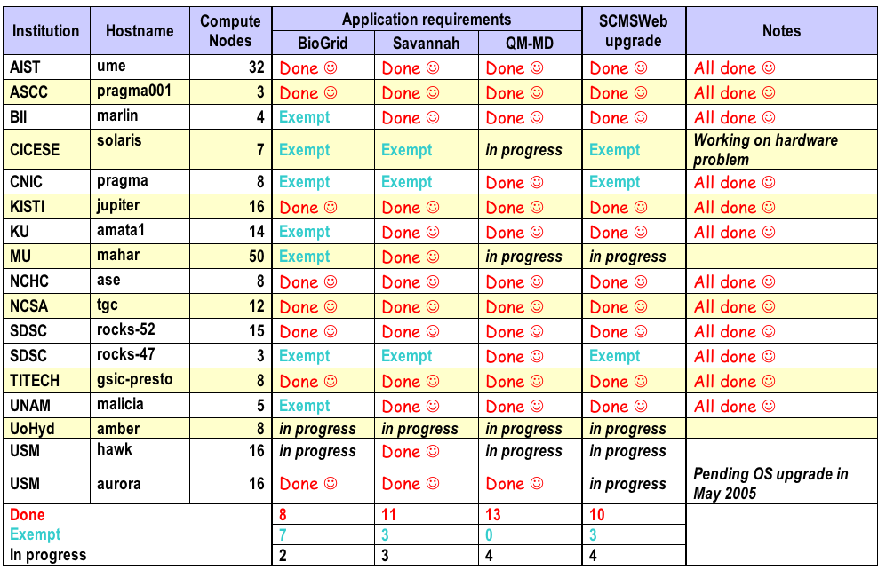
Current Status of Application Requirements

Slide 5
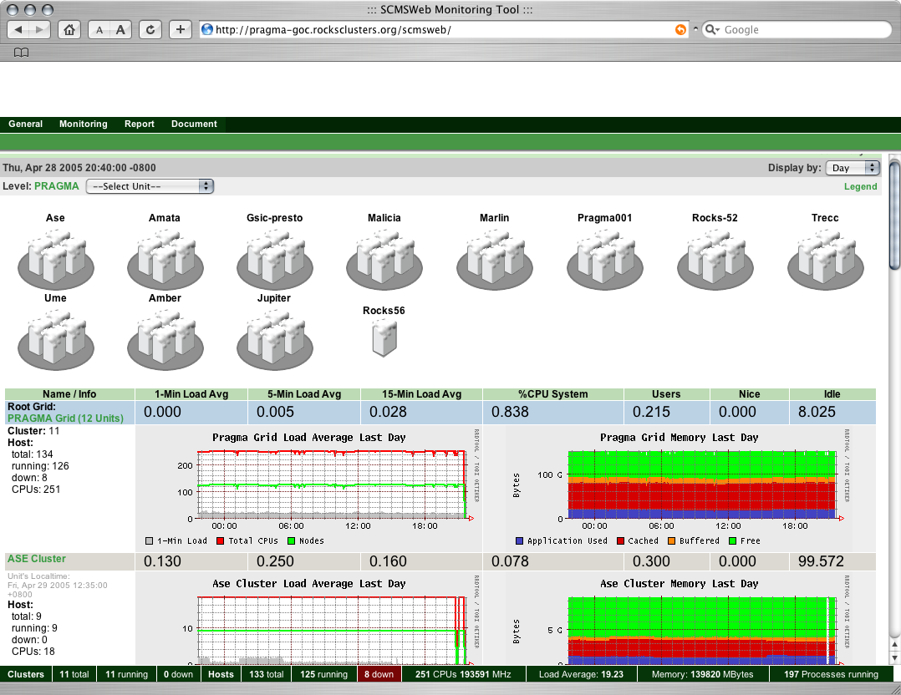
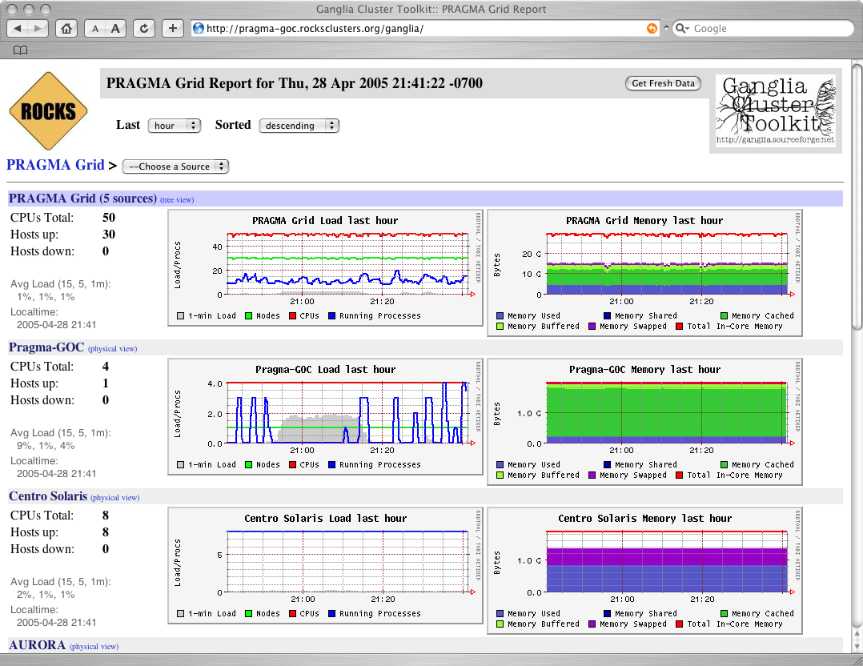
Grid Operations Center
Primary meta-view is SCMSWeb
Ganglia is for others (Preference, Portability)
KU/SDSC Planning on a translator for Ganglia->SCMSWeb

Slide 6
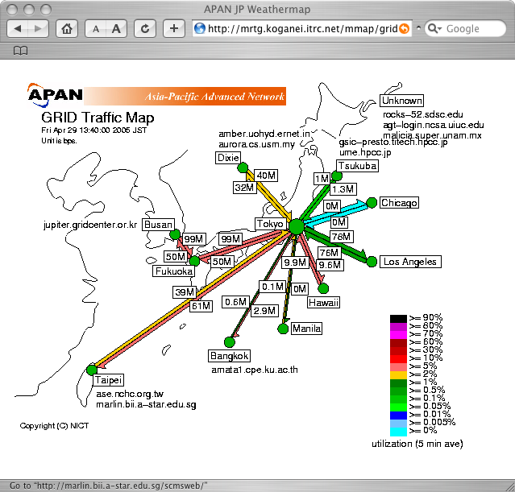
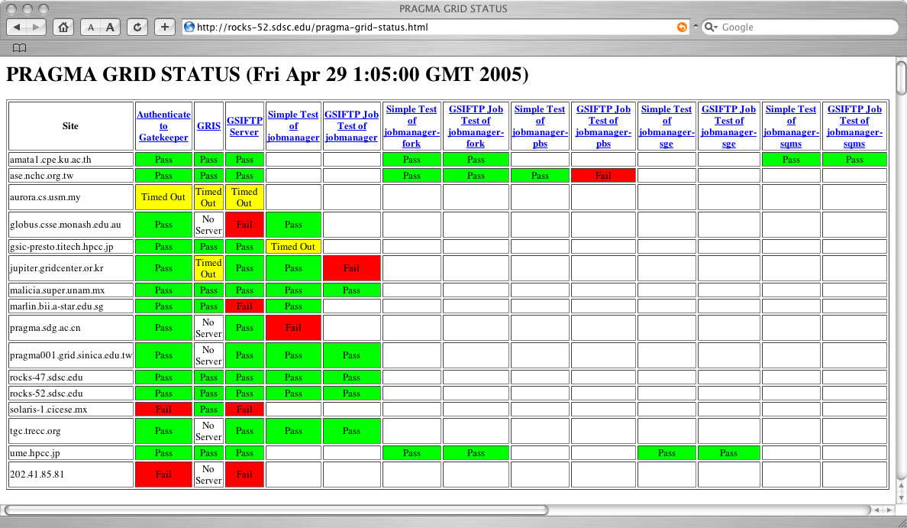
Network and Grid Monitoring
Real-Time Network Traffic
  APAN
  Kento Aida planning on a new network map
  Custom map created for PRAGMA
Testing Grid Services
  NCSA (Originally used on Tera-Grid)
  Actively probes all Globus services

Slide 7
Challenges
Routine use of Demonstrations is done -- almost
  TDDFT worked
  Current Demos are starting to work, you’ll see some at today’s Demo session
Issues still remain
  Demo lead is the application scientists
  Others cannot run the demo with ease
How do we move from Demonstrations to Applications (testbed to production)?
  Need application drivers from outside the Resources WG
  Need to make demo-ware easy for everyone to run
  Select 1-2 applications that non-application experts can contribute to
    EOL?
Concurrent Applications
  Competing demands of software configuration
  Adding functionality without breaking existing infrastructure
    E.g. SGE GRAM support for MPI and single CPU jobs
  Resource Allocation Policies (Scheduling, Partitioning, Dedicated Application Resources)
Training
  How can we help move cluster applications to grid
  Long term problem
  Bigger than the Resources WG

Slide 8
End
Resource WG Lunch Today (12:30)
Chairs and Speakers
Create agenda for 2 hour session tomorrow

