Slide 1

Status of
PRAGMA Grid Testbed
& Routine-basis Experiments
Cindy Zheng
Pacific Rim Application and Grid Middleware Assembly
San Diego Supercomputer Center
University of California, San Diego
http://pragma-goc.rocksclusters.org

Slide 2
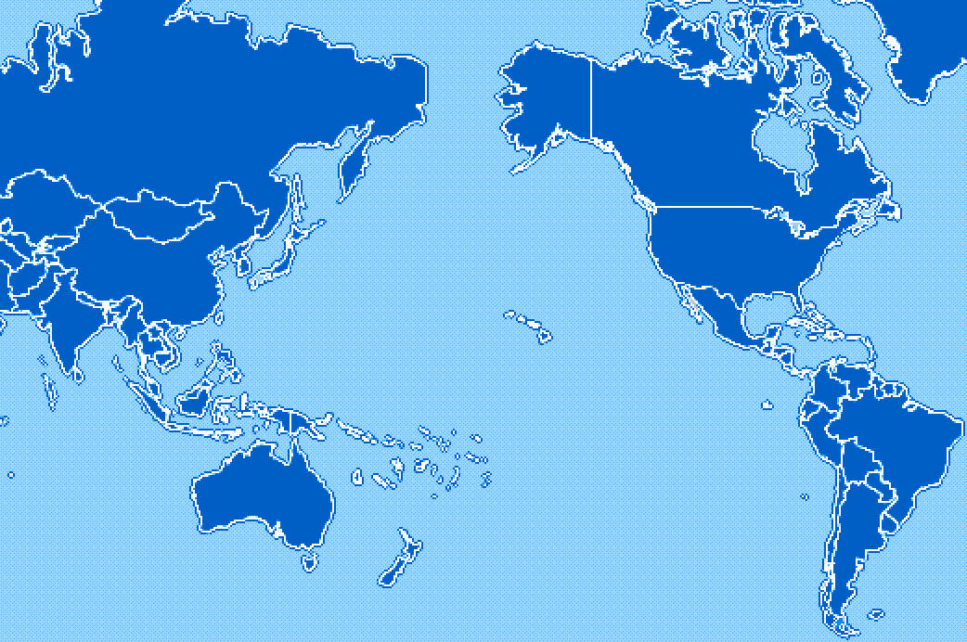
PRAGMA Grid Testbed
KISTI, Korea
NCSA, USA
CNIC, China
AIST, Japan
SDSC, USA
TITECH, Japan
UoHyd, India
NCHC, Taiwan
CICESE, Mexico
ASCC, Taiwan
KU, Thailand
UNAM, Mexico
USM, Malaysia
BII, Singapore
MU, Australia
UChile, Chile

Slide 3
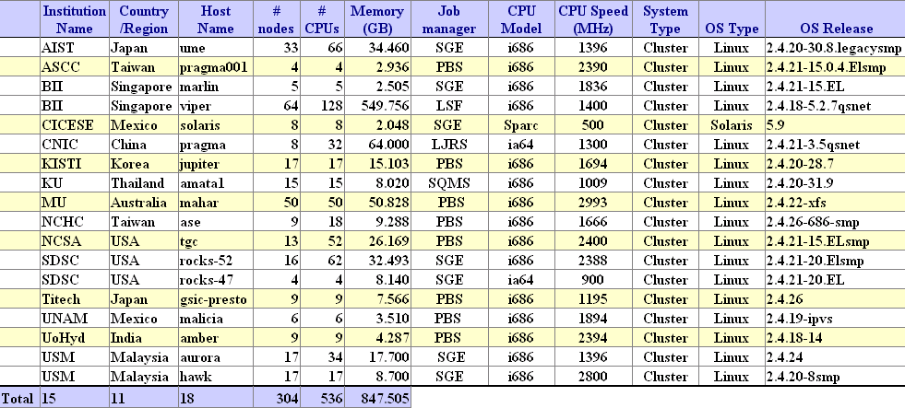
PRAGMA Grid resources http://pragma-goc.rocksclusters.org/pragma-doc/resources.html

Slide 4
Progress at a Glance
May
June
July
Aug
Sep
Oct
Nov
Dec
Jan
Feb
Mar
Apr
May
4
5
8
10
11
13
14
16
18
19
BioGrid Start
QM/MD Start
Setup SCMS Web
2nd User Start
NLANR Collab.
Setup Network Monitor
INCA Testing
GEON Collab.
Savannah Start
TDDFT Start
TDDFT End
Setup Ganglia Central
Setup Grid Op. Center
Setup Grid tests
Gfarm Prep.
BioGrid Demo.
SCMSWeb Upgrade
BioGrid Restart
TDDFT Prep.
BioGrid Prep.
Savannah Prep.
QM/MD Prep.
PRAGMA6
PRAGMA7
SC’04
PRAGMA8

Slide 5
Grid Applications and Middleware
Grid-ready
  TDDFT/Ninf-G (6/1/04 ~ 8/31/04, 2 ~ 10 sites)
  BioGrid (10/23/04 ~, 3 ~ 8 sites) 6 sites
  QMMD/Ninf-G (4/19/05 ~, 5 ~ 13 sites) 8 sites
  Savannah/Nimrod/G (4/26/05 ~, 3 ~ 11 sites) 4 sites
  Ocean Science, CICESE
To be grid’ified
  Flarm, drug design, CNIC, Bin Shen
  Geon, GSCAS/UMC, Huai Zhang
Middleware
  Tested and enhanced
  Introduced to more scientists

Slide 6
Grid Infrastructure
Documentation/communication
  pragma-goc, emails, VTCs, visits, meetings (on-going)
Resource requirements
  NCSA script (deployed)
  INCA (testing)
System/job monitoring
  SCMSWeb Central (deployed, upgrades on-going)
  Ganglia Central (deployed)
User/application environment
  Gfarm (started preparation)
Trust and access
  Naregi-CA (testing)
  GAMA (started collaboration)
Network monitoring
  APAN (deployed)
  NLANR (started collaboration)
Resource/job accounting
  NTU (plan to test in testbed)

Slide 7
Issues
Real science
  Identify real science applications
  Grid-enable
    Middleware training
  Produce meaningful results
Routine-use (not only for demo)
  More users run
    Package application setup
    Resource allocation
    Died process clean up
  Longer time run
    Longer time for experiment
    System policy on run time limit

Slide 8
Thank you
http://pragma-goc.rocksclusters.org

Slide 9
PRAGMA Grid Testbed
KISTI, Korea
NCSA, USA
CNIC, China
AIST, Japan
SDSC, USA
TITECH, Japan
UoHyd, India
NCHC, Taiwan
CICESE, Mexico
ASCC, Taiwan
KU, Thailand
UNAM, Mexico
USM, Malaysia
BII, Singapore
MU, Australia
UChile, Chile
12 countries, 19 clusters, 550 CPUs, 900GB memory

Slide 10
Status
Applications/Middleware
Done
  TDDFT/Ninf-G, AIST
Ongoing
  BioGrid, ASCC
  QMMD/Ninf-G, AIST
  Savannah/Nimrod/G, MU
Starting
  iGAP/Gfarm, AIST/SDSC
  Ocean Science, CICESE
To be grid’ified
  Flarm, drug design, CNIC
  Geon, GSCAS/UMC
Middleware
  Tested and enhanced
  Introduced to more scientists
Grid Infrastructure
On-going:
  pragma-goc, emails, VTCs, visits, meetings
  SCMSWeb
Deployed
  NCSA grid testing script
  Ganglia
  APAN network monitor
Starting
  INCA testing
  Collaboration with NLANRGfarm
  Naregi-CA
Planed
  GAMA
  NTU accounting

Slide 11
Issues
Real science
  Identify real science applications
  Grid-enable
    Middleware training
  Produce meaningful results
Routine-use (not only for demo)
  More users run
    Package application setup
    Resource allocation
    Died process clean up
  Longer time run
    Longer time for experiment
    System policy on run time limit

