Slide 1
Burnoff of the Australian savanna –
Does it affect the climate?
Testing the Pragma Testbed.
K. Görgen, A. Lynch, C. Enticott*, J. Beringer, D. Abramson**,
P. Uotila, N. Tapper
School of Geography and Environmental Science
* Distributed Systems Technology Centre
** School of Computer Science and Software Engineering

Slide 2
Nimrod Applications
Discipline | Organization | Exploration
Air Pollution | Victorian Environment Protection Authority | Ozone control strategies
Quantum Electro-dynamics | Griffith University | Electron collisions with a short lived laser excited target atom.
Ecology | CRC for Tropical Pest Management | Cattle Tick control strategies
Electronics | Monash University | Design of robust ad hoc wireless networks
Public Health Policy | Monash University | Spread of HIV and Hepatitis C by injecting drug users
Radiation Standards | Australian Radiation Protection and Nuclear Safety Agency | Design parameters for Australian X-Ray equipment
Computational Fluid Dynamics | University of New South Wales | Optimal aerofoil design
Electronics | Griffith University | Optimal multi-frequency antennae
Mechanical Engineering | Monash University | Robust design of mechanical structures
Astrophysics | Monash University | Simulation models of the early solar system, Simulation of orbits of Pluto
Rational Drug Design | Walter and Eliza Hall Institute/ CSIRO | Searching for effective drugs from large database

Slide 3
New Applications
Quantum Chemistry | UCSD/U of Zurich | Computation of Pseudo-potentials. Quantum based protein/ligand docking. | 2005
Biophysics | UCSD | Optimization of pacemaker placement. | 2005
Climate Modeling | Monash Univeristy | Modeling the effect of Savanna burn off on the onset of the wet season. | 2005
Pure Mathematics | VUT | Solving for a constant in inequality. | 2005
Cancer treatment | University of Cardiff | Optimal dose and x-ray exposure | 2005
Computational Fluid Dynamics | Cambridge University | Optimization of fluid flow | 2005
Earth Sciences | Monash University | Inverse modelling of geological structures | 2005

Slide 4
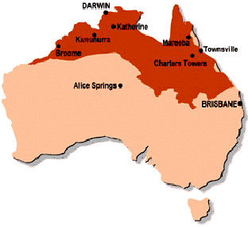
Savanna Burnoff
Extensive savanna eco-systems in northern Australia
  25 % of Australia
  Vegetation: spinifex / tussok grasslands; forest / open woodland
  Warm, semiarid tropical climate
  Primary land uses:
    Pastoralism
    Mining
    Tourism
    Aboriginal land management
(Tropical Savannas CRC)

Slide 5
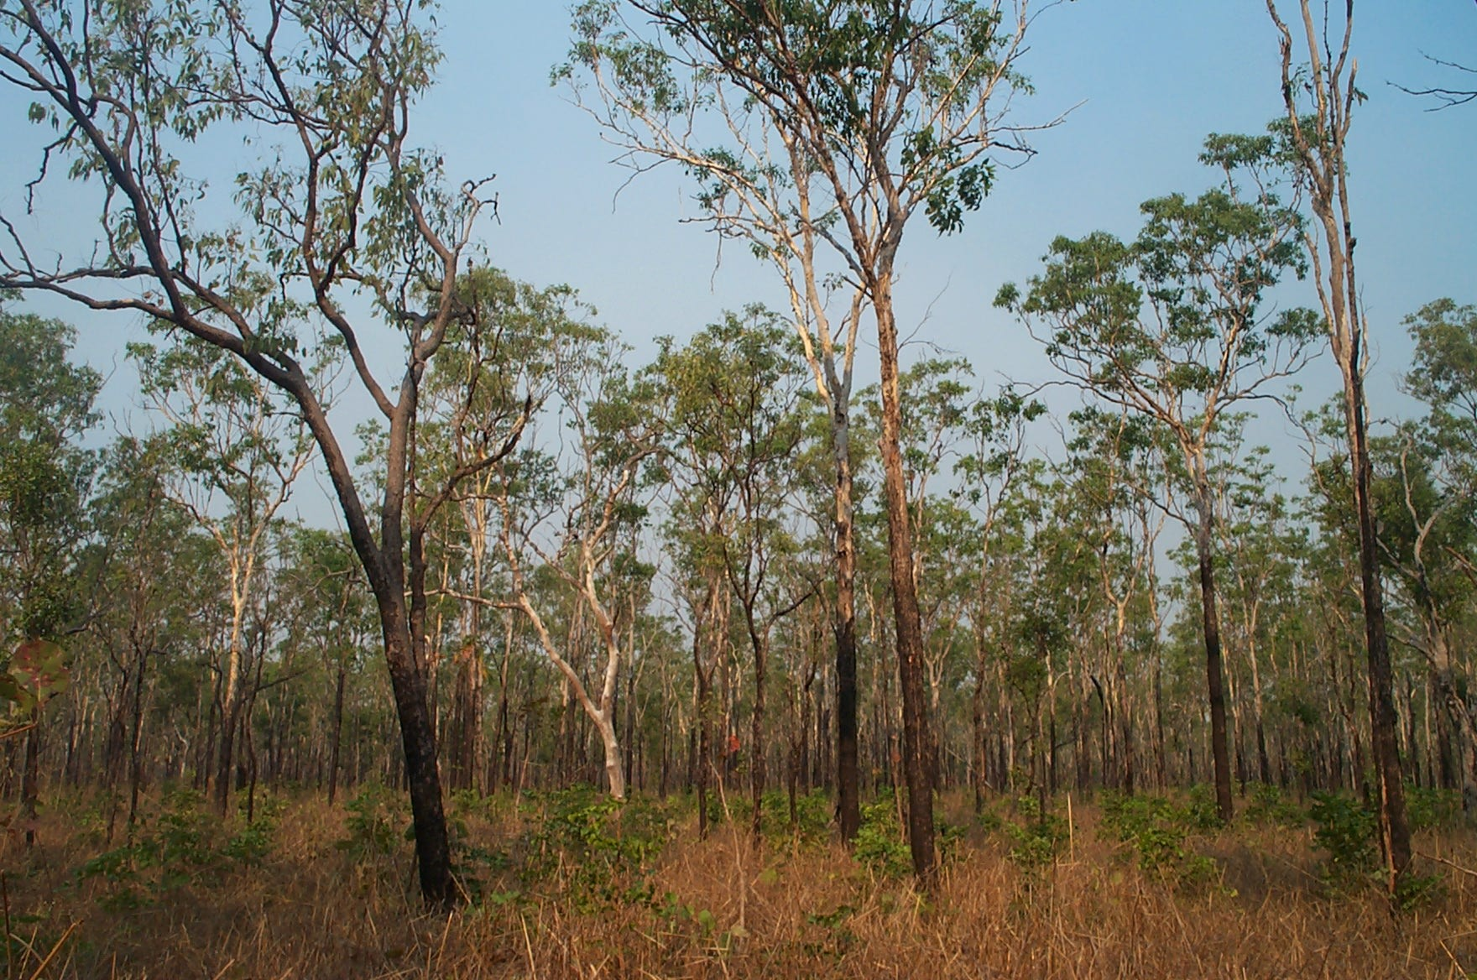
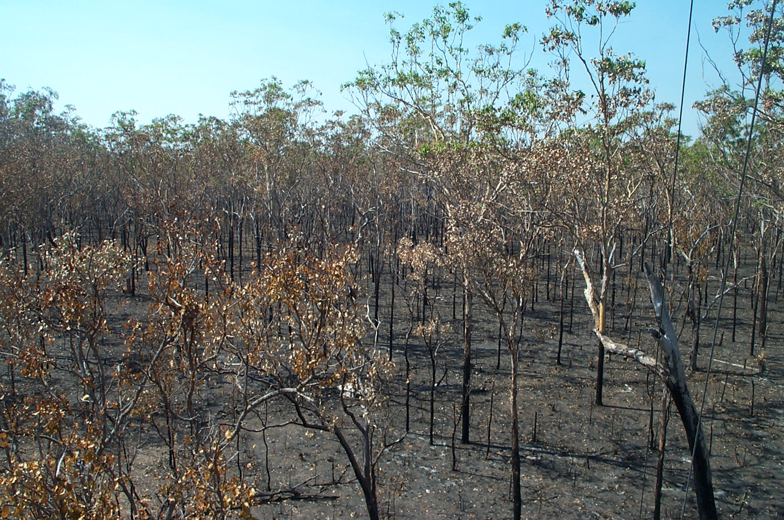
Motivation
Extensive savanna eco-systems in northern Australia
Changing fire regime
Fires lead to abrupt changes in surface properties
  Surface energy budgets
  Partititioning of convective fluxes
  Increased soil heat flux
  Modified surface-atmosphere coupling
(J. Beringer)

Slide 6
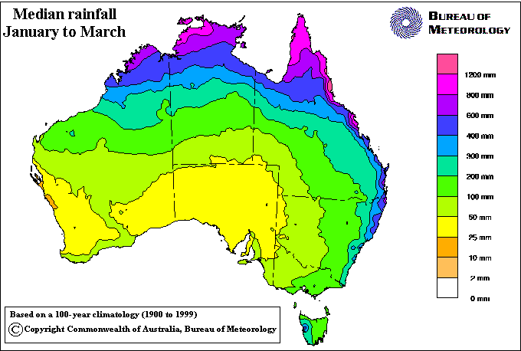
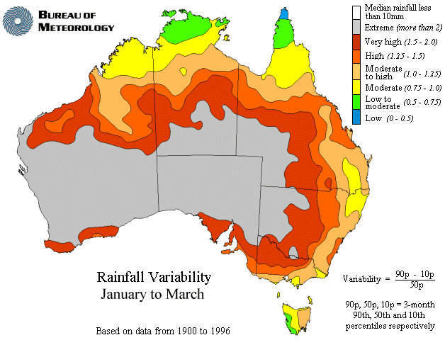
Motivation
Extensive savanna eco-systems in northern Australia
Changing fire regime
Fires lead to abrupt changes in surface properties
Sensitivity study: do the fire’s effects on atmospheric processes lead to changes in highly variable precipitation regime of Australian Monsoon?
Many potential impacts (e.g. agricultural productivity)

Slide 7
Experiment Design
Combination of atmospheric modelling (C-CAM), re-analysis and observational data
C-CAM Simulations
1974 to 1978
1979 to 1999
spinup
control run, no fires / succession
Part I
real fires / succession, selected scenarios
Part II
~ 90 independent runs (fire / succession scenarios)
for sensitivity studies → 1890 yrs of simulations

Slide 8
Use of Grid Computing
90 parallel independent model runs
Single CPU model version of parallelized C-CAM (MPI)
Distribution of forcing data repositories to cluster sites (~80 GB), 250 MB forcing data per month
Machine independent dataformats (NetCDF)
Architecture specific, validated C-CAM executables
~1.5 month CPU time for one experiment (90 exp. total)
Robust, portable, self-controlling model system incl. all processing tools and restart files
PRAGMA Testbed
  Can we get enough nodes to complete experiment?
  Can we maintain a testbed for 1.5 Months?
  Can we maintain a node up for 0.5 days?
  Can we make this routine for climate modelers?
Institution | Hostname | Nodes
AIST | ume | 32
ASCC | pragma001 | 3
BII | marlin | 4
CICESE | solaris | 7
CNIC | pragma | 8
KISTI | jupiter | 16
KU | amata1 | 14
MU | mahar | 50
NCHC | ase | 8
NCSA | tgc | 12
SDSC | rocks-52 | 15
SDSC | rocks-47 | 3
TITECH | gsic-presto | 8
UNAM | malicia | 5

Slide 9
Use of Grid Computing
Parametric modelling engine NIMROD/G
(Abramson et al. 2000, Buyya et al. 2000)
  Process control
  Distribution / setup of model system to various clusters
  Transfer of results / model systems to master repository
Plan file generation: NIMROD portal
Process Monitoring: NIMROD viewer
2 varying NIMROD/G input parameters:
  time index (monthly intervals)
    252 jobs
  experiment-ID describing the forcing perturbation combination
    90 jobs
  Total 22680 jobs

Slide 10
Nimrod/G Changes
Parameters normally generate parallel independent runs
Introduced new sorts of parameters
  Parallel Parameters – Parameters
  Sequential Parameters – Seqamaters
New Scheduler
Forcing
Combination
Time index

Slide 11
Demo

Slide 12
New features: Nimrod/G (Advertisement)
Embrace developments in the area of Grid standards
  Produce a version of Nimrod/G for Globus GT4.
  Add a Web Service interface for Nimrod/G
Add a number of user requested features
  Single job submission
  Interface to APST jobs
  More flexible inter-task dependencies (seqameters and parameters)
  Performance based data sourcing
  Develop Nimrod portlets
Enhance the portability and efficiency of current implementation
  Performance tuning and optimization
  Re-engineering some components for increased portability
  Expanding portal interface to support new features
Apply Nimrod/G in novel application domains
  PRAGMA
  UK e-Science program
  National demonstrators

Slide 13
Issues
Application issues
  Science not New version needed to be built and installed
  Even though designed for heterogeneity, rounding errors were significant
  Glib dependence
Testbed
  Globus related matters
  Environment
Nimrod
  New scheduler problems

