Slide 1
Multi-organisation Grid Accounting System (MOGAS):
PRAGMA deployment update
www.ntu-cg.ntu.edu.sg/mogas/pragma
A/Prof. Bu-Sung Lee, Francis
School of Computer Engineering,
Nanyang Technological University,
Singapore

Slide 2
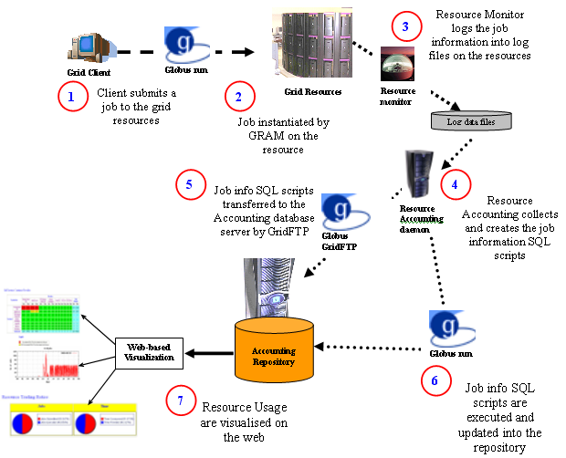
MOGAS overview

Slide 3
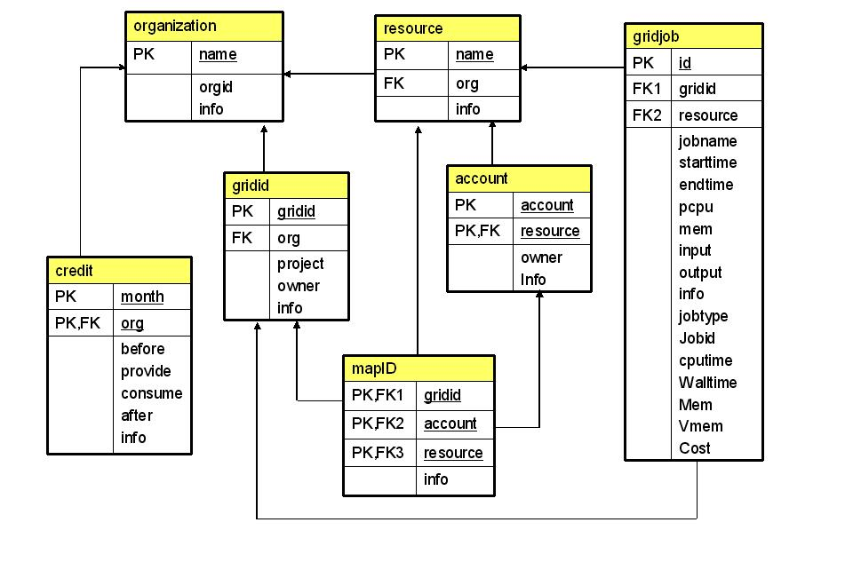

Slide 4
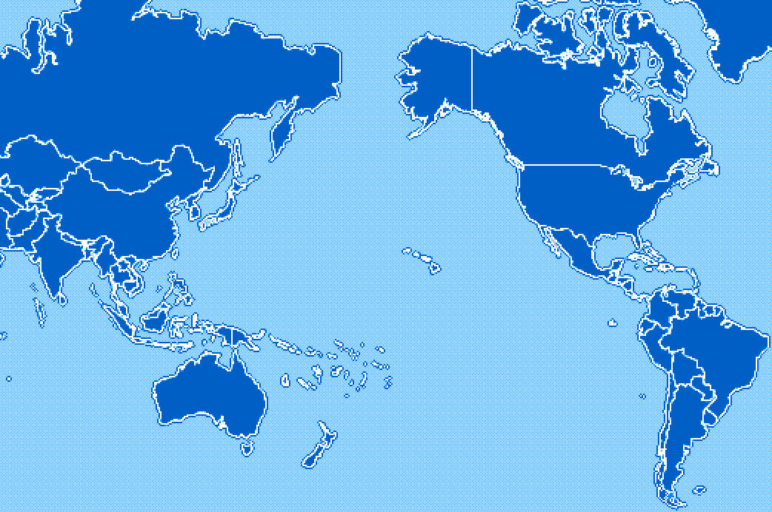
PRAGMA MOGAS status
KISTI, Korea
NCSA, USA
CNIC, China
AIST, Japan
SDSC, USA
TITECH, Japan
UoHyd, India
NCHC, Taiwan
CICESE, Mexico
ASCC, Taiwan
KU, Thailand
UNAM, Mexico
USM, Malaysia
BII, Singapore
MU, Australia
UChile, Chile
Cindy Zheng, GGF13, 3/14/05 modified by A/Prof. Bu-Sung Lee

Slide 5
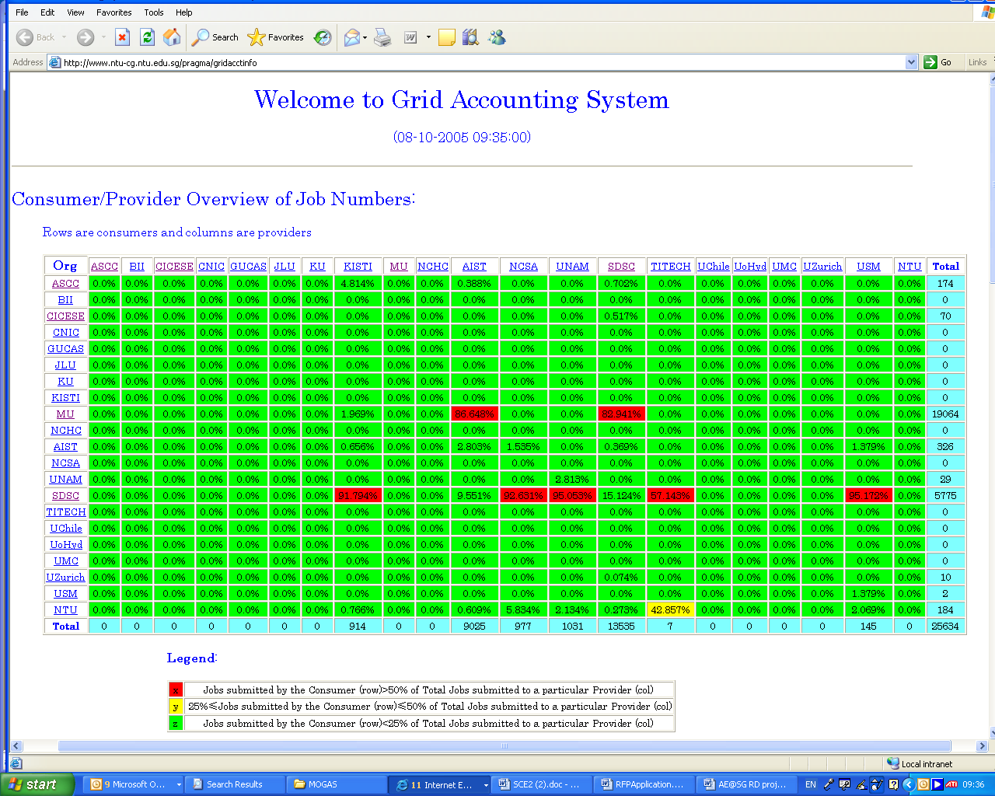
Resource usage(Oct’2005)

Slide 6
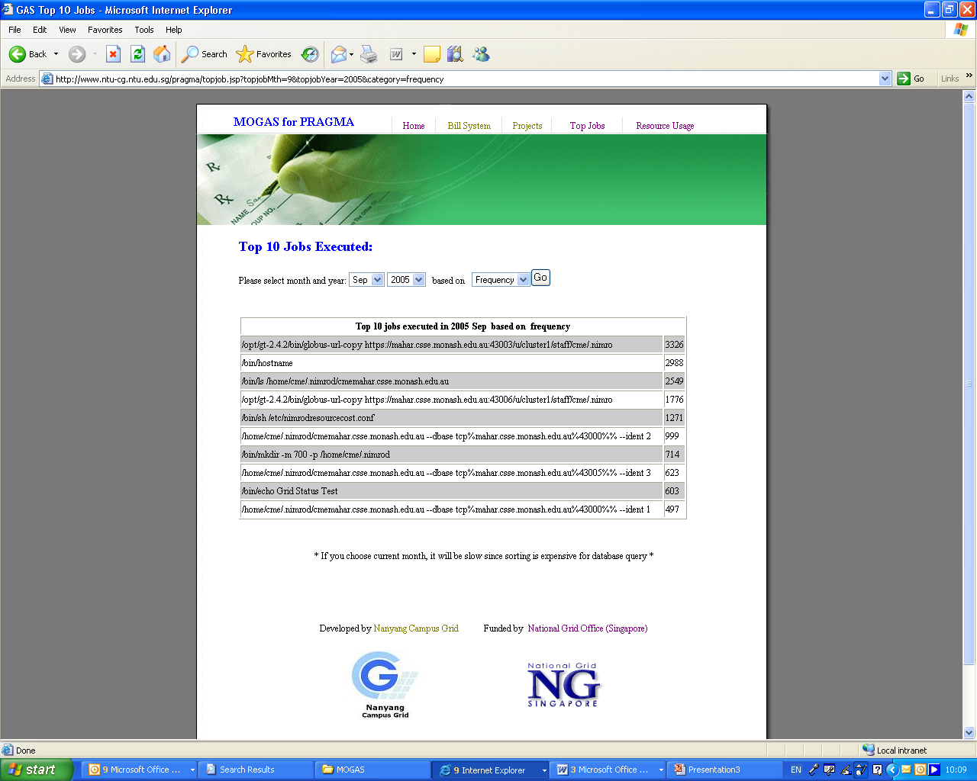
Top 10 Most frequent job

Slide 7
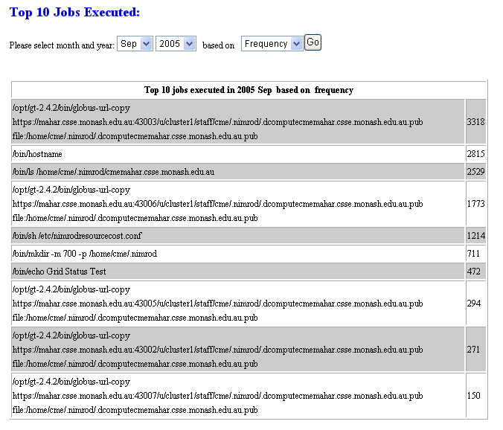

Slide 8
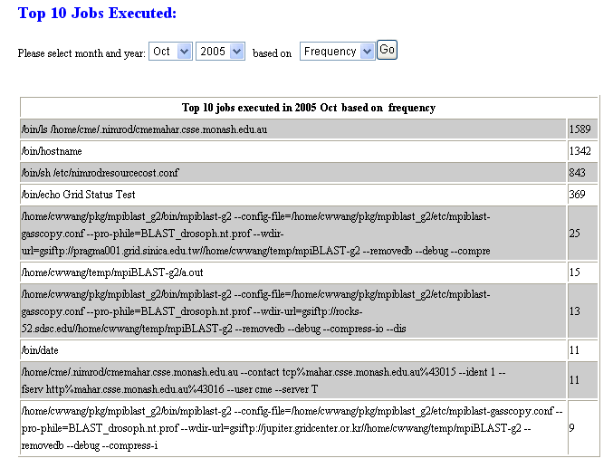

Slide 9
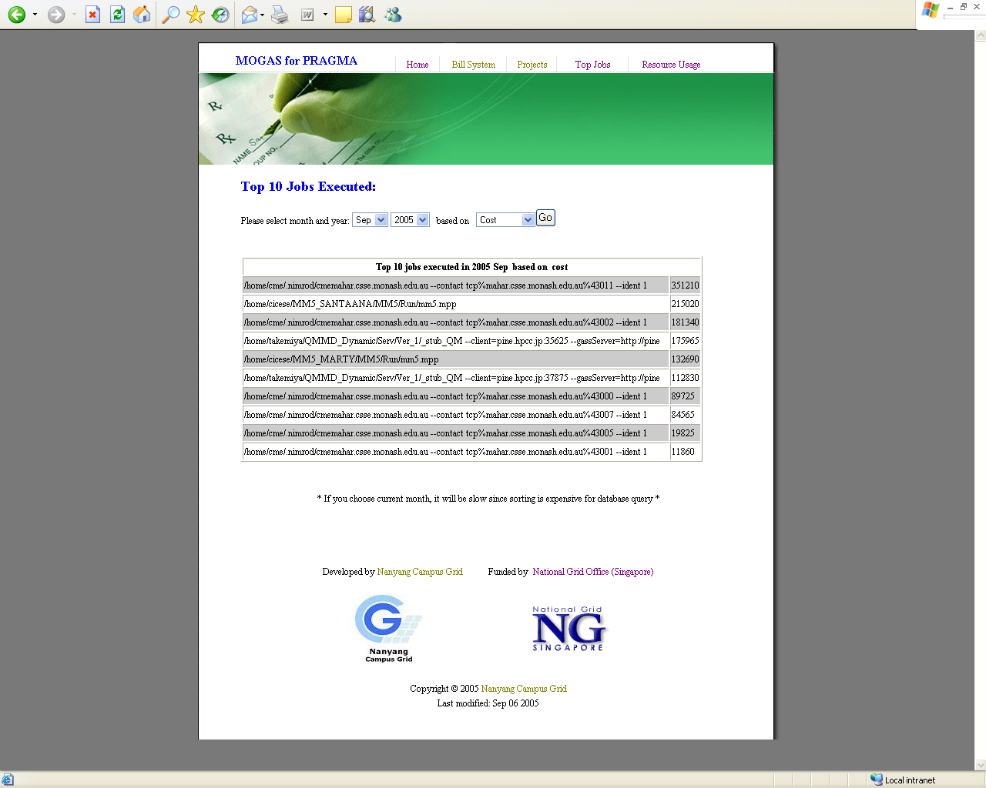
Top 10 Job

Slide 10
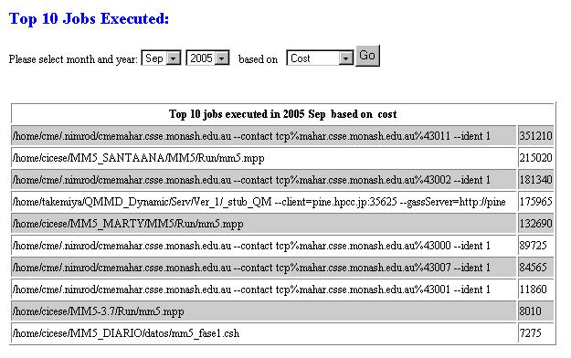

Slide 11
Jobs submitted in PRAGMA
Application:
  Savannah(by MU to Rock-52, ume-hpcc, juniper)
  QM-MD (by AIST)
  Climate MM5 simulator (by CICESE)
  MPI-Blast (by ASCC)
Maintainance job(by SDSC)
  /bin/Grid status Test
  /bin/hostname

Slide 12

1st Application– mpiBLAST-g2
A DNA and Protein sequence/database alignment tool
Drivers: Hurng-Chun Lee, Chi-Wei Wong (ASCC, Taiwan)
Application requirements
  Globus
  Mpich-g2
  NCBI est_human, toolbox library
  Public ip for all nodes
Started 9/20/04
SC04 demo
Automate installation/setup/testing
http://pragma-goc.rocksclusters.org/biogrid/default.html
Notes:
How many people knows the BLAST? It’s should be a very famous application in biology.
Think about the question … if you have a very large DNA sequence composed by four characters, say A, G, C, and T. and you have no any other information about this DNA. How will you do to identify the genes on it? The solution here is very simple. The researchers can do a lot of experiments to sequence a lot of the known gene fragments from cells. These fragments are collected to be a EST database. Then they do the alignment between the DNA sequence and the EST database. and BLAST is the tool to give us the help!!
So blast is …
<The first two items>
Because biologists may need to do the BLAST alignment everyday and they may send it multiple sequences for alignment. Throughput is the key issue for providing services
The original BLAST can be run only on single machine, so it has some limitations, such as:
- Not scalable
- Low throughput
- Unable to handle large dataset

Slide 13
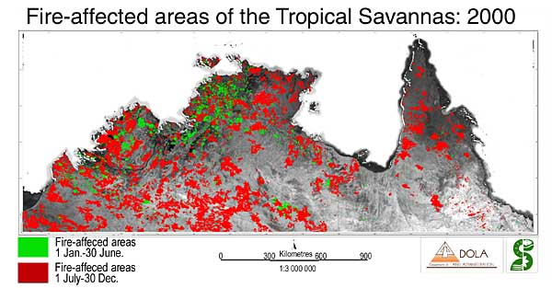
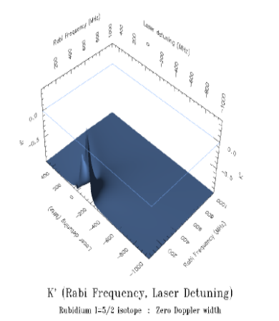
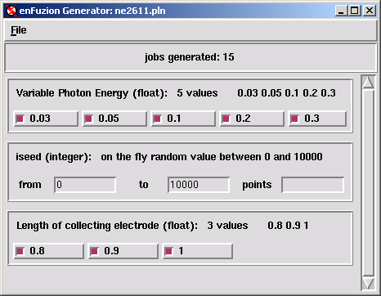
2rd Application–Savannah Case Study
Study of Savannah fire impact on northern Australian climate
- Climate simulation model
- 1.5 month CPU * 90 experiments
- Started 1/3/05
- Driver: Colin Enticott (Monash University, Australia)
- Requires GT2
- Based on Nimrod/G
Job 1
Job 2
Job 3
Job 4
Job 5
Job 6
Job 7
Job 8
Job 9
Description
of Parameters
PLAN FILE
Job 10
Job 11
Job 12
Job 13
Job 14
Job 15
Job 16
Job 17
Job 18
http://pragma-goc.rocksclusters.org/savannah/default.html

Slide 14
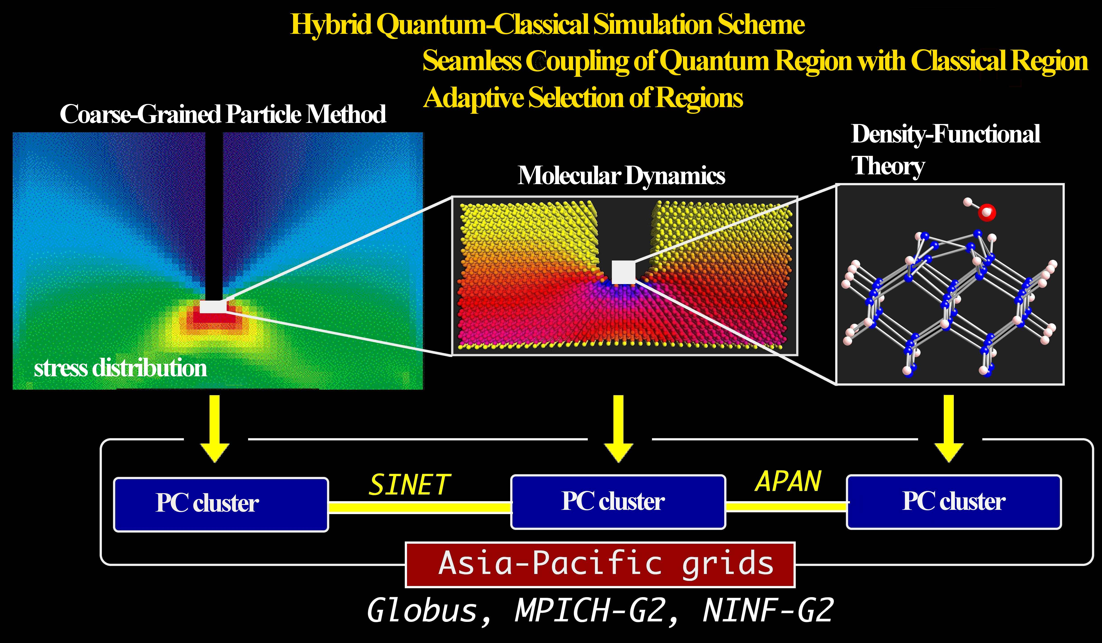
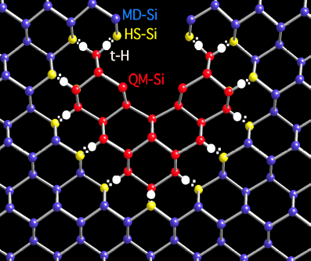
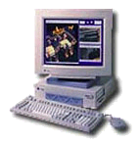

3rd Application- Hybrid QM/MD Simulation
Enabling large scale simulation with quantum accuracy. Combining classical MD Simulation with QM simulation
  MD simulation
      Simulating the behavior of atoms in the entire region
      Based on the classical MD using an empirical inter-atomic potential
  QM simulation
      Modifying energy calculated by MD simulation only in the interesting regions
      Based on the density functional theory (DFT)
QM simulation
based on DFT
MD Simulation
<client>
<front end>
<back end>
GRAM
PBS/SGE
GRAM
mpirun
http://pragma-goc.rocksclusters.org/QMMD/overview.html

Slide 15
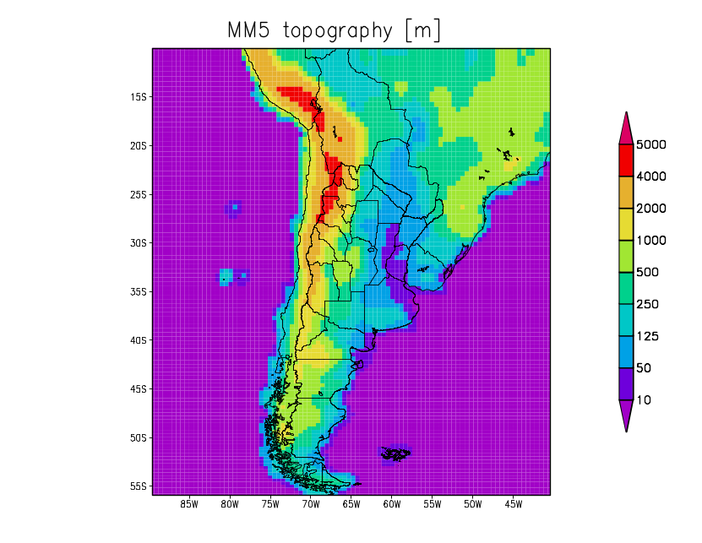
4th Application: MM5 Climate Simulator
To generate regional climate change scenarios over southern South America to improve information on the climate conditions under which natural and human systems will be exposed.
To study the sensitivity of climate to surface conditions, mainly soil moisture and sea surface temperatures, in particular, their impact on precipitation anomalies over southern South America.

Slide 16
Technical update
Access control. Only the respective resource manager can view who has used their resources.
World-view. Under development(80% complete)
Federation. Under development.

Slide 17
What’s next?
Need to move ahead.
  Integration with Ganglia
  Capturing of other informations:
    Network usage, eg. Gridftp.
    Categorising of application
Integration to PRAGMABank

