Slide 1
PRIME 2005 @ CNIC
Haiyan Xu, Kai Nan
xhy@cnic.ac.cn
CNIC, CAS

Slide 2
Working Group-1: Network Measurement
  PRIME student: John Lee
  Mentors:
    Kai Nan @ CNIC
    Ronn Ritke & Cindy Zheng @UCSD
  Others
Working Group-2: Bioscience
  PRIME student: Ian Yen Lee
  Mentors:
    Zhonghua Lu @ CNIC
    Philip Bourne @ UCSD
  Others

Slide 3
Visualization of Network Measurements by John Lee
The project is a collaborative effort of CNIC and SDSC to visualize the network measurements provided by AMP
The purpose is to provide an easier way to monitor the measurements among the AMP monitors
Currently, there are about 150 AMP monitors within United States, and over 170 AMP monitors throughout the world.

Slide 4
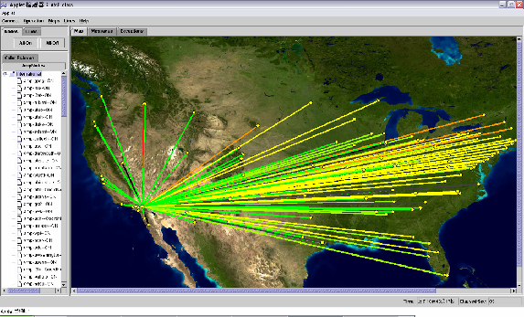
A snapshot of user interface

Slide 5
Phylogeny Determined by Incomplete Protein Domain Content by Ian Yen Lee
Generally, sequence comparison between DNA genomes has been widely used to examine phylogeny by the scientific community
Based on the similar work done by Song Yang at UCSD, except that Song used complete sequences
Ian’s job is to fragment the set of proteins at specific percentages and put them through SAM (scoring program) and Phylip to see what type of trees come out

Slide 6
Neighbor Joining Trees of Fragments of 2 Bacteria
+-----------------------------------------------20ba1 1
+----14
! ! +----------------------------------21ba1 1
! +------------13
! ! +------------------------22ba1 1
! +-------11
! +------------------------40ba1 1
-15
! +--------------41ba1 1
! +-----8
! +-----10 +--------------42ba1 1
! ! !
! ! +--------------------60ba1 1
+-------------------------12
! +--------------61ba1 1
! !
+------------9 +----------62ba1 1
! !
! ! +------80ba1 1
+---7 !
! ! +81ba1 1
! ! +-1
! ! +-2 +82ba1 1
+---6 ! !
! +-3 +Bact1 1
! ! !
! +-4 +Bact2 1
! ! !
+------5 +Eugl 1
!
+Fung 1
+--------------------------------------20ba2 1
+---------------12
! ! +-----------------------------21ba2 1
! +------11
! +-----------------------------22ba2 1
!
! +----------------------------40ba2 1
! !
! ! +41ba2 1
-14 +---------------------10 +--------------1
! ! ! +-----8 +42ba2 1
! ! ! ! !
! ! ! ! +--------------60ba2 1
! ! +-------9
! ! ! +--------61ba2 1
! ! ! +---6
! ! ! ! +--------62ba2 1
! ! +--------7
+--13 ! +------80ba2 1
! +----5
! +------81ba2 1
!
! +Bact1 1
! +-2
! +-3 +Bact2 1
! ! !
+---------------------------------------------------4 +Eugl 1
!
+Fung 1
For now, the data is insufficient to make any concrete discussion, but it can open eyes to potential solutions to come.

Slide 7
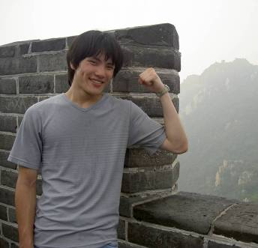
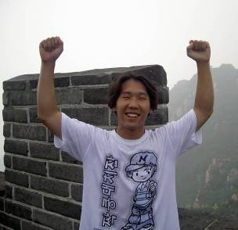
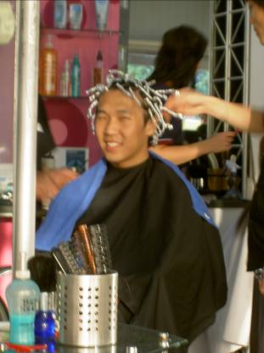
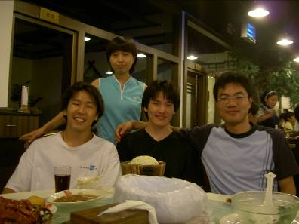
Happy Life in Beijing
Visit the Great Wall
John got a hair cut

Slide 8
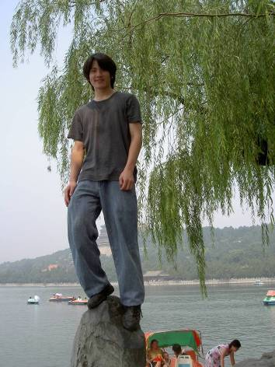
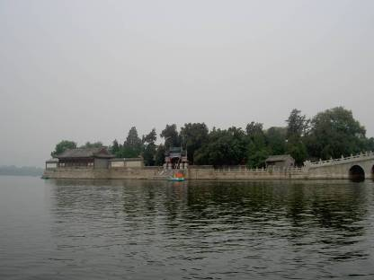
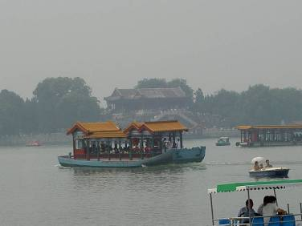
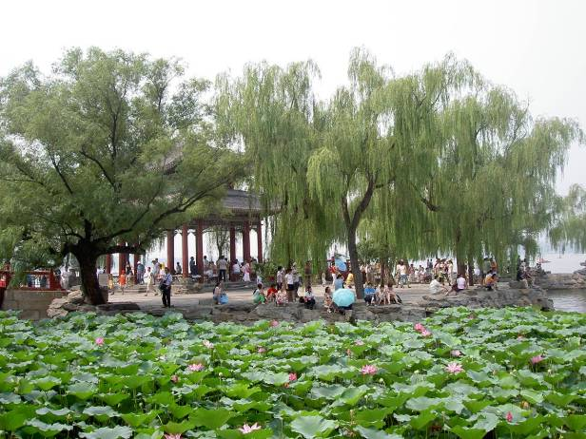
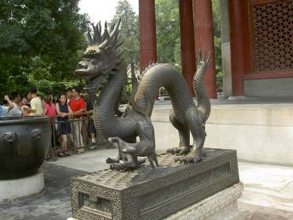
Visit the Summer Palace

Slide 9
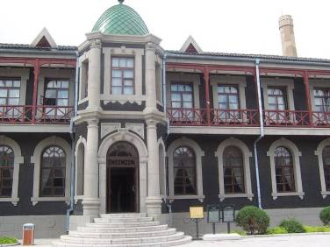
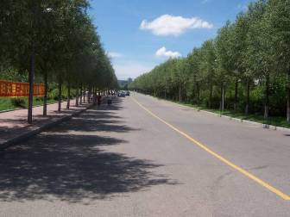
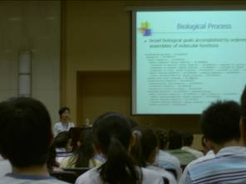
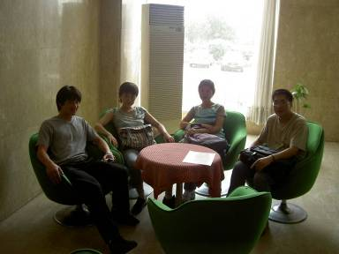
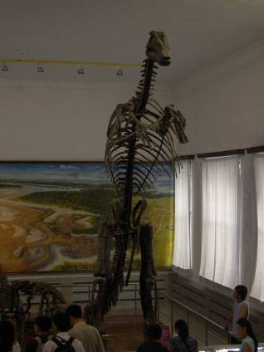
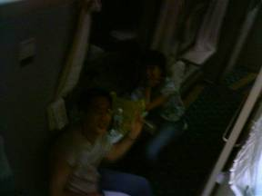
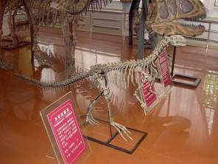
At Changchun
Attend a Bioinformatics Conference
Held in Jilin University
Visit the dinosaur fossil in the museum

Slide 10
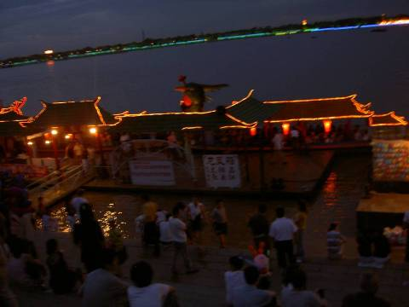
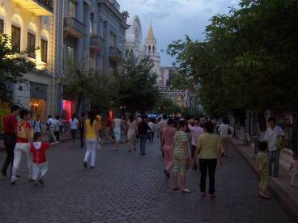
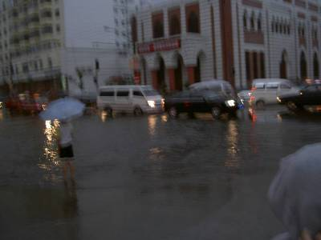

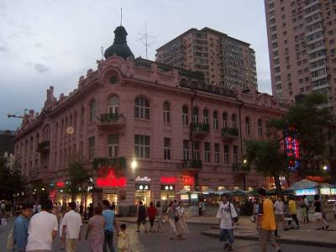
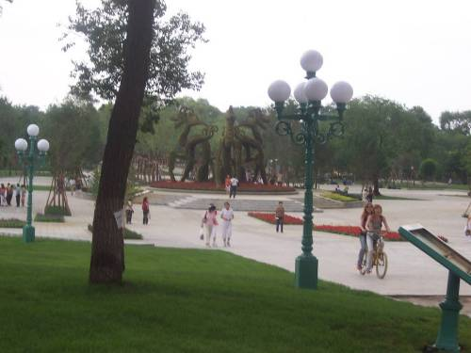
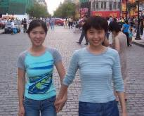
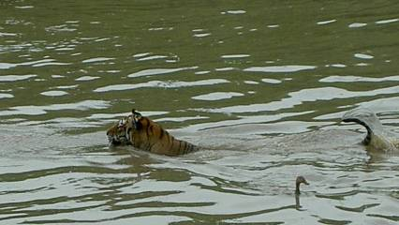
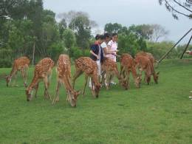
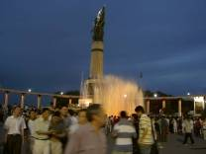
At Harbin
Visit the hometown of a group member during the weekend

Slide 11
Suggestions for Improvement
As the numbers of host sites and PRIME students increase, is it necessary to set up a mail list for PRIME organizers and coordinators to exchange and share the organizing experiences?
Should we give PRIME students a chance to evaluate the organizing work of their host sites?

Slide 12
Thanks !
We are expecting another successful PRIME year --- PRIME 2006

