Slide 1



Proposal to host a PRAGMA2007 workshop in Bangkok Thailand
National Electronics and Computer Technology Center
&
Thailand’s National Grid Project Office

Slide 2
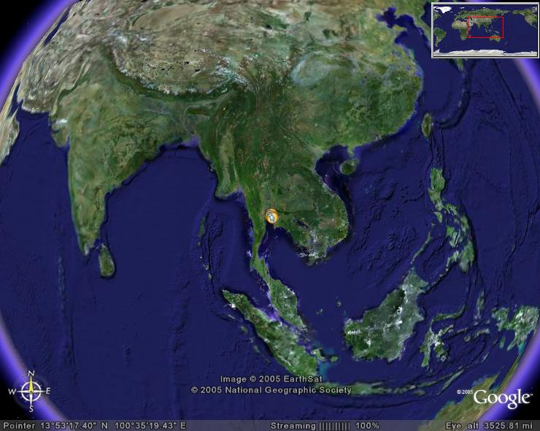

Slide 3
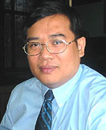
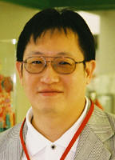
Local Organizer
Putchong Uthayopas
HPCNC, KU
Piyawut Srichaikul
NECTEC

Slide 4
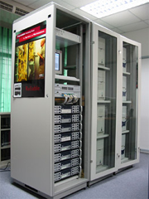
HPCNC at KU
 | Research Area - Cluster Computing, Cluster Software Tools - High Performance Scientific Computing - Grid Computing - Networking, Internet Technology - Distributed Computing

Slide 5
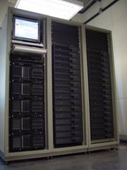
RD-C at NECTEC
Areas of interests:
Digital Archive
Knowledge Management Tools
Bioinformatics
Cluster and Grid Computing
Finite Element Analysis
Computational Nanotechnology

Slide 6
Why Thailand 2007
Thailand’s National Grid Project Office up in late 2006
With Thailand Grid activities
New SUVARNABHUMI International Airport Service expected to start in mid 2006
Others:
  Easily accessible via international travel
  Tasty Food
  Good Beer
  Beautiful places to see
  Shopping

Slide 7
Possible Venue
New National Grid Project Office ( Kasetsart University area)
Thailand Science Park (NECTEC is inside)
Considering:
  New Airport locations
  Transportation among Hotel, venue, and airport
  Facilities for workshop

Slide 8
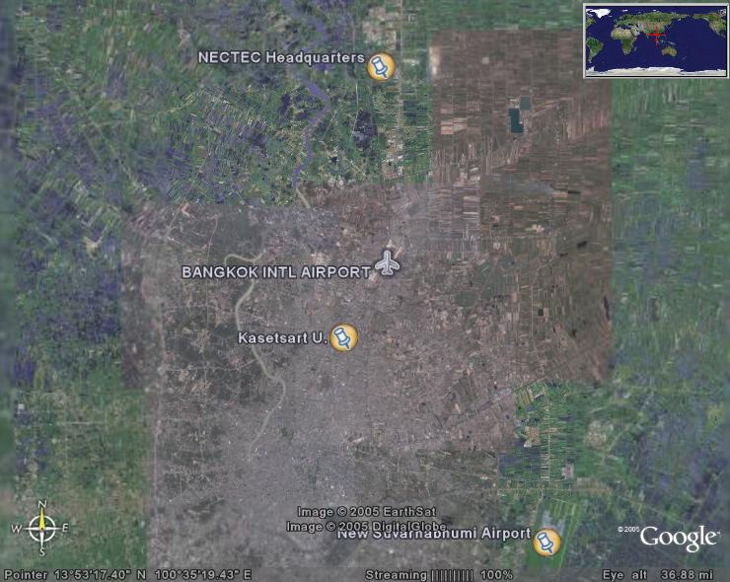

Slide 9
Possible Timing
March – May 2007
  Pro: Dry
  Con: Hot (hottest month is April)
  Avoid: 10-18 April
Sep – Nov 2007
  Pro: Cooler
  Con: Rainy sometime
  Concern: Fiscal year starts on 1st of October
Tourism hi-season: Nov - Feb
Concern: timing of ones before & after

Slide 10


ขอบคุณ
Thank you for your attention.
http://www.nectec.or.th/
Electronic * Computing * Telecommunication * Information
NECTEC is the founder of ThaiSarn, Software Park, Internet Thailand, SchoolNet, ThaiCERT, PTEC, TMEC, HAII and GITS.

