Slide 1
PRAGMA 10
Invitation
Presented at PRAGMA 9 (Hyderabad, India)
Rajesh Chhabra
QPSF Grid Manager
Project Leader- User Interface and Visualization Services (APAC)

Slide 2



Hosts

Slide 3
Dates
Welcome Reception- 26th Mar 06 (Eve)
PRAGMA Workshop- 27th-28th Mar 06
Lakes & Reef Grid (LRG) 2 meeting – 29th-30th Mar 06 -hosted by Australian Institute of Marine Science (AIMS)

Slide 4
Theme
Bringing the Grid to the Coastal Zones
  Emphasis on real world applications
  Sustainable uses of Coastal zones is a high priority agenda shared among many countries of the world.
  Sensor networks -a huge momentum in Australia.
    Ecosystem
    Bush fires
    Transportation etc

Slide 5
Dynamic Proposal
Tutorial proposal-
  Using SRB to form Sensor Grids.
    Arcot Rajasekar (SDSC, US)
    Fang Pang Lin (NCHC, Taiwan)
    Raj Chhabra (QPSF/APAC, Australia)
  Possible date- 26th March (Sunday)

Slide 6
Venue-Townsville, Queensland
SouthBank hotel http://www.southbankhotel.com.au
In the city centre of Townsville, close to all the action

Slide 7
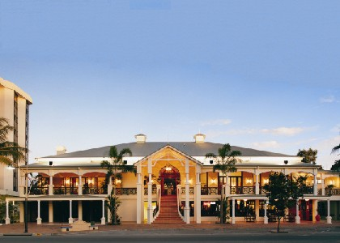
Venue..

Slide 8
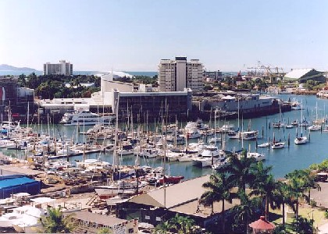
Venue..

Slide 9

Venue..
Largest coral reef exhibit (aquarium) with 2.5 Million Litres of Water.
http://www.reefhq.com.au/
5 minutes walk from the venue

Slide 10
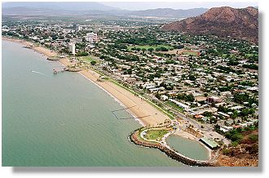
Venue..
Beautiful bayside/beachside precinct – The Strand
15 minutes walk from the venue
Australia’s cleanest beach 2004.
QLD’s cleanest beach 2003

Slide 11

Venue..

Slide 12
Food..
Queensland is known for its seafood.
Australia is known for its great and rich variety of wines too.

Slide 13
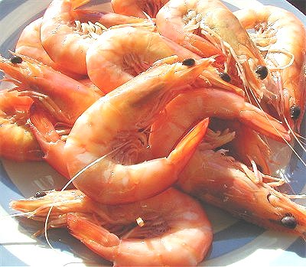
Food..

Slide 14
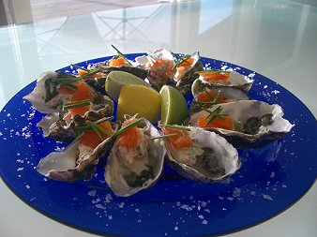
Food..

Slide 15
Getting there
Direct flights from Brisbane (2 hours flight) or Cairns (30 minutes flight)
Also direct flights from Sydney (3.5 hours)
Qantas operates direct flights from LA to Brisbane (4 times a week)
Many direct flights to Brisbane from Singapore, Malaysia, Japan etc

Slide 16
Visas
http://www.immi.gov.au/
Passport holders of these countries eligible for ETA (Electronic Travel Authority)
  US, Singapore, Malaysia, Japan, South Korea, Taiwan

Slide 17
PRAGMA 10 procedure
Program committee formation
Planning meeting via VTC (Australia still prefers Access Grid )
A website will be done
  Or/and how about a wiki? - http://auriga.qut.edu.au/Pragma10
Martin Lack Association Pty Ltd (event organizer)

Slide 18
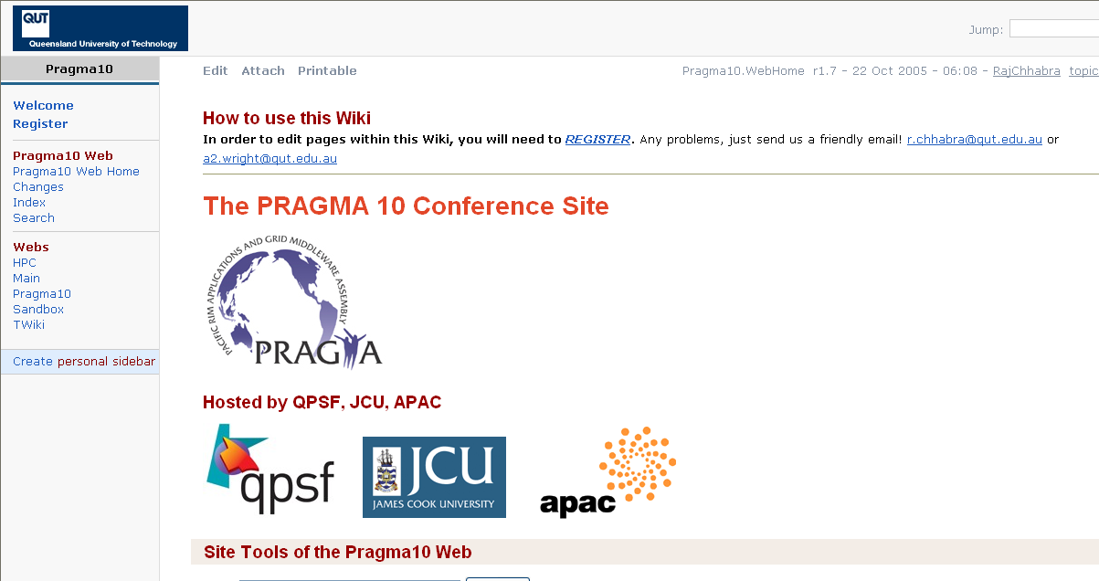
PRAGMA10 Wiki

Slide 19
APAC Grid Program
Infrastructure Projects
  Compute
  Information Services (Data)
  User Interface and Visualization
Application Projects
  Astronomy
  BioInformatics
  Chemistry
  Earth System Science
  GeoSciences
  High Energy Physics
“Infrastructure projects are driven by the need of application projects”

Slide 20
APAC Grid Program..
Compute- Globus toolkit-2.4 and 4.0.x supported
  Major resources to be connected via Gateway machines
  These Gateway machines will have Virtual OS. Images will be developed by a central group.
  Most of the grid software is expected to be installed on these machines
Data- Storage Resource Broker (SRB)
User Interface- GridSphere
  Portlet (JSR168) technology
  Pluggable portable modules

Slide 21
Once Again
On behalf of Prof Bernard Pailithorpe (CEO of QPSF) I would like to cordially invite everyone to PRAGMA10 in Australia.

