Slide 1




NLANR International AMP Mesh Overview
Ronn Ritke
Tony McGregor
NLANR/MNA
(UCSD/SDSC)
http://mna.nlanr.net/
Funded by the National Science Foundation/CISE/SCI
cooperative agreement no. ANI-0129677

Slide 2
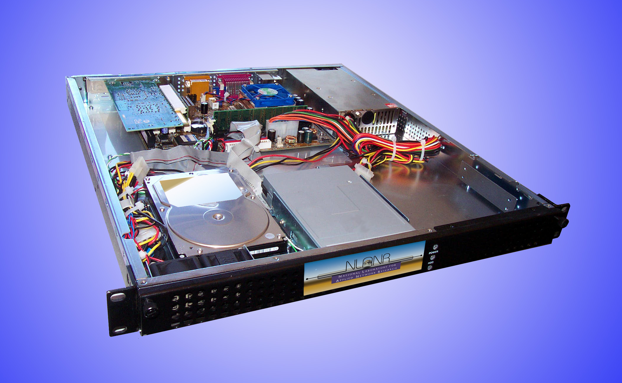
Active Measurement Project (AMP)
Led by Tony McGregor
AMP performs site-to-site
active measurements
(RTT, topology, loss, and
on-demand throughput)
and analysis which give
network researchers and
engineers a full mesh of
real-time and historical
performance data between well understood end hosts.

Slide 3
International Collaborations
Why hosting an AMP is simple: design decisions
Based on off-the-shelf, inexpensive, PC technology
1 RU profile saves rack space
AMPs can be set-up to use many different power supplies
Simple online AMP request form (IP address, Gateway, mailing address, local contact)
Simple installation (network connection and power)

Slide 4

International Collaborations (NSRC)
Based at the Univ. of Oregon (UO), the Network Startup Resource Center (NSRC) project provides technical information, engineering assistance, training, and equipment to universities, research institutions, and networking organizations in developing areas.
The NSRC's primary goal is to make it easier for U.S. scientists and engineers to collaborate via the Internet with their international colleagues. NSRC is partially supported by the National Science Foundation (NSF).
NLANR/MNA is working with Steve Huter of UO-NSRC.

Slide 5
International Collaborations
The NLANR/MNA group now has AMP monitors deployed in Australia, Brazil, Canada, Chile, China, Finland, Germany, Hungary, India, Ireland, Japan, Korea, Mexico, the Netherlands, New Zealand, Norway, Pakistan, Singapore, South Africa, Spain, Switzerland, Taiwan, Thailand, and the United Kingdom.
The majority of the PRAGMA Grid Test-bed countries now also have AMP monitors deployed. We are working to place an AMP at the Grid Test-bed site in Malaysia.

Slide 6
PRAGMA Collaborations
- NLANR AMP is investigating the needs of international grid- based collaborations. We are working with PRAGMA to measure some performance aspects of the PRAGMA Grid Testbed.
- This will extend the reach of our active measurement activities by developing tools, measurements, analyses, and data visualizations which are designed for the grid computing environment, in particular the PRAGMA Grid Testbed.
- This will further develop AMP’s utility, as well as improve the quality, ease of use, and performance of PRAGMA’s Grid Testbed.

Slide 7
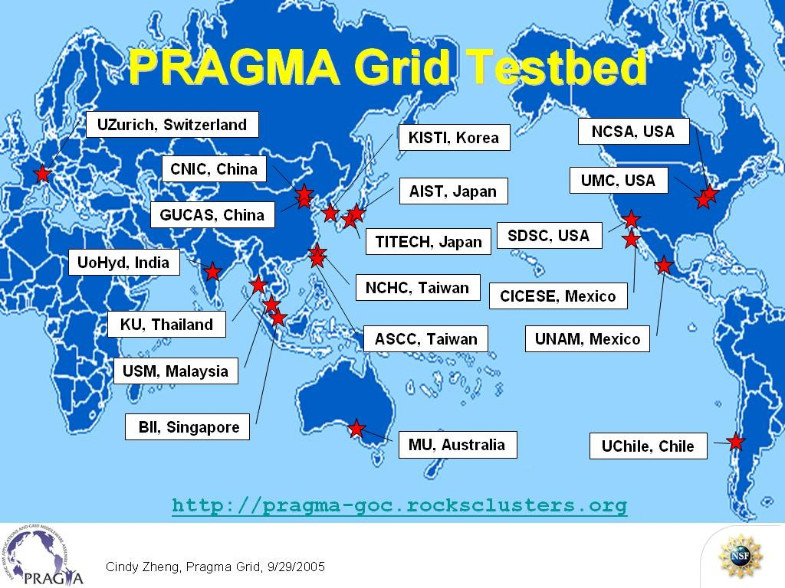
PRAGMA Grid Testbed

Slide 8
International Collaborations (other meshes)
Groups from the following countries have
- deployed, or are experimenting with developing, their own AMP meshes:
Korea (16), Taiwan (17), New Zealand (2 meshes, 33), Brazil (3) and Australia
- expressed interest in developing their own AMP mesh:
China, Chile, Japan, and Mexico.

Slide 9
New AMP Software Goals
New AMP software goals.
- Easier to hand off to others for their own use.
- Portability - run on many Unix operating systems.
- Flexibility to add new tests to the AMP software.
- Share the software with others by making it available on our Website.

Slide 10
International Collaborations (data)
Availability of the data
- All NLANR/MNA data is made publicly available on our website. AMP data is available as Web-based performance graphs and visualizations, raw data, and
- Thanks to Warren Matthews we have a webservices interface that provides the AMP data in GGF standard format.
- AMP data is located at: http://watt.nlanr.net/active/

Slide 11
International Collaborations (Cont’d-2)
As a trusted, neutral party, NLANR/MNA has facilitated cooperation across many different organizational and national boundaries.
The result is that NLANR/MNA is establishing a world-wide measurement infrastructure for gathering performance data from high-speed next-generation research networks around the globe and, as is our norm, making this information publicly available to systems administrators, engineers, and the research community.

Slide 12
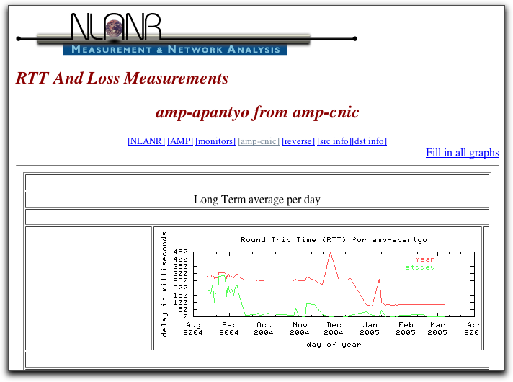

Slide 13
